Slide 1
Rescuing the Naamans Among us
Plano Texas Stake Leadership

Slide 2
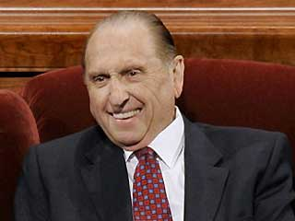
President Monson April Conference
My beloved friends, under no circumstances allow yourselves to become trapped in the viewing of pornography, one of the most effective of Satan's enticements.
And if you have allowed yourself to become involved in this behavior, cease now.
Seek the help you need to overcome and to change the direction of your life.
Take the steps necessary to get back on the strait and narrow, and then stay there.

Slide 3
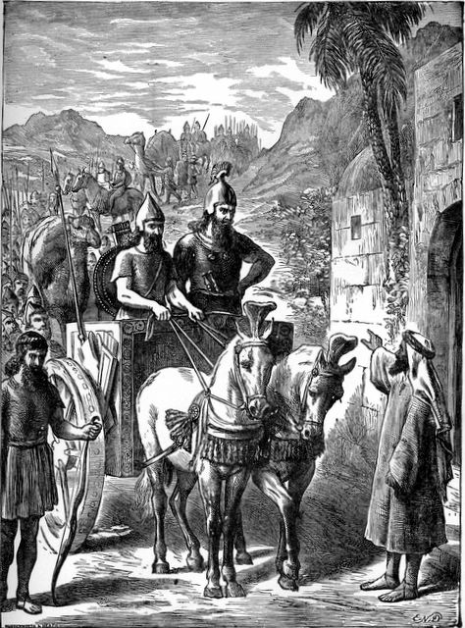
2 Kings 5
Now Naaman, captain of the host of the king of Syria, was a great man with his master, and honourable, because by him the Lord had given deliverance unto Syria; he was also a mighty man of valour,
but he was a leper.
[And the Hebrew maid of his wife] said unto her mistress, Would God my lord were with the prophet that is in Samaria! For he would recover him of his leprosy.

Slide 4
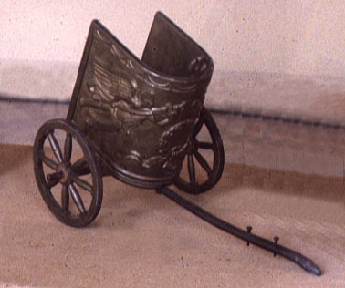
Elisha’s Response?
So Naaman came with his horses and with his chariot, and stood at the door of the house of Elisha.
And Elisha sent a messenger unto him, saying, Go and wash in Jordan seven times, and thy flesh shall come again to thee, and thou shalt be clean.

Slide 5
Pornography
Three Main Types
1- Has occasionally looked at pornography and feels guilty. (Many Men)
2- Views pornography on a regular basis and cannot stop. Feels very guilty. (Naamans)
3- Sexual addicts. Has affairs; acts out. May go to clubs, etc. Pornography is simply part of the their overall disorder. (Sexual Addicts)

Slide 6
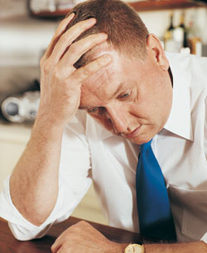
Elder Russell Nelson
“Addiction surrenders later freedom to choose. Through chemical means, one can literally become disconnected from his or her own will”
(in Conference Report, Oct. 1988, 7; or Ensign, Nov. 1988, 7).

Slide 7
The Addiction Tunnel
Daily Concerns
Reacts with
Uncomfortable Thoughts
And Feelings
Use
Triggering
Event
Feeds
Emotional Aftermath

Slide 8
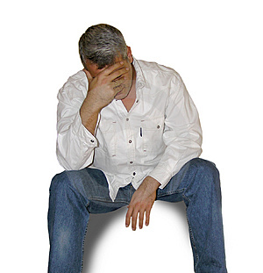
Keys to Healing: Key #1
Healing from pornography, like any weakness, is not simply about the mere exercise of will power or free agency.
Healing comes only through surrender to the Atonement of Christ and following, exactly, the steps He’s revealed .
Church’s Addiction Recovery Program (ARP)
He heals what they cannot.

Slide 9
Key #2
His addiction is not due to anything his wife is or isn’t doing.
It is not about the level or frequency of marital intimacy.
However, she will, initially, be blaming herself for his weakness.

Slide 10
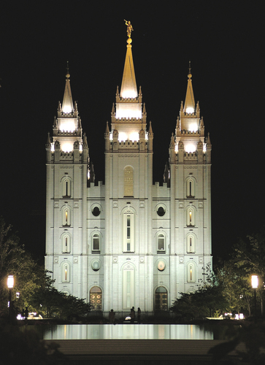
Key #3
Those who are able to maintain regular Temple attendance, as part of their continuing repentance process, tend to do better than those who do not.

