Slide 1
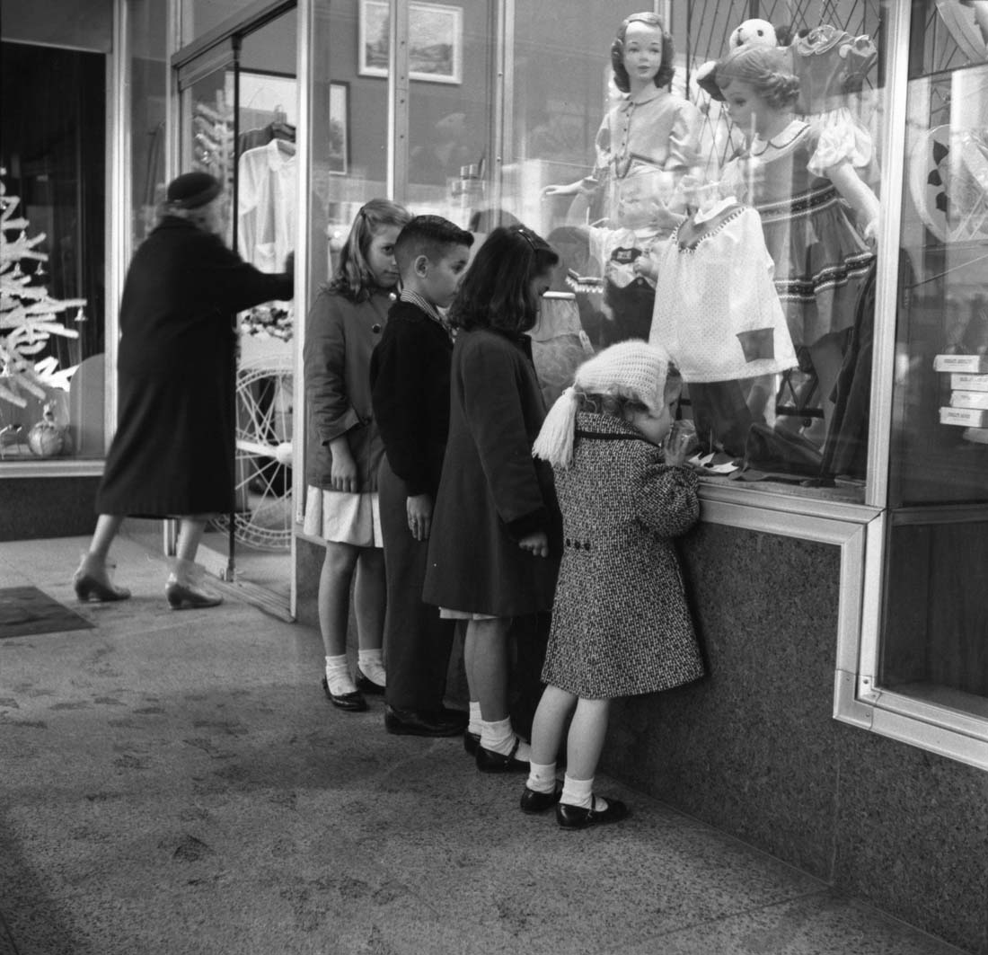
Aligning Our Desires

Slide 2

For Starters…
Question: what kind of things do you worry about?
Unless it is:
Current world conditions
Financial markets and US Debt
Terrorist Threats and warnings
Natural Disasters
Shifting political policies
Your job security
Your retirement security
Raising a family/Youth leader?
Peer pressure
Normalization of same-sex culture
Pornography
Texting
Lady Gaga
Personal:
Your debt
Your weight
Your calling
The car
Your sins
Your kid’s sins
Your high blood pressure
And even more importantly:
Will American Idol Survive?
Team Edward or Team Jacob?
Can Dr. House find true love?

Slide 3

Amy
Questions:
Its not fair!
I got an answer to marry him. What happened?
Plus, the Lord knew my husband would do that. Why didn’t the Lord warn me not to marry him?
I just wanted to do the right thing!

Slide 4
Pres. Joseph F. Smith
…the education of our desires is one of far-reaching importance to our happiness in life”
Gospel Doctrine, p. 297
Desires?
Wait! I know what I what I need- don’t I?

Slide 5
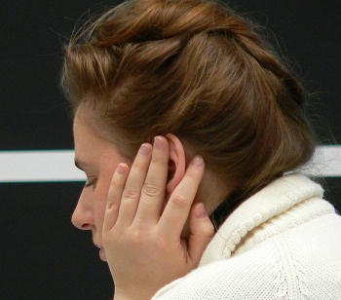
Elder Neal A. Maxwell
Letter to a Grandchild
How, you inquire, can we better "educate our desires," as President Joseph F. Smith urged? Doing this is a tall order. So much could be said about it.
One little-used way of more honestly testing the correctness of our desires is to place those desires more honestly and specifically before God in reverent, personal prayer.
Why so? Because if we are too embarrassed to petition Him concerning some of our desires, this will quickly confirm their incorrectness!
Basically, we can educate our desires only as we learn more about what God's desires for us are. Since He is perfect in knowledge and love, we can trust Him to desire what is best for us—now and forever…
That Ye May Believe ( 1992)

Slide 6

Four Eternal Truths
1-My wants and desires are a mix: composed of what my natural man wants, combined with what my spirit really desires…
2-Educating my desires means, “Lord, all I want for me is what you want for me”
3-His plans for me will result in more happiness and joy than my plans for me
4-He loves me too much to reveal all his future plans to me.

Slide 7
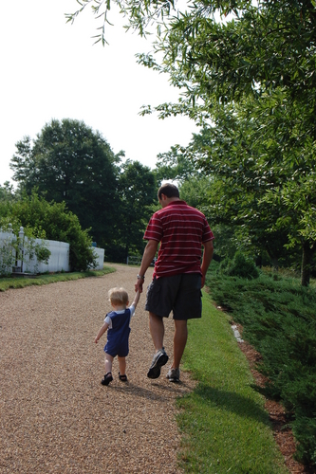
LDS Addiction Recovery Program
Step 3 – trust…
KEY PRINCIPLE:
Decide to turn your will and your life over to the care of God the Eternal Father and His Son, Jesus Christ.

Slide 8
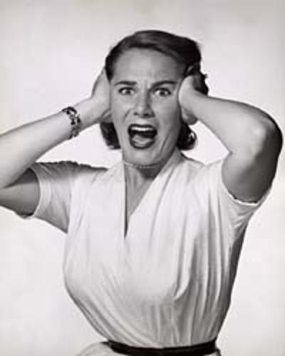
Why I might hesitate:
Somewhere, deep down inside of me, I KNOW:
I’ll have to change my behavior
I’ll have to change how I see me
I’ll have to trust—and I don’t trust that/them/me/Him…
I’ll have to give up my favorite sin.
I’ll have to let go of a favorite gripe or grudge…
I’ll have to get involved.
I’ll have to help someone I’m uncomfortable with…

Slide 9

Elder CS Lewis
There have been times when I think we do not desire heaven;
but more often I find myself wondering whether, in our heart of hearts, we have ever desired anything else.
All the things that have ever deeply possessed your soul have been hints of it—tantalizing glimpses, promises never quite fulfilled, echoes that died away just before they caught your ear.
Beyond all possibility of doubt you would say, ‘here at last is the thing I was made for.’…
It is the secret signature of the soul, the communicable and unappeasable want, the thing we desired before we met our wives or made our friends or chose our work,
And which we shall still desire on our deathbeds, when the mind no longer knows wife or friend or work.
While we are, this is. If we lose this, we lose all.
The Problem of Pain, p, 151.

Slide 10
Familiar Scripture…
There is a law, irrevocably decreed in heaven before the foundations of this world, upon which all blessings are predicated—
And when we obtain any blessing from God, it is by obedience to that law upon which it is predicated.
Law
Blessing
Law
Blessing
Notes:
How we interpret the following scripture adds to the problem. We tend to interpret this as “each law has its attendant blessing.” Keeping the Law of Tithing, for instance, should bring forth the promised blessings. What happens, then, when that doesn’t happen? We keep the Word of Wisdom and get cancer. We keep the Law of Tithing and lose our job. Worse yet, we wonder if we’ve “earned” our blessings, why God withholds what we’ve earned. Does he love us less or are we unworthy. Does He really “owe” us?

Slide 11
A Little Misunderstanding
There is a law, irrevocably decreed in heaven before the foundations of this world, upon which all blessings are predicated—
And when we obtain any blessing from God, it is by obedience to that law upon which it is predicated.
A Law
in heaven
All Blessings
Law of Sacrifice
Broken Heart
And Contrite Spirit
Notes:
The answer is to look closely at the scripture. There is A LAW- a single law, on which ALL blessings rest. It was established in Heaven. It was made clear to Adam and Eve before they left the garden. The One Law, on which our blessings rest, is sacrifice and obediance- specifically, a broken heart and contrite spirit. When we humble ourselves and become meek and submissive, we are given all the blessings we don’t deserve but are given anyway. And, there are no A saints or B saints, just humble saints that can receive all the Father hath, if we are meek and teachable.

Slide 12
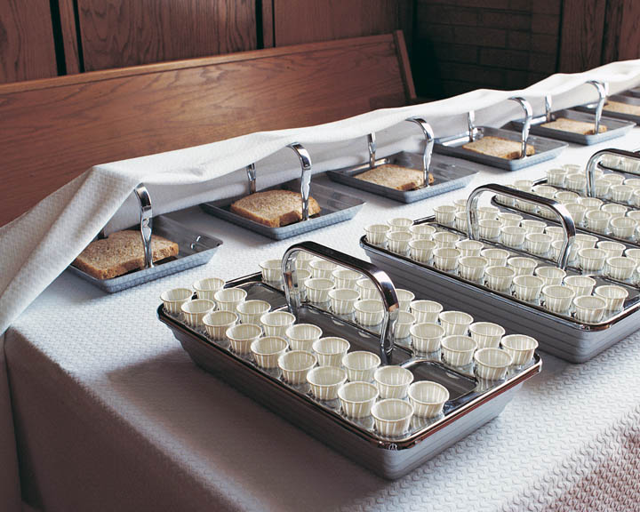
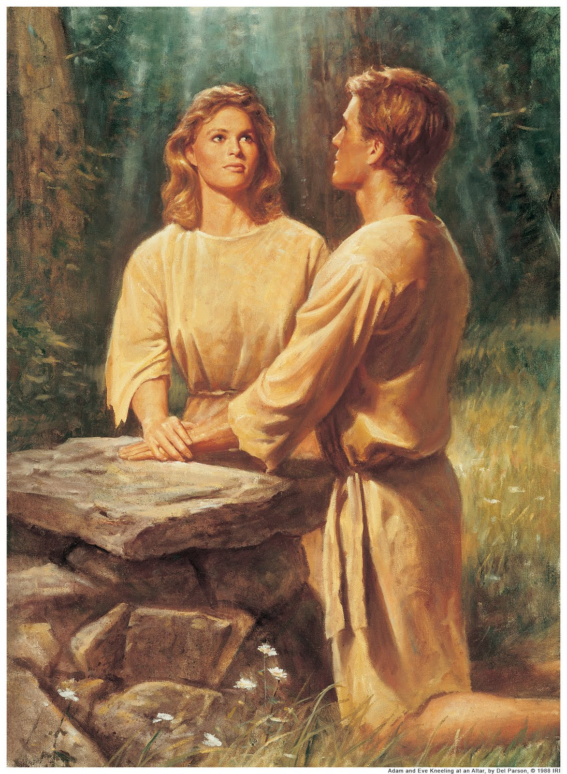
Alter of Sacrifice

Slide 13
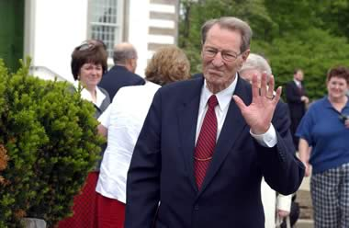
Elder Maxwell
In today's society, at the mere mention of the words obedience and submissiveness hackles rise and people are put on nervous alert. . . .
People promptly furnish examples from secular history to illustrate how obedience to unwise authority and servility to bad leaders have caused much human misery and suffering.
It is difficult, therefore, to get a hearing for what the words obedience and submissiveness really mean--even when the clarifying phrase, "to God," is attached. ["Not My Will, But Thine" , p. 1]

Slide 14
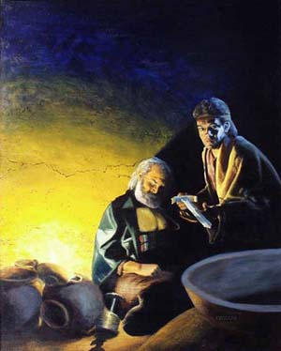
1 Nephi 4
Therefore let us go up; let us be strong like unto Moses; for he truly spake unto the waters of the Red Sea and they divided hither and thither, and our fathers came through, out of captivity, on dry ground, and the armies of Pharaoh did follow and were drowned in the waters of the Red Sea.
Now behold ye know that this is true…Let us go up; the Lord is able to deliver us, even as our fathers, and to destroy Laban, even as the Egyptians.
And I was led by the Spirit, not knowing beforehand the things which I should do.
…as I came near unto the house of Laban I beheld a man, and …he was drunken with wine….And when I came to him I found that it was Laban.
And I beheld his sword, and I drew it forth from the sheath thereof; and the hilt thereof was of pure gold, and the workmanship thereof was exceedingly fine, and I saw that the blade thereof was of the most precious steel.
And it came to pass that I was constrained by the Spirit that I should kill Laban;

Slide 15

30 Day EMD Challenge
“Educate my desires”
1- Express gratitude, but ask for nothing.
2- Explain, “All I Want is What You Want”
3- Ask, “What would you have me do?”
4- Listen for promptings or needs

Slide 16

From the Isaiah Poem Book
Hearken to me, ye that follow after righteousness, ye that seek the LORD:
look unto the rock whence ye are hewn,
and to the hole of the pit whence ye are digged.
Look unto Abraham your father,
and unto Sarah that bare you:
for I called him alone, and blessed him, and increased him.
For the LORD shall comfort Zion:
he will comfort all her waste places;
and he will make her wilderness like Eden,
and her desert like the garden of the LORD;
joy and gladness shall be found therein, thanksgiving, and the voice of melody.

Slide 17
Its time…

