Slide 1
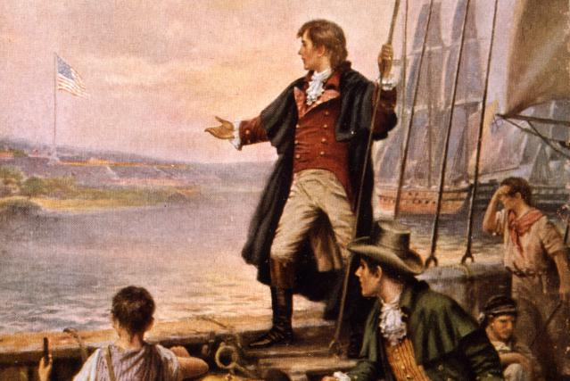
America- Manifest Destiny

Slide 2
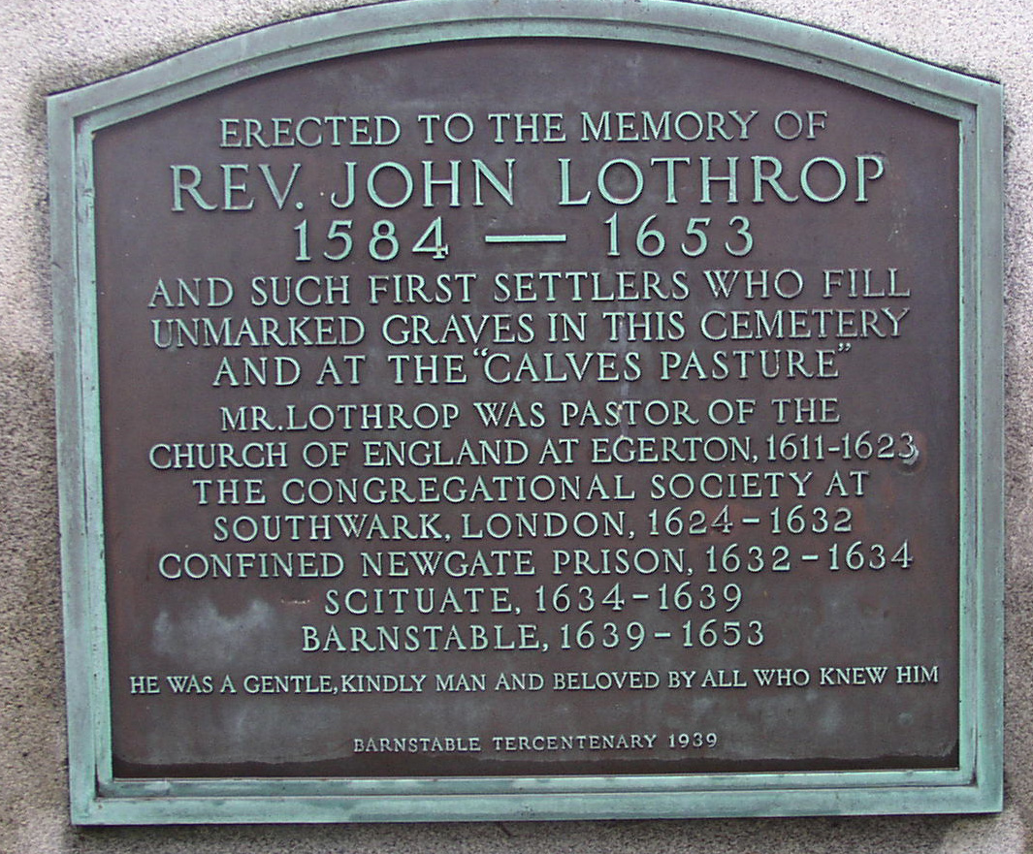
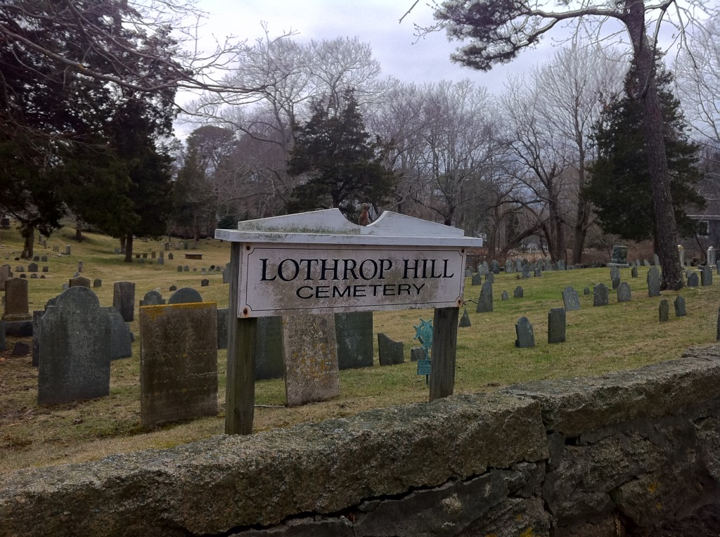
John Lothrop
Minister, Church of England. 1623, Kent
Arrested 1632 (State Sponsored Religion Issues)
1634, Allowed to leave for Boston with his followers
Settled in Barnstable, Mass,
Common ancestor for the Smiths, Youngs, Pratts, Taylors, Kimballs, etc…. And Hinckleys

Slide 3
Joseph Smith
“The Constitution of the United States is a glorious standard; it is founded in the wisdom of God.
It is a heavenly banner; it is to all those who are privileged with the sweets of liberty, like the cooling shades and refreshing waters of a great rock in a thirsty and weary land.
It is like a great tree under whose branches men from every clime can be shielded from the burning rays of the sun.”

Slide 4
Wilford Woodruff
“Those men who laid the foundation of this American government and signed the Declaration of Independence were the best spirits the God of heaven could find on the face of the earth.
They were choice spirits, not wicked men. General Washington and all the men that labored for the purpose were inspired of the Lord.”

Slide 5
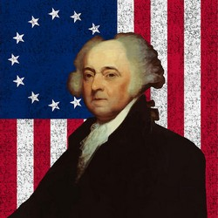
John Adams
“I always consider the settlement of America with reverence and wonder, as the opening scene and design in Providence for the illumination of the ignorant, and the emancipation of the slavish part of mankind all over the earth.”
This is the Manifest Destiny and American Exceptionalism the founders sought for.

Slide 6
Dedication of the Idaho Falls Temple
'We thank thee that thou hast revealed to us that those who gave us our constitutional form of government were men wise in thy sight and that thou didst raise them up for the very purpose of putting forth that sacred document
"'We pray that kings and rulers and the peoples of all nations under heaven may be persuaded of the blessings enjoyed by the people of this land by reason of their freedom and under thy guidance and be constrained to adopt similar governmental systems, thus to fulfill the ancient prophecy of Isaiah and Micah that " . . . out of Zion shall go forth the law

Slide 7
John Fiske
They believed that they were doing a wonderful thing. They felt themselves to be instruments in accomplishing a kind of “manifest destiny”. Their exodus from Europe was that of a chosen people who were at length to lay the everlasting foundations of God’s kingdom upon earth…
This steadfast faith in an unseen ruler and guide was to them a pillar of cloud by day and of fire by night. It was of great moral value. It gave them a clearness of purpose and concentration of strength, and contributed towards making them, like the children of Israel, a people of indestructible vitality and aggressive energy.

Slide 8
Question
What was so unique about the Founding Fathers and why were they different from any other set of “freedom Fighters” in any other country?

Slide 9
Founding Fathers
Englishmen- With proper classical education
Particular Love/Hate with Oxford’s William Blackstone (Commentaries on the Laws of England) 1758
Belief in “Natural Laws”

Slide 10
Blackstone on Natural Laws
Those rights, then, which God and nature have established, and therefore called natural rights, such as life and liberty, need not the aid of human laws to be more effectually invested in every man than they are;
neither do they receive any additional strength when declared by the municipal laws to be inviolable.
On the contrary, no human legislature has power to abridge or destroy them, unless the owner shall himself commit some act that amounts to a forfeiture.”

Slide 11
Marcus Tullius Cicero
"True law is right reason in agreement with nature; it is of universal application, unchanging and everlasting; it summons to duty by its commands, and averts from wrong-doing by its prohibitions.
It is a sin to try to alter this law, nor is it allowable to attempt to repeal a part of it, and it is impossible to abolish it entirely. We cannot be freed from its obligations by Senate or People, and we need not look outside ourselves for an expounder or interpreter of it.
And there will not be different laws at Rome and at Athens, or different laws now and in the future, but one eternal and unchangeable law will be valid for all nations and all times, and there will be one master and ruler, that is, God, over us all, for He is the author of this law, its promulgator, and its enforcing judge.
Whoever is disobedient is fleeing from himself and denying his human nature, and by reason of this very fact he will suffer the worst penalties, even if he escapes what is commonly called punishment . . ." -- Marcus Tullius Cicero, Republic, The Laws, 59 - 47 B.C.

Slide 12
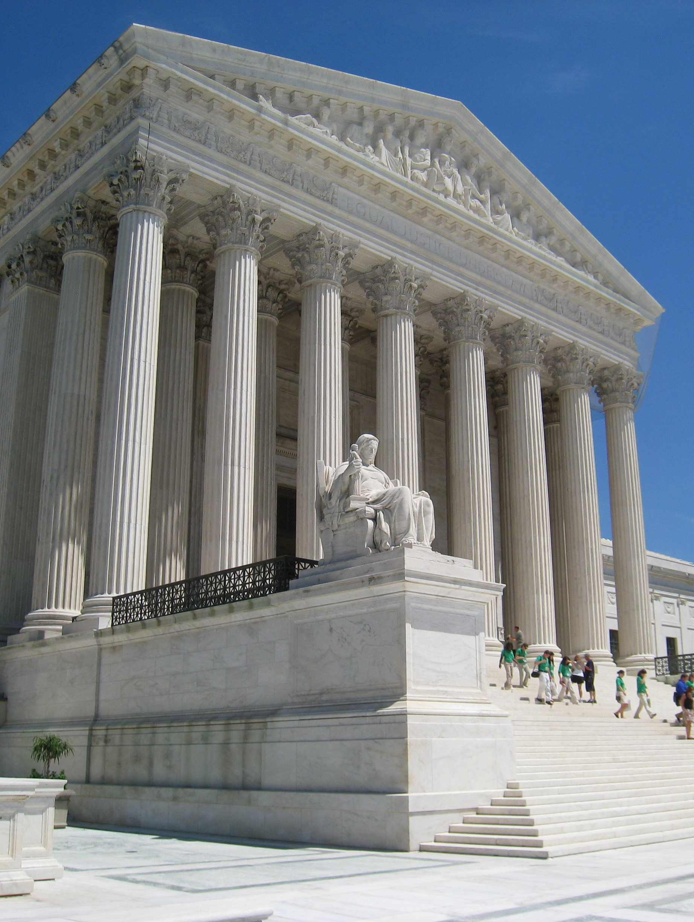
One More Cicero
But if the principles of Justice were founded on the decrees of peoples, the edicts of princes, or the decision of judges, then Justice would sanction robbery and adultery and forgery of wills, in case these acts were approved by the votes or decrees of the populace.
But if so great a power belongs to the decision and decrees of fools that the laws of Nature can be changed by their votes, then why do they not ordain that what is bad and baneful shall be considered good and salutary?
Or, if a law can make Justice injustice can it not also make good out of bad?

Slide 13
Book of Mormon?
Mosiah 2
Mosiah 29
Pre-Existance?

Slide 14
Left Wing
Right Wing

Slide 16
People’s Law
1777
The Articles of Confederation
Rulers Law
Anarchy

Slide 17
5000 Year Leap
As the Founders studied the record of the ancient Israelites they were intrigued by the fact that they also operated under a system of laws remarkably similar to those of the Anglo-Saxons.
The two systems were similar both in precept and operational structure
In fact, the Reverend Thomas Hooker wrote the “Fundamental Orders of Connecticut” based on the principles recorded by Moses in the 1st Chapter of Deuteronomy.
This constitutional charter operated so successfully that it was adopted by Rhode Island.
When the English colonies were converted over to independent states, these were the only two states which had constitutional documents which readily adapted themselves to the new order of self-government. All of the other states had to write new constitutions.
The basic tenet was: Proclaim liberty throughout all the land unto all the inhabitants thereof. (Lev 25:10). This is the inscription on the Liberty Bell.

Slide 18
Law of Moses
Exodus 18: 13-26

Slide 19
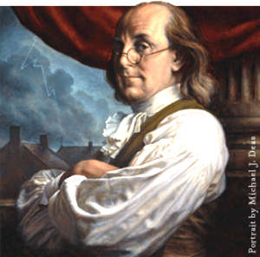
Benjamin Franklin
…There is a natural inclination in mankind to a kingly government. [It gives the people the illusion that a king will establish] equality among citizens; and that they like.
I am apprehensive, therefore—that the Government of these States may in future times end in a monarchy.
But this catastrophe, I think, may be long delayed, if in our proposed system we do not sow the seeds of contention, faction, and tumult, by making our posts of honor places of profit.

Slide 20
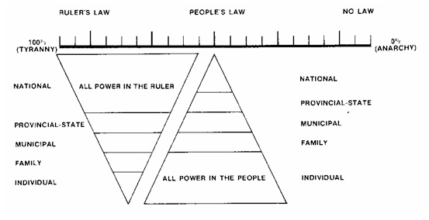

Slide 21
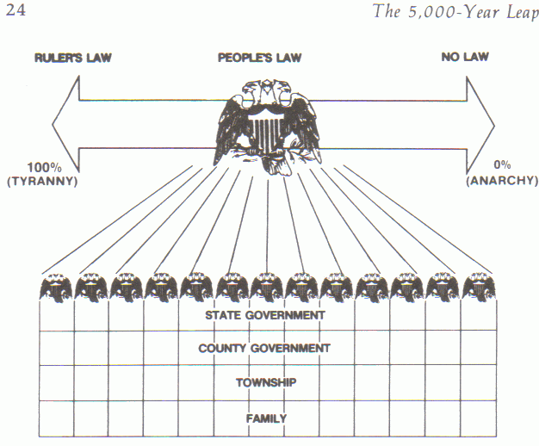

Slide 22
Dedication of the Idaho Falls Temple
'We thank thee that thou hast revealed to us that those who gave us our constitutional form of government were men wise in thy sight and that thou didst raise them up for the very purpose of putting forth that sacred document
"'We pray that kings and rulers and the peoples of all nations under heaven may be persuaded of the blessings enjoyed by the people of this land by reason of their freedom and under thy guidance and be constrained to adopt similar governmental systems, thus to fulfill the ancient prophecy of Isaiah and Micah that " . . . out of Zion shall go forth the law

Slide 23
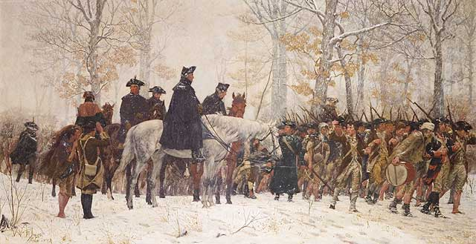
George Washington at Valley Forge
Providence has a joint claim to my humble and grateful thanks, for its protection and direction of me, through the many difficult and intricate scenes, which this contest hath produced; and for the constant interposition in our behalf, when the clouds were heaviest and seemed ready to burst upon us.
The hand of Providence [he wrote] has been so conspicuous in all this, that he must be worse than an infidel that lacks faith, and more than wicked, that has not gratitude, enough to acknowledge his obligations. . .

Slide 24
The Refuge from the Coming Storm
Isaiah 4: 5,6
And the LORD will create upon every dwelling place of mount Zion, and upon her assemblies, a cloud and smoke by day, and the shining of a flaming fire by night: for upon all the glory shall be a defence.
And there shall be a tabernacle for a shadow in the daytime from the heat, and for a place of refuge, and for a covert from storm and from rain
Three Places of Refuge:
1- Every dwelling place
2- upon her assemblies
3- a tabernacle for:
a shadow in the daytime
a place of refuge
a covert from storm and from rain

Slide 25
The Solution
Wash [ye], make you clean; put away the evil of your doings from before mine eyes; cease to do evil; (1:16)
Learn to do well; seek [justice], relieve the oppressed, [vindicate] the fatherless, plead for the widow. (1:17)
Come now, and let us reason together, saith the Lord: though your sins be as scarlet, they shall be as white as snow; though they be red like crimson, they shall be as wool. (1:18)
If ye be willing and obedient, ye shall eat the good of the land; (1:19) But if ye refuse and rebel, ye shall be devoured with the sword. for the mouth of the Lord hath spoken it. (1:20)

Slide 26
Thomas Paine
THESE are the times that try men's souls. The summer soldier and the sunshine patriot will, in this crisis, shrink from the service of their country; but he that stands by it now, deserves the love and thanks of man and woman.
Tyranny, like hell, is not easily conquered; yet we have this consolation with us, that the harder the conflict, the more glorious the triumph. What we obtain too cheap, we esteem too lightly: it is dearness only that gives every thing its value.
Heaven knows how to put a proper price upon its goods; and it would be strange indeed if so celestial an article as FREEDOM should not be highly rated

