Slide 1
The Song of the Suffering Servant

Slide 2
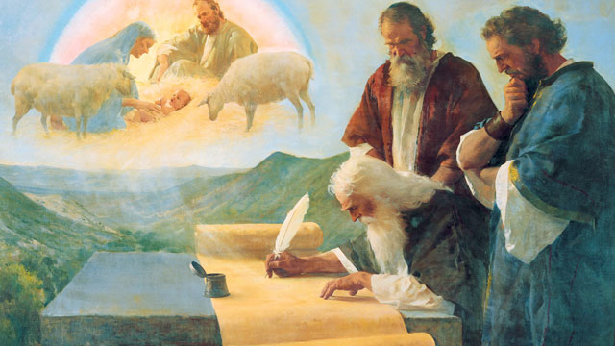
Our Report
Isaiah 53:1,2

Slide 3
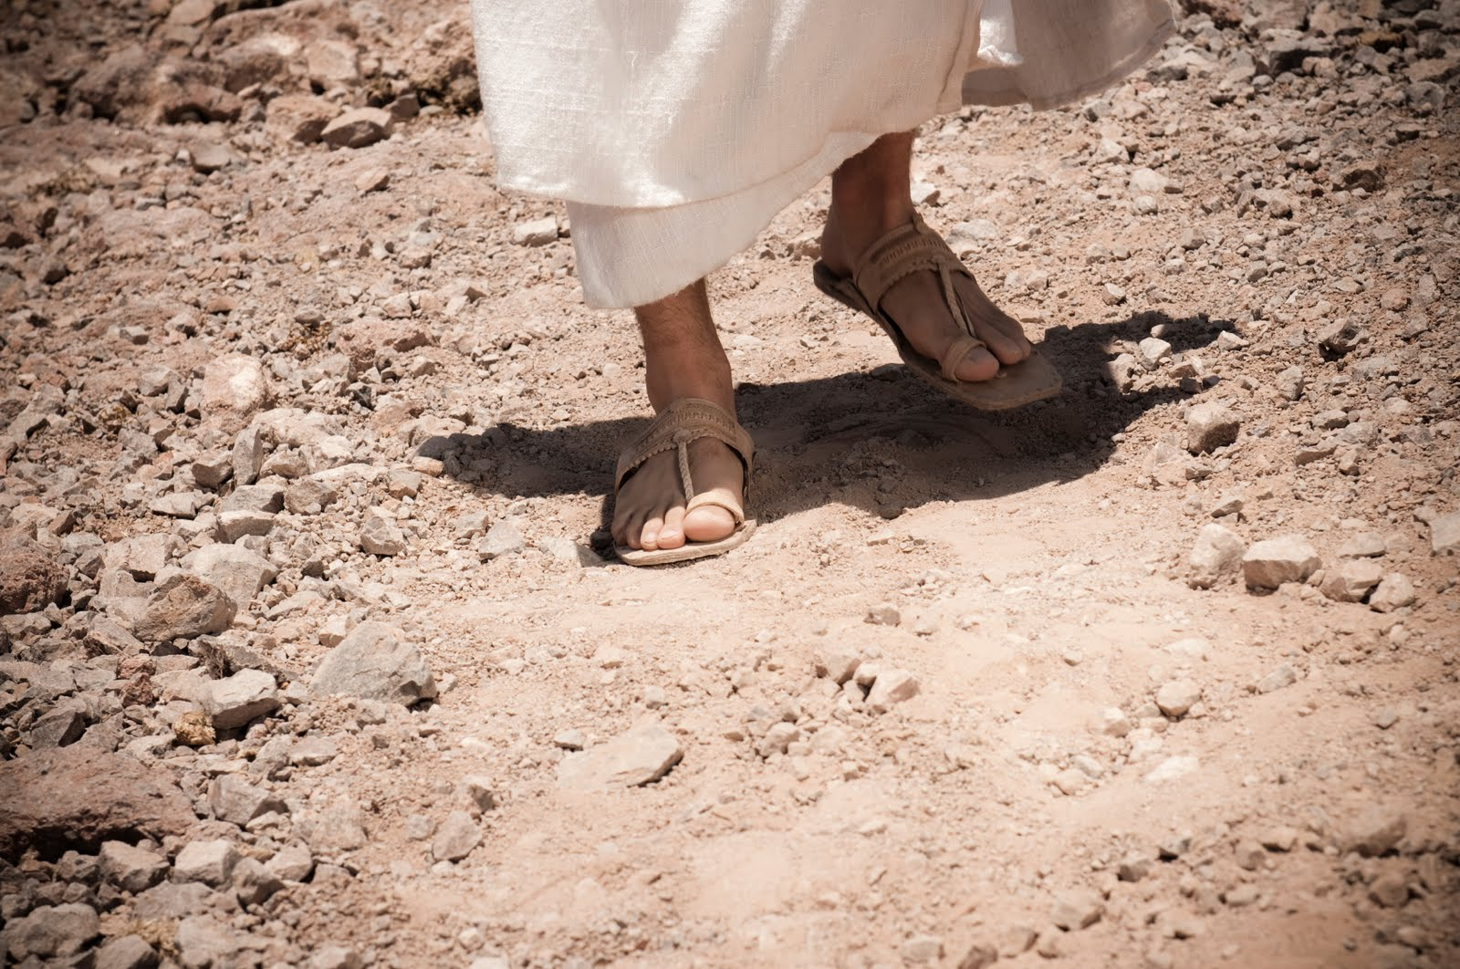
Isaiah 53:2
For he shall grow up before him as a tender plant, as a root out of dry ground
He hath no form nor comeliness; and when we shall see him, there is not beauty that we should desire him.

Slide 4
Christian writer Jonnie Moore
[Jesus] was the teacher from a small town who knew and understood the economic insecurity that was common in the first century. Times must have been rather tough for Jesus at points in his life, for he even spoke of being homeless, having to sleep on the ground with no roof over his head.
He also knew what it was like to have his message rejected and how it felt to be misunderstood. Jesus was regarded with such little significance in his hometown that one of his critics once remarked sardonically, “Isn’t this the carpenter’s son?” Jesus eventually had to move to different city (Capernaum) because his teachings so infuriated the people living in his hometown that they drove him out of Nazareth and even tried to throw him off a cliff.
The real Jesus had dirt underneath his fingernails and calluses on his hands. He probably smelled badly from sweating profusely in the Judean sun on his long hikes to Jerusalem, and Jesus was, without a doubt, rumored to be a hypocrite or absolutely mad for all the time he spent with prostitutes and those afflicted with leprosy.
The brilliance of Christianity is the image of a God, named Jesus, who arrived with dirty hands.

Slide 5
Personalize His Stripes
He is despised and rejected of men
A man of sorrows and acquainted with grief
We hid as it were our faces from him,
He was despised, and we esteemed him not
Surely he hath borne our griefs and carried our sorrows (pains)
Yet we did esteem him stricken, smitten of God and afflicted
But he was wounded for our transgressions, he was bruised for our iniquities
The chastisement of our peace was upon him, And with his stripes we are healed.

Slide 6
Four Stages of Forgiveness
Forgo (Let it alone)
Forbear (Stop Punishing Behaviors)
Forget (Refuse to Dwell and Revisit)
Forgive (Abandon the Emotional Debt)

Slide 7
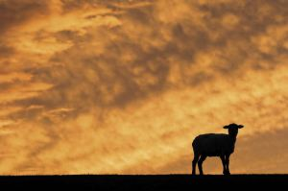
Wandering Sheep
Isaiah 53:6

Slide 8
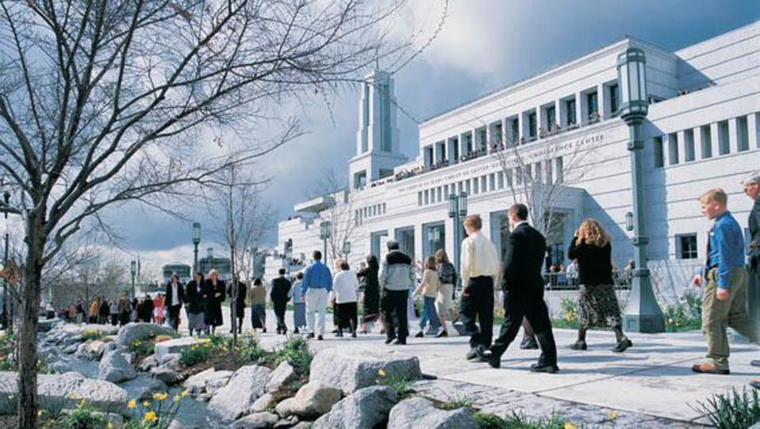
His Seed
Isaiah 53:10

