Slide 1
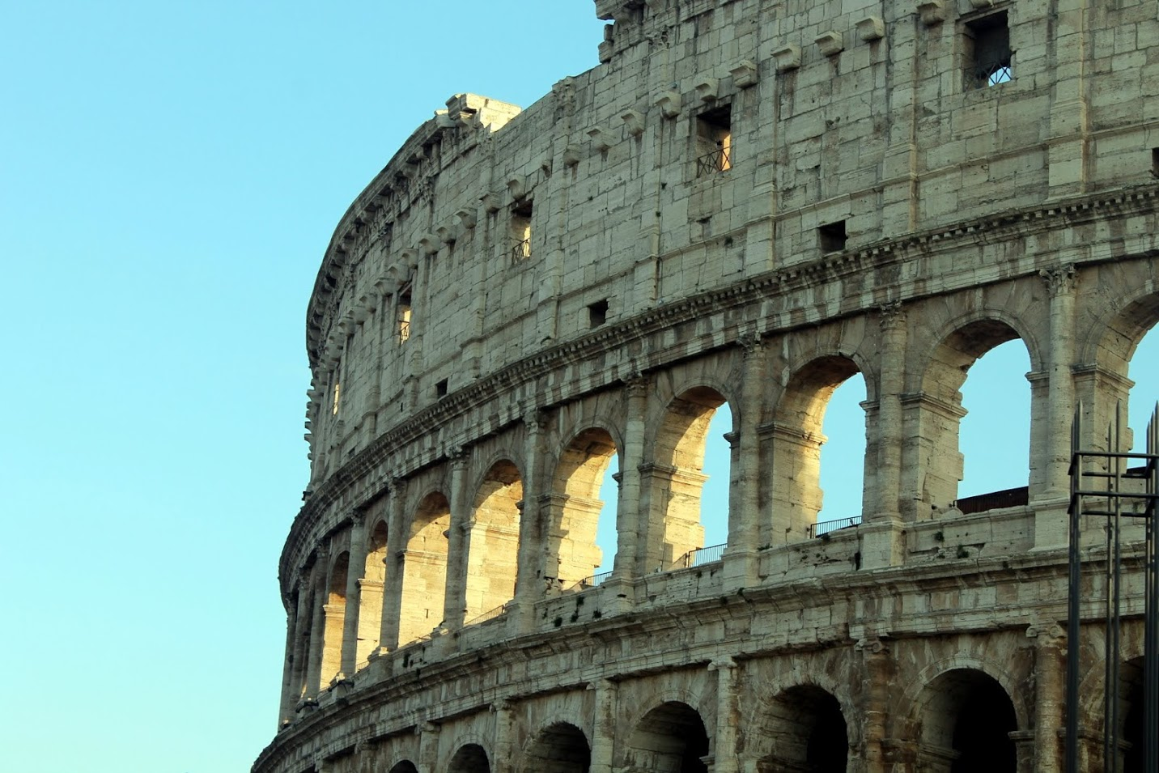
The Sins of the Fathers

Slide 2
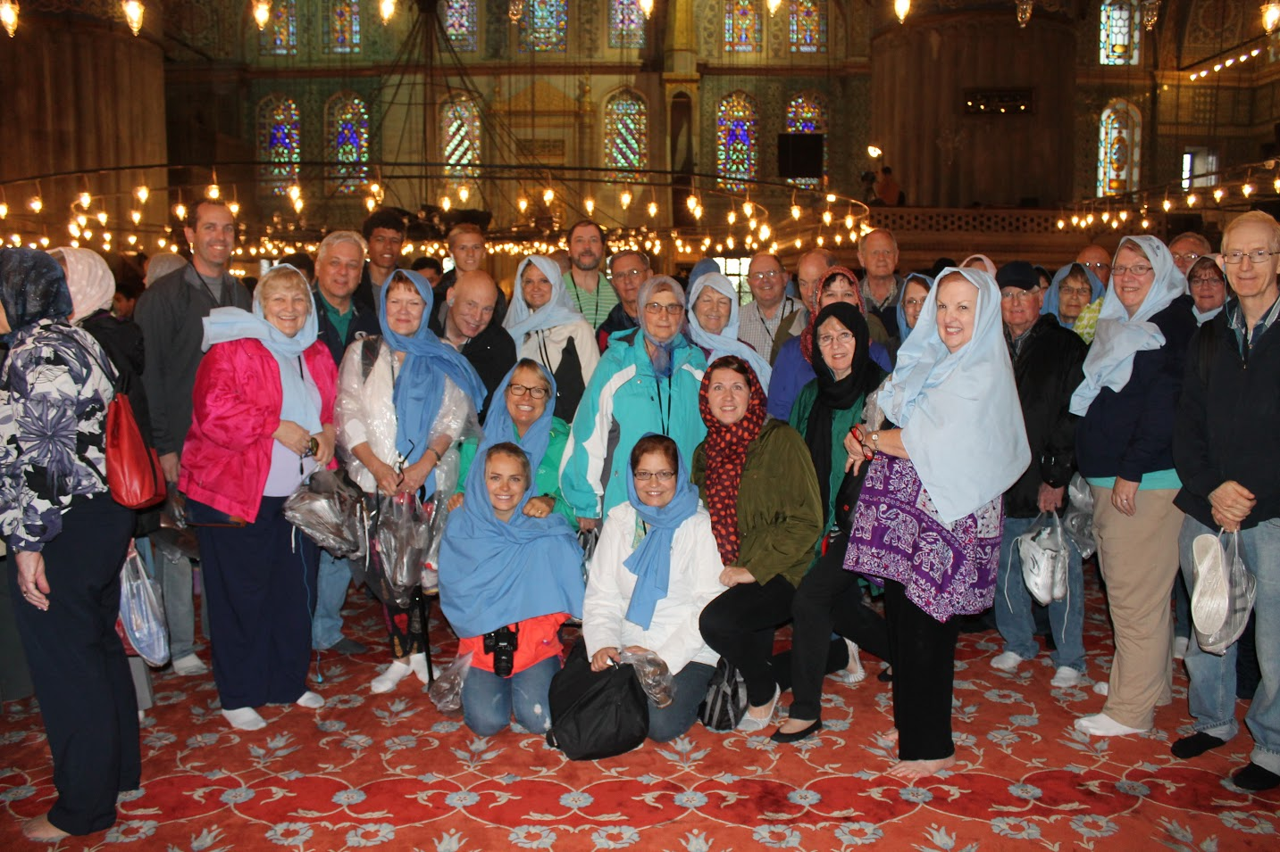

Slide 3
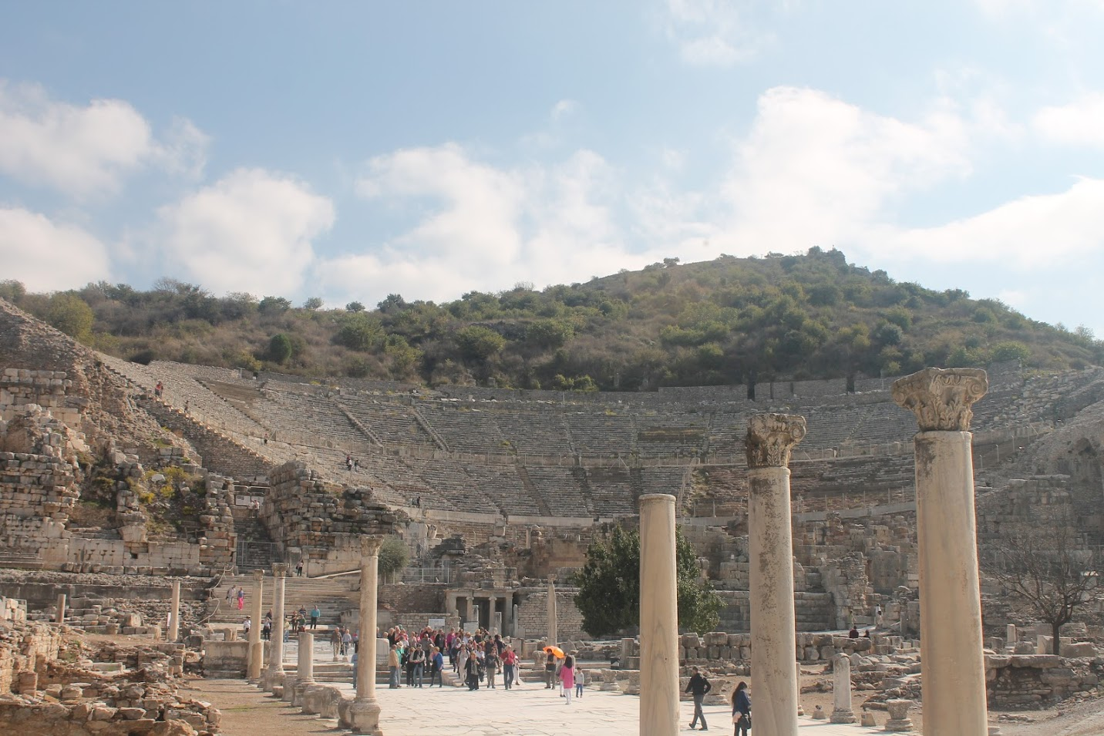

Slide 4
Mists and Vapors
1 Nephi 12

Slide 5
Recent Blog
You are beloved!
I testify that there are as many Plans of Salvation as there are Children of God
I testify that you have a Heavenly Parents who love you and adore you just the way you are…

Slide 6
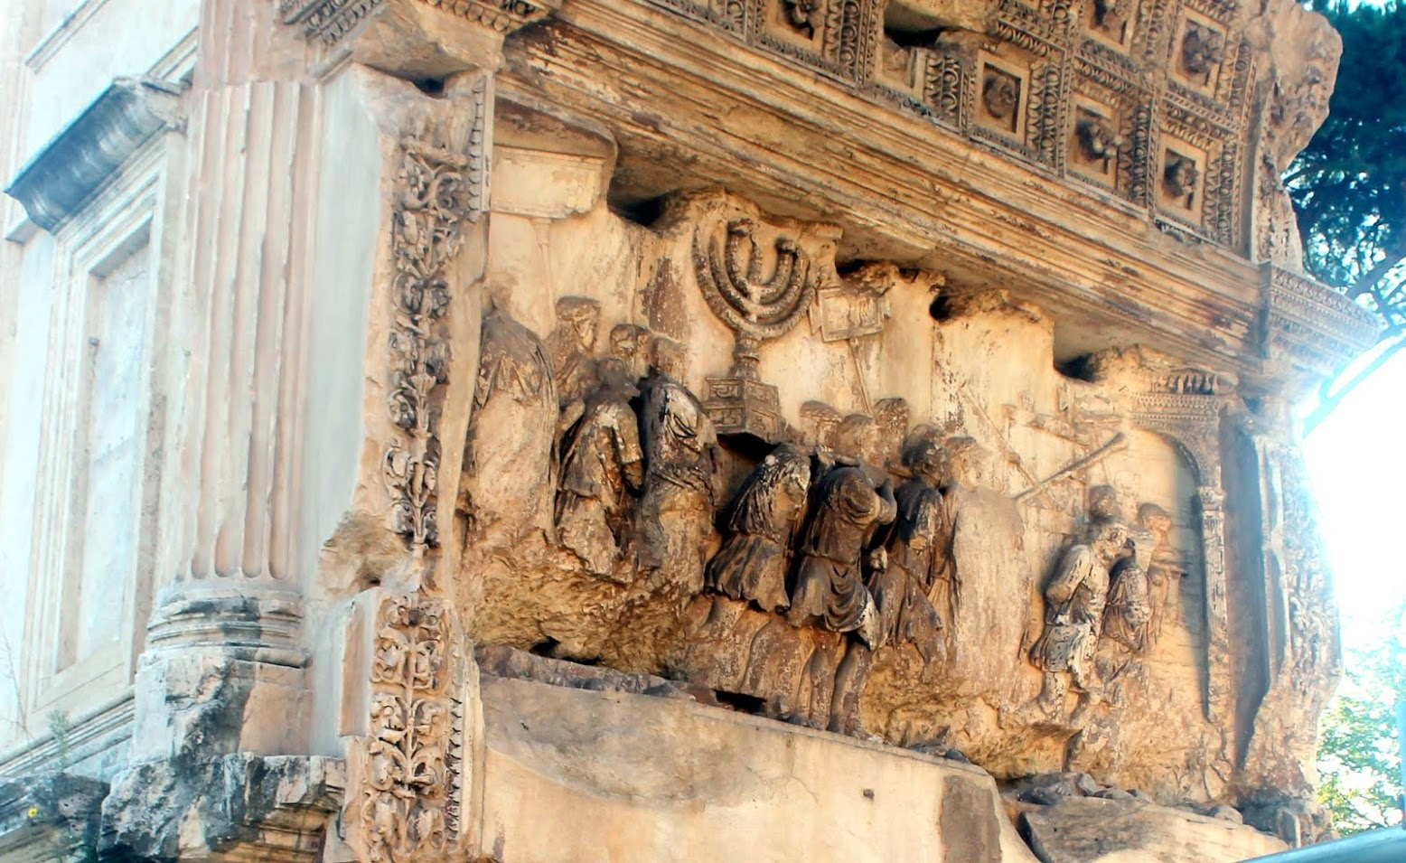
Nations and Kingdoms
1 Nephi 13

Slide 7
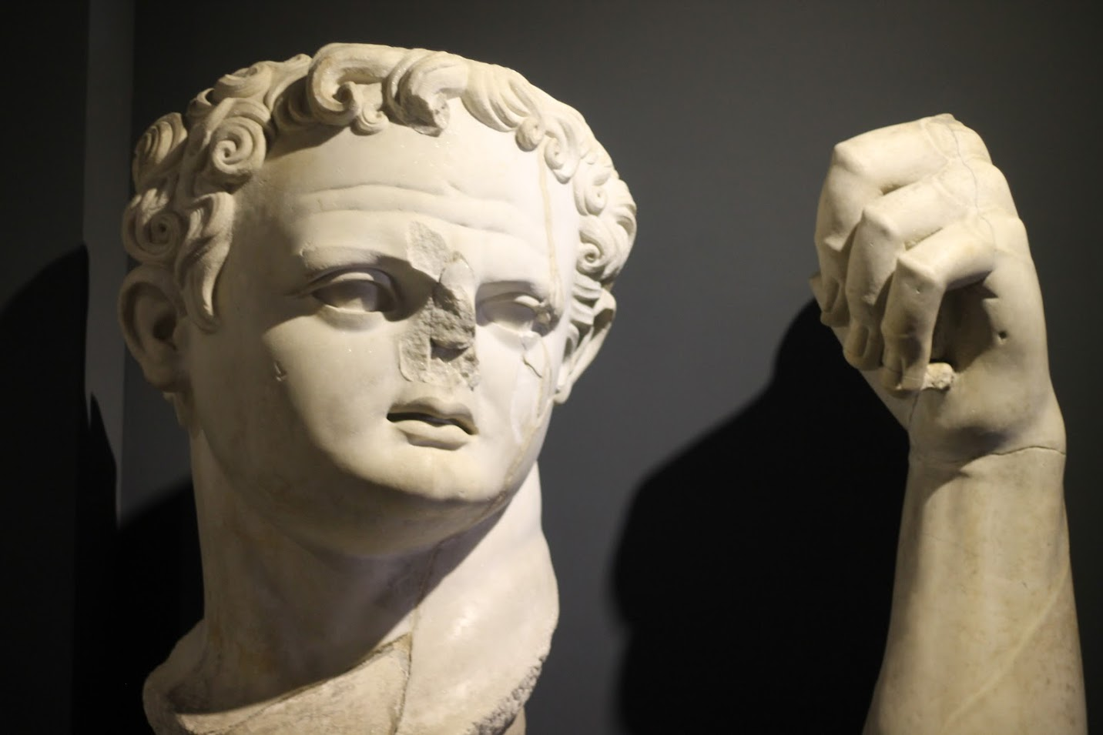
Christian Martyrs
1 Nephi 13:5

Slide 8
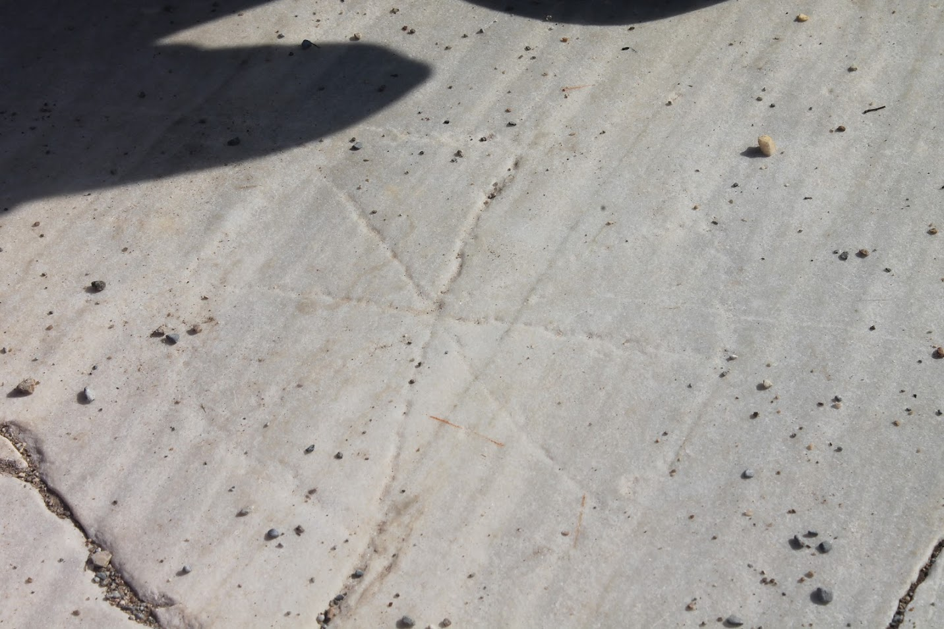

Slide 9
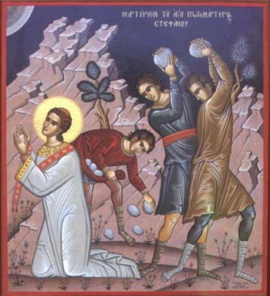
Joseph Smith
Joseph Smith once came across John Foxe's, Book of Martyrs. John Foxe had lived in the 1500's and personally witnessed the persecutions and martyrdoms of many early reformers. Edward Stevenson later described the Prophet's reaction to the book:
"He expressed sympathy for the Christian martyrs and a hope for their salvation. He asked to borrow the book, promising to return it when he should meet us again in Missouri.
On returning it he said, 'I have, by the aid of the Urim and Thummim, seen those martyrs. They were honest, devoted followers of Christ, according to the light they possessed. They will be saved.'"
(S. Michael Wilcox, Fire in the Bones, 16-17)

Slide 10
The Martyrs
For what crimes were these early saints destroyed? In England, "The principal cause... was for teaching their children and family the Lord's Prayer and Ten commandments in English." Parents who taught these things to their children "were burned. Their children were warned to forget the offending words placed in their memory by loving parents and to remember only the fate they had suffered... a standard question of the Inquisition was, 'Have you read or do you own the scriptures in the common tongue?"
William Tyndale, who translated the Bible into English prior to the King James commission, was hung and then burned in 1536. His generation of English Reformers were similarly executed. On the continent, thousands were executed and persecuted by various elements of the Inquisition.
In the mid-1500's in England, Queen Mary became known as "bloody Mary" by executing those in support of an Anglican church. "It is a broad fact that during the last four years of Queen Mary's reign no less than 288 persons were burnt at the stake for their adhesion to the Protestant faith."

