Slide 1
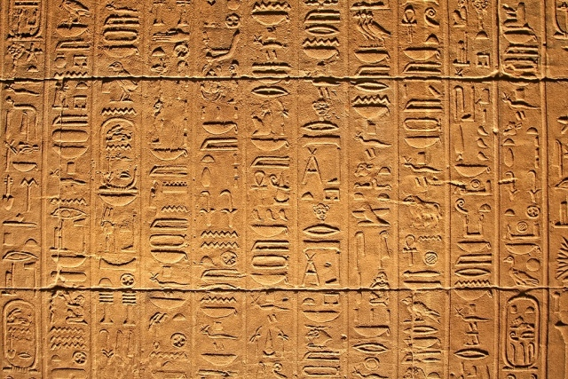
The Plates of Brass

Slide 2
Reminder…
King Josiah’s Reforms
620 BC
Rediscovery (and editing) of the Book of Deuteronomy
Strict adherence to the letter of Law of Moses
Limited all sacrifice to the Temple
Belief in Israel’s ‘righteousness’ [and divine protection] due to strict obedience to the Law
Persecution of false prophets (visionaries)
Rejection of any additional divine guidance outside of the Law (A Torah, a Torah, we have a Torah!)
Strict punishment against any preforming sacrifices outside the Temple

Slide 3
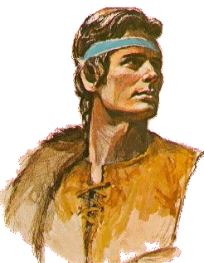
The Unspoken “Subplot
Nephi (The New “Joseph”) vs Laman and Lemuel (the orthodox Deuteronomists)
Nephi is:
The Younger Brother
Named for the “grain god of Egypt” by his father
Left to be killed of wild beasts in the wilderness by his brothers
Made a ruler over his brothers
Has visions and dreams

Slide 4
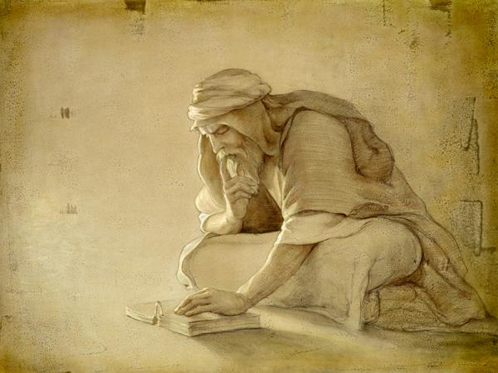
Dreams and Visions
1 Nephi 2:1

Slide 5
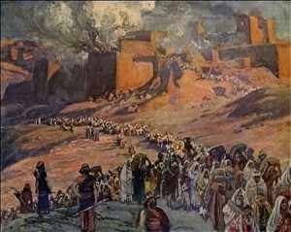
The Problem (Inverted)
Thus,
And [Laman and Lemuel] were like unto the Jews who were at Jerusalem
Neither did they believe that Jerusalem…could be destroyed according the words of the prophets.
They did murmur because they knew not the dealings of that God who created them
Laman and Lemuel, being the eldest, did murmur against their father

Slide 6
Neal A. Maxwell
Failing to understand the “dealings” of the Lord with His children—meaning His relations with and treatment of His children—is very fundamental.
Murmuring is but one of the symptoms, and not the only consequence either; in fact, brothers and sisters, this failure affects everything else!
To misread something so crucial constitutes a failure to know God, who then ends up being wrongly seen as unreachable, uninvolved, uncaring, and unable—a disabled and diminished Deity,
really—about whose seeming limitations, ironically, some then quickly complain.
Oct 1999 General Conference

Slide 7
The Problem
An ex-Mormon blog, which currently counts nearly 12,000 “recovering Mormons”, posted group survey results in early 2013 that showed that
nearly half of those who answered the survey would describe themselves as atheist,
another 30% would describe themselves as agnostic,
whereas only 0.5% would describe themselves as Catholic and only 2.4% would describe themselves as following an “other Christian religion”…

Slide 8
How Nephi knew
1 Nephi 2:16

Slide 9
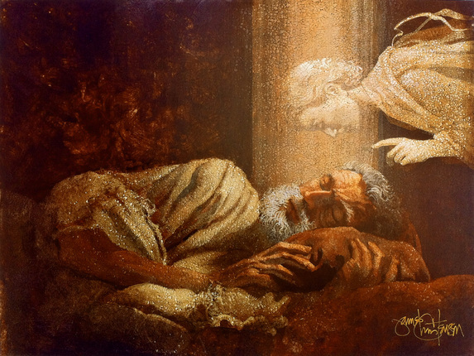
The Abrahamic Journey
Abraham 1:2
Follower
Desire-er
Follower
Possessor
Lehi
Obedient
Revelation
Hard Obedience
Greater Vision
Nephi
Obedient
Revelation
Hard Obedience
Greater Vision
What About Us?

Slide 10
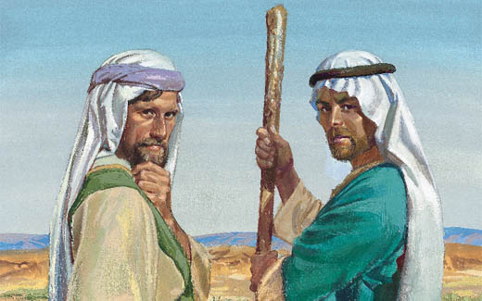
Of Brass Plates and Rods
1 Nephi 3,4

