Slide 1
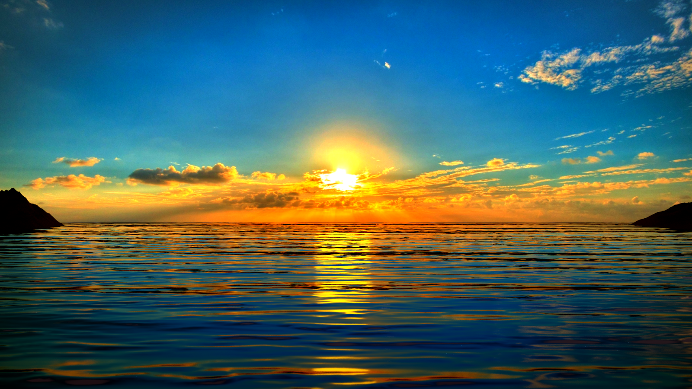
The Acceptable Year of the Lord

Slide 2
The Lord’s Purpose
Isaiah 61:1
The Spirit of the Lord God is upon me:
because the Lord hath anointed me
to preach good tidings unto meek;
He hath sent me to bind up the brokenhearted,
To proclaim liberty to the captives, (Jer 34:8)
And the opening of the prison to them that are bound
Isaiah 58:6 (Feast/Fast)
Is not this the fast that I (God) have chosen
to loose the bands of wickedness
to undo the heavy burdens
To let the oppressed go free and that
Ye break every yoke

Slide 3
Isaiah 61:2,3
To proclaim the acceptable year of the Lord, and the day of vengeance of our God;
To comfort all that mourn, to appoint unto them that mourn in Zion
…to give unto them
Beauty (Heb: bonnet of fine linen) for ashes, (Exodus 29:38)
The oil of joy for mourning,
The garment of praise for the spirit of heaviness
That they might be called:
Trees of righteousness (Strong trees or rams)
The planting of the Lord,

Slide 4
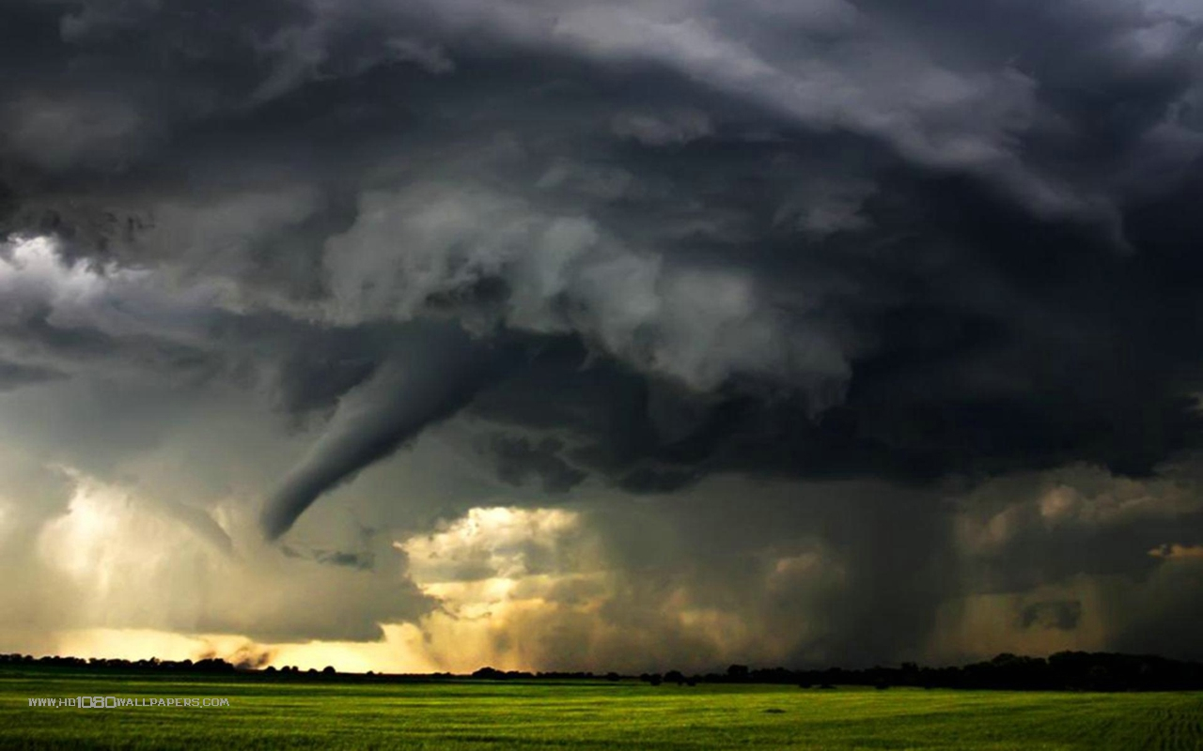
Isaiah 63:5
5 And I looked, and there was none to help; and I wondered that there was none to uphold: therefore mine own arm brought salvation unto me; and my fury, it upheld me.
6 And I will tread down the people in mine anger, and make them drunk in my fury, and I will bring down their strength to the earth.
7 I will mention the lovingkindness of the Lord and the praises of the Lord, according to all that the Lord hath destowed on us, and the great goodness toward the house of Israel, which he hath bestowed on them according to his mercies, and according to the multitude of his lovingkindnesses.
Isaiah 59:16
16 ¶And he saw that there was no man, and wondered that there was no intercessor: therefore his arm brought salvation unto him; and his righteousness, it sustained him.
17 For he put on righteousness as a breastplate, and an helmet of salvation upon his head; and he put on the garments of vengeance for clothing, and was clad with [fury] as a cloak.
18 According to their deeds, accordingly he will repay, fury to his adversaries, recompence to his enemies; to the islands he will repay recompence.

Slide 5
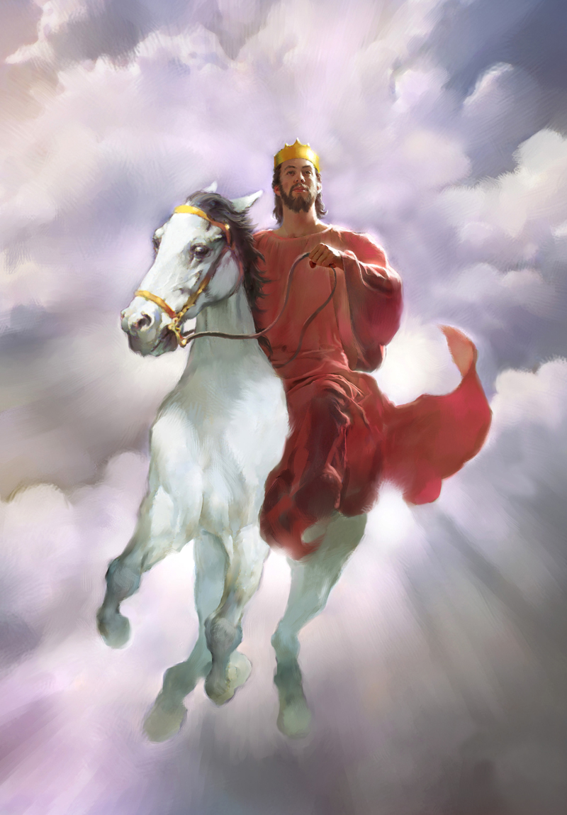
Treading the Winepress
Isaiah 63:1-3

Slide 6
Elder Holland None were with him

Slide 7
Thou Art Our Father!
Isaiah 64:1-8

Slide 8
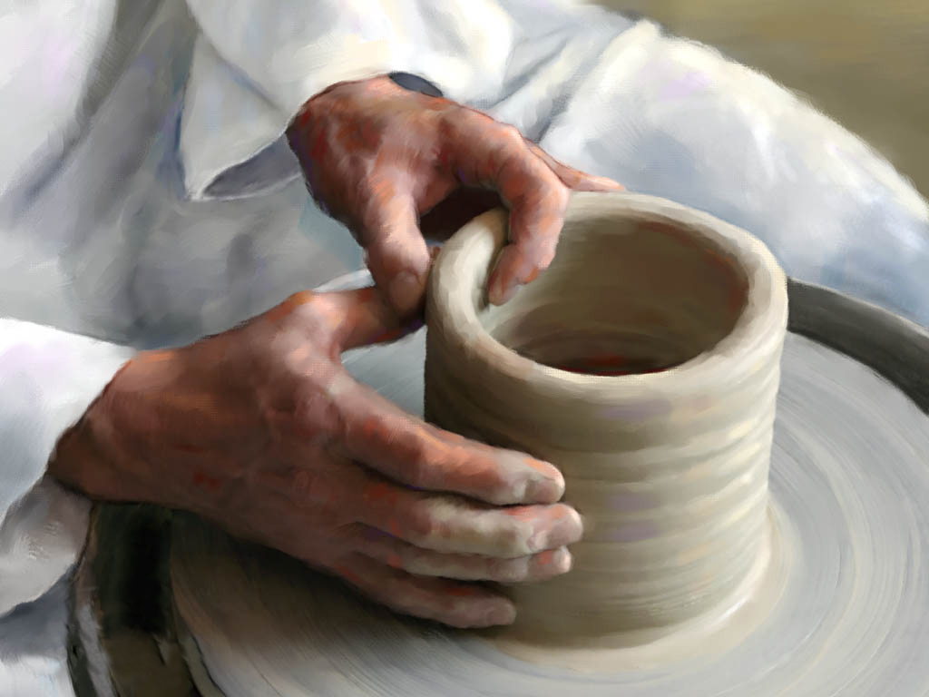
Camille Fronk
First, let’s look at the qualities in the clay itself. This readily available raw material is part of the earth. It is in itself one of God’s creations. We are struck from the very beginning by the humility and unpretentiousness manifest in unworked clay.
How appropriate to compare our mortal bodies to tabernacles of clay (see Mosiah 3:5), a lowly substance capable of being formed into vessels of glory. It reminds us of our own nothingness without the skills, the vision, and the sacrifice of the Master Potter.
Of all sculpting materials, clay responds the easiest to touch and retains the most minute detail, even a thumbprint. Each detail can be changed innumerable times until the potter is satisfied and declares the vessel complete. As sons and daughters of God, each of us bears his imprint.
In the metaphor of the potter, the Lord’s handiwork and detail in the clay is an enduring reminder that he has formed us and that we will “not be forgotten of [him]” (Isaiah 44:21).

Slide 9
Potter and Clay video

