Slide 1
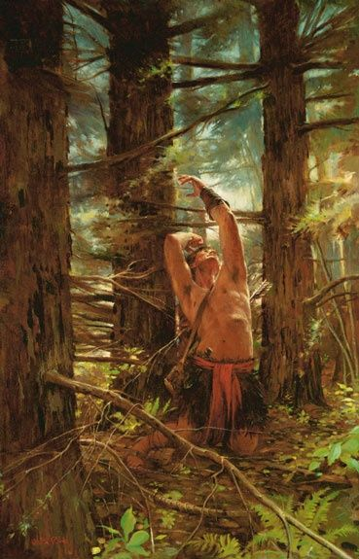
Jacob, Sherem and Enos

Slide 2
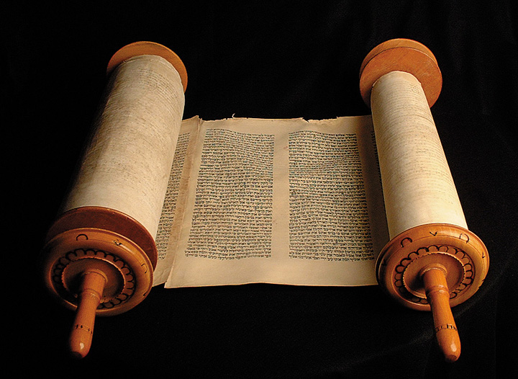
Jacob on Trial
Jacob 7

Slide 3
Timeline
Mosiah Benjamin
124 BC
Jacob
421 BC
King Noah
Abinadi
148 BC
Enos
420 BC
Zeniff
200 BC
Nephite
Dark Ages

Slide 4
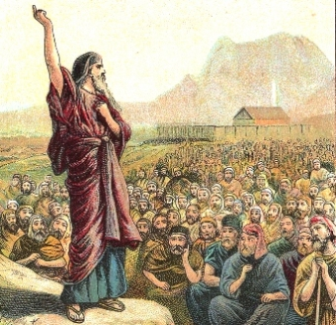
Sherem
Jacob 7

Slide 5
Jacob on Trial
Jacob 7: 7
And ye have led away much of this people that they pervert the right way of the Lord
Deut 24: If there arise among you a prophet…saying, Let us go after other gods, which thou hast not known, and let us serve them…that prophet, or that dreamer of dreams, shall be put to death
I, Sherem, declare unto you that this is blasphemy
Lev 24:16 And he that blasphemeth the name of the Lord, he shall surely be put to death, and all the congregation shall certainly stone him:
…for no man knoweth of such things; for he cannot tell of things to come.
Deut 24 …a dreamer of dreams, and giveth thee a sign or a wonder…shall be put to death

Slide 6
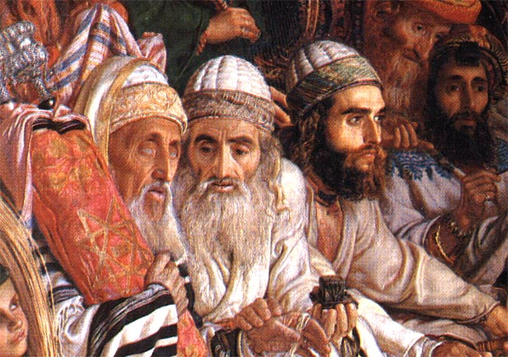
Sign Seeking
In the Deutermomic law, God was assumed to be in the court (Deut 19:17) and it was widely held that “God’s presence in the court would sufficiently enlighten the minds of the judges to detect the falsehood of any testimony in time.
The crucial text in this regard is found in Deuteronomy: “if a false witness rise up against any man to testify against him that which is wrong; then both the men, between whom the controversy is, shall stand before the Lord.
Thus Sherems’s conduct requesting Jacob to produce Devine evidence as not a casual case of idle sign seeking, but rather following a significant rule of ancient Israelite jurisprudence.

Slide 7
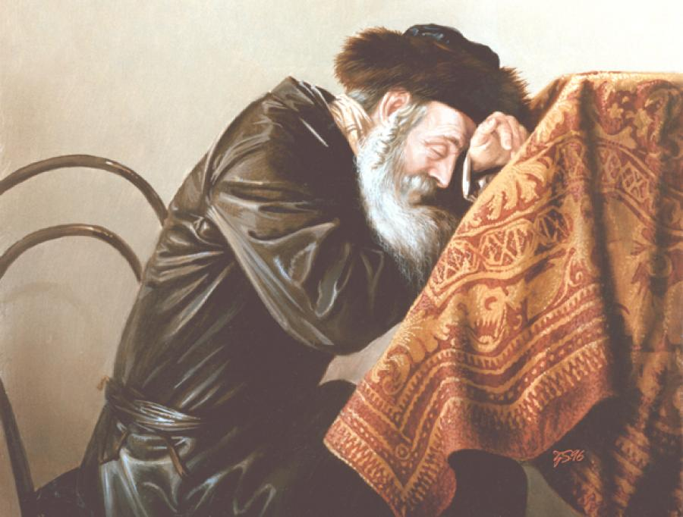
Sherem’s Confession- in Chiasmus.
I fear lest I have committed the unpardonable sin
For I have lied unto God
For I have denied the Christ
And said I that I believed the scriptures
And they truly
Testify of him
And because I have thus lied unto God
I greatly fear lest my case shall be awful; but I confess unto God

Slide 8
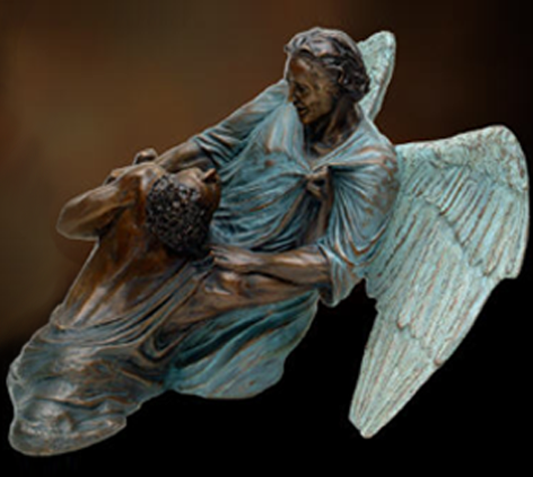
Jacob and Enos
Enos
Genesis 32

Slide 9
Saint Hugh Nibley
Professor Budine, the old Danish philosopher used to say that sorrow is our limitations. It’s your limitations that make you sad. There you are again— your limitations are due to your guilt. The inadequacies are the things you have given in to. You went for easy solutions; you wouldn’t exercise your capacity or expand it or anything. So your limitations haunt you on all sides.
“Cooped, cabined, cribbed, confined, bound in by saucy doubts and fears,
we can’t move at all.”
So we struggle with our own limitations. That’s what we are struggling for. If you had the power to take care of anything you thought was wrong, you wouldn’t worry at all. You’d enjoy doing it, wouldn’t you? Well, there you are.

