Slide 1
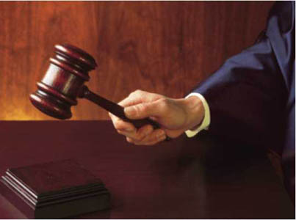
The Advocate D&C 45
www.kevinhinckley.com

Slide 2
…Sigh….
Boyd K Packer family reunion near July 4 2006 (as told to me by a co- worker at my elementary school whose niece is married to Boyd K Packer's grandson)
As Pres. Packer was giving counsel to his family as a patriarch he admonished them again to get their storage and preparedness items.
He said, "The next step is to prepare to leave our homes if necessary."

Slide 3
…Oh my…!
I would like to add a story I was told by a friend. Her daughter married the son of a seventy awhile back in the SL temple. President Hinckley stopped by to say hello and to congratulate the couple.
He gave them the advice to return all their presents, and buy food storage. This happened while my friend was there and she heard it with her own ears.
Some one else also related another story very similar to this but it was a 3rd hand.

Slide 4
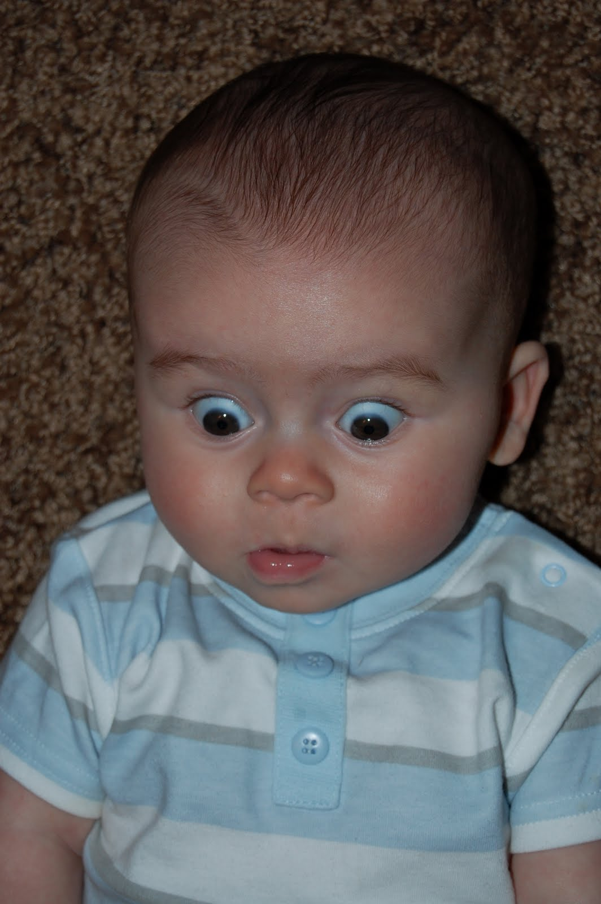
And the latest from the goose pimple gang…
“Elder Bednar of the Quorum of the 12 was here to a Singles Conference this past week. He told them that if Mitt Romney wins the Republican nomination, the Church would see persecution that we have never seen before in our lifetime and that our testimonies would be tested .
He said that even the Sacred Temple Covenants would be made known to the world….
If this does happen, it will be in fulfillment of the scriptures, so we knew it would be coming sometime. Please see that the young folks of our families are Spiritually and mentally prepared for this so if and when it comes, we can all stand firm.”

Slide 5
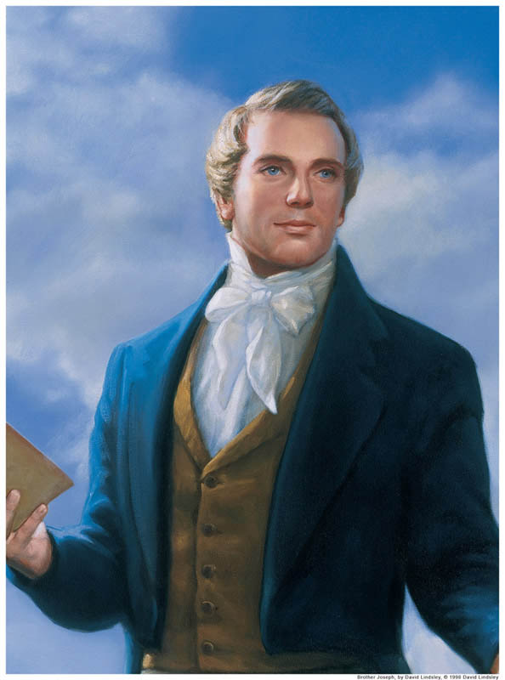
Section 45
1831
Wild speculation on the 2nd Coming
Counterfeit spiritual manifestations
Why?

Slide 6
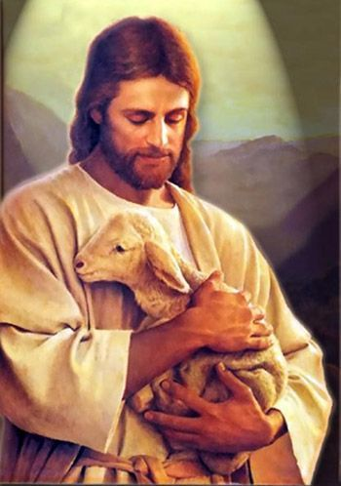
The Nature of God
D&C 45:3-5

Slide 7
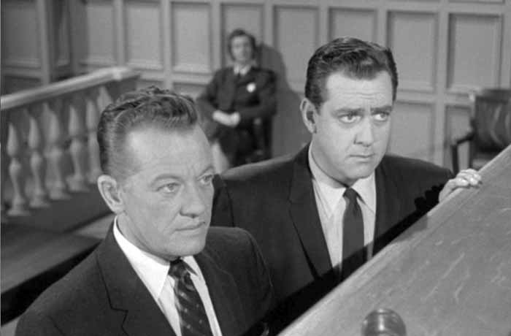
Robert Millett
Imagine that you had been asked to serve as the defense attorney for a man who had been arrested for robbing a local food store… You stand and speak with much confidence, ‘Judge, jury, I demand that you set this man free!’
The judge answers: ‘On what grounds?’ You reply: ‘Because of my excellent reputation as an attorney, because of my marvelous record of service to the innocent who are unjustly accused.’ One can imagine how the judge and jury would respond. You would no doubt be laughed out of the courtroom.
And yet, note in a modern revelation how the Savior pleads our case, how he mediates between us and the Eternal Father…
What a strange defense! What an unusual manner of defending us! The Lord here pleads our cause on the basis of his merits; we are saved through his works, his mercy and grace.
And what does he require? ‘Wherefore, Father, spare these my brethren that believe on my name, that they may come unto me and have everlasting life.’
(Robert L. Millet, Steadfast and Immovable: Striving for Spiritual Maturity [Salt Lake City: Deseret Book Co., 1992], 120.)

Slide 8
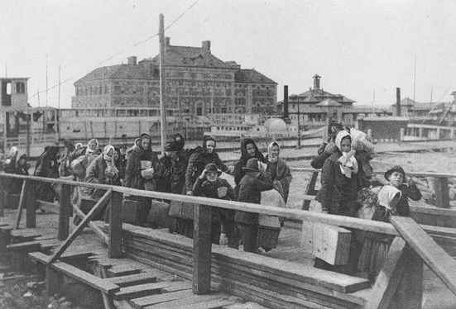
Who are we?
D&C 45: 13,14
Strangers?
Israel
Modern Church
Us

Slide 9
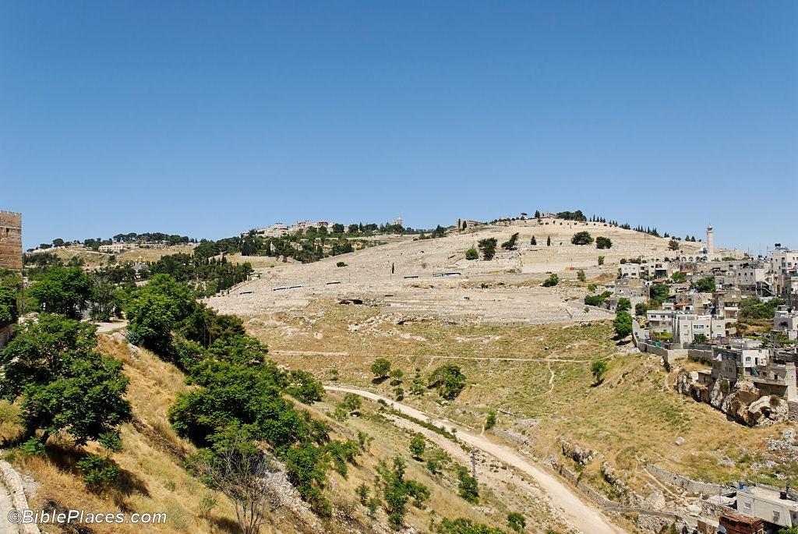
Three Time Periods
Destruction of Jerusalem
(D&C 45:18-21)
Fullness of the Times of the Gentiles
v. 25
v. 51-53 (2nd Coming)
v. 56,57 The Ten Virgins
1831
v. 63,64

