Slide 1
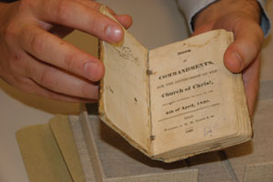
Prophecies and Promises: the Lord’s Preface
www.kevinhinckley.com

Slide 2
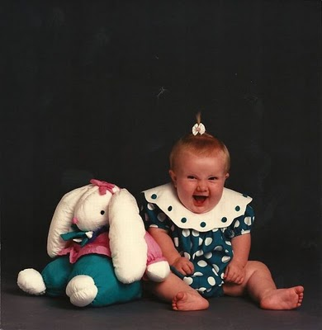
Thank you for the family Christmas Photos

Slide 3
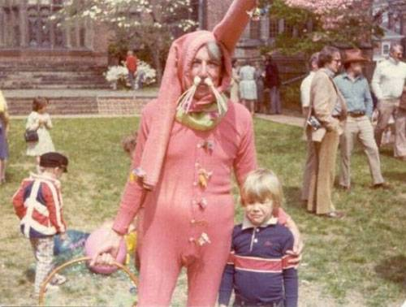

Slide 4
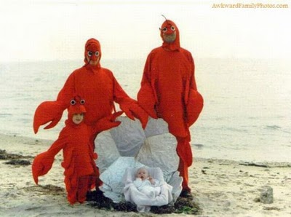

Slide 5
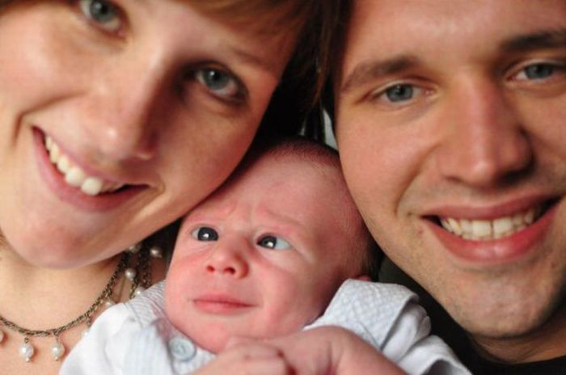

Slide 8
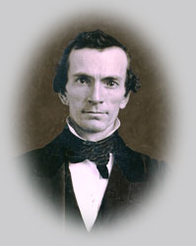
Joseph smith
[Oliver Cowdrey] wrote to inform me that he had discovered an error in one of the commandments-Book of Doctrine and Covenants: ‘And truly manifest by their works that they have received the Spirit of Christ unto a remission of their sins’ (D&C 20:37)
“The above quotation, he said, was erroneous, and added: ‘I command you in the name of God to erase those words, that no priestcraft be amongst us!’
“I immediately wrote to him in reply, in which I asked him by what authority he took upon him to command me to alter or erase, to add to or diminish from, a revelation or commandment from Almighty God.
“A few days afterwards I visited him and Mr. Whitmer’s family, when I found the family in general of his opinion concerning the words above quoted, and it was not without both labor and perseverance that I could prevail with any of them to reason calmly on the subject.
However, Christian Whitmer at length became convinced that the sentence was reasonable, and according to Scripture; and finally, with his assistance, I succeeded in bringing, not only the Whitmer family, but also Oliver Cowdery to acknowledge that they had been in error,

Slide 9
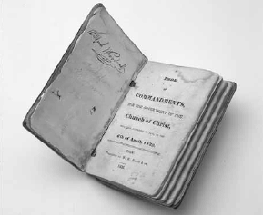
The Book of Commandments
1831- Conference of Elders
Desire to publish 63 revelations
1833 Missouri Mobs
1835 First Published
1844 New Version
1876 Updated Version

Slide 10
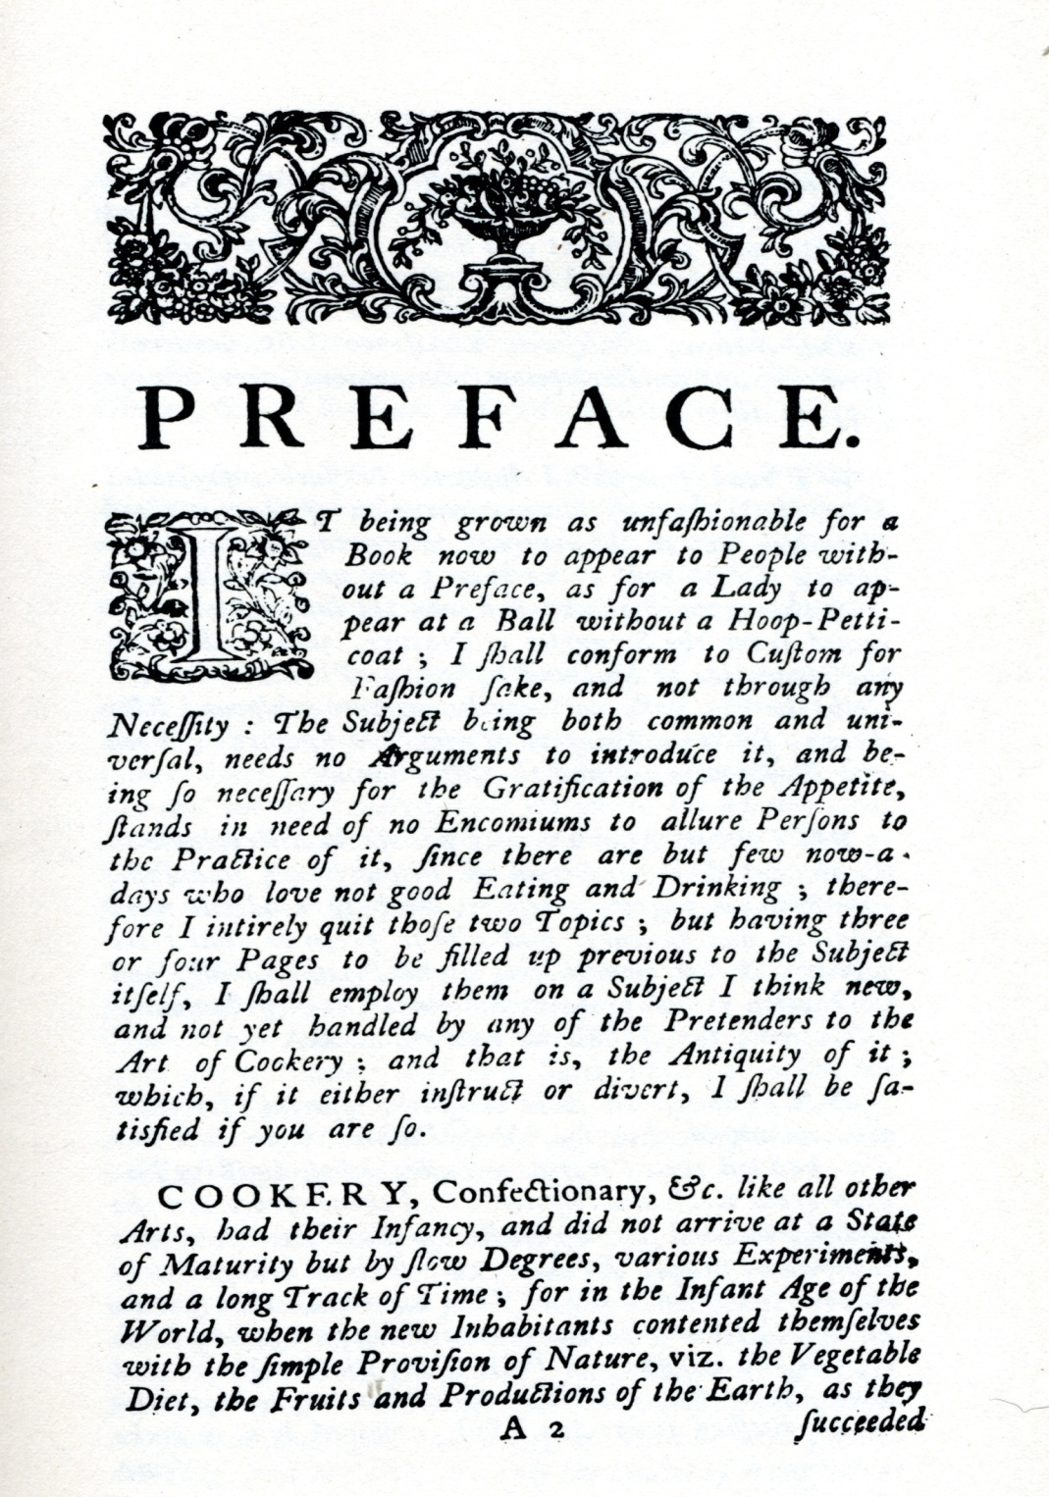
The Lord’s Preface
D&C 1:6

Slide 11
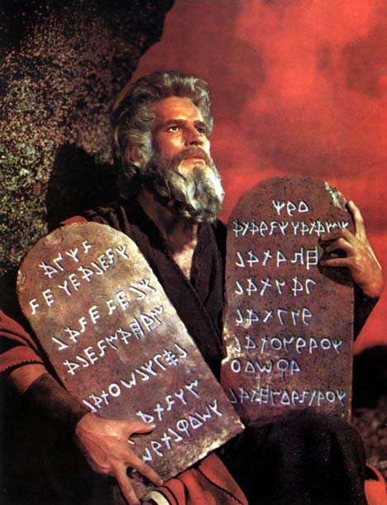
Why Commandments?
D&C 1:17

Slide 12
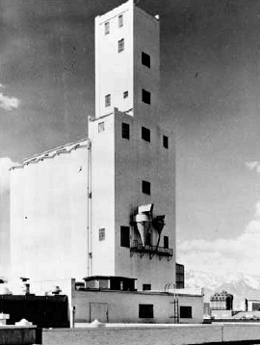
Harold B. Lee
The Lord has given us in this day the greatest organization upon the face of the earth, with his power and his authority to direct it. He has given us sound principles; he has shown us the plan and the way by which want and distress may be done away among us. He has shown us the way to brotherly love.
If the afflictions which have been predicted do come upon us, they will come upon us because we have not kept the faith and because we have been disobedient and have thrown away the opportunities that our Heavenly Father has given us to prepare for the day of calamity which he foretold ( D&C 1:17), over one hundred years ago, would come in this generation.
I remember at the dedication of the grain elevator in 1940 hearing President McKay in an inspired and prophetic prayer utter these words:
May this be an edifice of service, a contribution of love, and as such we dedicate it unto thee and ask thy blessings to attend all who have contributed to its erection and all who may contribute to the keeping of these bins filled with the wheat
which is considered necessary to be preserved preparatory to the judgments that await the nations of the earth.
Conference, April, 1946

Slide 13
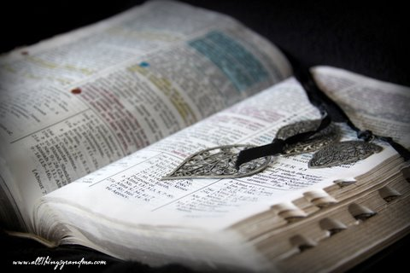
Why Commandments?
The Lord’s Desires:
(V. 19-23)
That:
…every man might speak in the name of God
…faith also might increase in the earth
… mine everlasting covenant established
…the fulness of my gospel proclaimed
Therefore, I gave commandments to my servants (in their weakness)
Therefore (inasmuch):
(v. 25-28)
…as they err it will be made known
…if they seek wisdom they’ll be instructed
…if they sin, they will be chastened
…if they are humble, they will be:
made strong,
Be blessed
And receive knowledge

Slide 14
How do we do this?
D&C 1:36,37

Slide 15
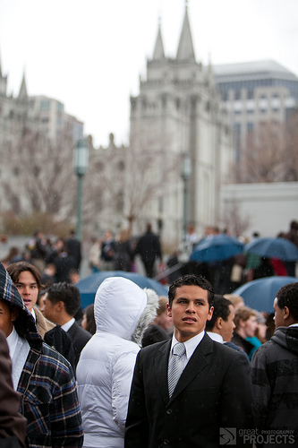
Neal Maxwell
D&C 1:30
Ironically, as the restored Church comes “out of obscurity,” what seems to be stern challenges will actually disclose further the distinctiveness of the Church.
Nevertheless, matching our behavior more closely with our beliefs will bring relentless reminders about the ongoing duties of discipleship.
The restored gospel is buoyant, wide, and deep- beyond our comprehension. It edifies, whether concerning divine design in the universe or stressing the importance of personal chastity and fidelity.
Only meek disciples can safely handle such bold theology.
2002 Oct. General Conference

Slide 16
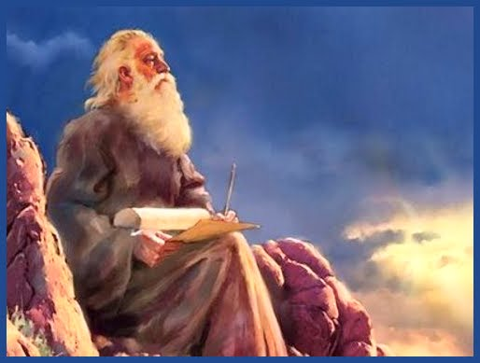
"Prophets, priests and kings . . . have looked forward with joyful anticipation to the day in which we live; and fired with heavenly and joyful anticipations they have sung and written and prophesied of this our day;
but they died without the sight;
we are the favored people that God has made choice of to bring about the Latter-day glory;
it is left for us to see, participate in and help to roll forward the Latter-day glory, ‘the dispensation of the fulness of times’"
(Teachings of the Prophet Joseph Smith, sel. Joseph Fielding Smith [1976], 231).

Slide 17
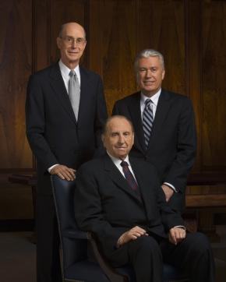
President Hinckley
This is “the only true and living church upon the face of the whole earth” according to the word of revelation. Here lies the truth. Here lies the priesthood.
Hold to the Church. Do not ever lose sight of the fact that the Church must ever remain preeminent in your lives if you are going to be happy as the years pass.
Never let yourselves be found in the position of fighting The Church of Jesus Christ of Latter-day Saints. You cling to it and be faithful to it. You uphold and sustain it. You teach its doctrine and live by it.
And I do not hesitate to say that your lives will be the richer and the happier because of that. You cannot find happiness fighting the work of God. Those who have done so have gone down to a dismal end.
(“Excerpts from Recent Addresses of President Gordon B. Hinckley,” Ensign, Apr. 1996, 72–73)

