Slide 1
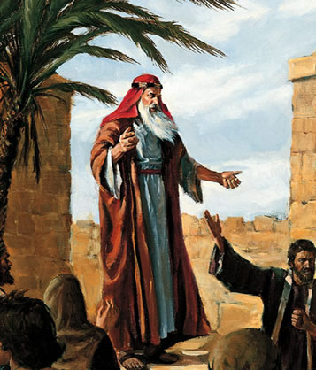
Take your family and flee!
1 Nephi 1

Slide 2
King Josiah’s Reforms
620 BC
Rediscovery (and editing) of the Book of Deuteronomy
Strict adherence to the letter of Law of Moses
Limited all sacrifice to the Temple
Belief in Israel’s ‘righteousness’ [and divine protection] due to strict obedience to the Law
Persecution of false prophets (visionaries)
Rejection of any additional divine guidance outside of the Law (A Torah, a Torah, we have a Torah!)
Strict punishment against any preforming sacrifices outside the Temple

Slide 3
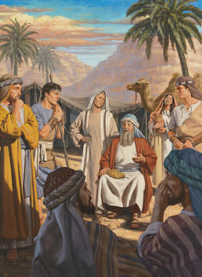
Lehi’s Family
The situation in Jerusalem after Josiah’s reforms may shed some light on understanding Laman and Lemuel as well as illuminating some of the religious conflict that runs throughout the Book of Mormon. …
Lehi’s family may be a microcosm of the conflict in Jerusalem between those who espoused Josiah’s Deuteronomic reforms and the pre-reform religion. Lehi’s theology had affinities with the older religion.
What if Laman and Lemuel were believers in the reform?
Brant A. Gardner, Second Witness: Analytical and Contextual Commentary on the Book of Mormon, 6 vols. (Salt Lake City, Utah: Greg Kofford Books, 2007–2008), 1:92.

Slide 4
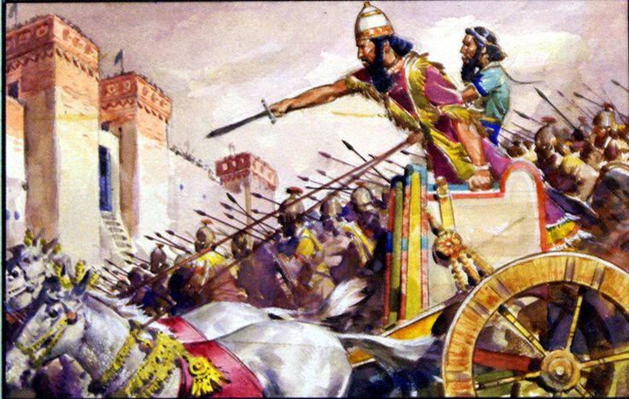
600 BC

Slide 5
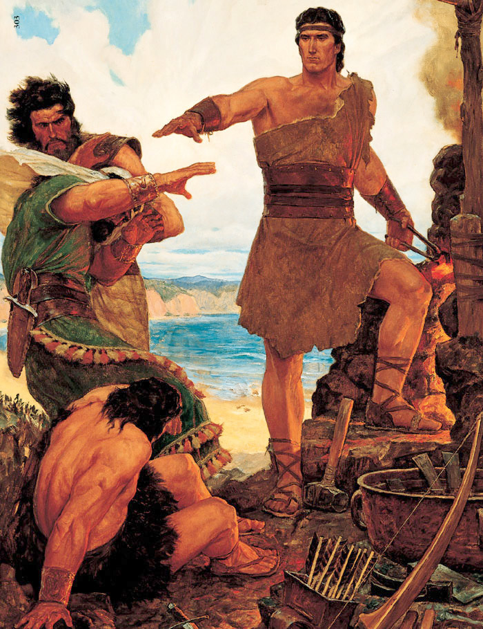
Nephi
1 Nephi 1:1

Slide 6
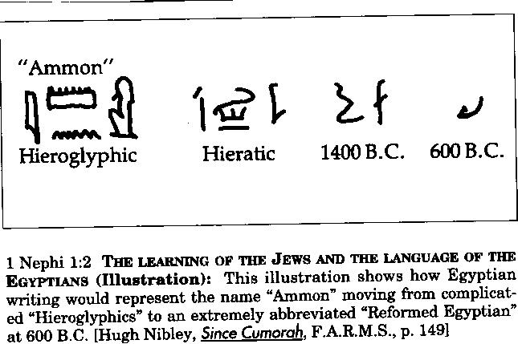
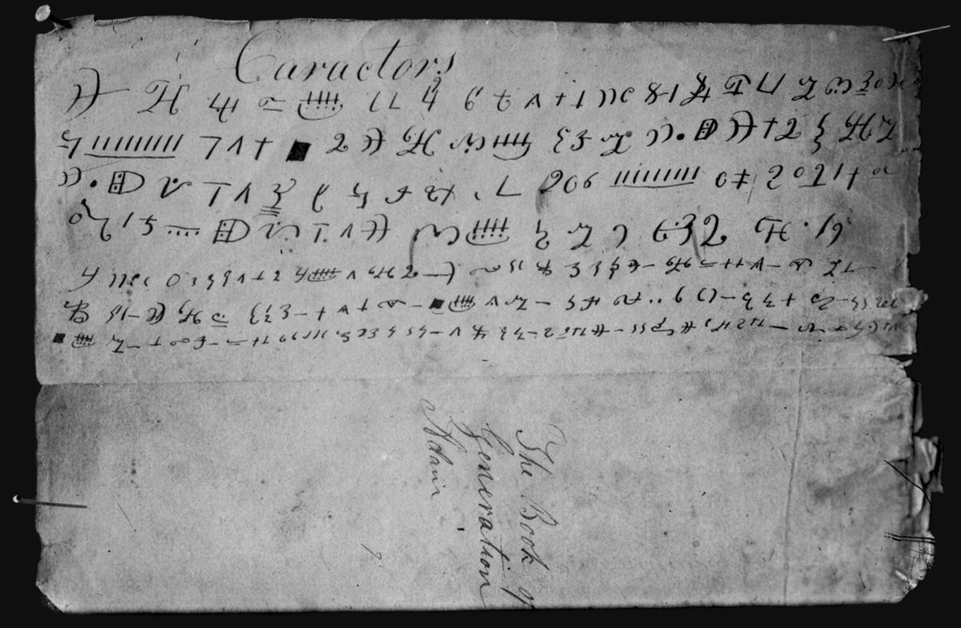

Slide 7
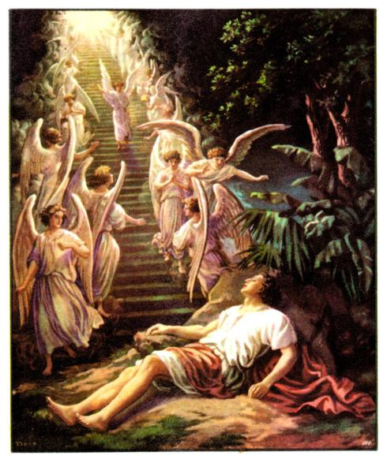
The Lord of Hosts Seeing the ‘sod’ (Heb: cowd)
1 Nephi 1:8
Jeremiah 23:18,22

Slide 8
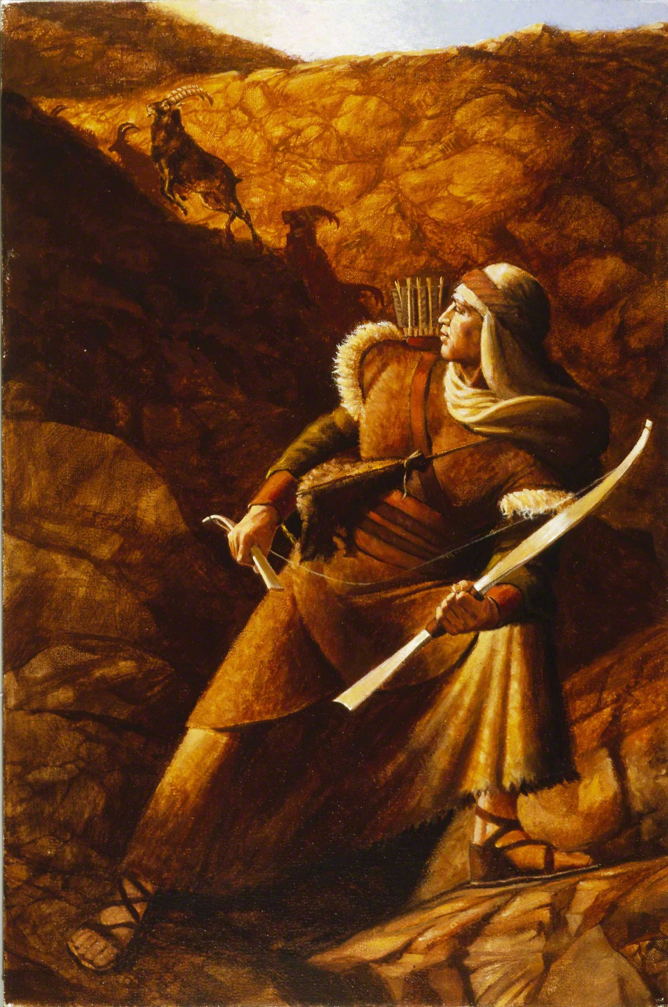
I, Nephi, will show unto you…
1 Nephi 1:20
1 Nephi 1:1

Slide 9
Grief and Forgiveness
Grieving a Loss
Forgiveness
Goal: Pursuing Peace
How?
1) Avoid personalization
2) Rewrite the story you tell yourself and others (Hero or Victim)
3) Develop a gratitude disposition
Stress Response

Slide 10
Life Script
Grievance/Grudge/Victim Story
Repeat it often in your head
Tell your grievance to other people
Relive the emotional trauma when triggered
You are the victim, controlled by another’s unfairness.
Harden your “captive” self image
Make daily decisions based on that image
Gratitude Story
Nephi 1:1
Repeat it often in your head
Tell your gratitude to other people
Remember but do not re-live
You are blessed, despite life’s unfairnesses.
Mold your self image as “one who is loved” and overcomes hard things.
Make daily decisions based on that image.

