Slide 1
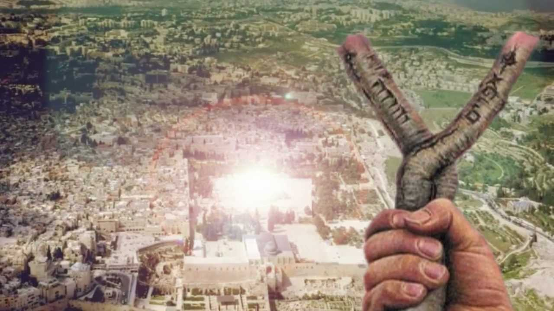
Sticks and Bones

Slide 2
When your mom is talking about embarrassing stuff in her testimony

Slide 3
First day in the Nursery

Slide 4
When you drive by the San Diego Temple for the first time

Slide 5
When you study Ezekiel….

Slide 6
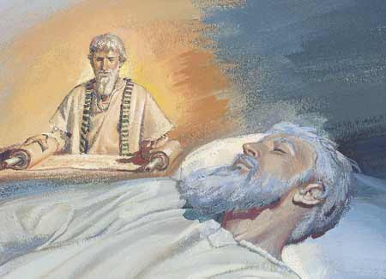
Prophets
Ezekiel 2: 9 ¶And when I looked, behold, an hand was sent unto me; and, lo, a roll of a book was therein;
10 And he spread it before me; and it was written within and without: and there was written therein lamentations, and mourning, and woe.
1 Moreover he said unto me, Son of man, eat that thou findest; eat this roll, and go speak unto the house of Israel.
2 So I opened my mouth, and he caused me to eat that roll.
3 And he said unto me, Son of man, cause thy belly to eat, and fill thy bowels with this roll that I give thee. Then did I eat it; and it was in my mouth as honey for sweetness.
Rev 10: 8 And the voice which I heard from heaven spake unto me again, and said, Go and take the little book which is open in the hand of the angel which standeth upon the sea and upon the earth.
9 And I went unto the angel, and said unto him, Give me the little book. And he said unto me, Take it, and eat it up; and it shall make thy belly bitter, but it shall be in thy mouth sweet as honey.
10 And I took the little book out of the angel’s hand, and ate it up; and it was in my mouth sweet as honey: and as soon as I had eaten it, my belly was bitter.

Slide 7
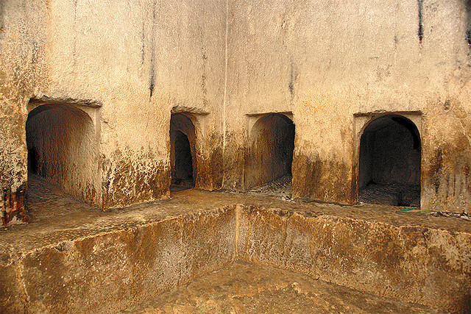
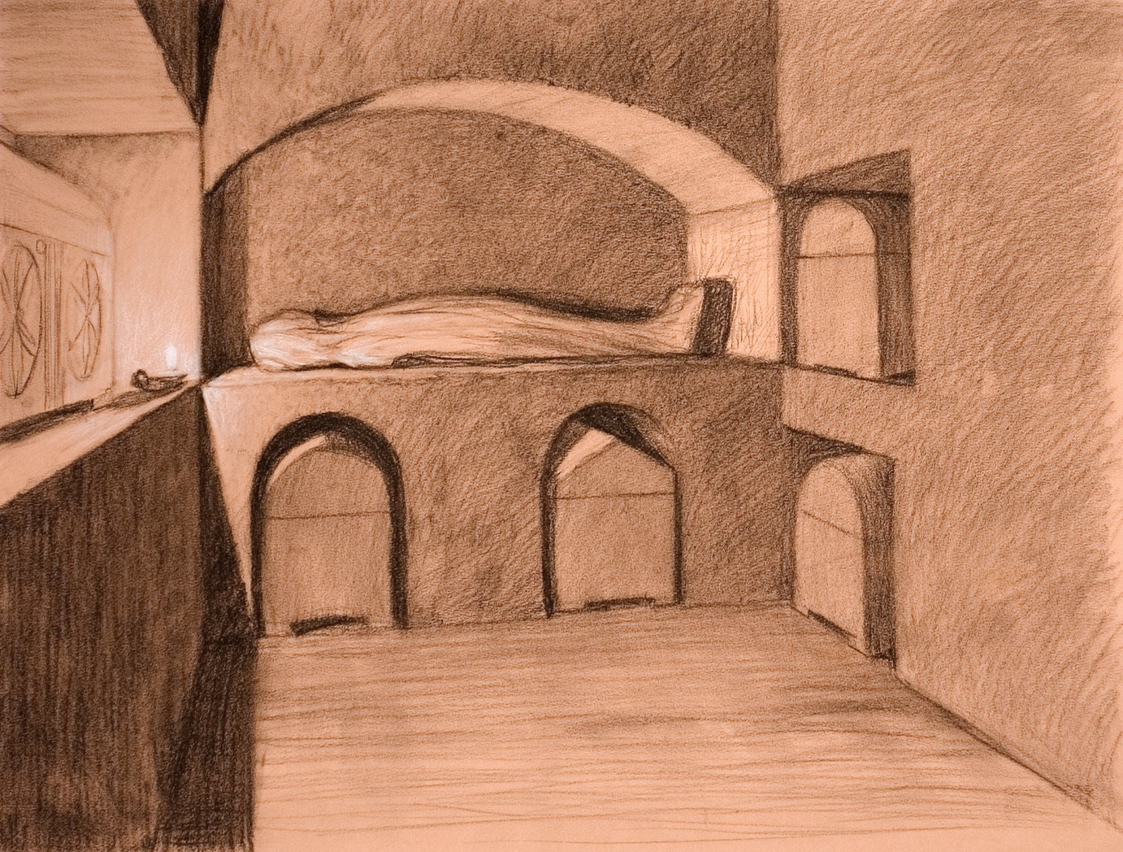
Jewish Burials

Slide 8
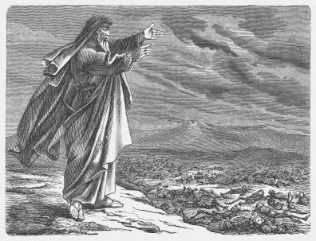
Sticks and Bones
Ezekiel 37

