Slide 1
Snatched and Reborn

Slide 2
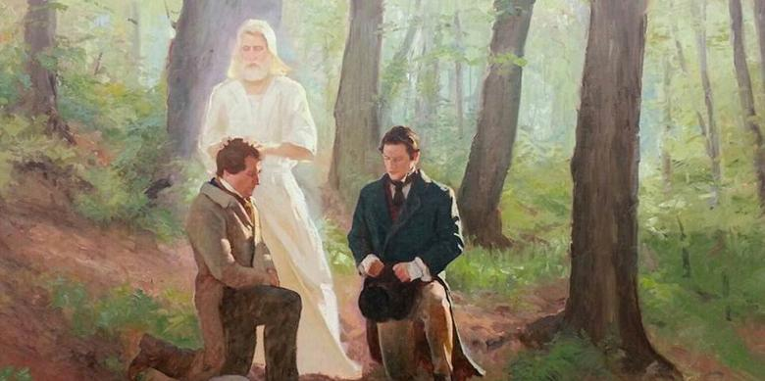
President Wilford Woodruff
The Lord never did nor ever will send an angel to anyone merely to gratify the desire of the individual to see an angel.
If the Lord sends an angel to anyone, He sends him to perform a work that cannot be performed only by the administration of an angel”
St. Hugh Nibley
Brigham Young said, 'Pray that you never see an angel.' He was talking historically. Almost everybody who saw an angel left the Church. They came back, but they had these terrible problems. It gave them inflated egos, etc. They thought they were somebody special.
They were, but they couldn't take it. It would be very dangerous if we were exposed to the other world to any degree. Only people that are very humble can do that.
Not us, we can't do that. We are not that humble."
(The Teachings of the Book of Mormon, Lecture 41, p.193)

Slide 3
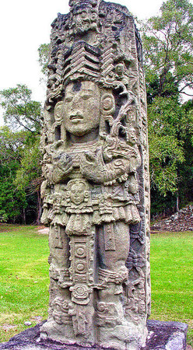
Alma
Mosiah 27:8

Slide 4
My Experiences in the past
Today’s
Choices
My Belief in what is going to happen
Remember, Remember..
Faith

Slide 5
Pres Eyring
Remember, Remember

Slide 6
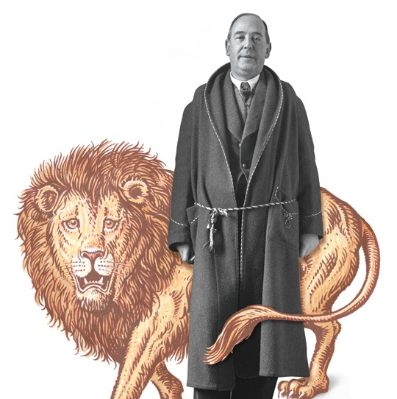
Elder CS Lewis
"You must picture me alone in that room at Magdalen, night after night, feeling, whenever my mind lifted even for a second from my work, the steady, unrelenting approach of Him whom I so earnestly desired not to meet.
That which I greatly feared had at last come upon me.
In the Trinity Term of 1929 I gave in, and admitted that God was God, and knelt and prayed: perhaps, that night, the most dejected and reluctant convert in all England"
(Surprised By Joy, ch. 14, p. 266).

