Slide 1
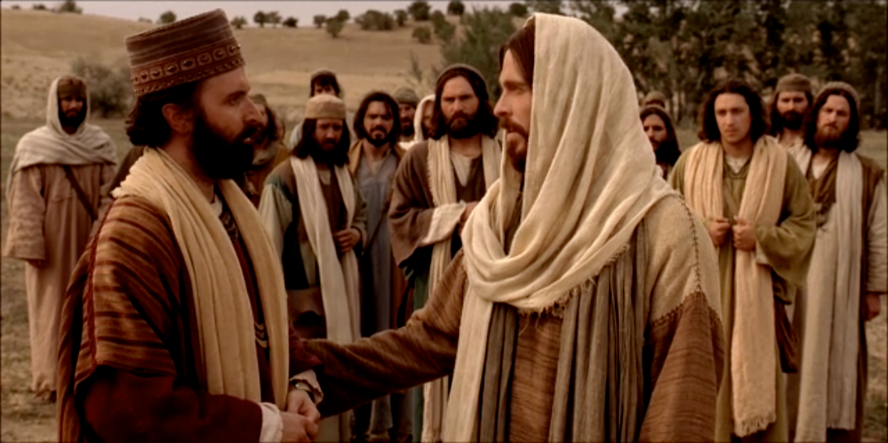
Riches and Salvation….
Mark 10

Slide 3
How are we ‘saved’?
"For," said Nephi, "we labor diligently to write, to persuade our children, and also our brethren, to believe in Christ, and to be reconciled to God; for we know that it is by grace that we are saved, after all we can do." (2 Nephi 25:23. Also Alma 24:11)
Stephen Robinson: "LDS commentators are agreed that the word after in this passage is used as a preposition of separation rather than of time.
The sense is that apart from all we can do, it is ultimately by the grace of Christ that we are saved. This meaning is apparent from the fact that none of us actually does all he can do."

Slide 4
Pres. Joseph F. Smith
…the education of our desires is one of far-reaching importance to our happiness in life.
God’s ways of educating our desires are, of course, always the most perfect…
And what is God’s way?
Everywhere in nature we are taught the lessons of patience and waiting. We want things a long time before we get them…
In nature we have our seed-time and harvest; Nature resists us and keeps admonishing us to wait; indeed, we are compelled to wait…
Gospel Doctrine, p. 297

Slide 5
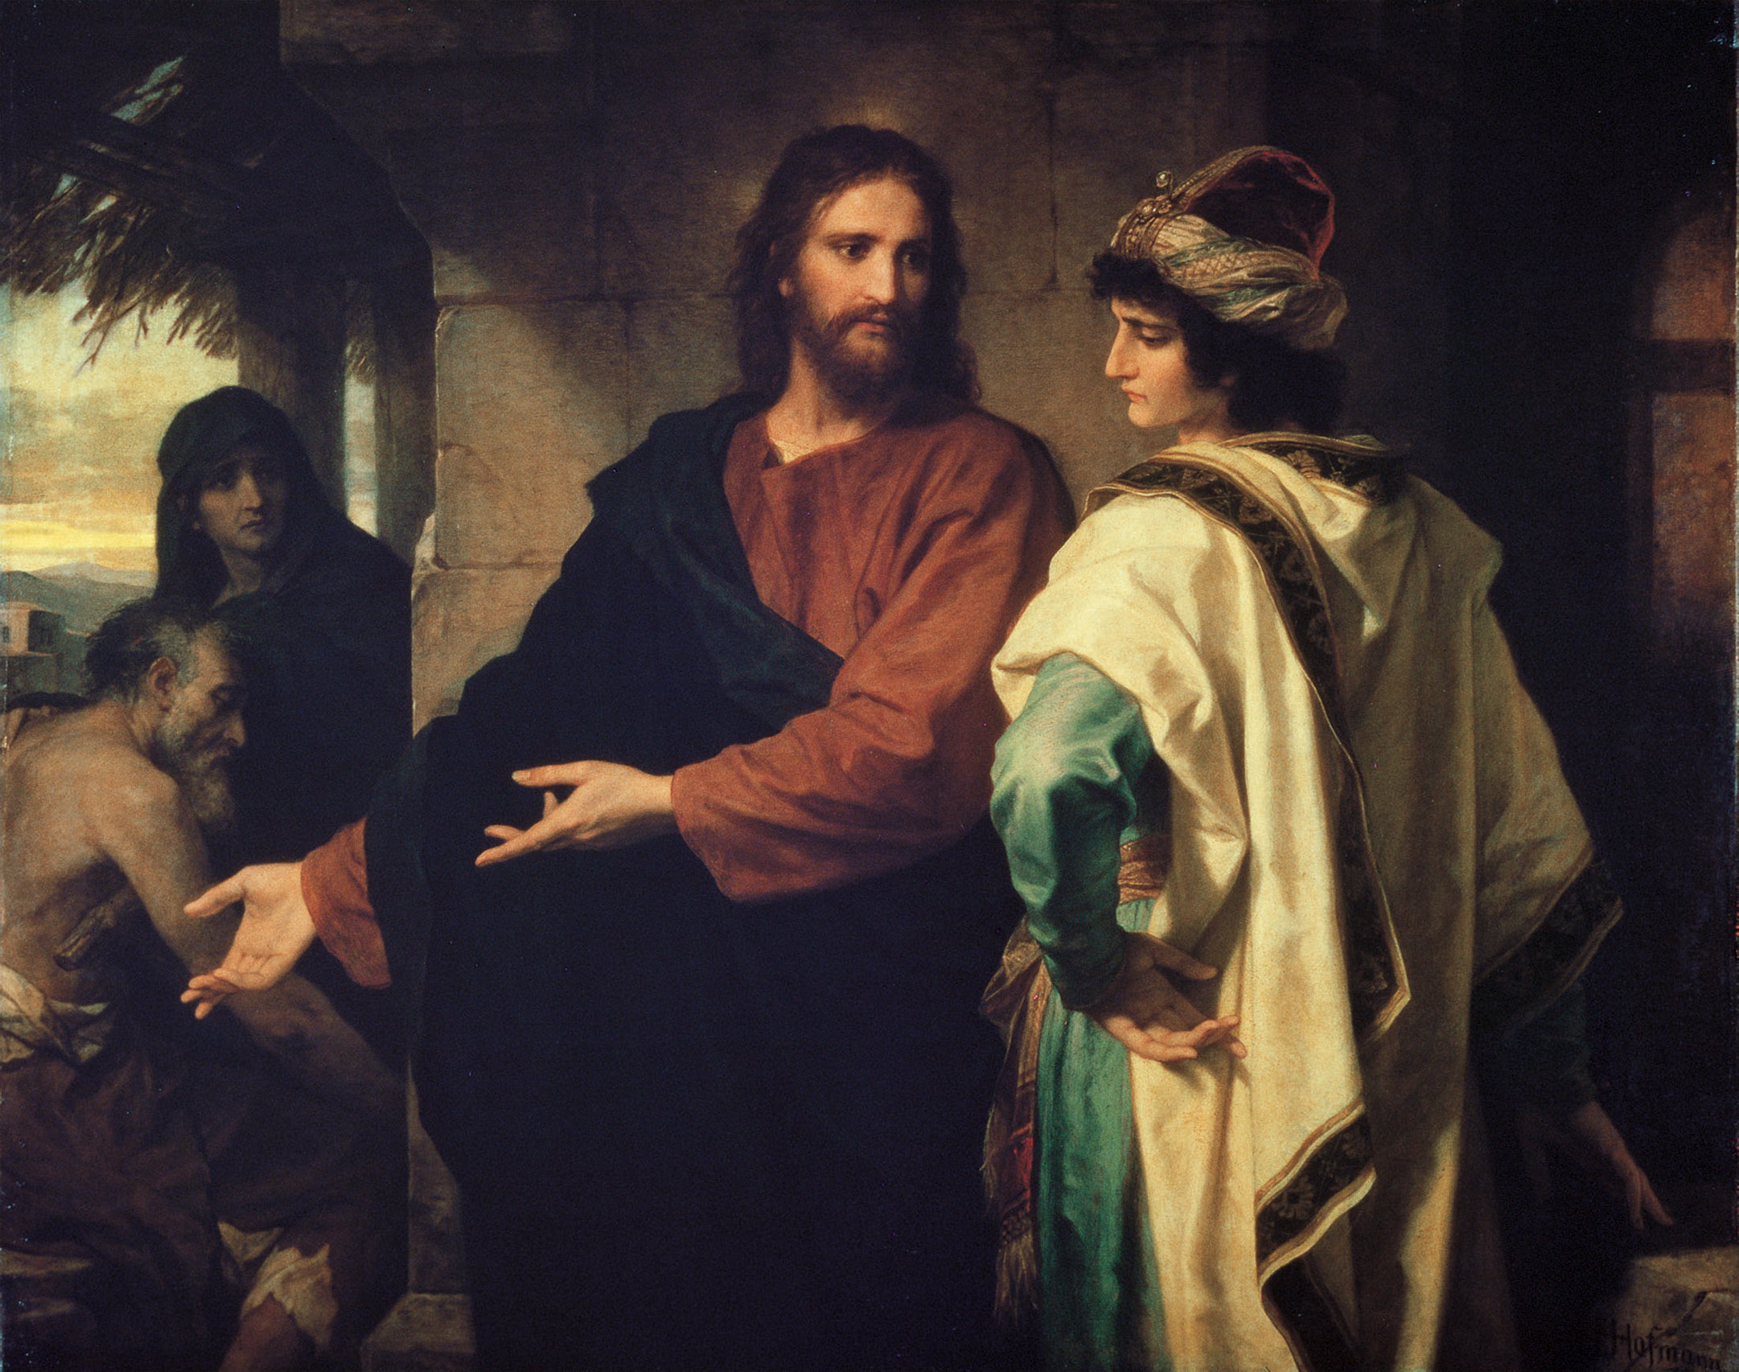
Rich young ruler
Mark 10:17

Slide 6
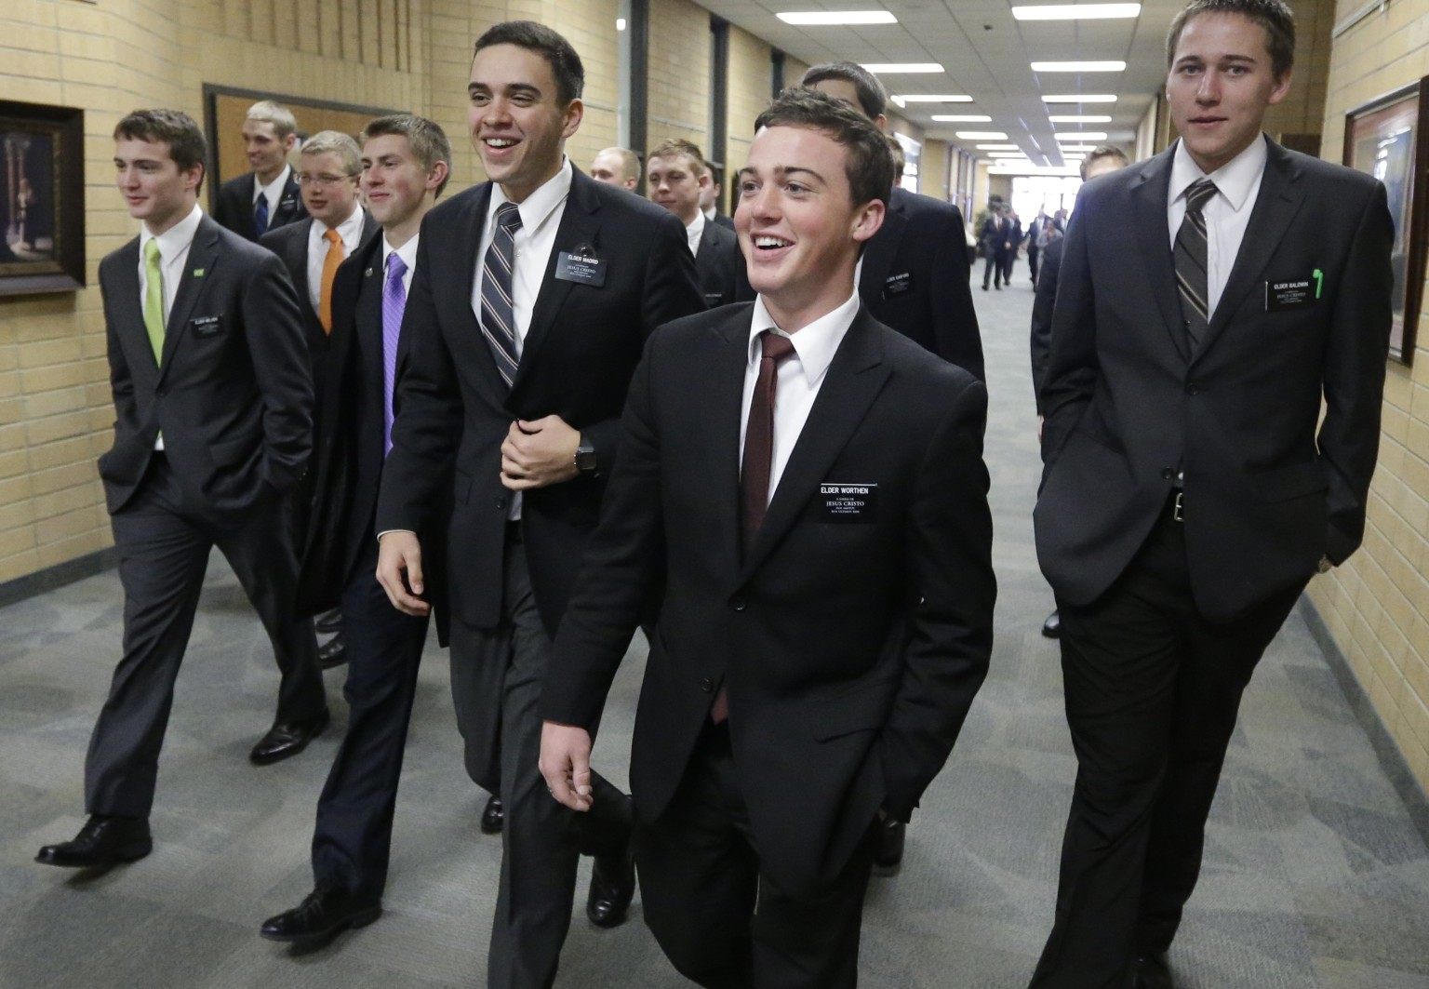
Pride of the Righteous
Mark 10:28-31

Slide 7
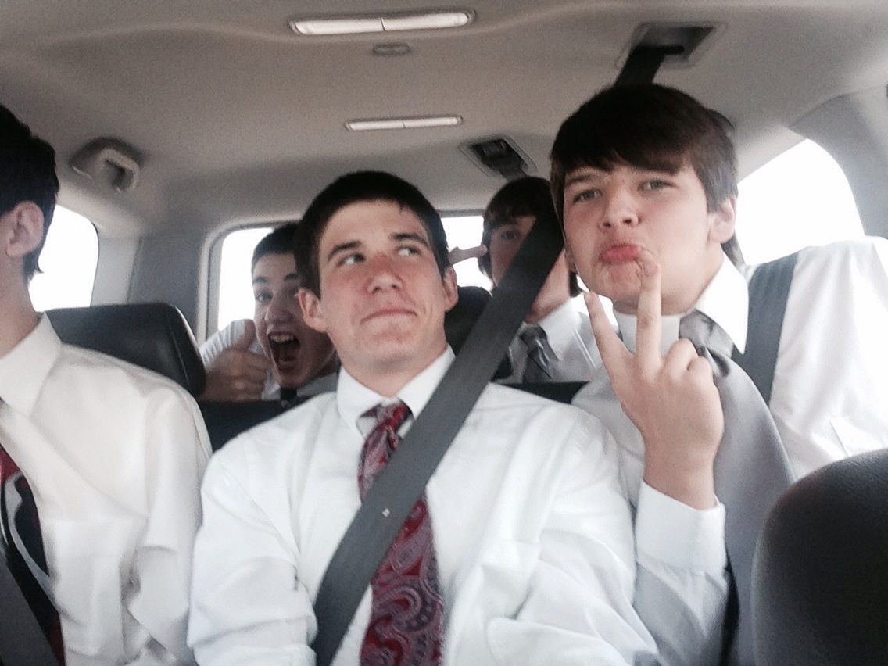
Who is the more better mormon?
Mark 10:35

Slide 8
Joseph Smith
There has been a great difficulty in getting anything into the heads of this generation. It has been like splitting hemlock knots with a corn-dodger for a wedge, and a pumpkin for a beetle. Even the Saints are slow to understand.
I have tried for a number of years to get the minds of the Saints prepared to receive the things of God; but we frequently see some of them, after suffering all they have for the work of God, will fly to pieces like glass as soon as anything comes that is contrary to their traditions.
(Teachings of the Prophet Joseph Smith, selected and arranged by Joseph Fielding Smith [Salt Lake City: Deseret Book Co., 1976], 331.)

Slide 9
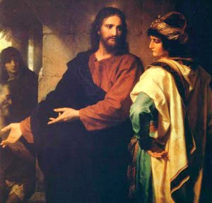
Change of heart
Mark 12:28

