Slide 1
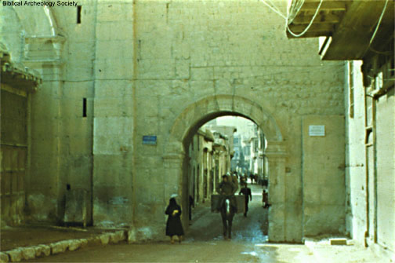
Phillip and Paul

Slide 2
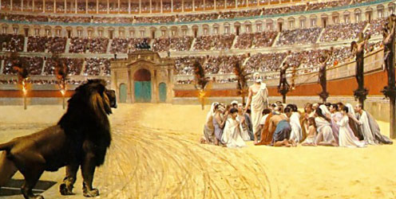
Persecution and adversity
Acts 8:1

Slide 3
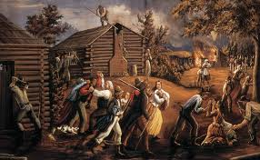
Early Saints persecution

Slide 4
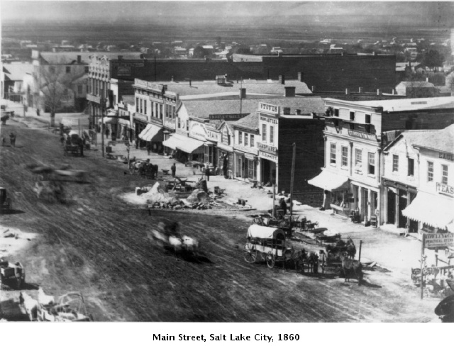
Brigham Young during the Civil War
Had we not been persecuted, we would now be in the midst of the wars and bloodshed that are desolating the nation, instead of where we are, comfortable located in our peaceful dwellings in these silent, far off mountains and valleys.
Instead of seeing my brethren comfortably seated around me to-day, many of them would be found in the front ranks on the battle field.
I realize the blessings of God in our present safety. We are greatly blessed, greatly favored and greatly exalted, while our enemies, who sought to destroy us, are being humbled.

Slide 5
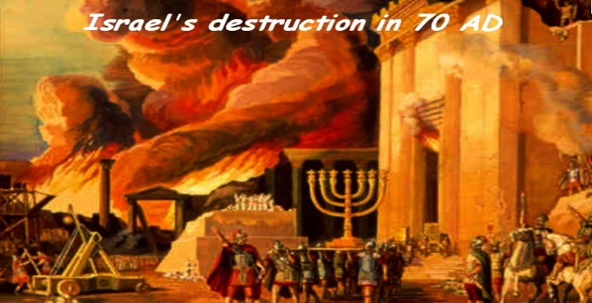

Slide 6
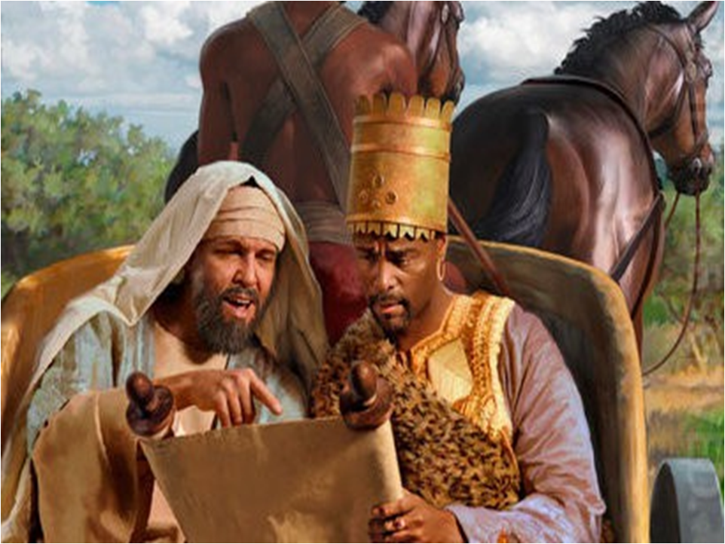
Phillip
Acts 8:26

Slide 7
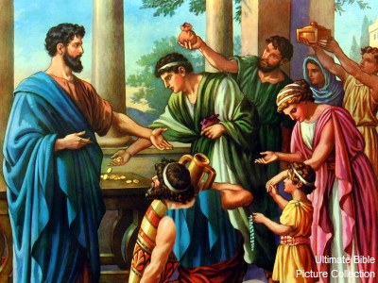
Teaching Elder Holland
"President Spencer W. Kimball once pled: 'Stake presidents, bishops, and branch presidents, please take a particular interest in improving the quality of teaching in the Church. ... I fear,' he said, 'that all too often many of our members come to church, sit through a class or a meeting, and ... then return home having been largely [uninspired]. It is especially unfortunate when this happens at a time ... of stress, temptation, or crisis [in their life].
We all need to be touched and nurtured by the Spirit,' he said, 'and effective teaching is one of the most important ways this can happen. We often do vigorous work,' President Kimball concluded, 'to get members to come to Church but then do not adequately watch over what they receive when they do come.'
On this subject President Hinckley himself has said, 'Effective teaching is the very essence of leadership in the Church.' May I repeat that. 'Effective teaching is the very essence of leadership in the Church. Eternal life,' President Hinckley continued, 'will come only as men and women are taught with such effectiveness that they change and discipline their lives. They cannot be coerced into righteousness or into heaven. They must be led, and that means teaching.'"
("A Teacher Come from God," Ensign, May 1998, 25)

Slide 8
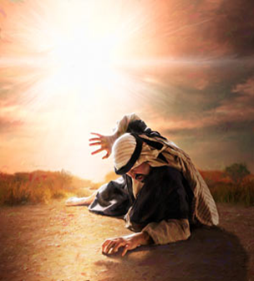
Saul
Acts 9

Slide 9
Two roads
Road to Emmaus
Grieving Disciples
Eyes were 'holden' (shielded)
Christ appeared gently
Easily Taught
Hearts burned before they really saw Him
Returned and rejoiced with other disciples
Road to Damascas
Saul was angry
Eyes were blinded by rage
Christ appeared in power
Saul had to be rebuked
Needed the '3 Day' transformation
Had to be lead to the 'Straight' road

