Slide 1
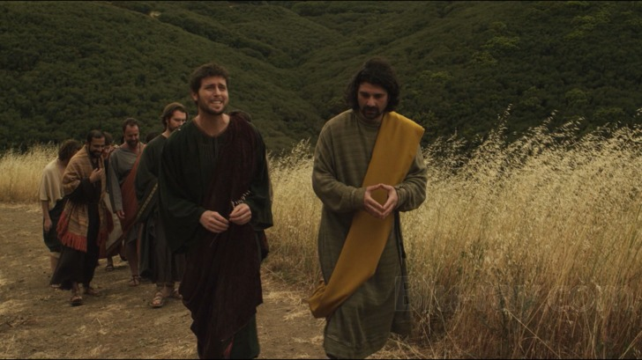
Peter

Slide 2
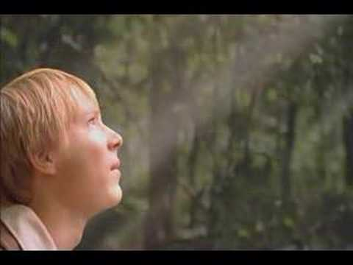
Charles L. Walker Journal
2nd Feb Thurs [1893] Cold and chilly. Attended Fast Meeting.... Br John Alger said while speaking of the Prophet Joseph, that when he, John, was a small boy he heard the Prophet Joseph relate his vision of seeing The Father and the Son,
That God touched his eyes with his finger and said “Joseph this is my beloved Son hear him.” As soon as the Lord had touched his eyes with his finger he immediately saw the Savior. After meeting, a few of us questioned him about the matter and he told us at the bottom of the meeting house steps that he was in the House of Father Smith in Kirtland when Joseph made this declaration,
and that Joseph while speaking of it put his finger to his right eye, suiting the action with the words so as to illustrate and at the same time impress the occurence on the minds of those unto whom He was speaking. We enjoyed the conversation very much, as it was something that we had never seen in church history or heard of before.

Slide 3
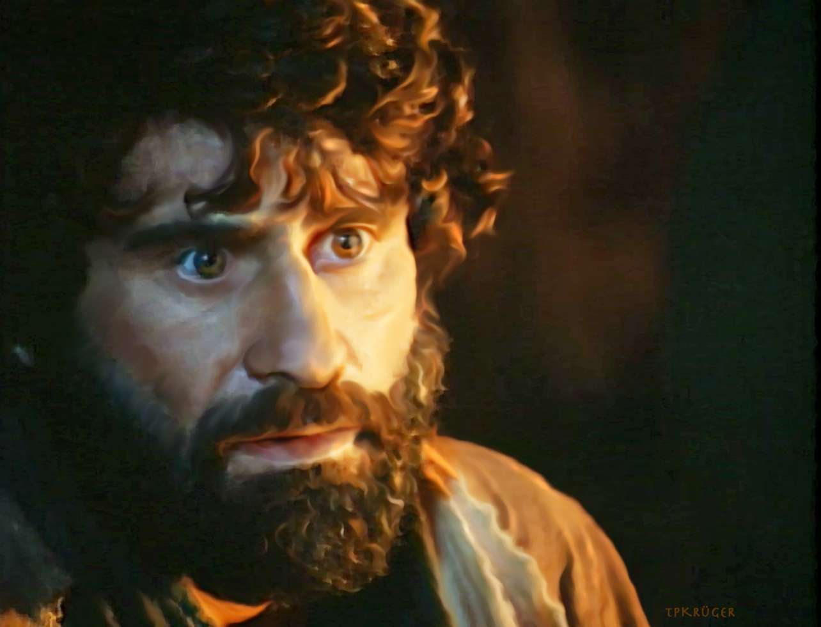
Joseph Smith:
Peter penned the most sublime language of any of the apostles.
(TPJS, 301.)

Slide 4
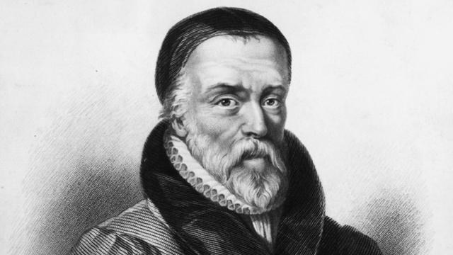
William Tyndale
Still Small Voice
knock and it shall be opened unto you
In the twinkling of an eye
seek and you shall find
eat, drink and be merry
ask and it shall be given you
judge not that you not be judged
Fight the good fight
let there be light
my brother's keeper
the salt of the earth
filthy lucre
it came to pass
gave up the ghost
the signs of the times
the spirit is willing, but the flesh is weak

Slide 5
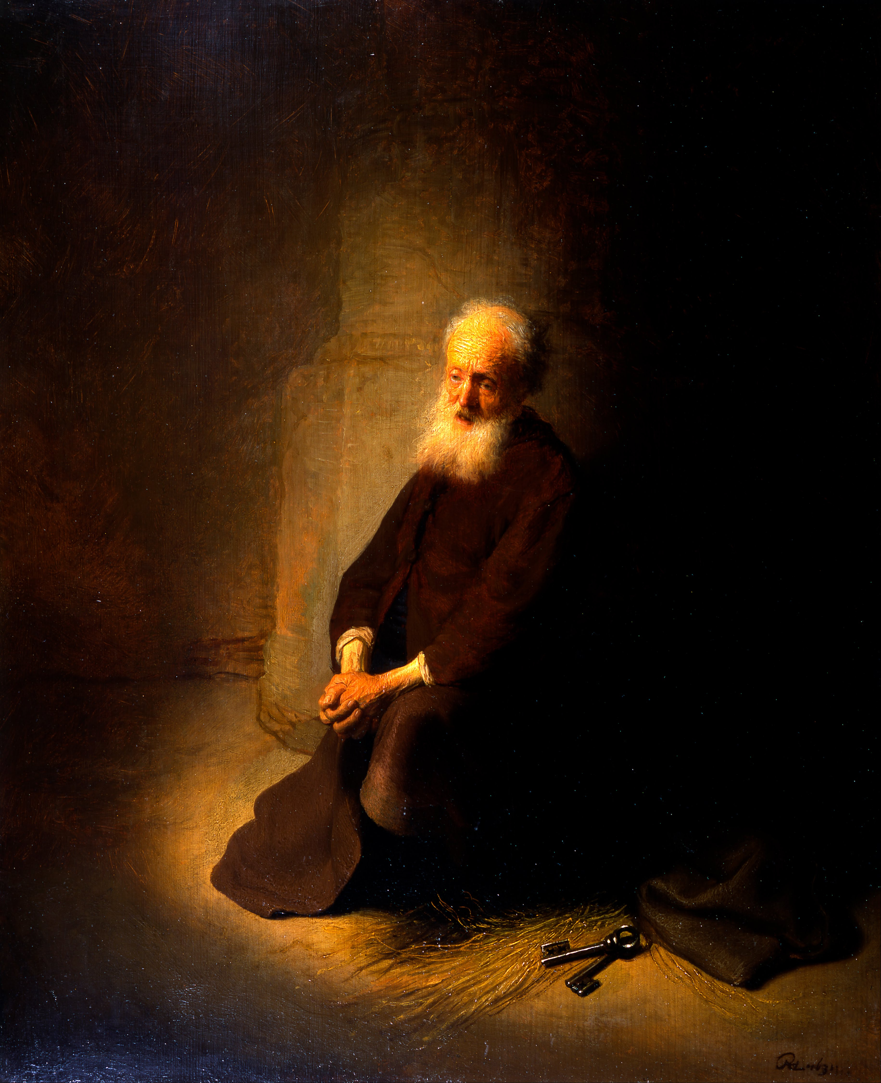
Peter
Returned unto the Shepherd and Bishop of your souls
The hidden man of the heart
Be not afraid of every shadow
Charity preventeth a multitude of sins (JST)
…your adversary the devil, as a roaring lion, walketh about, seeking whom he may devour
Greet one another with the kiss of charity
A lively hope by the resurrection
Your faith once tried being much more precious than gold…
Gird up the loins of your mind
Your old lusts of ignorance
All flesh is as grass, and all the glory of man as the flower of grass
Ye are a chosen generation, a royal priesthood
Using your liberty for a cloke of maliciousness

Slide 6
Faith and Adversity
1 Peter 1

Slide 7
A thought…
…that your faith, once tried, being much more precious that gold…
Notice it is not God’s faith in us that is being tried and refined. It is OUR faith in ourselves—our trust in our own willingness to follow him regardless of the sacrifice.
When we truly understand that then shall our confidence wax strong, having been refined in the furnace of our afflictions. And there is nothing more precious…

Slide 8
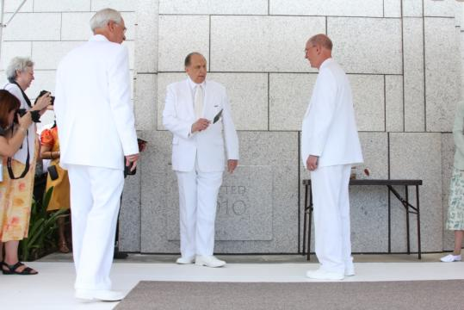
Lively Stones
1 Peter 2:4

Slide 9
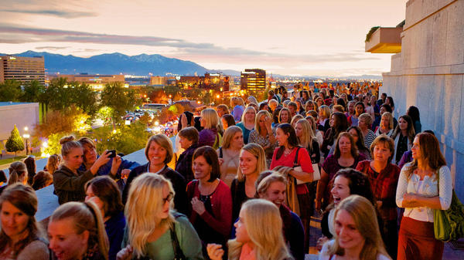
Wives
1 Peter 3

Slide 10
Charity
1 Peter 4:8

