Slide 1
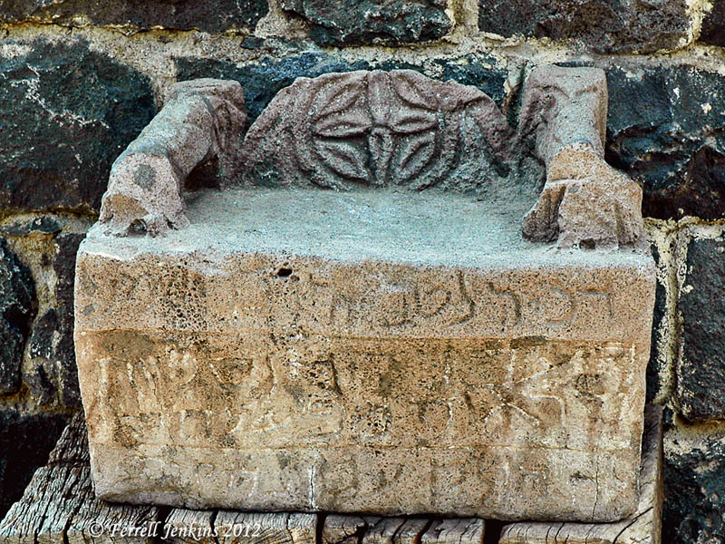
Noah and Abinadi
Mosiah 11

Slide 2
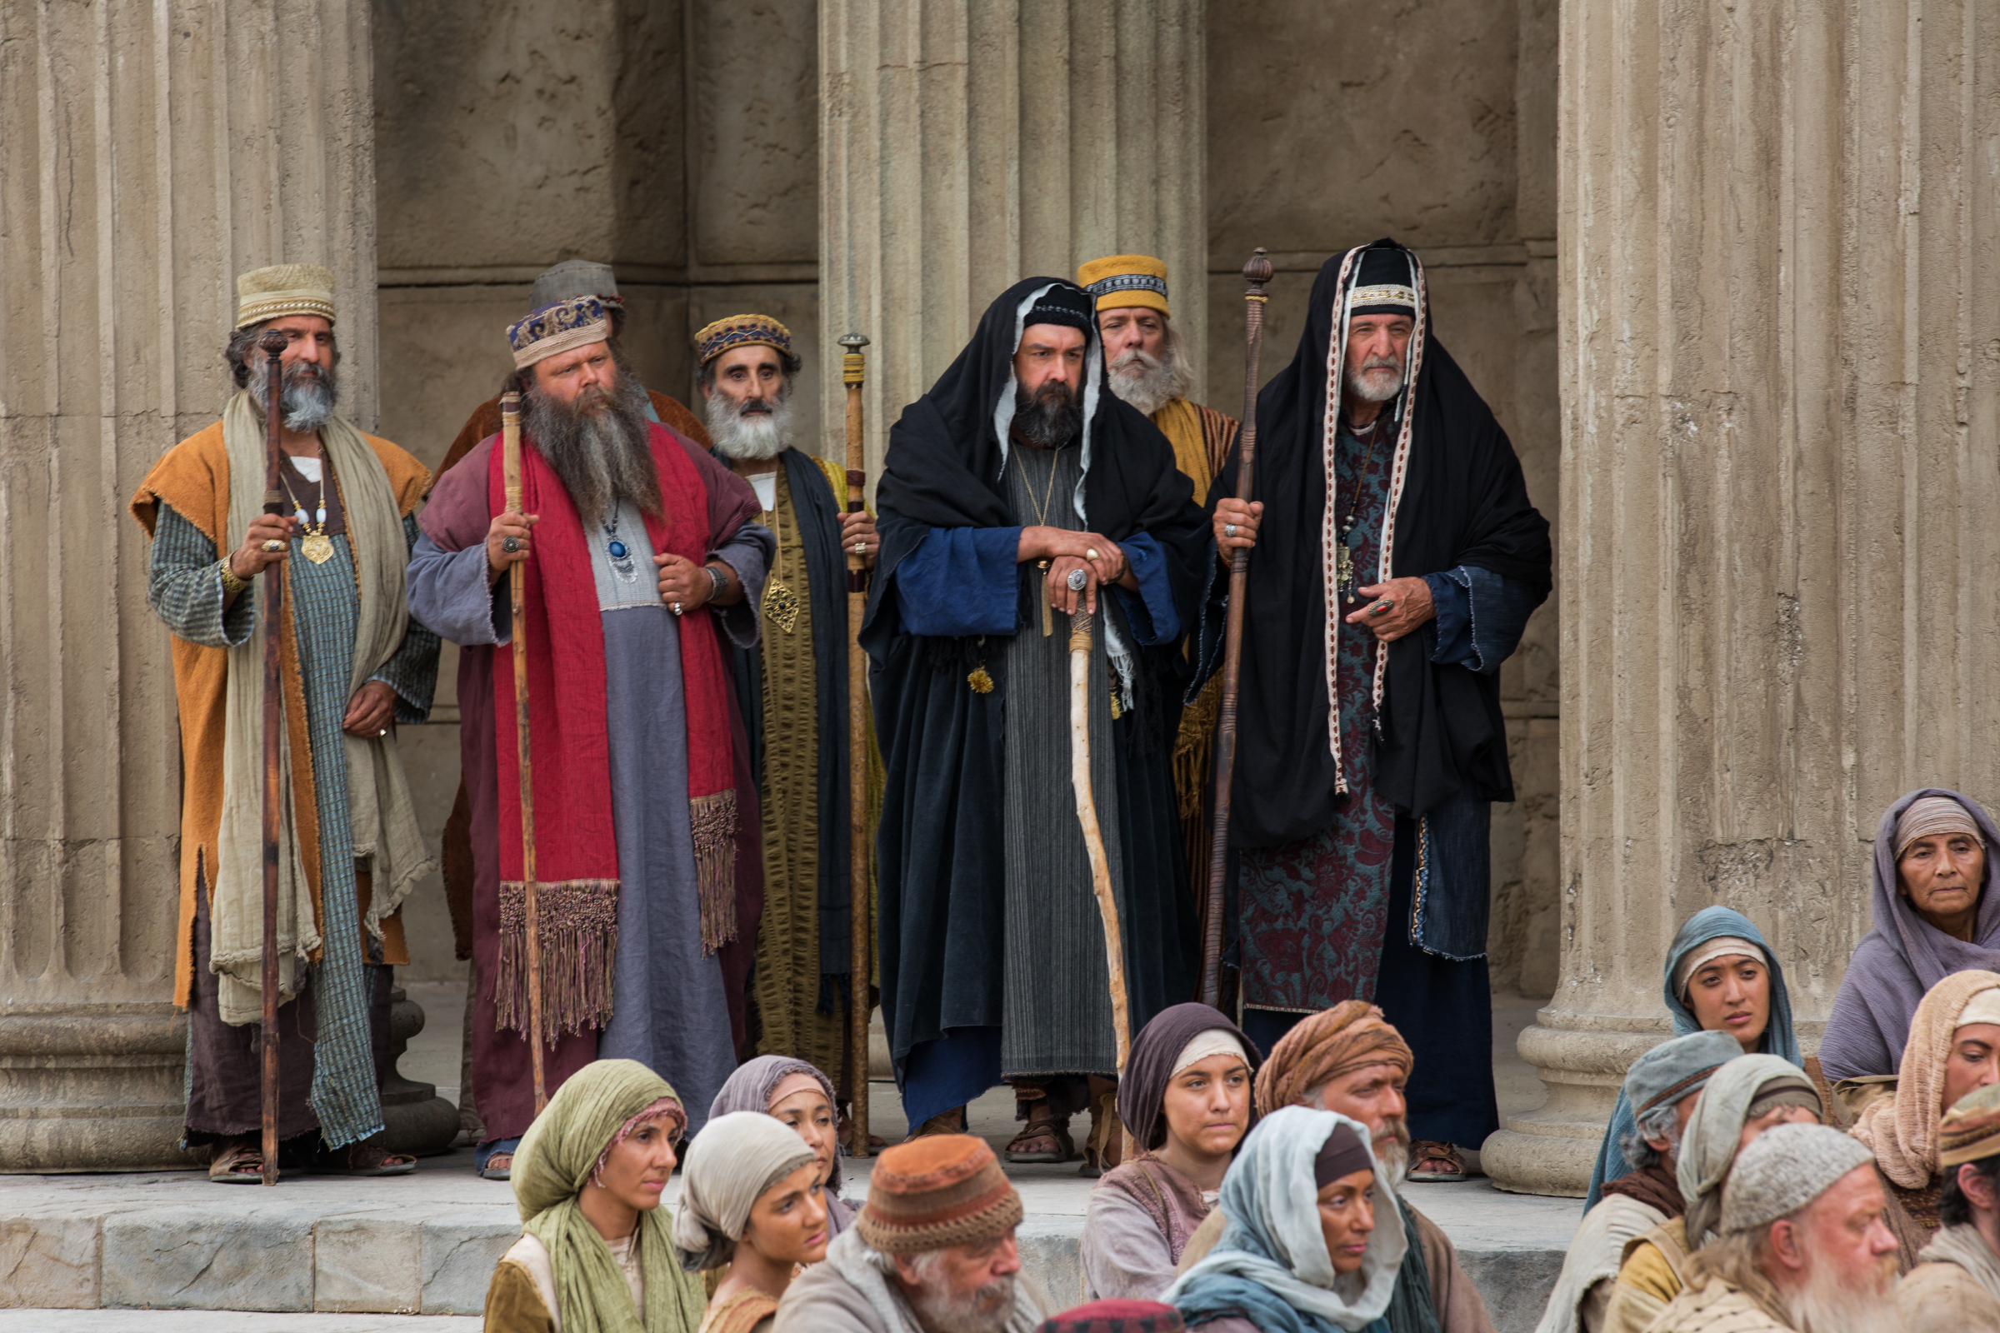
Attacks by “Observant Jews”
Pharasees:
Rural
Poorer
Legalistic Interpretations and traditions
Building “walls around the law”
Sadducees:
Wealthy
Kingly Class
Used Taxes to Gain Wealth
Believed more in the oral traditions
The Savior’s Ministry

Slide 3
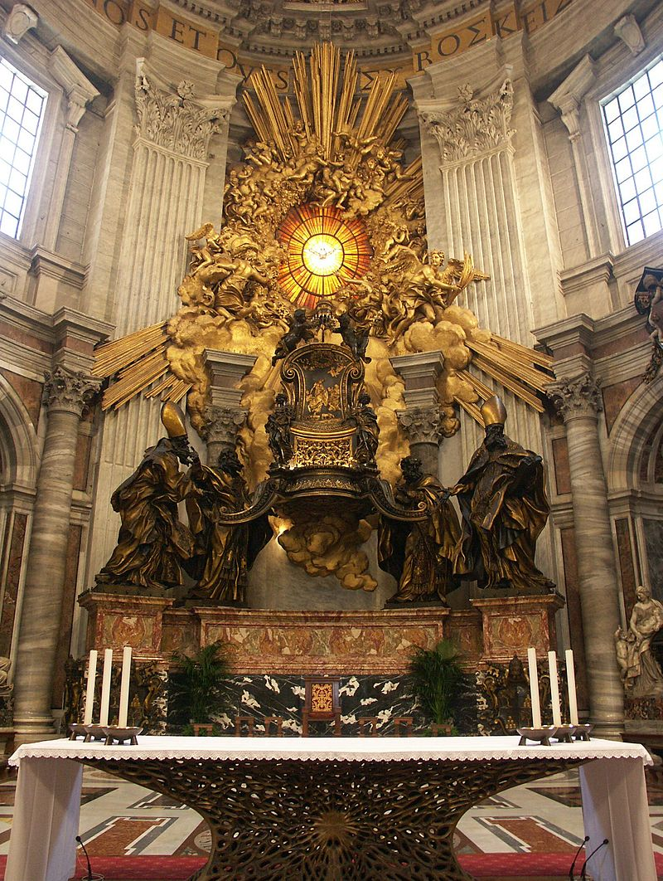
Seat of Moses
Mosiah 11:11

Slide 4
King Noah
Mosiah 11:7 Yea, and they also became idolatrous, because they were deceived by the vain and flattering words of the king and priests; for they did speak flattering things unto them.
Question:
What is the difference between “praise” and flattery?

Slide 5
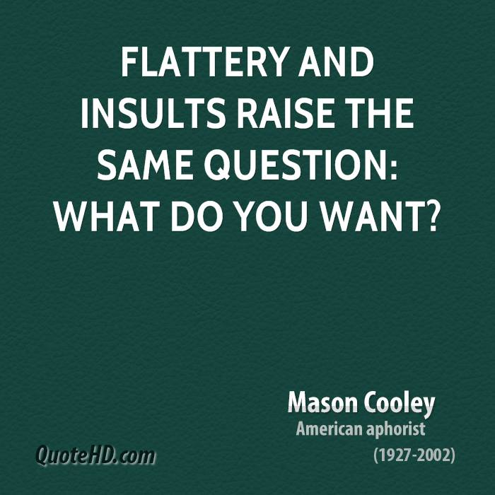
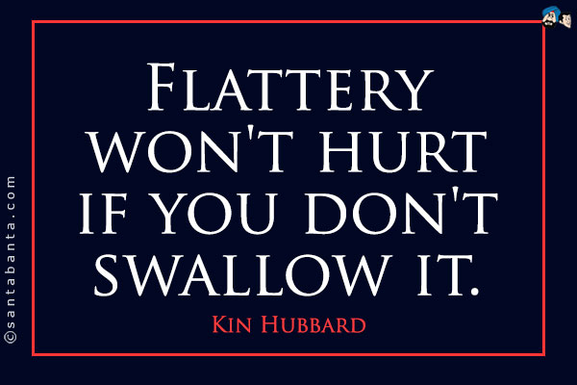
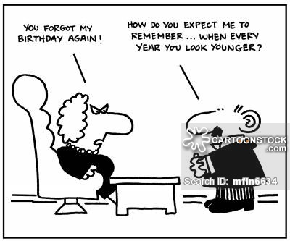
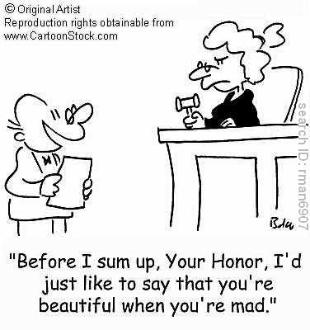
A Few Quotes
Flatterers actually dislike those they flatter
and think themselves better than the people they profess to admire

Slide 6
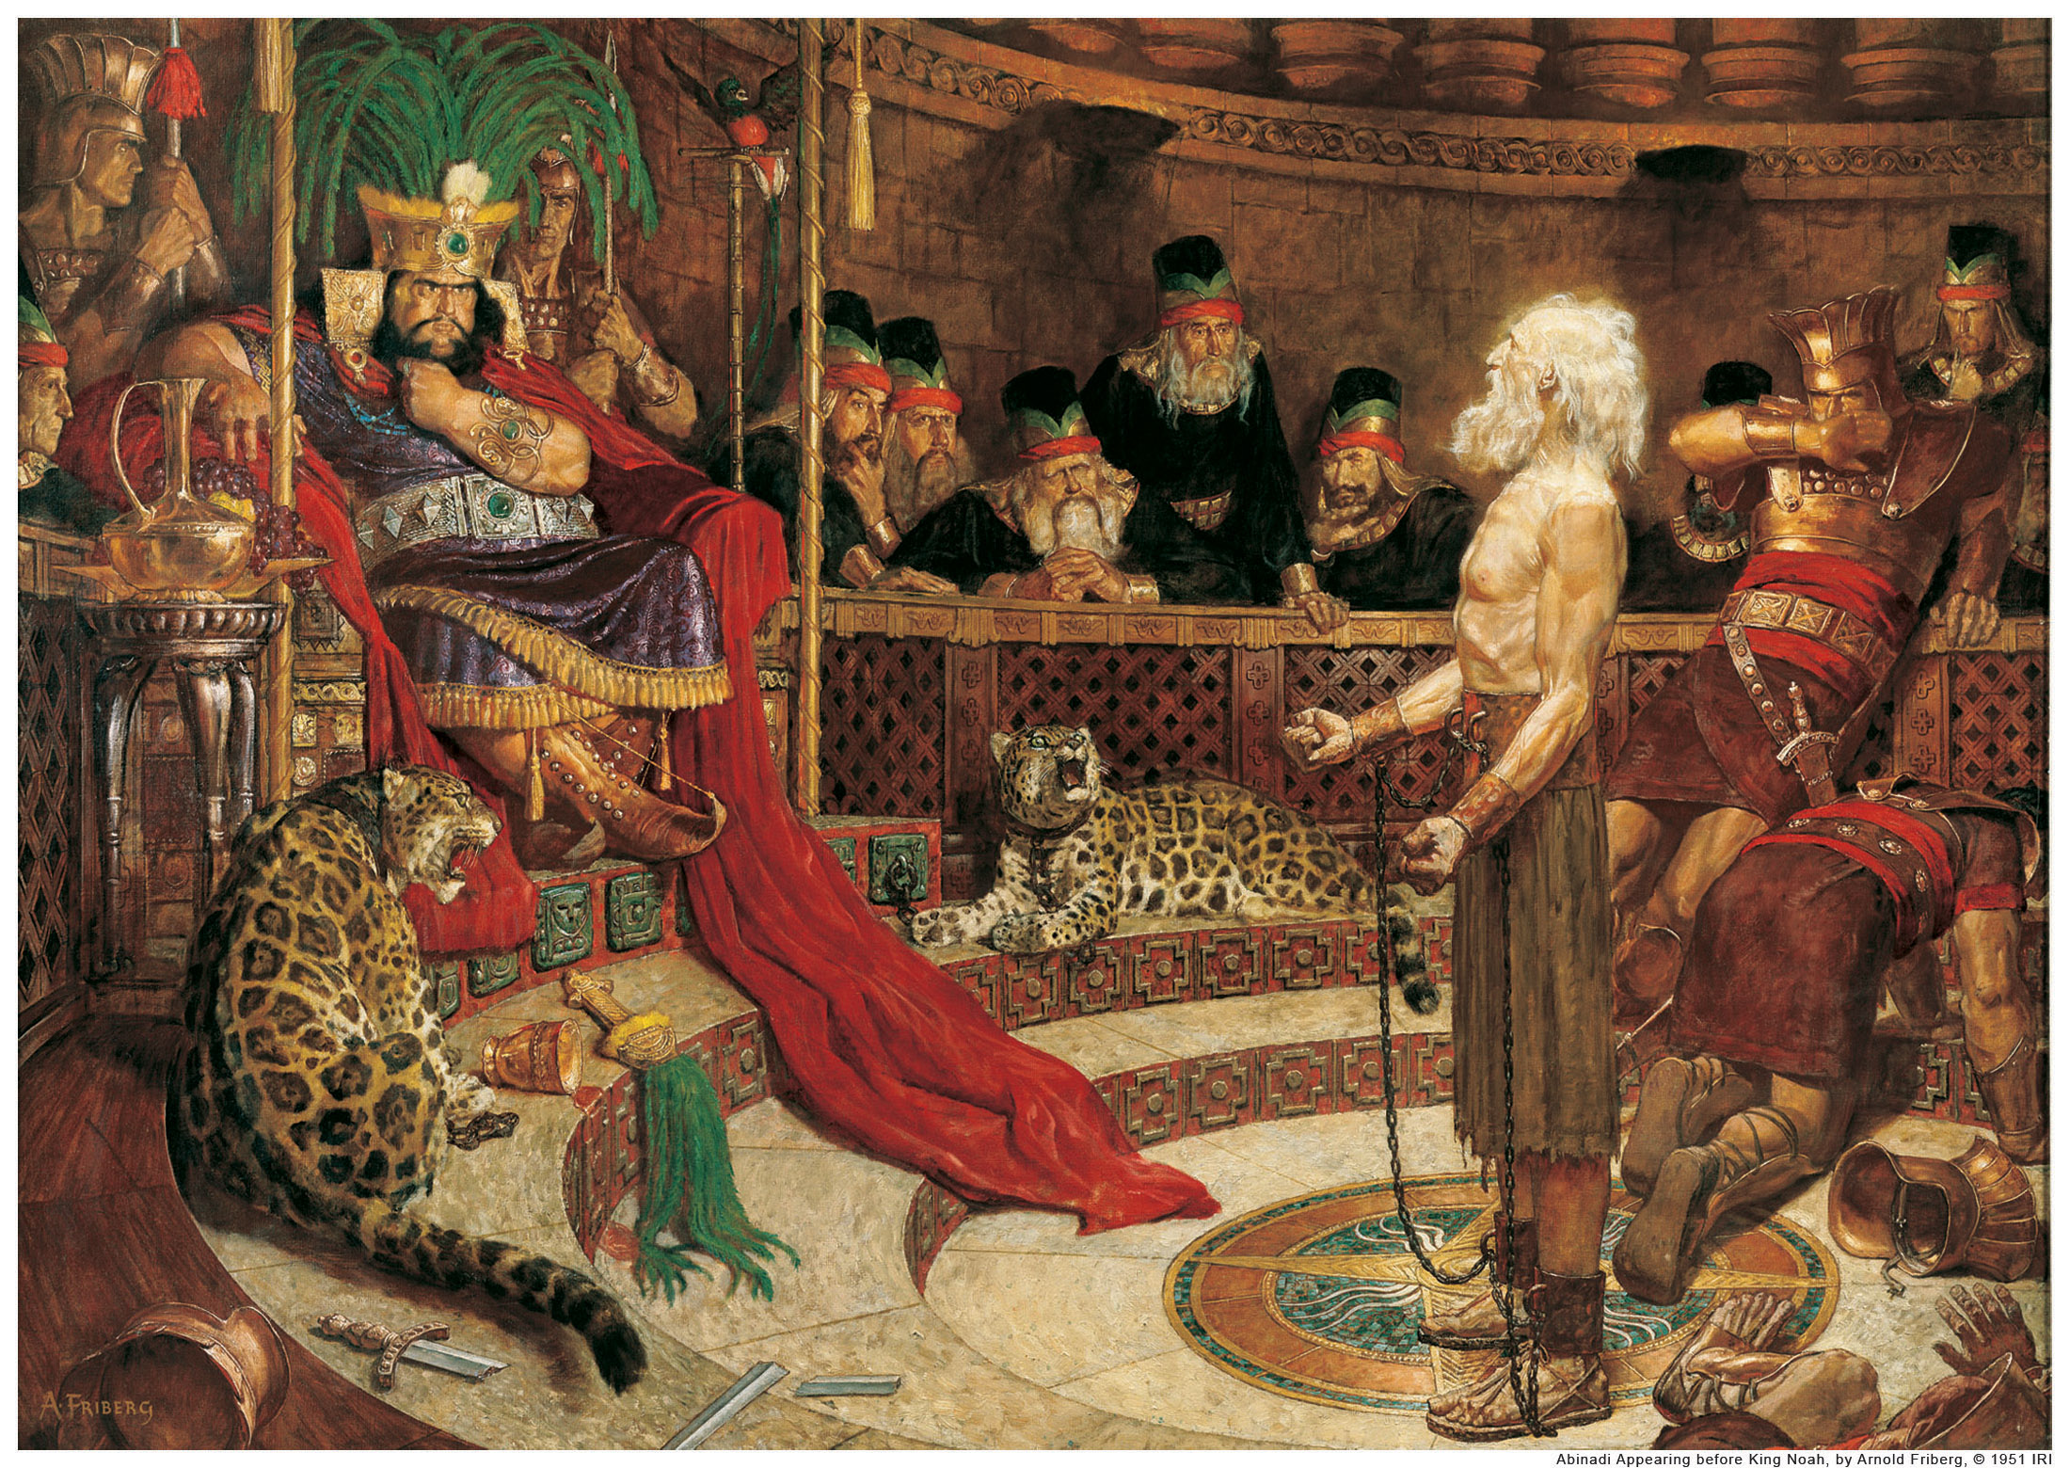
The REAL problem with Flattery
Mosiah 11:20 And it came to pass that there was a man among them whose name was Abinadi; and he went forth among them, and began to prophesy, saying:
Behold, thus saith the Lord, and thus hath he commanded me, saying, Go forth, and say unto this people, thus saith the Lord—
Wo be unto this people, for I have seen their abominations, and their wickedness, and their whoredoms; and except they repent I will visit them in mine anger.

Slide 7
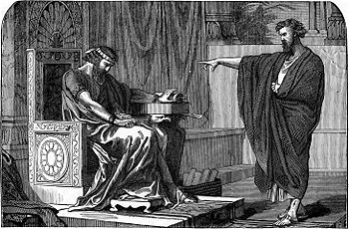
The Response of the Flattered…
Mosiah 12
13 And now, O king, what great evil hast thou done, or what great sins have thy people committed, that we should be condemned of God or judged of this man?
14 And now, O king, behold, we are guiltless, and thou, O king, hast not sinned; therefore, this man has lied concerning you, and he has prophesied in vain.
15 And behold, we are strong, we shall not come into bondage, or be taken captive by our enemies; yea, and thou hast prospered in the land, and thou shalt also prosper.
Jeremiah 16
10 ¶And it shall come to pass, when thou shalt shew this people all these words, and they shall say unto thee,
Wherefore hath the Lord pronounced all this great evil against us? or what is our iniquity? or what is our sin that we have committed against the Lord our God?

Slide 8
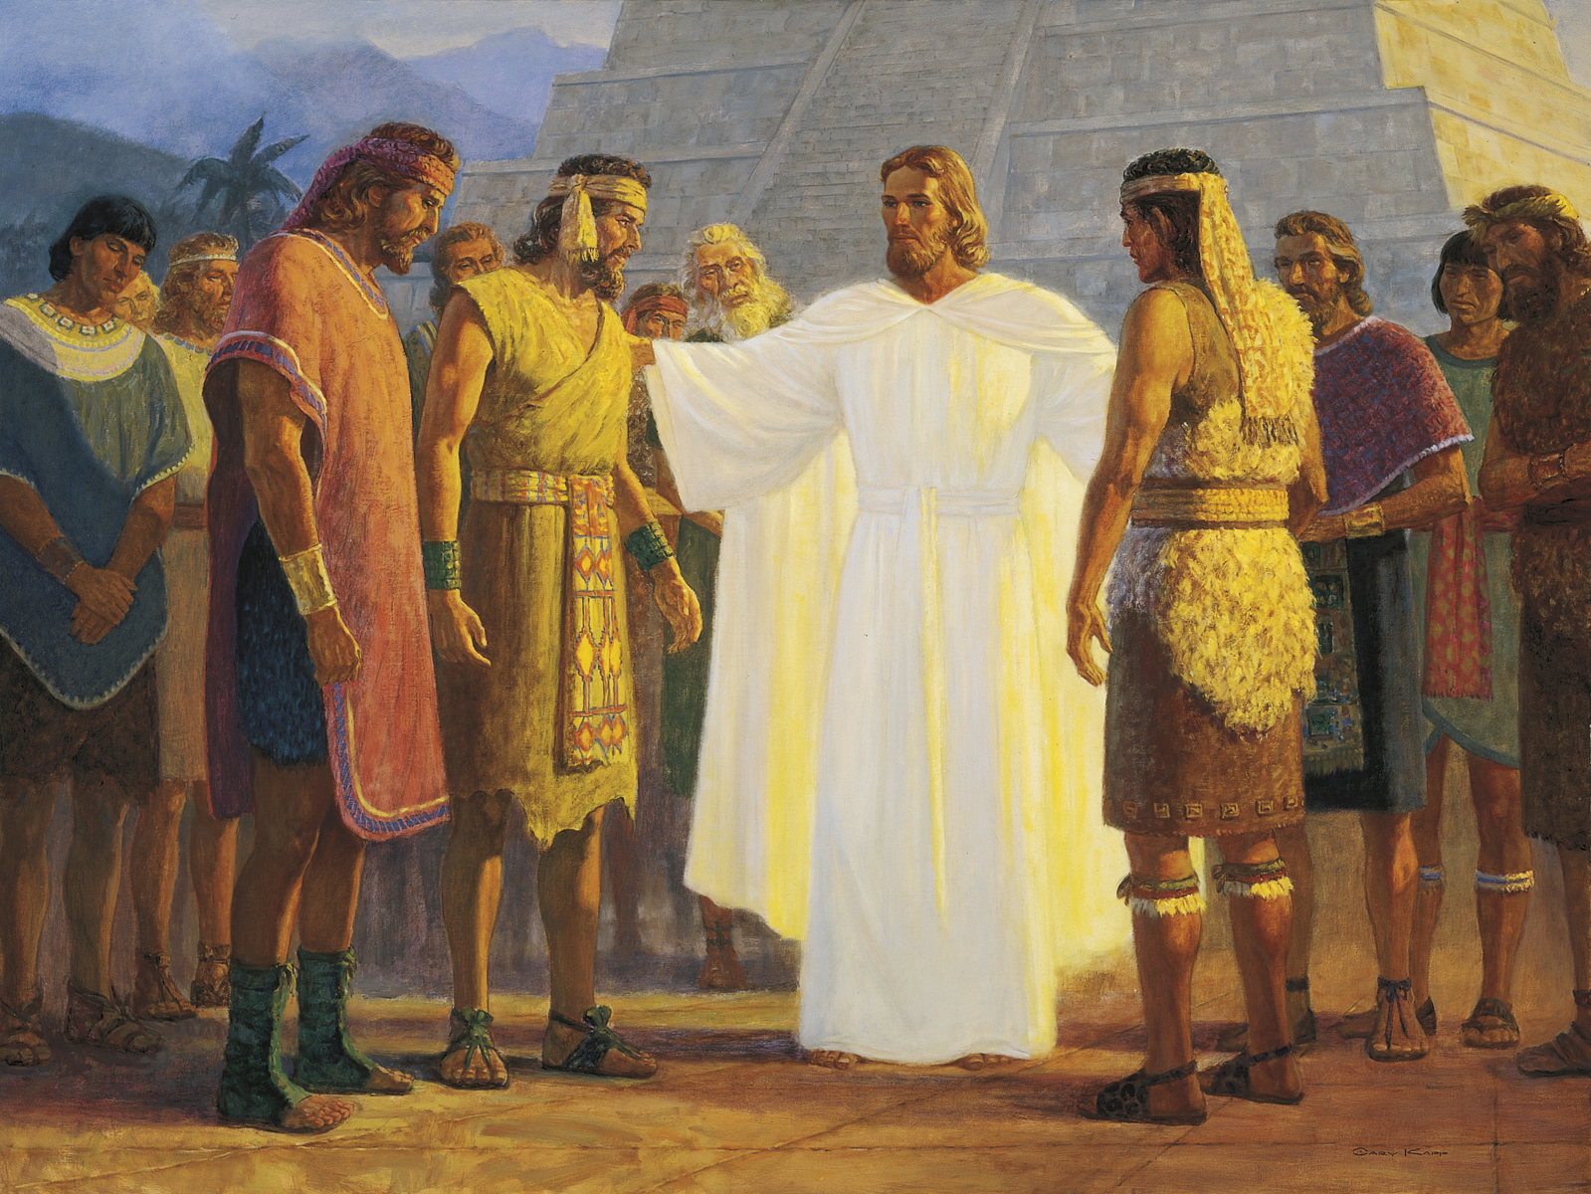
How Salvation Cometh…
Mosiah 13:27
Mosiah 15:10

