Slide 1
Nephi’s Final Speech

Slide 2
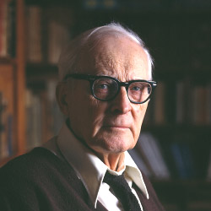
St. Hugh Nibley
“The Book of Mormon was written by a bunch of worried men.”
Why would he say that?

Slide 3
Different Styles of Israelite Prophesy
Old World Hebrew
Visions, symbols (Law of Moses, Jacob 5)
Open to interpretation
Directed to Israel
Altered by Josiah’s scribes
Nephi’s New World
Directed towards Israel and Gentiles
Plain and bold
No misunderstanding
Angers the wicked

Slide 4
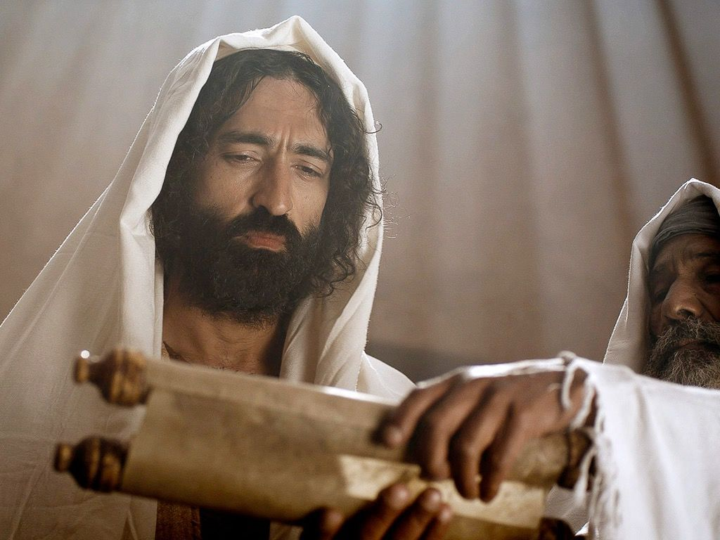
Final Discourse
2 Nephi 25

Slide 5
Grace
2 Nephi 25:23-26

Slide 6
Grace and Gap Theology
A young BYU student once approached Wilcox, struggling to grasp the purpose of grace. She was concerned that her best efforts to keep God’s commandments weren’t enough to warrant Christ’s grace filling the rest of “the gap” between herself and God. Wilcox remembers drawing two dots, representing God and ourselves. He asked the young woman to draw a line indicating how much was our responsibility, which she did.
Said Wilcox: ‘The truth is, there is no line. Jesus filled the whole gap. He didn’t pay it all except for a few coins. He paid our debt in full.’” The young woman was surprised. Wilcox continued, “I said, ‘You have plenty to do, but it is not to fill the gap.’”
He then went on to explain an analogy involving piano lessons. “Mom pays the piano teacher … Because Mom pays the ‘debt’ in full, she can ask her child for something. What is it? Practice!” said Wilcox. “Does the child’s practice pay the piano teacher or repay Mom for paying the piano teacher? No. Practicing is how the child shows appreciation for Mom’s incredible gift … Mom’s joy is found not in getting repaid, but in seeing her gift used.”

Slide 7
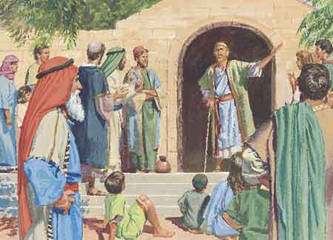
Plain Language
2 Nephi 31

Slide 8
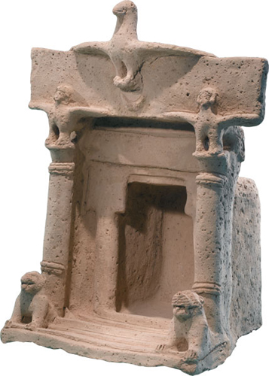
The Sign of the Dove
Matthew 3:13
2 Nephi 31:8

Slide 9
The Tongue of Angels
2 Nephi 31:13

Slide 10
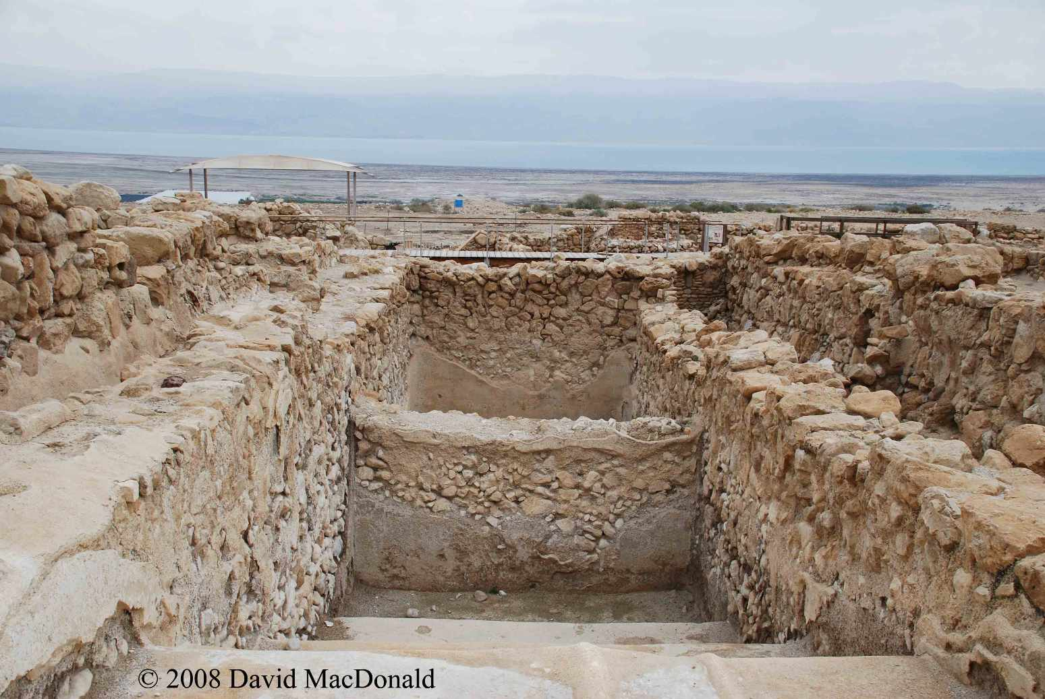
Tongue of Angels
The pseudepigraphical Testament of Job (ca.100 BCE–100CE) contains a conclusion which is believed to relate to the compiling of the hymnbook used by a Therapeutae community. Job gives one of his daughters "a cord" (a stringed instrument of some kind?)
"And she took on another heart—no longer minded toward earthly things—but ecstatically in the angelic dialect, sending up a hymn to God in accord with the style of the angels. And as she spoke ecstatically, she allowed “The Spirit” to be on her garment." (T. Job 48:2-3)
1 Cor 13: Though I speak with the tongues of man and of angels

