Slide 1
The Rise of Priestcraft- and the Decline of Everything Else!
Mosiah 29

Slide 2
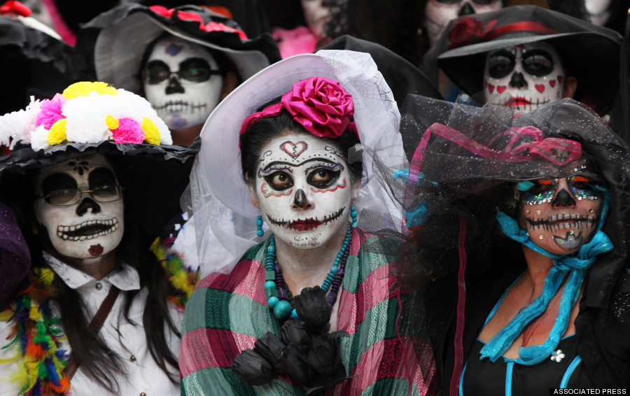
History Repeating?
Evangelical Christians in Mexico are facing increasing persecution at the hands of rural followers of a hybrid faith who demand submission, say advocates, who are calling on the government to protect religious freedom. An alarming number of incidents over the past year have seen Christians in a handful of states in southern Mexico attacked, beaten and even banished from their villages…
The perpetrators are allegedly synchretists, who consider themselves Christian but practice a blend of mythologies, faiths and traditions. “They will try to force them to convert, and if they refuse, they are banned from their villages, unable to live with or see their families, When they refuse to recant their faith, they are expelled from the community.”
While Mexico is considered more than 80 percent Catholic, the nation's synchretists count themselves in that majority even though the faith they practice incorporates a baffling stew of spiritual beliefs. “They will try to force them to convert and if they refuse, they are banned from their villages, unable to live with or see their families.” ­ Around the world, synchretism describes any faith that incorporates two or more religions or philosphies and includes such beliefs as Rastafarianism, Unitarian­Universalism Santeria and blends of Buddhism, Taoism and Confucianism ….
In January, some 30 evangelical Christians in the state of Chiapas were banished by village elders who then destroyed their homes, according to supporters. “Chiapas, where most of these incidents occurred, is very indigenous, …"Most of these areas in the south are self governing. And if the majority of the town is Catholic, then the town activities are Catholic and anybody that declines to participate is ostracized.

Slide 3
Overview of Mormon’s Abridgement
Judges
(Freedom)
Priestcraft
(Kingcraft)
Good King
Bad King
A Church

Slide 4
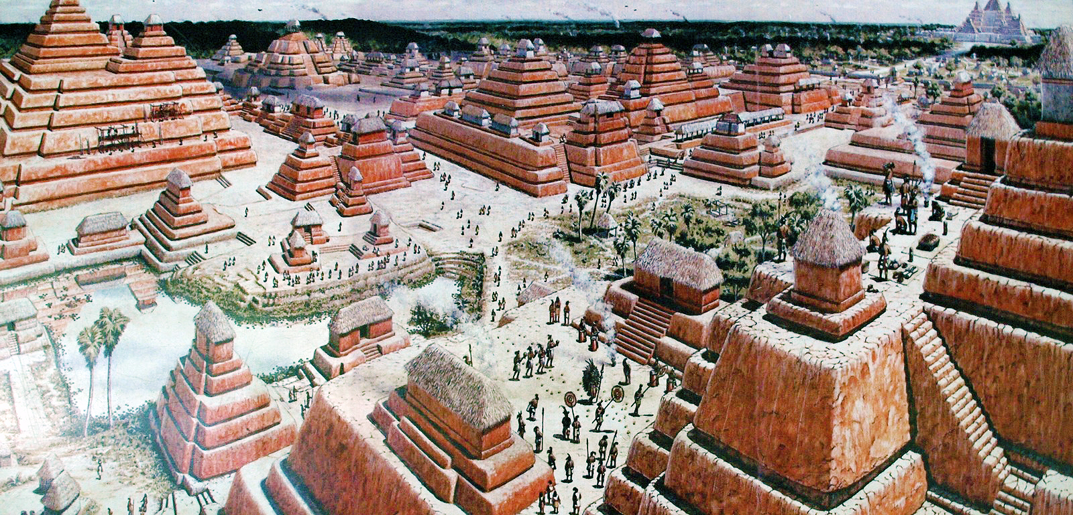
Who was Who?
Mosiah 25
People of Mosiah
Mulekites
People of Zarahemla
People of Alma
People of Limhi

Slide 5
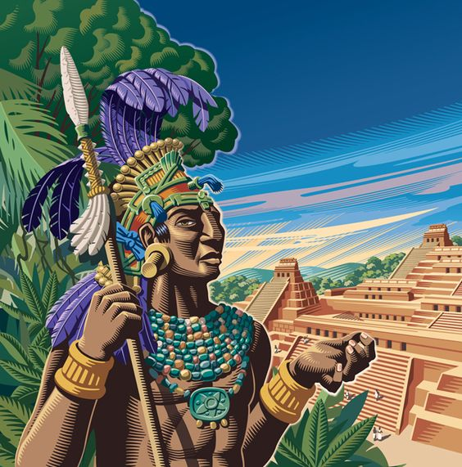
Secession Crisis
Mosiah 29

Slide 6
President J. Reuben Clark
"I have a complete confidence in the aggregate wisdom of the...people, if they are given and made to understand the facts. The wisdom of the mass is always greater than the wisdom of the individual or of the group.
The few may be more subtle, more agile-minded, more resourceful; they may for a time push to the front and scamper ahead in the march; they may on occasion and for a time entice us down the wrong highway at the crossroads.
But the great slow-moving, deliberate-thinking mass plods along over the years down the divinely appointed way. Led astray, they slowly, cumberously swing back to the right road, no matter what the toil or the sacrifice may be, and when they start the return, they crush whatever lies in their path. So has humanity come up through the ages."
(Prophets, Principles, and National Survival, compiled by J. L. Newquist, p. 110)

Slide 7
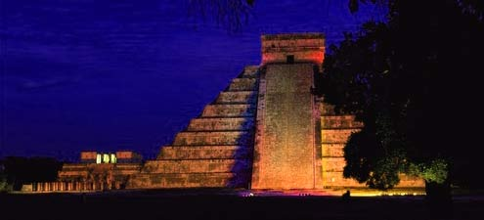
The Attack begins
Alma 1

Slide 8
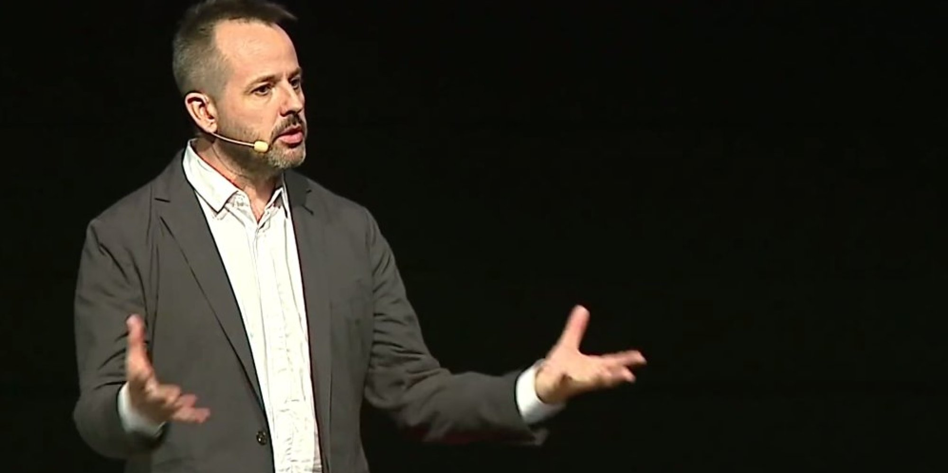
More Hugh Nibley
Hugh Nibley
"What is wrong with this upbeat, cheerful religion-this popular message? ... It says, 'In the end, all men shall have eternal life'-and that's the whole story. Everyone is saved, and that is that.
This short circuits and bypasses the whole plan of salvation, which is that this is a time of probation here, accepting salvation the hard way...Should we lower our standards to gain converts? Well, that's the great thing.
The great Catholic Church historian-not only of our time, but I think the greatest of them all-was Duchesne. He said that's exactly what happened. The church was able to expand and conquer after the fourth century because it just kept lowering its standards, lower and lower. Every time it lowered them, it could get more people in. Finally, everybody was willing to join because they didn't have any standards at all as far as morals were concerned.
This is the thing that happened here with Nehor; he made himself very popular. He was like a popular evangelist, and this is what people want to hear."
(Teachings of the Book of Mormon, Lecture 42, p. 216-7)

Slide 9
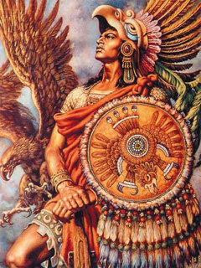
Priestcraft Revealed
Alma 2

