Slide 1
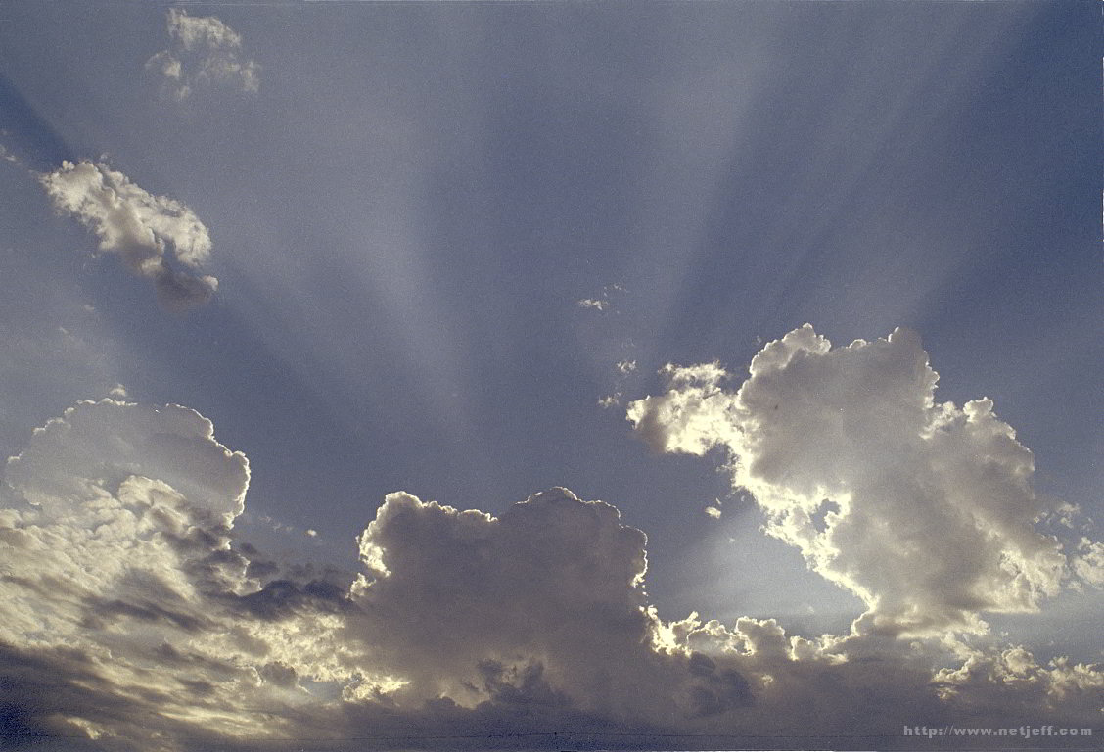
Inherit the Kingdom Prepared for You
www.kevinhinckley.com

Slide 2
A quick peek at Deacon’s Quorum

Slide 3
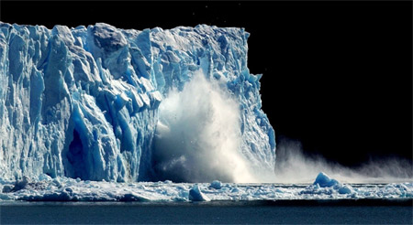
A Politically Correct Moment….
Unfortunately, It is an Inconvenient Truth!
Global Warming is Real...
...And it is definitely man made.
We must act before the earth—as we know it—is gone!
All we have to do is repent… ☺

Slide 4
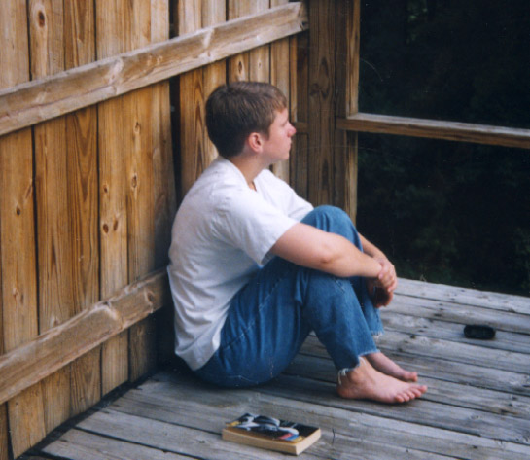
Alma 34
"And now, as I said unto you before, as ye have had so many witnesses, therefore, I beseech of you that ye do not procrastinate the day of your repentance until the end; for after this day of life, which is given us to prepare for eternity, behold, if we do not improve our time while in this life, then cometh the night of darkness wherein there can be no labor performed.
"Ye cannot say, when ye are brought to that awful crisis, that I will repent, that I will return to my God. Nay, ye cannot say this;
for that same spirit which doth possess your bodies at the time that ye go out of this life, that same spirit will have power to possess your body in that eternal world

Slide 5
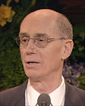
President Eyring
Complacency is a danger for us all. It can come to naive youth who feel that there will be plenty of time in the future for spiritual things. They might think that they have already done enough, considering the brief time they have lived. …
Complacency can affect even the seasoned adult. The better and the longer you serve, the more likely that the tempter can place this lie in your mind: "You have earned a rest." You may have been the Primary president in your little branch twice. Or you may have worked long and hard on your mission and sacrificed so much to serve.

Slide 6
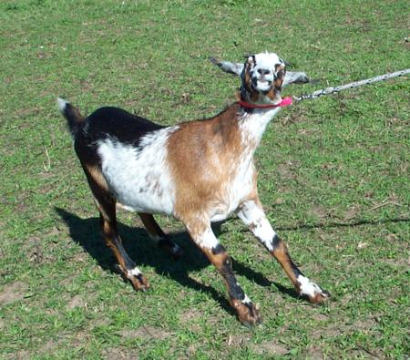
Matthew 25
When the Son of man shall come in his glory, and all the holy angels with him, then he shall sit upon the throne of his glory;
And before him shall be gathered all nations; and he shall separate them one from another, as a shepherd divideth sheep from the goats; the sheep on his right hand, but the goats on his left.
Question:
Why would sheep and goats need to be separated?

Slide 7
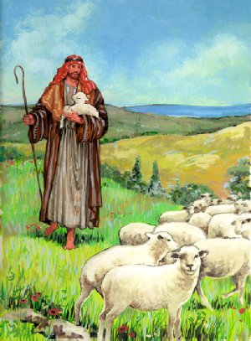
Question:
How do we know when we are
Sheep Thinking
and when we are
Goat Thinking?

Slide 8
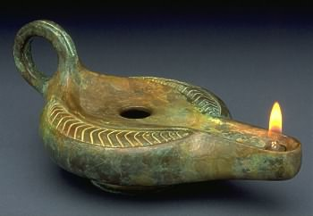
The Ten Virgins
Matthew 25

