Slide 1
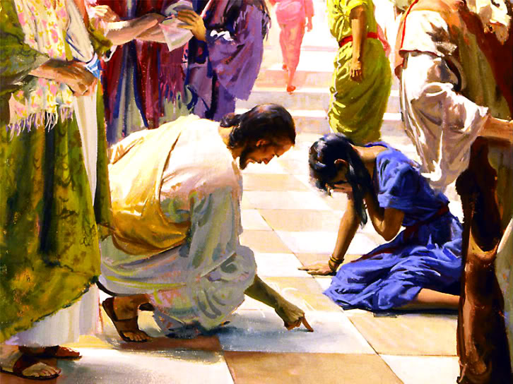
One Needful Thing

Slide 2
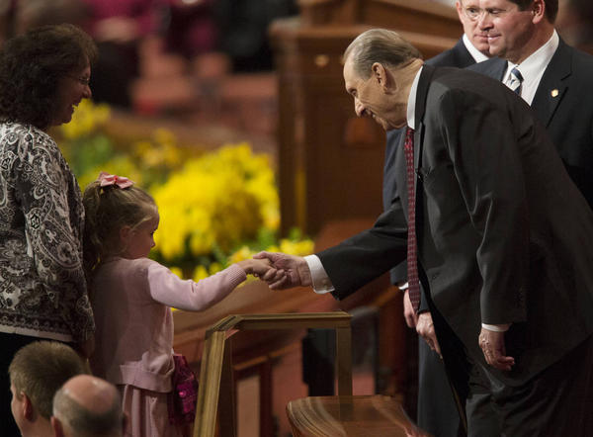
Conference Time!

Slide 3
Elder Ridd

Slide 4
President Uchtdorf

Slide 5
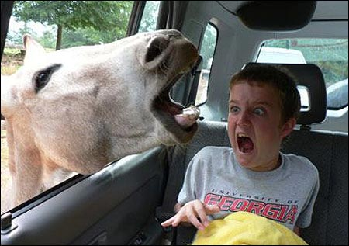
Good Monday Morning!

Slide 6
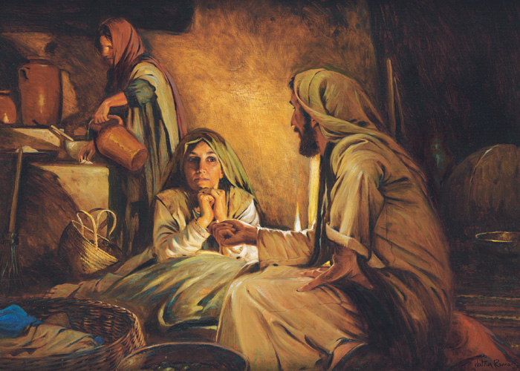
Mary and Martha
Luke 10:38
John 12:1

Slide 7
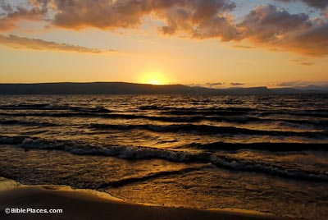
Patricia Holland
On a pristinely clear and beautifully bright day, I sat overlooking the Sea of Galilee and reread the tenth chapter of Luke. But instead of the words on the page, I thought I saw with my mind and heard with my heart these words: “[Pat, Pat, Pat], thou art careful and troubled about many things.” Then the power of pure and personal revelation seized me as I read, “But one thing [only one thing] is [truly] needful.”…
Our loving Father in Heaven seemed to be whispering to me, “You don’t have to worry over so many things. The one thing that is needful—the only thing that is truly needful—is to keep your eyes toward the sun—my Son.”
Suddenly I had true peace. I knew that my life had always been in his hands—from the very beginning! The sea lying peacefully before my eyes had been tempest-tossed and dangerous—many, many times. All I needed to do was to renew my faith, and get a firm grasp on his hand—and together we could walk on the water.

Slide 8
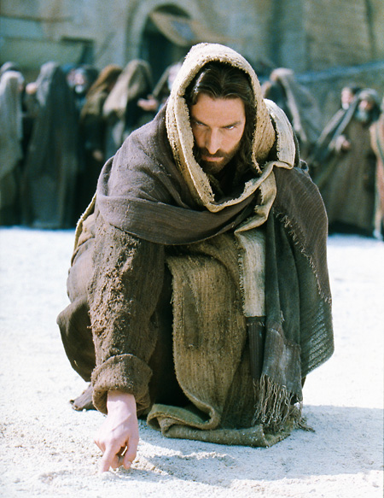
The Woman
John 8:1

Slide 9
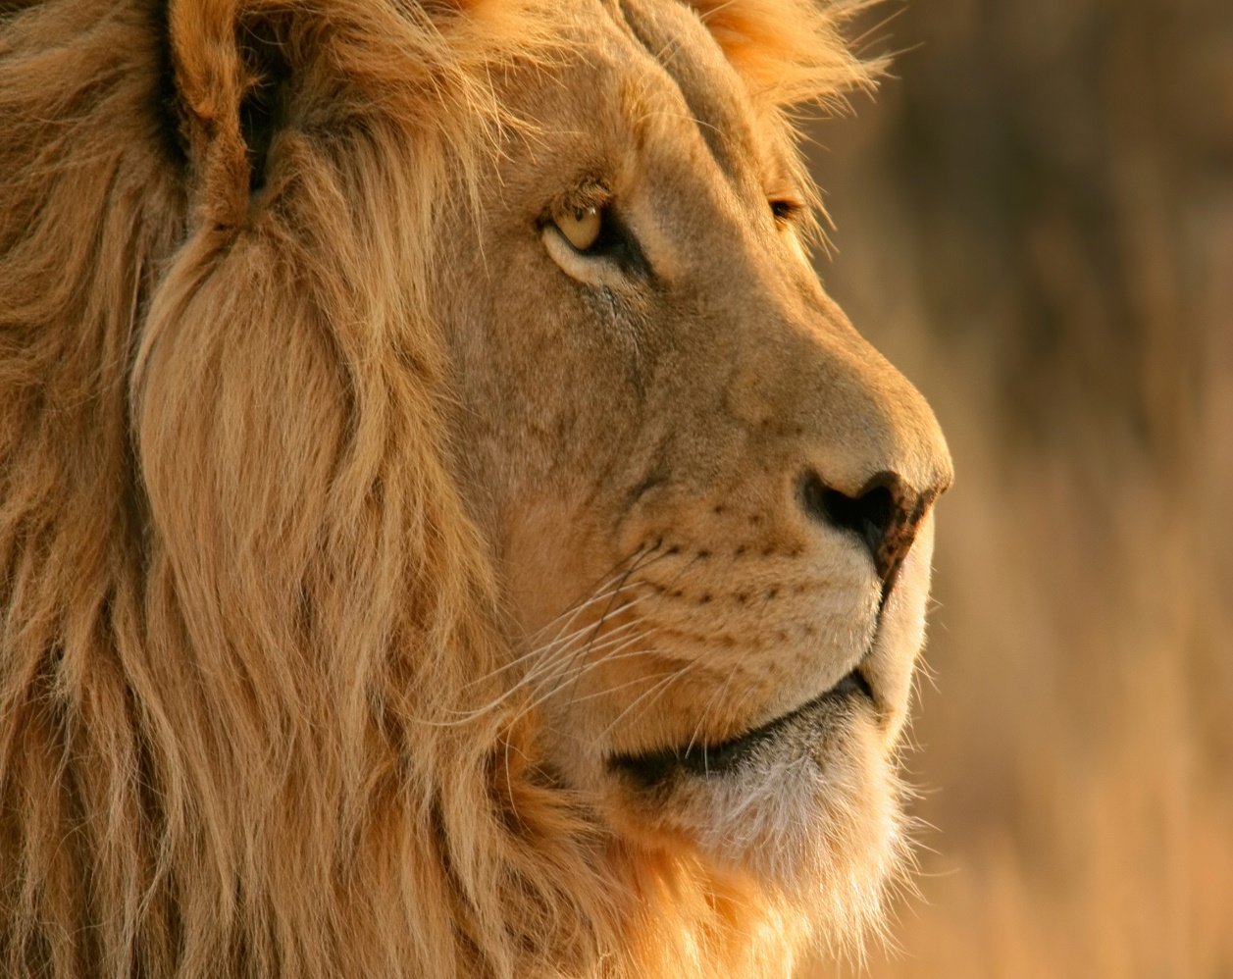
Elder CS Lewis
“Although the sight of water made her feel ten times thirstier than before, she didn’t rush forward and drink. She stood as still as if she had been turned into stone, with her mouth wide open. And she had a very good reason; just on this side of the stream lay the lion.
It lay with its head raised and its two fore-paws out in front of it, like the lions in Trafalgar Square. She knew at once that it had seen her, for it eyes looked straight into hers for a moment and then turned away– as if it knew her quite well and didn’t think much of her.
‘If I run away, it’ll be after me in a moment,’ thought Jill. ‘And if I go on, I shall run straight into its mouth.’ Anyway, she couldn’t have moved if she had tried, and she couldn’t take her eyes off it.
How long this lasted, she could not be sure; it seemed like hours. And the thirst became so bad that she almost felt she would not mind being eaten by the lion if only she could be sure of getting a mouthful of water first.
‘If you’re thirsty, you may drink.’
…For a second she stared here and there, wondering who had spoken. Then the voice said again, ‘If you are thirsty, come and drink,’ and she…realized that it was the lion speaking.

Slide 10
Elder CS Lewis
Anyway, she had seen its lips move this time, and the voice was not like a man’s. It was deeper, wilder, and stronger; a sort of heavy, golden voice. It did not make her any less frightened than she had been before, but it made her frightened in a rather different way.
‘Are you not thirsty?’ said the Lion.
‘I’m dying of thirst,’ said Jill
‘Then drink,’ said the Lion.
‘May I—could I—would you mind going away while I do?’ said Jill.
The Lion answered this only by a look and a very low growl. And as Jill gazed at its motionless bulk, she realized that she might as well have asked the whole mountain to move aside for her convenience. The delicious rippling noise of the stream was driving her nearly frantic.
‘Will you promise not to—do anything to me, if I do come?’ said Jill.
‘I make no promise,’ said the Lion.

Slide 11
Elder CS Lewis
‘Do you eat girls?’ she said.
‘I have swallowed up girls and boys, women and men, kings and emperors, cities and realms,’ said the Lion. It didn’t say this as if it were boasting, nor as if it were sorry, nor as if it were angry. It just said it.
‘I daren’t come and drink,’ said Jill.
‘Then you will die of thirst,’ said the Lion.
‘Oh dear!’ said Jill, coming another step nearer. ‘I suppose I must go and look for another stream then.’
‘There is no other stream,’ said the Lion.”

