Slide 1
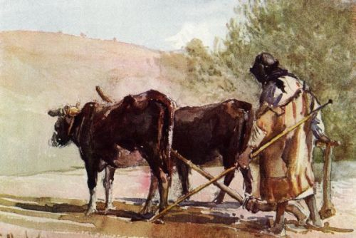
I Will Not Leave Thee

Slide 2
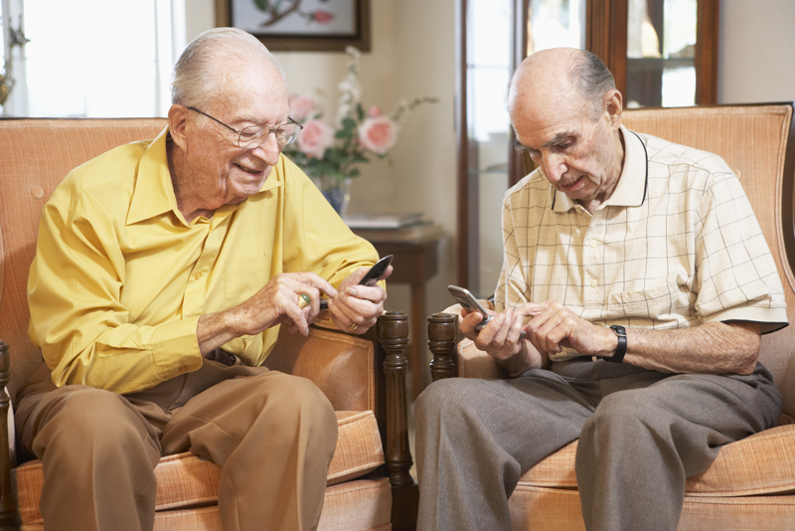
Texting Tips for Seniors
ROFLACGU
Rolling on the floor laughing and can’t get up
ATD
At the doctors
BTW
Bring the wheelchair
BYOT
Bring your own teeth
LMDO
Laughing my dentures out
TTYL
Talk to your louder

Slide 3
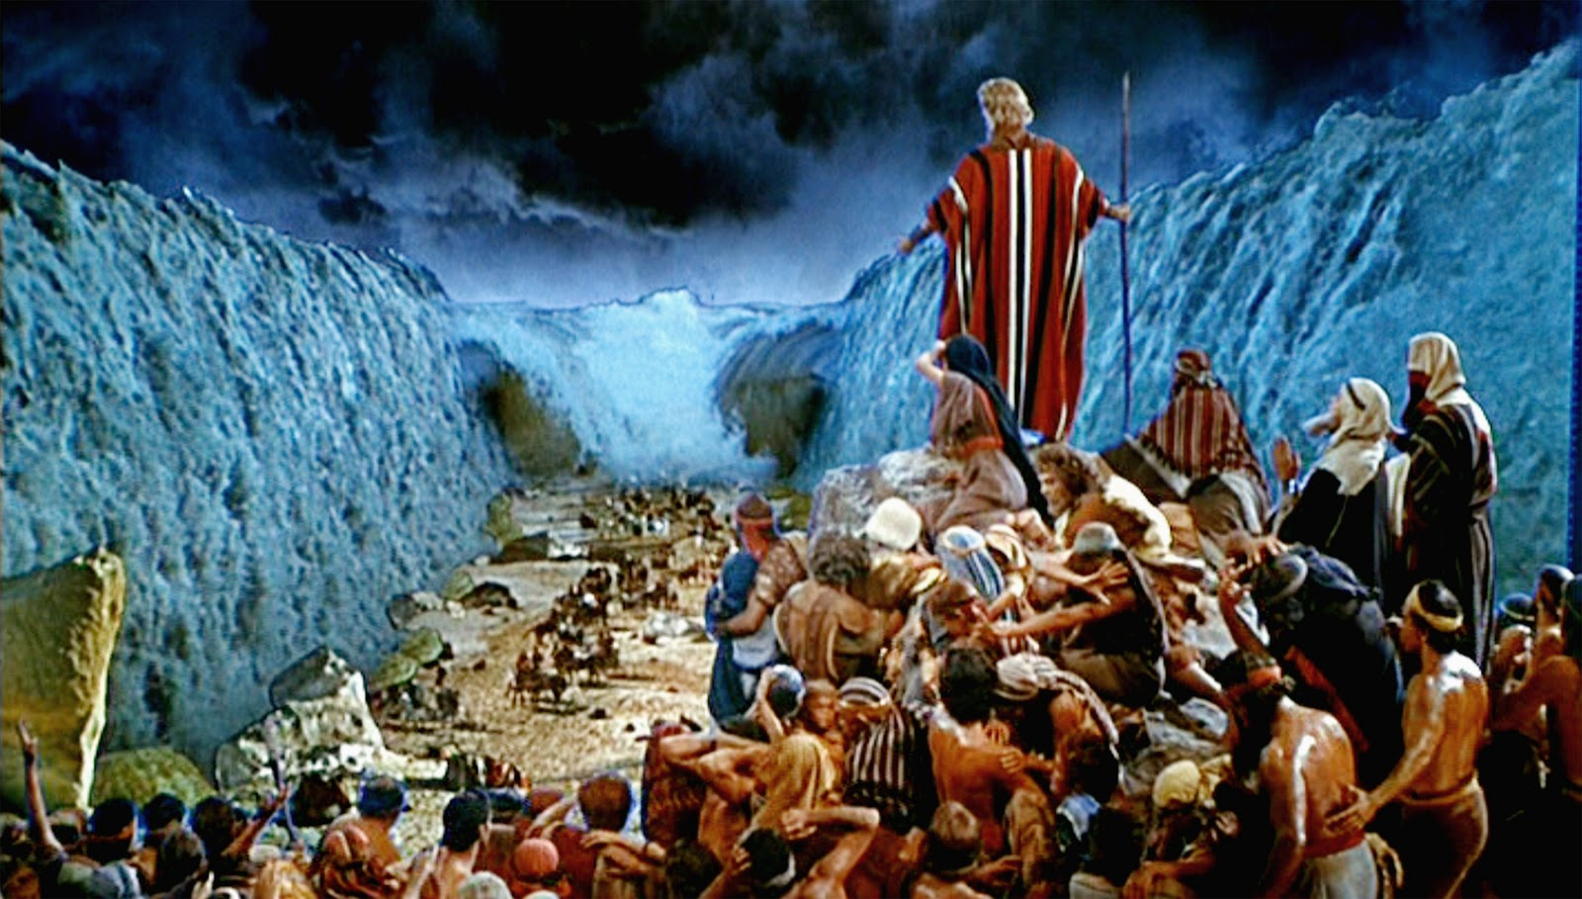
Elisha Prophet Principle #1
I will not leave thee
2 Kings 2:2

Slide 4
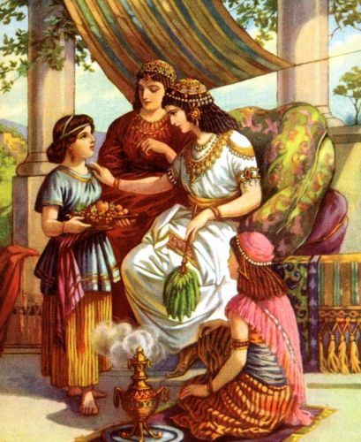
Prophet Principle #2
Stand as a Witness
2 Kings 5

Slide 5
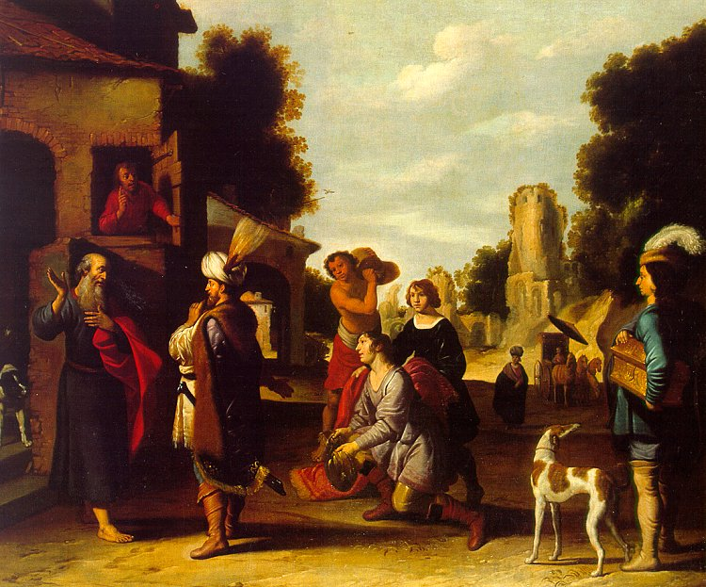
Prophet Principle #3
Whether by mine voice or the voice of my prophet or the voice of his servants…it is the same.

Slide 6
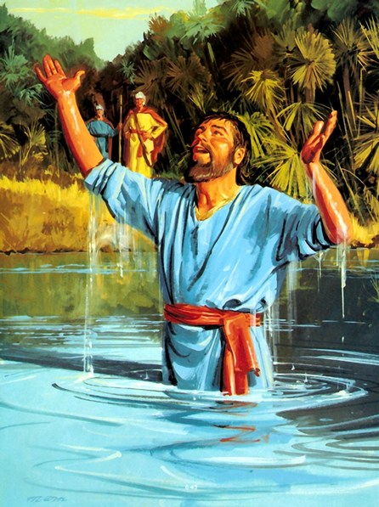
Prophet Principle #4
Follow his words exactly

Slide 7
Prophet Principle #5
Prophets see things we cannot
2 Kings 6:11

Slide 8
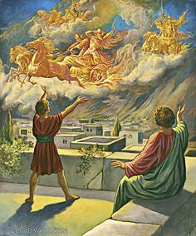
Prophet Principle #6
He is not alone- and neither are we.

Slide 9
Elder Holland
“In the gospel of Jesus Christ you have help from both sides of the veil and you must never forget that.
When disappointment and discouragement strike—and they will—you remember and never forget that if our eyes could be opened we would see horses and chariots of fire as far as the eye can see riding at reckless speed to come to our protection.
They will always be there, these armies of heaven, in defense of Abraham’s seed”
(Jeffrey R. Holland, 1980, 15). Times of Trouble,” New Era,

