Slide 1
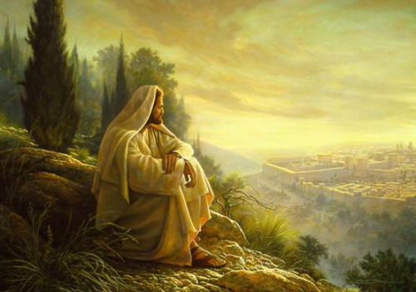
How Beautiful Upon the Mountains

Slide 2
Obstinate!
Isaiah 48

Slide 3
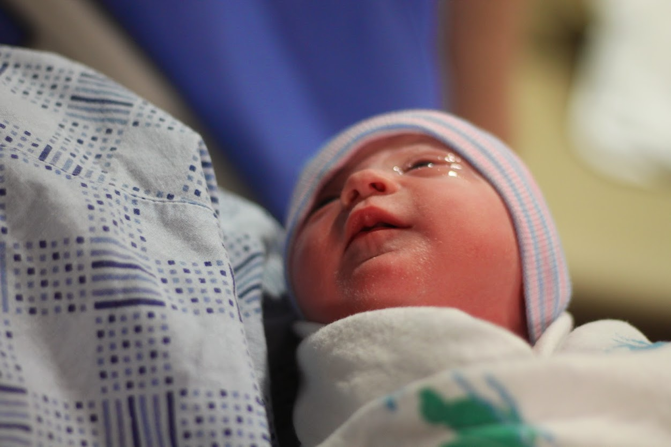
Motherhood
Isaiah 49

Slide 4
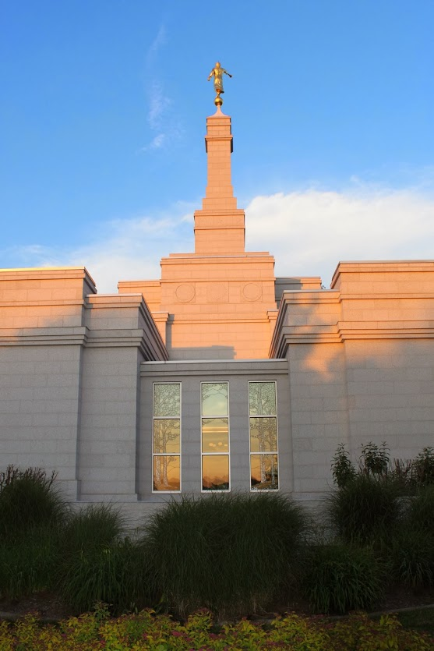
The Mountains
Isaiah 52

Slide 5
Isaiah’s Many Layered Verses Layer 1- The Hebrew
Isaiah 52
And then shall they say, How beautiful (Navu) upon the mountains are the feet of him that bringeth good tidings unto the, that publisheth peace; that bringeth good tidings unto them of good, that publisheth salvation; (Yeshuah) that saith unto Zion, Thy God reigneth!
Interestingly, Isaiah declares that the feet of the Lord are “nauvoo,” or beautiful, upon the hills of Zion. More important is the fact that Isaiah actually announces the name of the coming Messiah in this passage: Yeshuah, which is the Hebrew word we render as the name Jesus. (Breck England)

Slide 6
Layer 2 Abinadi’s Commentary
Yea, and are not the prophets, every one that has opened his mouth to prophesy, that has not fallen into transgression, I mean all the holy prophets ever since the world began? I say unto you that they are his seed.
"And behold, I say unto you, this is not all. For O how beautiful upon the mountains are the feet of him that bringeth good tidings, that is the founder of peace, yea, even the Lord, who has redeemed his people; yea, him who has granted salvation unto his people" (Mosiah 15:13-14,18).
Notes:
Layer 2, the “feet” are those of anyone who teaches the gospel.

Slide 7
Layer 3 The Savior’s Commentary
Isaiah 52
Awake, awake, put on thy strength, O Zion; put on thy beautiful garments, O Jerusalem, the holy city; for henceforth there shall no more come into thee the uncircumcised and the unclean.
Shake thyself from the dust; arise, and sit down, O Jerusalem; loose thyself from the bands of thy neck, O captive daughter of Zion.
For thus saith the Lord, Ye have sold yourselves for naught; and ye shall be redeemed without money.
Therefore, my people shall know my name; yea, in that day they shall know that I am he that doth speak; behold, it is I.
And then shall they say, How beautiful upon the mountains are the feet of him that bringeth good tidings unto the, that publisheth peace; that bringeth good tidings unto them of good, that publisheth salvation; that saith unto Zion, Thy God reigneth!
Thy watchmen shall lift up the voice; with the voice together shall they sing; for they shall see eye to eye, when the Lord shall bring again Zion.
3 Nephi 20
And it shall come to pass that the time cometh, when the fulness of my gospel shall be preached unto them;
And they shall believe in me, that I am Jesus Christ…
Then shall their watchmen lift up their voice, and with the voice together shall they sing; for they shall see eye to eye.
And then shall be brought to pass that which is written: Awake, awake again, and put on thy strength, O Zion; put on thy beautiful garments, O Jerusalem, the holy city, for henceforth there shall no more come into thee the uncircumcised and the unclean.
Shake thyself from the dust; arise, sit down, O Jerusalem; loose thyself from the bands of thy neck, O captive daughter of Zion.
Verily, verily, I say unto you, that my people shall know my name; yea, in that day they shall know that I am he that doth speak.
And then shall they say: How beautiful upon the mountains are the feet of him that bringeth good tidings unto them, that publisheth peace; that bringeth good tidings unto them of good, that publisheth salvation; that saith unto Zion: Thy God reigneth!
Notes:
Layer 3: The “feet” are those of the Savior, standing on the Mount of Olives

Slide 8
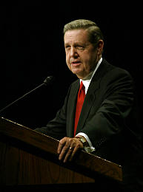
Elder Holland
These familiar passages, written first by Isaiah but spoken of and inspired by Jehovah himself, are often applied to anyone- especially missionaries-who bring the good tidings of the gospel and publish peace to the souls of men.
There is nothing inappropriate about such an application, but it is important to realize-as the prophet Abinadi did-that in its purest form and original sense, this psalm of appreciation applies specifically to Christ.
It is he and only he who ultimately brings the good tidings of salvation. Only through him is true, lasting peace published. To Zion, in both the old and new Jerusalems, it is Christ who declares, "Thy God reigneth!" It is his feet upon the mountain of redemption that are beautiful.
Notes:
Christ and the New Covenant

