Slide 1
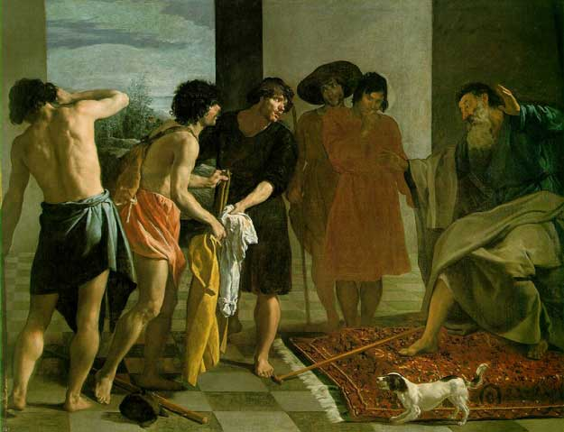
Joseph

Slide 2
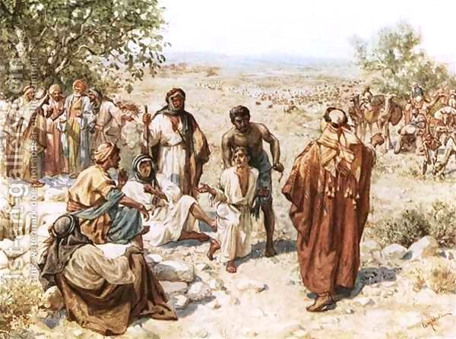
Joseph
Genesis 37

Slide 3
Hugh Nibley
Here we have “I detect, I perceive, I note.” (He’s blind, you see.) “the odor, the spirit, the smell of Joseph, if you do not think me out of my head from old age and a bit barmy.”
It talks about the spirit that is in it, the east wind that has brought it, etc. And this is a very important thing: “When they placed it upon the face of Jacob, he smelled also the smell of the Garden of Eden. For behold there is not in all the earth another garment that has that smell in it.”
This is a unique thing; this is the garment.“For there is not in any other garment on earth of the winds of the garden of Eden, unless it is in this one garment.” So you can see why the brethren were so jealous; it was the garment of the priesthood. Teachings of the Book of Mormon, vol. 3, 51-52

Slide 4
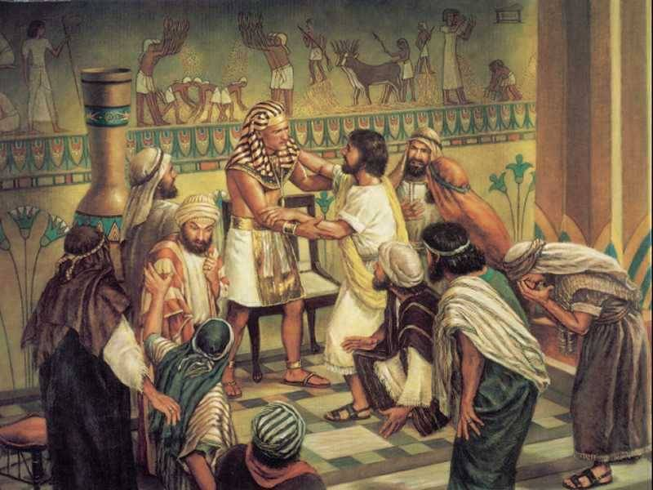
Joseph Prevails
Genesis 41

Slide 5
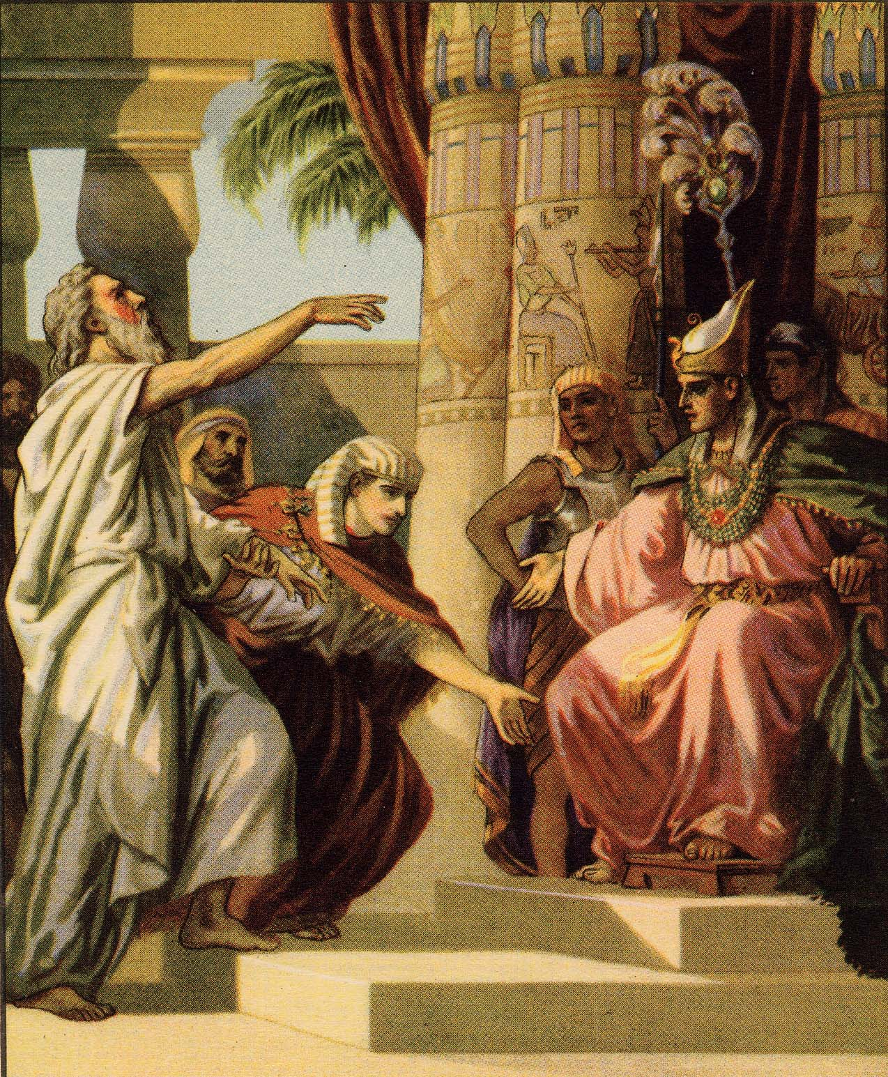
Repentance…
Genesis 42

Slide 6
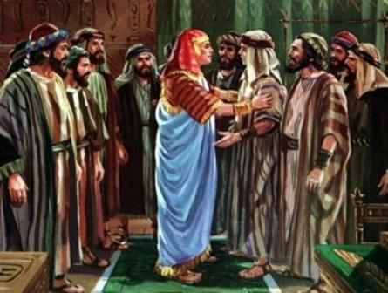
Reconciled
Genesis 45

