Slide 1
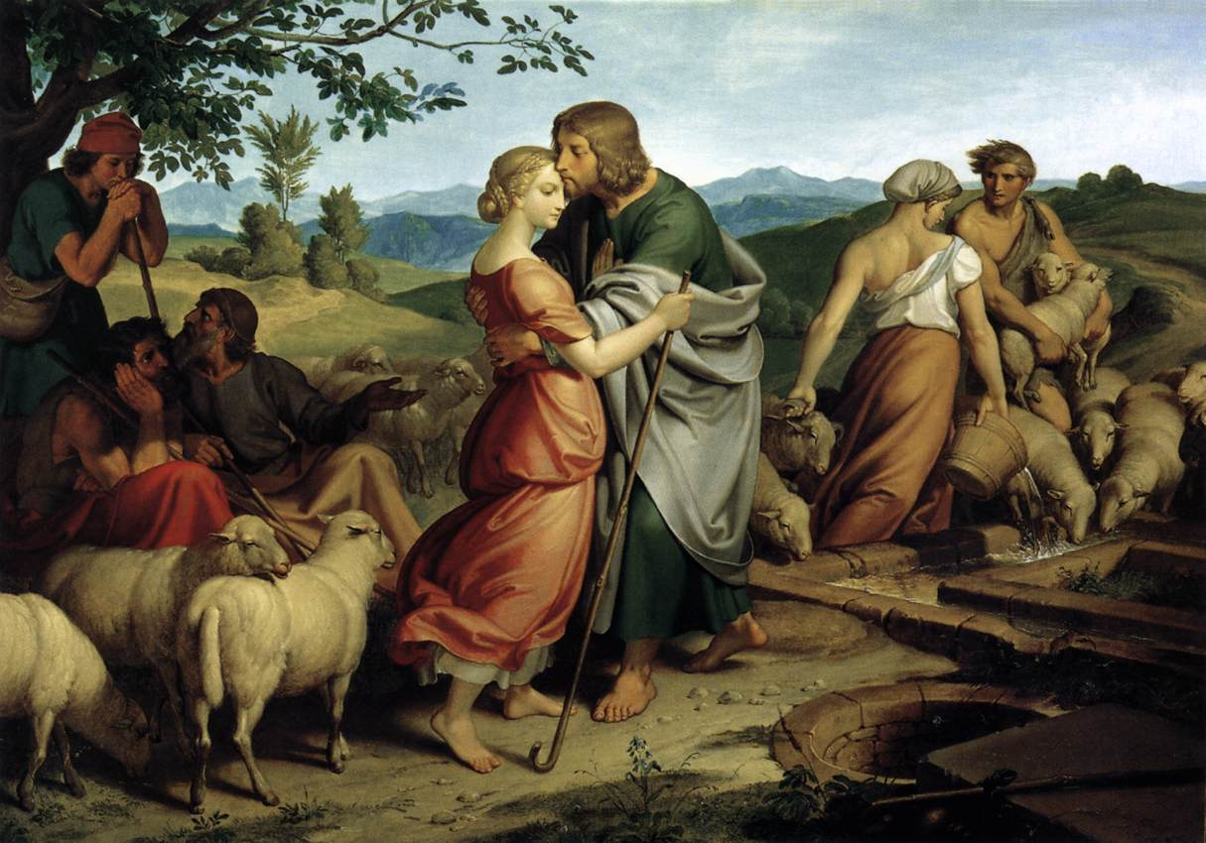
Covenants
Abraham, Isaac, and Jacob

Slide 2
Scene from my office…

Slide 3
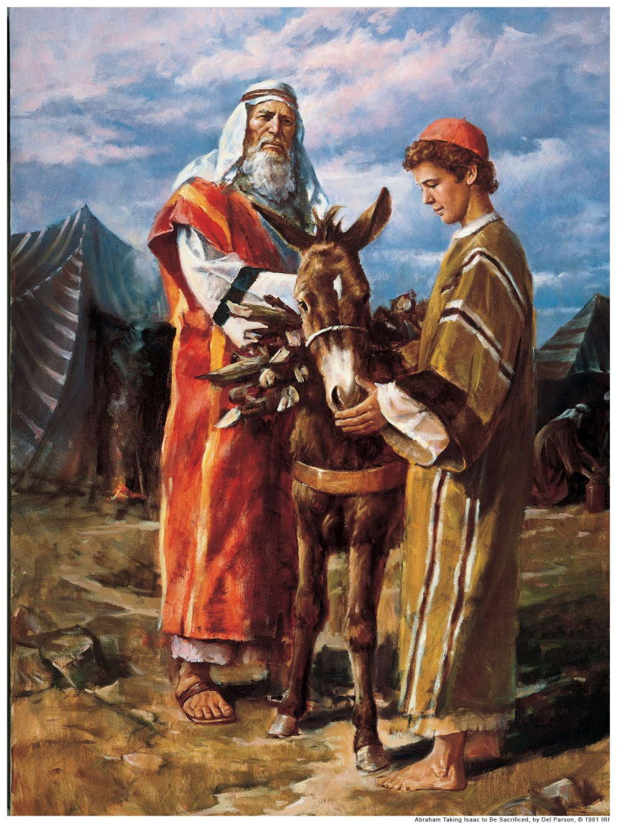
The Great Test
Genesis 22

Slide 4
Book of Jasher Chapter 23
25 And whilst Abraham was proceeding with his son Isaac along the road, Satan came and appeared to Abraham in the figure of a very aged man, humble and of contrite spirit, and he approached Abraham and said to him, Art thou silly or brutish, that thou goest to do this thing this day to thine only son?
26 For God gave thee a son in thy latter days, in thy old age, and wilt thou go and slaughter him this day because he committed no violence, and wilt thou cause the soul of thine only son to perish from the earth?
27 Dost thou not know and understand that this thing cannot be from the Lord? for the Lord cannot do unto man such evil upon earth to say to him, Go slaughter thy child.
28 And Abraham heard this and knew that it was the word of Satan who endeavored to draw him aside from the way of the Lord, but Abraham would not hearken to the voice of Satan, and Abraham rebuked him so that he went away.

Slide 5
Book of Jasher
50 And when they were going along Isaac said to his father, Behold, I see here the fire and wood, and where then is the lamb that is to be the burnt offering before the Lord?
51 And Abraham answered his son Isaac, saying, The Lord has made choice of thee my son, to be a perfect burnt offering instead of the lamb.
52 And Isaac said unto his father, I will do all that the Lord spoke to thee with joy and cheerfulness of heart.
53 And Abraham again said unto Isaac his son, Is there in thy heart any thought or counsel concerning this, which is not proper? tell me my son, I pray thee, O my son conceal it not from me.
54 And Isaac answered his father Abraham and said unto him, O my father, as the Lord liveth and as thy soul liveth, there is nothing in my heart to cause me to deviate either to the right or to the left from the word that he has spoken to thee.

Slide 6
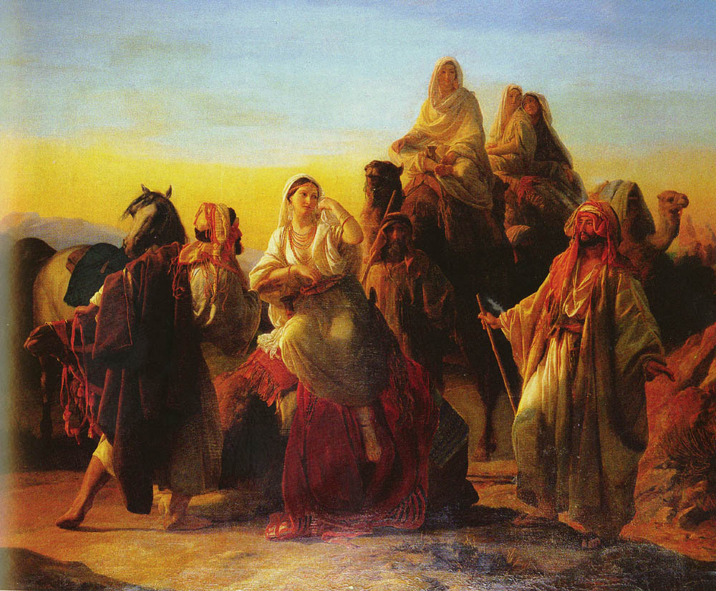
Issac and Rebekah
Genesis 25:21

Slide 7
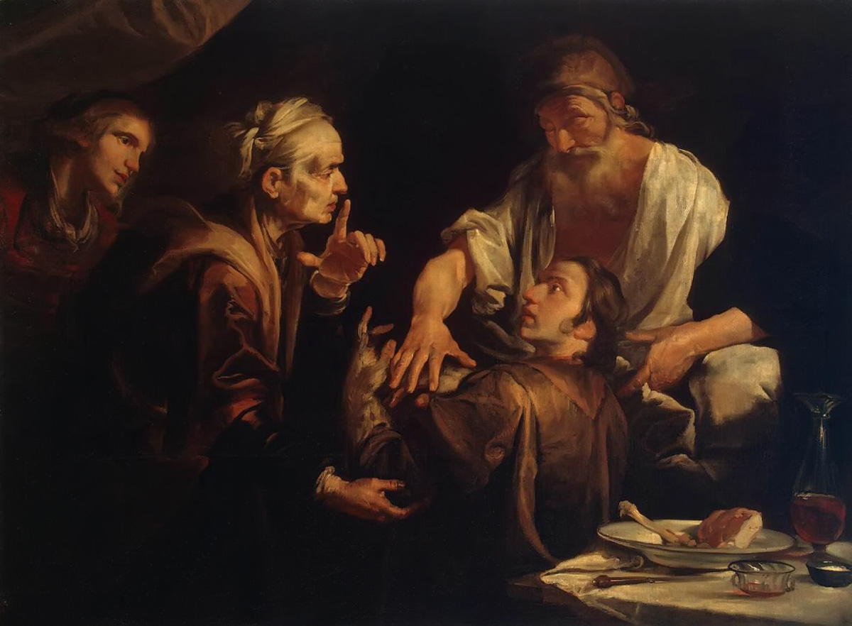
The Birthright
Genesis 27

Slide 8
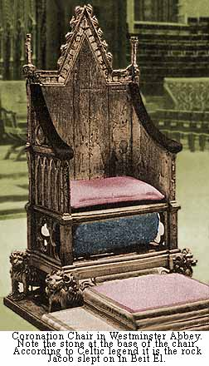
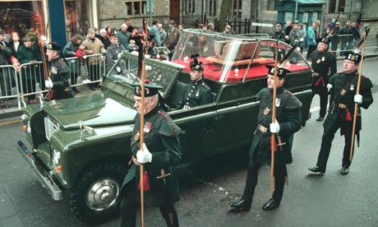
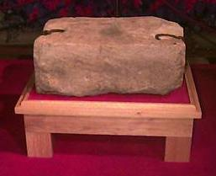
Stone of Scone

Slide 9
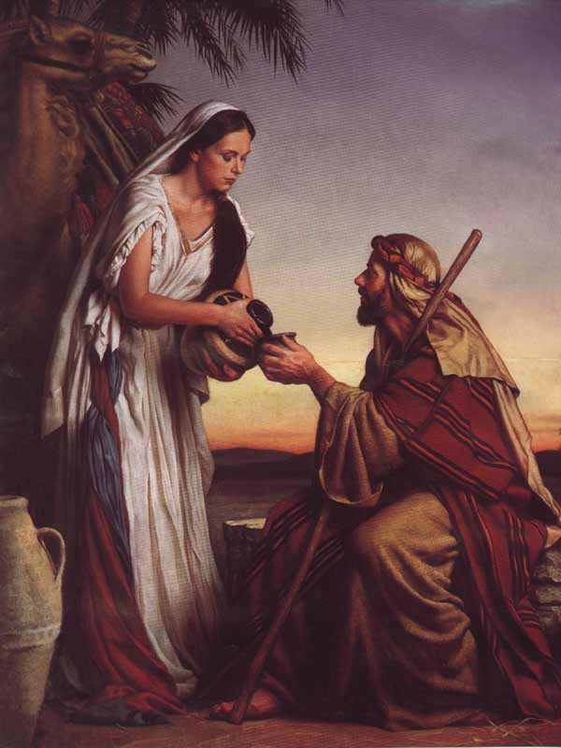
Rachel
Genesis 29

