Slide 1
Finding the Promised Land
I Nephi 17

Slide 2
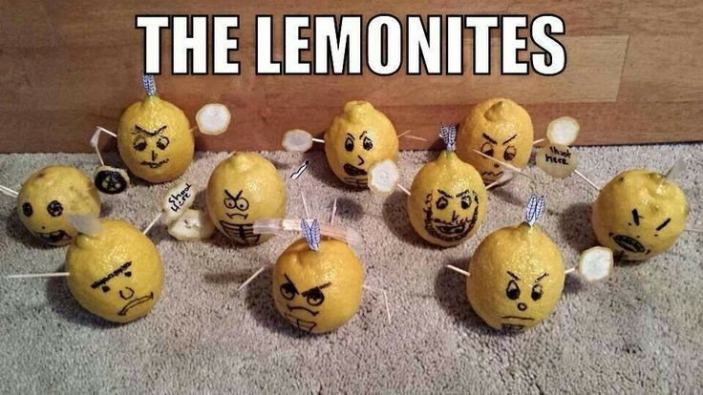

Slide 3
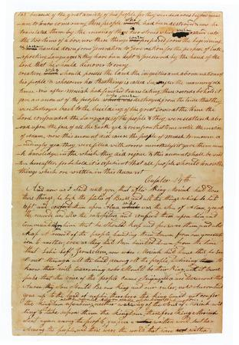
FYI…
1 Nephi 12:18 And the large and spacious building, which thy father saw, is vain imaginations and the pride of the children of men. And a great and a terrible gulf divideth them; yea, even the word of the justice of the Eternal God,
Original Book of Mormon Manuscript
And the large and spacious building, which thy father saw, is vain imaginations and the pride of the children of men. And a great and a terrible gulf divideth them; yea, even the [s]word of the justice of the Eternal God,

Slide 4
Elder CS Lewis
I read to know that I’m not alone…

Slide 5
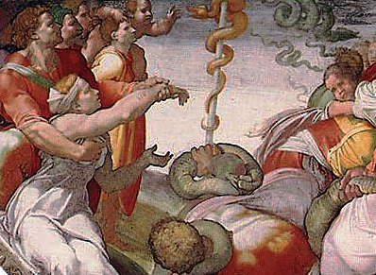
Simplicity
1 Nephi 17:41

Slide 6
Feel his words
1 Nephi 17:45

Slide 7
Elder Neal A. Maxwell
"Some young people belong to peer groups in which there is an almost constant celebration of the senses: tactile, visual, and aural. It is significant that three prophets (Nephi, Paul, and Mormon) in three different cultures and at three different times, each used the same two words to describe a people who had celebrated the senses so much that they had lost their capacity to feel.
The words 'past feeling' appear in the scriptures to depict people who had become sufficiently encrusted in their excesses that they killed their capacity to feel. The very capacity to feel which they celebrated was lost in the process of celebration.
They were in a situation in which increasingly stronger stimulants were needed to feel anything, and finally no dose was large enough to appease their appetites." (A Time to Choose, p. 15 - 16.)

Slide 8
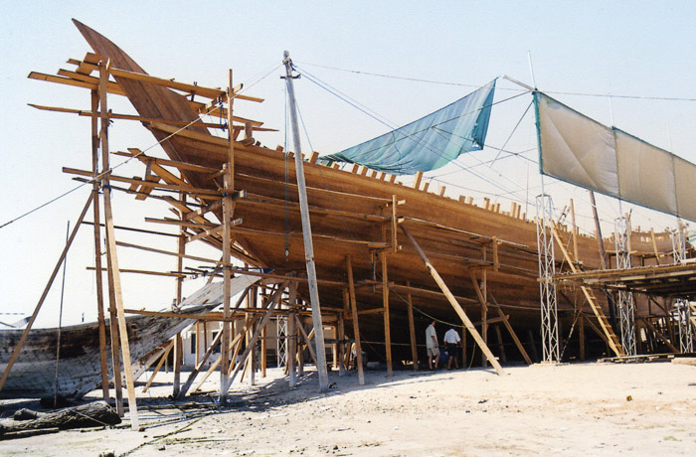
Building a Ship

Slide 9
Led by Light, Driven by Wind
Lord’s Design For Nephi
“I [did not] build the ship after the manner of men” (1 Nephi 18:2)
Divine Tutoring
I, Nephi, did go into the mount oft and I did pray oft unto the Lord (I Nephi 18:3)
Light to see
“And I will also be your light in the wilderness; and I will prepare the way before you (1 Nephi 17:13)
Driven by Wind
We did put forth into the sea and were driven forth before the wind towards the promised land (1 Nephi 18:8)
Lord’s Design for Jaredites
Jared did go to work…and built barges…according to the instructions of the Lord
Divine Tutoring
Lord came again unto the brother of Jared…and for..three hours did the Lord talk with [him]
Light to See
“What will ye that I should do that ye may have light in your vessels?
Driven the Wind
Lord God caused that there should be a furious wind blow upon the face of the waters…and the wind did never cease to blow…

Slide 10
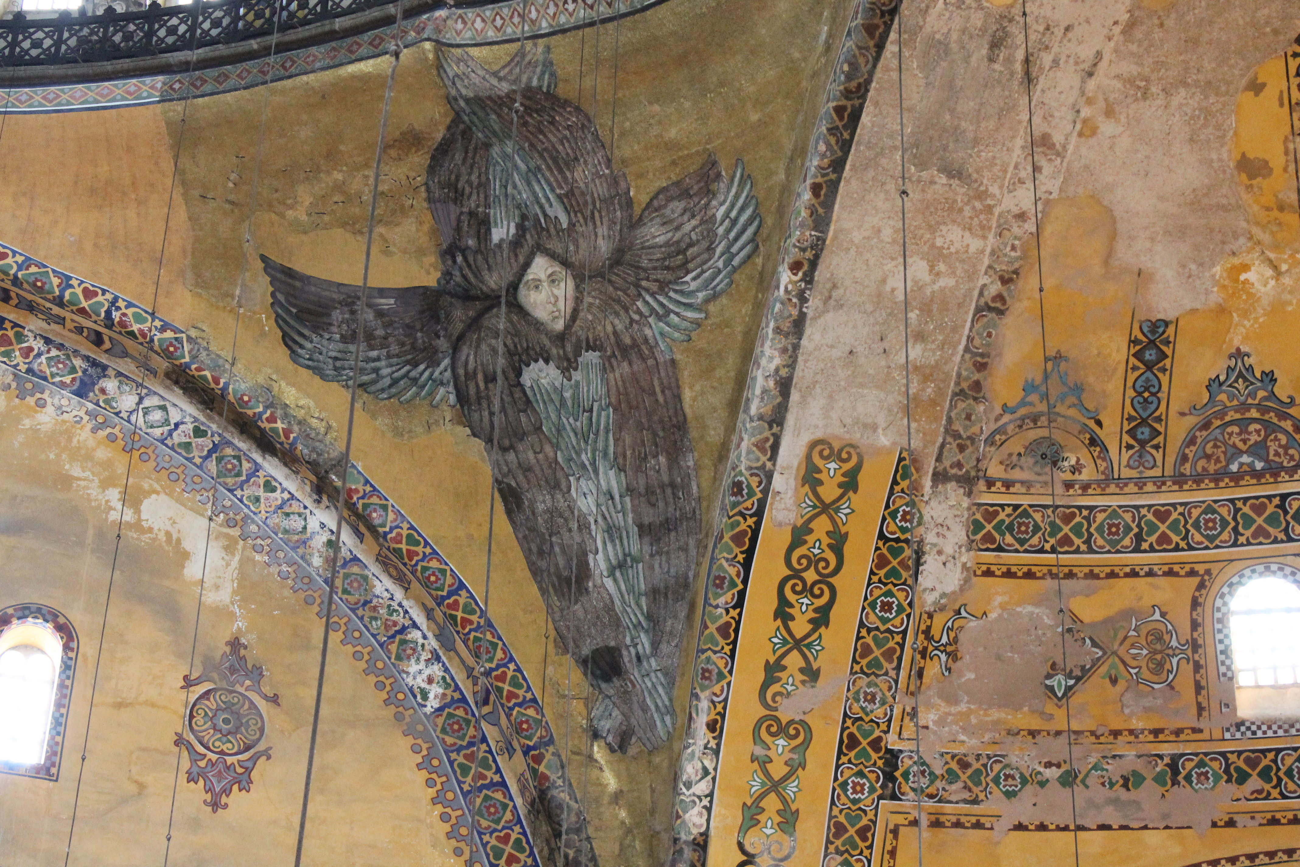
Kirtland Temple Dedication
36 Let it be fulfilled upon them, as upon those on the day of Pentecost; let the gift of tongues be poured out upon thy people, even cloven tongues as of fire, and the interpretation thereof.
37 And let thy house be filled, as with a rushing mighty wind, with thy glory.
79 And also this church, to put upon it thy name. And help us by the power of thy Spirit, that we may mingle our voices with those bright, shining seraphs around thy throne, with acclamations of praise, singing Hosanna to God and the Lamb!

Slide 11
Weakness?
1 Nephi 19:6

Slide 12
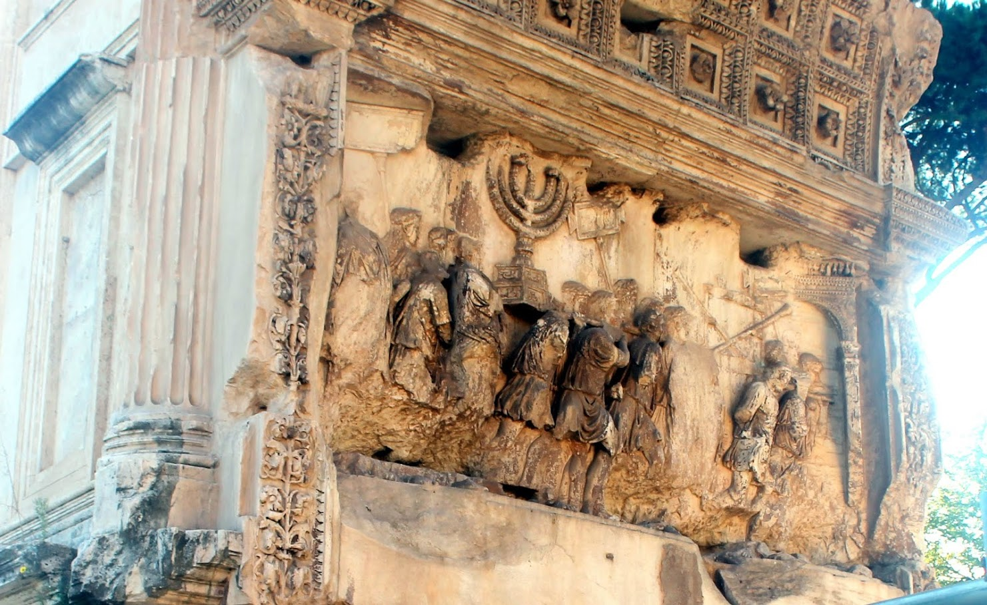
Gather or Wander?
1 Nephi 19:13

