Slide 1
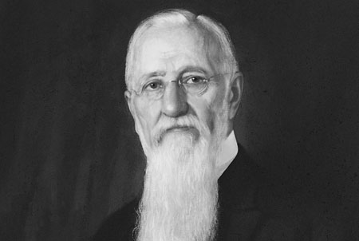
Visions
D&C 137, 138

Slide 3
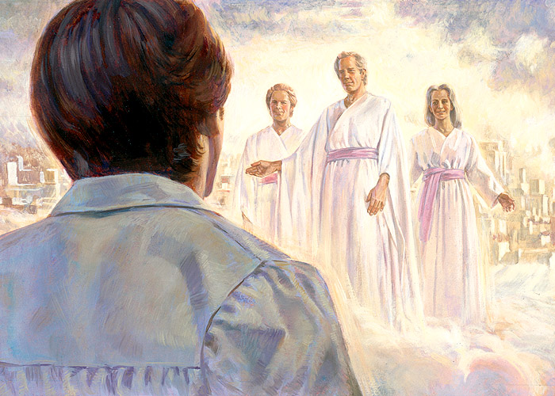
Marvelings
D&C 137 1-5

Slide 4
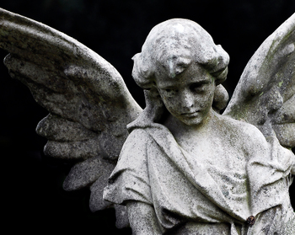
George McDonald
Come to God, then, my brother, my sister, with all thy desires and instincts, all thy lofty ideals, all thy longing for purity and unselfishness, all thy yearning to love and be true…
Come to him with all thy weaknesses, all thy shames, all thy futilities; with all thy helplessness over thy own thoughts;
with all thy failure, yea, with the sick sense of having missed the tide of true affairs;
come to him with all thy doubts, fears, dishonesties, meannesses, paltrinesses, misjudgments, wearinesses, disappointments, and stalenesses:
Be sure he will take thee and all thy miserable brood, whether of draggle-winged angels, or covert-seeking snakes, into his care…

Slide 5
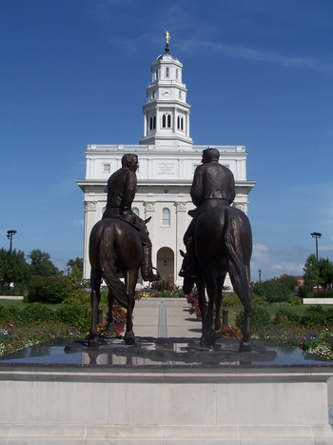
Joseph F. Smith
D&C 138

Slide 6
Elder C.S. Lewis
How strange that we cannot love time. It spoils our loveliest moments. Nothing quite comes up to expectations because of it. We alone: animals, so far as we can see, are unaware of time, untroubled. Time is their natural environment. Why do we sense that it is not ours?
It suggests that we have not always been or will not always be purely temporal creatures. It suggest that we were created for eternity.
Not only are we harried by time, we seem unable, despite a thousand generations, even to get used to it. We are always amazed at it – how fast it goes, how slowly it goes, how much of it is gone.
Where, we cry, has the time gone? We aren’t adapted to it, not at home in it. If that is so, it may appear as a proof, or at least a powerful suggestion, that eternity exists and is our home. "

