Slide 1
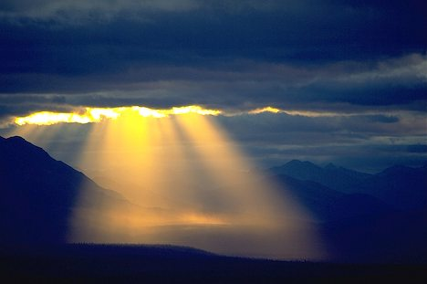
Heaven’s Messengers D&C 130

Slide 2
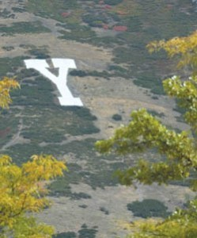
BYU Graffiti
Police Beat (Daily Universe):
Graffiti was found at the bus stop next to the law library.
The phrase “There are angels among us” was written in black permanent marker.

Slide 3
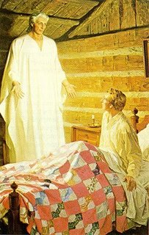
Messengers
D&C 129:1-4

Slide 4
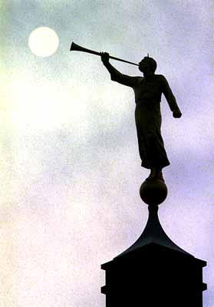
Moroni 7
Have angels ceased to appear unto the children of men? Or has he withheld the power of the Holy Ghost from them? Or will he, so long as time shall last, or the earth shall stand, or there shall be one man upon the face thereof to be saved?
Behold I say unto you, Nay; for it is by faith that miracles are wrought; and it is by faith that angels appear and minister unto men; wherefore, if these things have ceased wo be unto the children of men, for it is because of unbelief, and all is vain.
Moroni 7:36

Slide 5
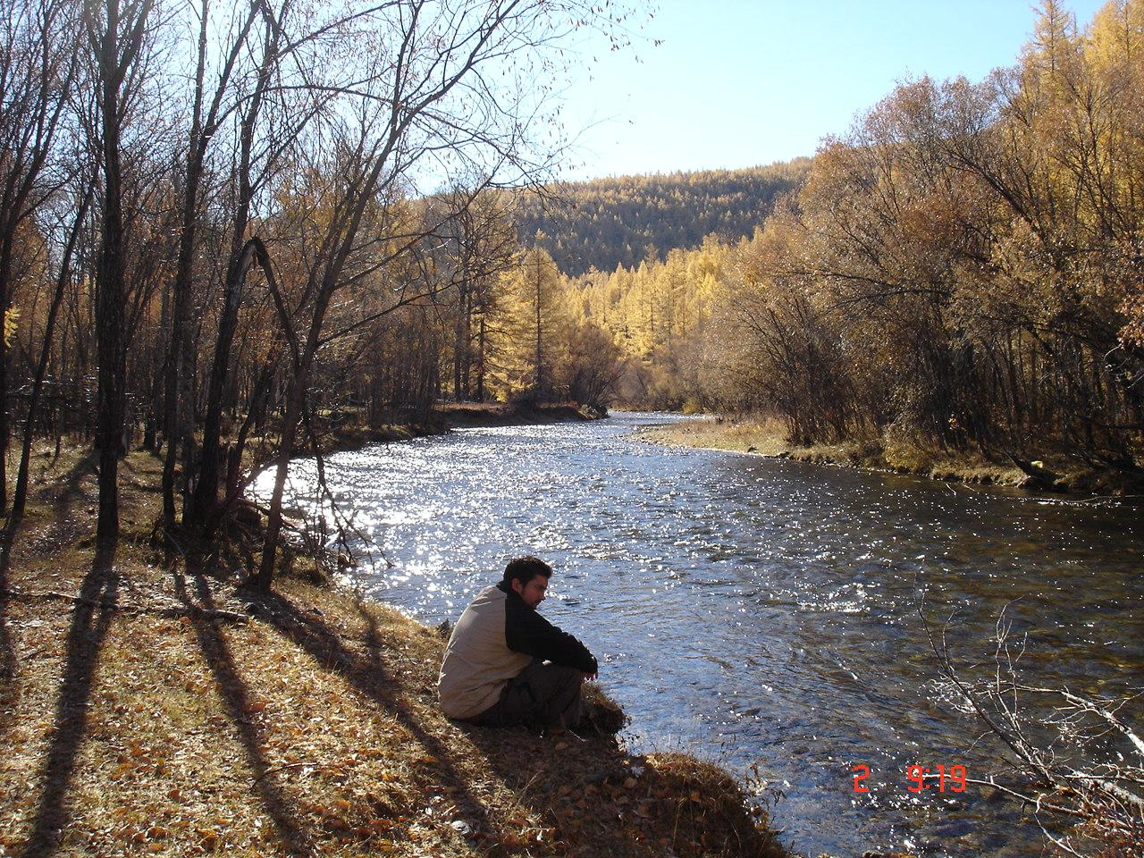
So, what about us?
In our search for answers, are we ever aided, though unaware, by angelic visitors?
Mormon:
And now, I say unto you, and I would that ye should remember, that God is merciful unto all those who believe on his name;
And now, he imparteth his word by angels unto men, yea, not only men but women also.
Now this is not all; little children do have words given unto them many times, which confound the wise and the learned… (Alma 32:22-23)

Slide 6
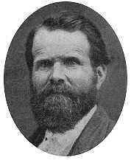
So, who might minister to us?
President Joseph F. Smith
…when messengers are sent to minister to the inhabitants of this earth, they are not strangers, but from the ranks of our kindred, friends, and fellow-beings and fellow-servants...
Our fathers and mothers, brothers, sisters and friends who have passed away from this earth, having been faithful, and worthy to enjoy these rights and privileges, may have a mission given them to visit their relatives and friends upon the earth again, bring from the divine Presence messages of love, of warning, or reproof and instruction, to those whom they had learned to love in the flesh.”
(Gospel Principles, p. 435)

Slide 7
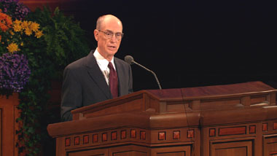
President Eyring
When we honor [the] priesthood, we have heavenly hosts and angels who are watching over us. Some of us know how literally that is true.
Some of us have an absolute assurance that those whom we have known who held the priesthood who are now part of that heavenly host are deeply aware of what we are doing and sometimes deeply concerned for the quality of our service. Making Covenants with God, BYU Devotional
Notes:
Making Covenants with God, BYU

Slide 8
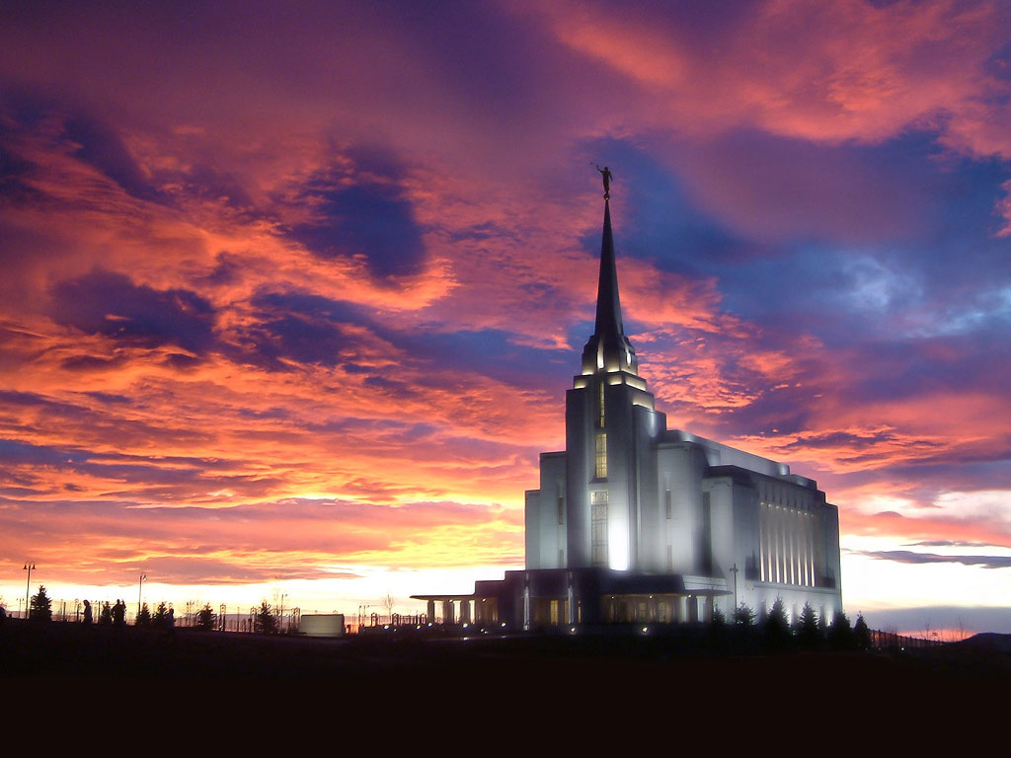
Unseen sentinels
Elder Featherstone
As the evil night darkens upon the this generation, we must come to the temple for light and safety. In our temples we find quiet, sacred havens where the storm cannot penetrate to us.
There are hosts of unseen sentinels watching over and guarding our temples. Angels attend every door. As it was in the days of Elisha so it will be for us, “those that be with us are more than they that be against us.”
There will be greater hosts of unseen beings in the temple. Prophets of old as well as those in this dispensation will visit the temples.
Those who attend will feel their strength and feel their companionship. We will not be alone in our temples. (Temple Statement for the Utah South Area, April 1987)

Slide 9
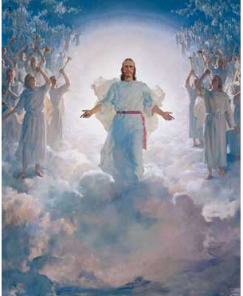
More Doctrine
D&C 130:1

Slide 10
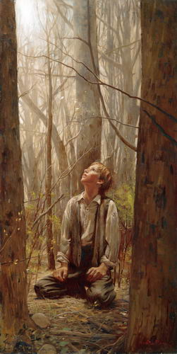
Interesting question…
Joseph Smith- Faith
First, the idea that he actually exists.
Secondly, a correct idea of his character, perfections, and attributes.
Thirdly, an actual knowledge that the course of life which he is pursuing is according to his will.
Lectures On Faith, Lecture 3rd

Slide 11
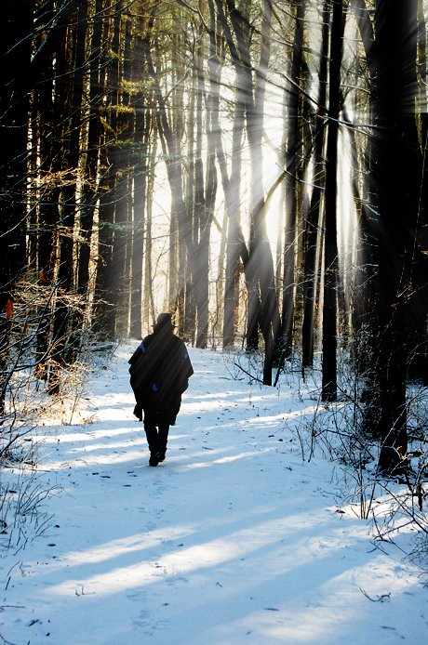
Elder CS Lewis
Every idea of Him we form,
He must in mercy shatter…

Slide 12
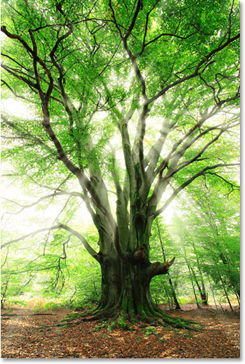
However, On a more personal level
Until we understand His True Nature
We may be trying to trust in a god of our own making

Slide 13
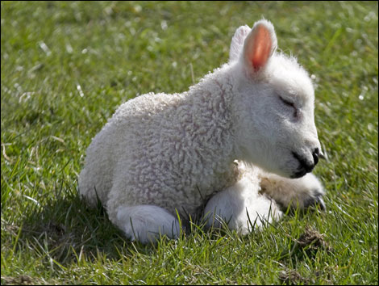
THE Law
D&C 130:18-21

Slide 14
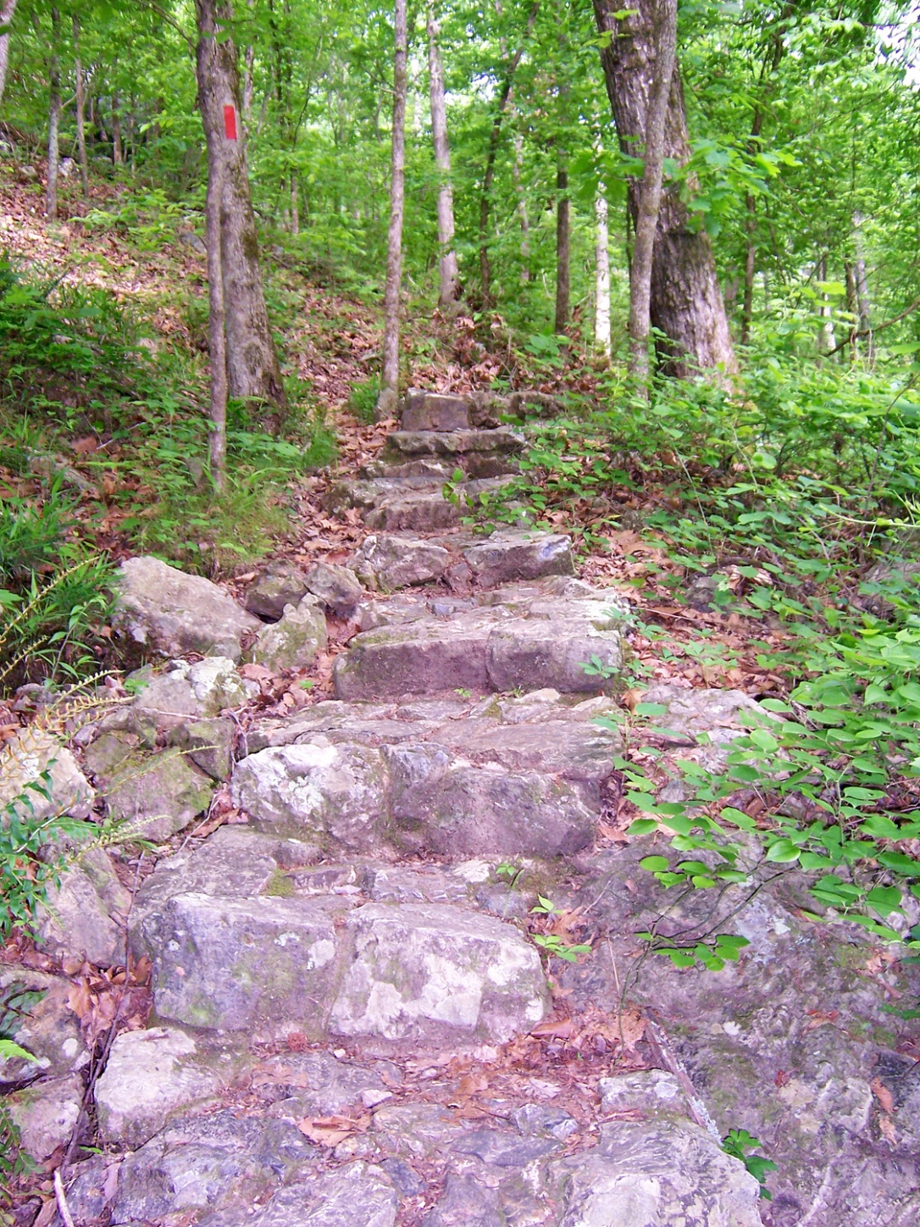
Neal A. Maxwell
Each of us might well ask, "In what ways am I shrinking or holding back?" Meek introspection may yield some bold insights!
For example, we can tell much by what we have already willingly discarded along the pathway of discipleship. It is the only pathway where littering is permissible, even encouraged.
In the early stages, the debris left behind includes the grosser sins of commission.
Later debris differs; things begin to be discarded which have caused the misuse or underuse of our time and talent.

