Slide 1
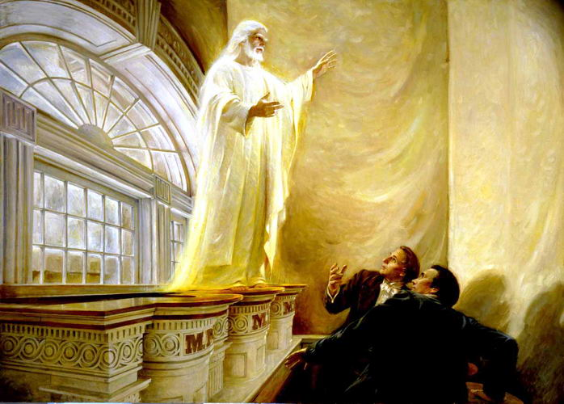
The Keys Section 110

Slide 2
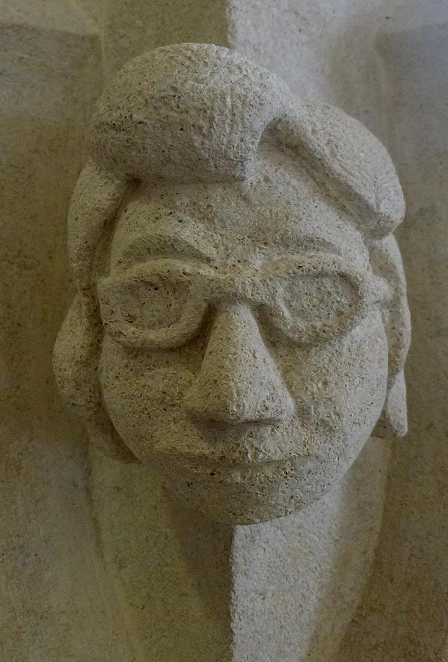
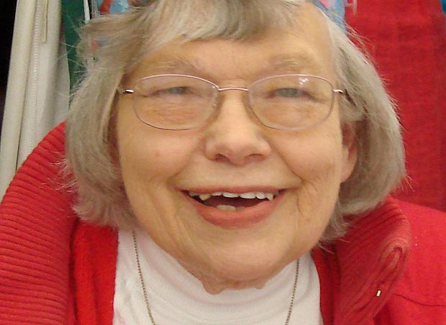
The Church Lady Gargoyle

Slide 3
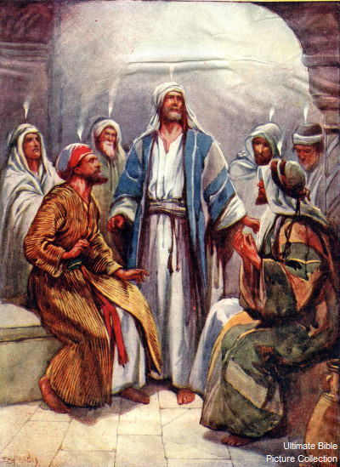
The Lord’s Way
1 Nephi 18:9
Ether 6:5
D&C 109:37

Slide 4
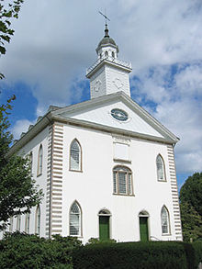
Season of Rejoicing
Section 110

Slide 5
Harold B. Lee
The spirit of gathering has been with the Church from the days of that restoration. Those who are of the blood of Israel, have a righteous desire after they are baptized, to gather together with the body of the Saints at the designated place. This, we have come to recognize, is but the breath of God upon those who are converted, turning them to the promises made to their fathers.
Thus, clearly, the Lord has placed the responsibility for directing the work of gathering in the hands of the leaders of the Church to whom he will reveal his will where and when such gatherings would take place in the future.
It would be well . . . before the frightening events concerning the fulfillment of all God's promises and predictions are upon us, that the Saints in every land prepare themselves and look forward to the instruction that shall come to them from the First Presidency of this Church as to where they shall be gathered and not be disturbed in their feelings until such instruction is given to them as it is revealed by the Lord to the proper authority.
CR 1948

Slide 6
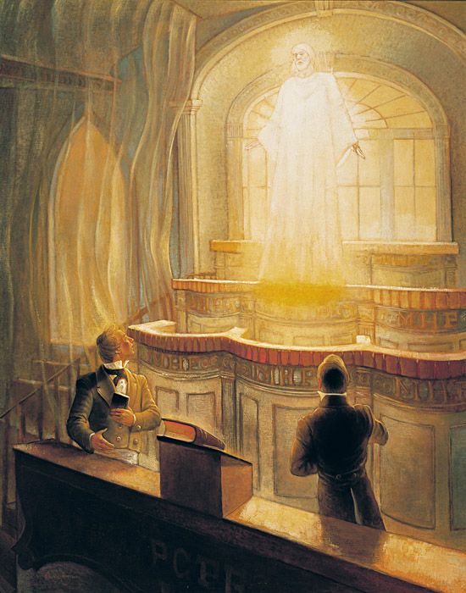
Keys Given
Savior
Accepts their sacrifice and His house
Moses
Keys of the Gathering of Israel
Elias
Keys of the Gospel of Abraham
Elijah
Keys of Sealing and Binding

Slide 7
13 Years Earlier- From Moroni
Behold, I will reveal unto you the Priesthood, by the hand of Elijah the prophet, before the coming of the great and dreadful day of the Lord
And he shall plant in the hearts of the children the promises made to the fathers,
And the hearts of the children shall turn to their fathers

Slide 8
Elder Boyd K. Packer
Some years ago, at the dedication of the temple in Buenos Aires, Argentina, Elder Boyd K. Packer said: "We are dedicating a monument to [the] resurrection and exaltation of the human family. If the outside world knew about what was happening here, the cars would stop, planes would not take off, and people would gather to see what the Lord hath wrought. This work we have a part in; it is cause for great rejoicing

