Slide 1
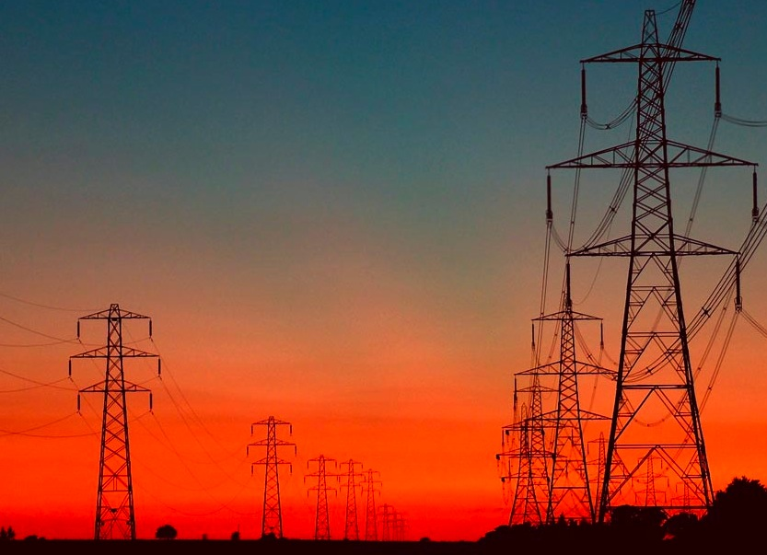
The Holy Order after the Son of God
Section 107

Slide 2
Elder Oaks
The direct, personal channel of communication to our Heavenly Father through the Holy Ghost is based on worthiness …
Similarly, we cannot communicate reliably through the direct, personal line if we are disobedient to or out of harmony with the priesthood line. …
Unfortunately, it is common for persons who are violating God’s commandments or disobedient to the counsel of their priesthood leaders to declare that God has revealed to them that they are excused from obeying some commandment or from following some counsel.
Such persons may be receiving revelation or inspiration, but it is not from the source they suppose.
Oct Conference, 2010

Slide 3
Section 107: The new 12 Apostles request a revelation
‘The time when we are about to separate is near; and when we shall meet again, God only knows;
we therefore feel to ask of him whom we have acknowledged to be our Prophet and Seer, that he inquire of God for us, and obtain a [written] revelation, (if consistent) that we may look upon it when we are separated, that our hearts may be comforted.
Our worthiness has not inspired us to make this request, but our unworthiness.
(HC 2:210, March 28, 1835.] (CR, April 1935, pp. 80-82.)

Slide 4
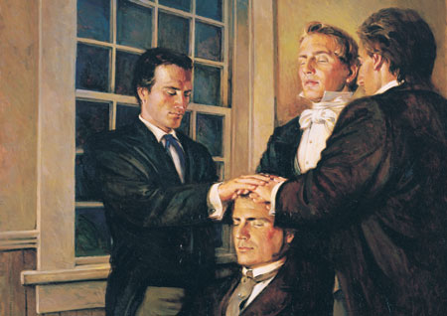
The Answer:
D&C 107: 1,2

Slide 5
Question:
Why aren’t men and women equal in the Mormon Church?

Slide 6
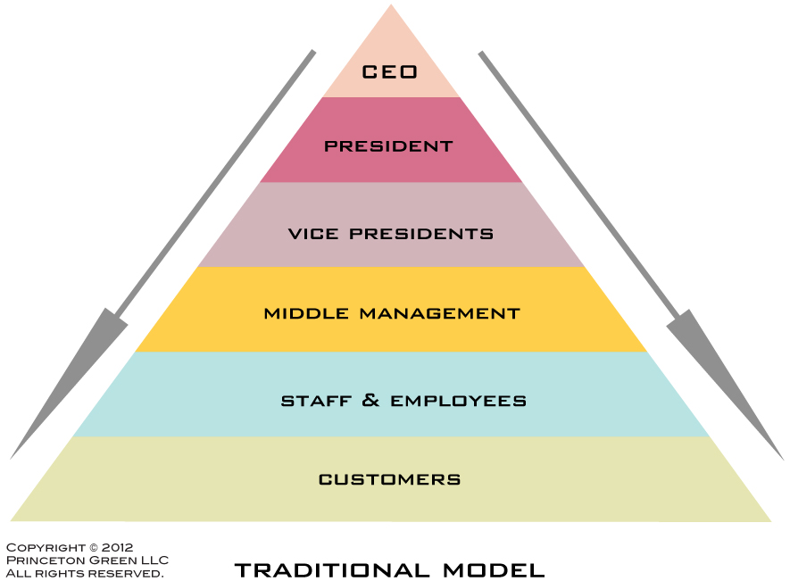

Slide 7
Elder Dallin H. Oaks
"While we sometimes refer to priesthood holders as 'the priesthood,' we must never forget that the priesthood is not owned by or embodied in those who hold it.
It is held in a sacred trust to be used for the benefit of men, women, and children alike."
(Ensign, May 1992, 36.)

Slide 8
Relief Society
Aaronic Priesthood
High Priests
Elders Quorum
Holy
Priesthood

Slide 9
Name and Symbol
D&C 107:3-5
JST Gen 14:25-40

Slide 10
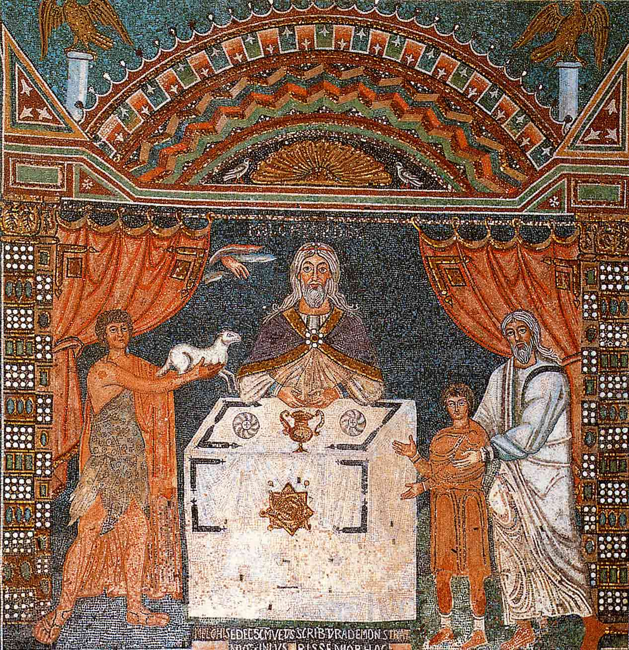

Slide 11
Power and Authority
D&C 107:18,19

Slide 12
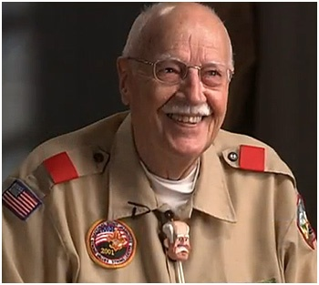
Finally- What is our Duty?
D&C 107:99,100

