Slide 1
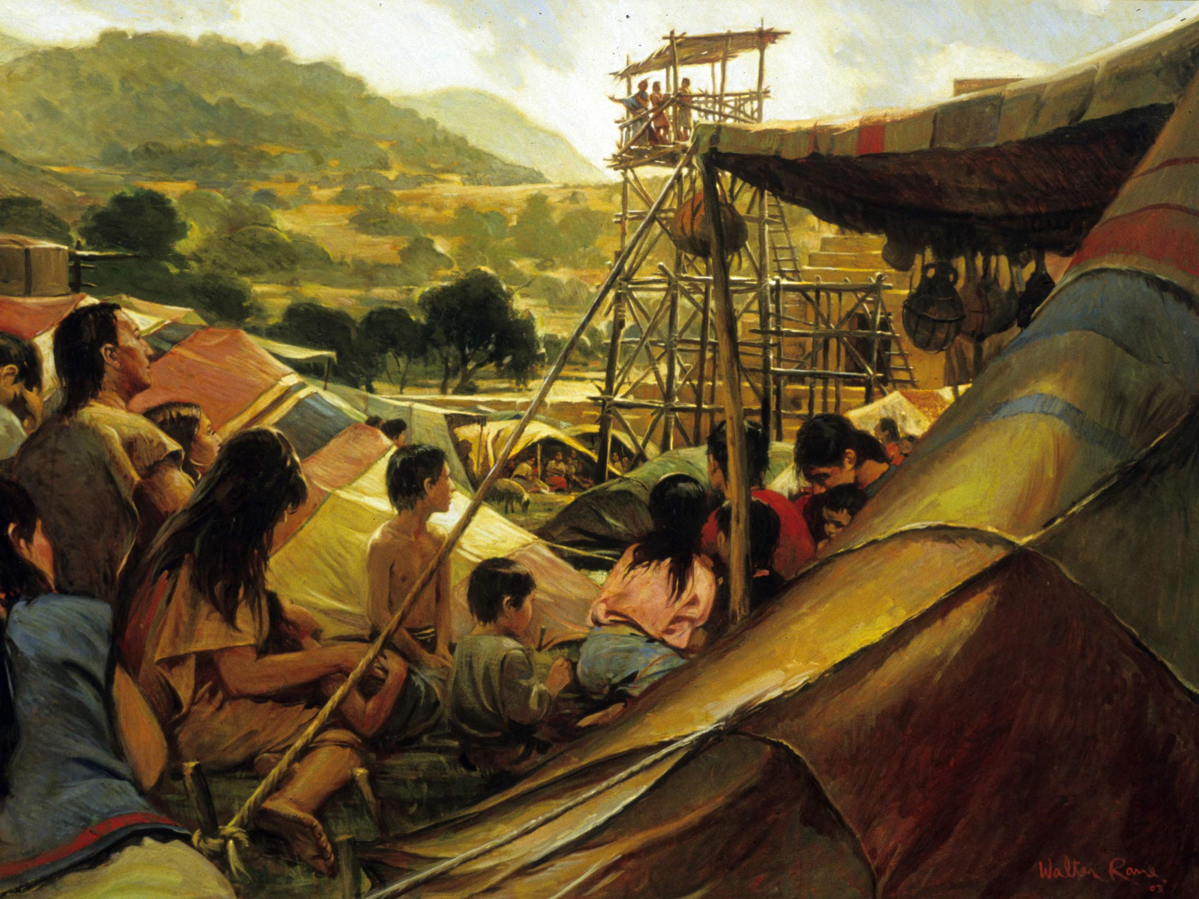
Creating a Holy People
King Benjamin part 2

Slide 2
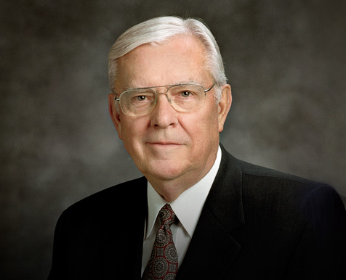
Elder Ballard
Last night — Friday night — Elder M. Russell Ballard, of the Council of the Twelve, delivered a fireside address to the seminary and institute teachers of the Church. What he had to say was striking, and very welcome.
He said, flatly, that earlier Church Education System curriculum was not adequate to today’s challenges from critical materials on the Internet, etc., and that it left our young people unprepared. They are no longer “sheltered.”
He repeatedly spoke about “inoculating” students against difficulties and faith crises by candidly approaching such specific, controversial issues as polygamy and past statements and practices regarding race.
He said that we can no longer dismiss issues by telling students “don’t worry about it,” or avoid grappling with challenges by merely bearing testimony.
He exhorted teachers to know the Church’s new “Gospel Topics” essays “like the back of your hand.”
He acknowledged his own reliance upon experts when his personal knowledge was inadequate to a topic, and he encouraged teachers to make use of solid scholarship in their teaching, and to be ready for honest, faithful discussions on difficult topics.

Slide 3
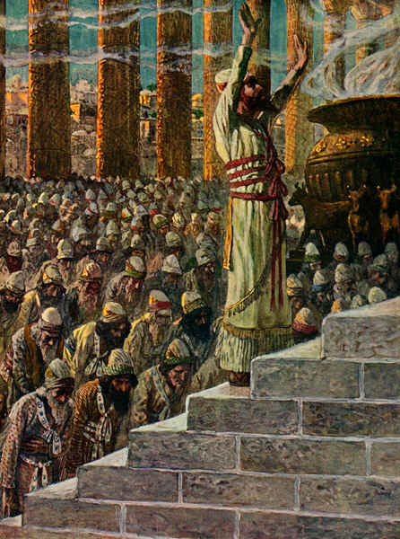
Temples
I Kings 8
29 That thine eyes may be open toward this house night and day, even toward the place of which thou hast said, My name shall be there:
46 If they sin against thee, (for there is no man that sinneth not,)
51 For they be thy people, and thine inheritance, which thou broughtest forth out of Egypt,
53 For thou didst separate them from among all the people of the earth, to be thine inheritance, as thou spakest by the hand of Moses thy servant, when thou broughtest our fathers out of Egypt, O Lord God.
if they shall bethink themselves in the land whither they were carried captives, and repent, …saying, We have sinned, and have done perversely, we have committed wickedness;
48 And so return unto thee with all their heart, and with all their soul,
58 That he may incline our hearts unto him, to walk in all his ways, and to keep his commandments, and his statutes,
66 On the eighth day he sent the people away: and they blessed the king, and went unto their tents joyful
Mosiah 2
11 And moreover, I shall give this people a name,
that thereby they may be distinguished above all the people which the Lord God hath brought out of the land of Jerusalem;
25 And now I ask, can ye say aught of yourselves? I answer you, Nay. Ye cannot say that ye are even as much as the dust of the earth; yet ye were created of the dust of the earth;
And they all cried aloud with one voice, saying: O have mercy, and apply the atoning blood of Christ that we may receive forgiveness of our sins, and our hearts may be purified;
15 But ye will teach [the children] to walk in the ways of truth and soberness; ye will teach them to love one another, and to serve one another.
he dismissed the multitude, and they returned, every one, according to their families, to their own houses.

Slide 4
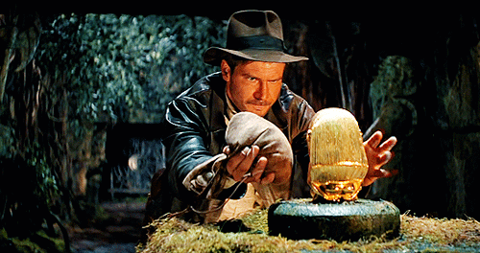
Two Important Keys #1: How to understand “The Mysteries”
Mosiah 2:9
…that you should hearken unto me,
and open your ears that you may hear (Listen)
And your hearts that ye may understand (Feel)
And your minds (Study)
That the mysteries of God may be unfolded to your view

Slide 5
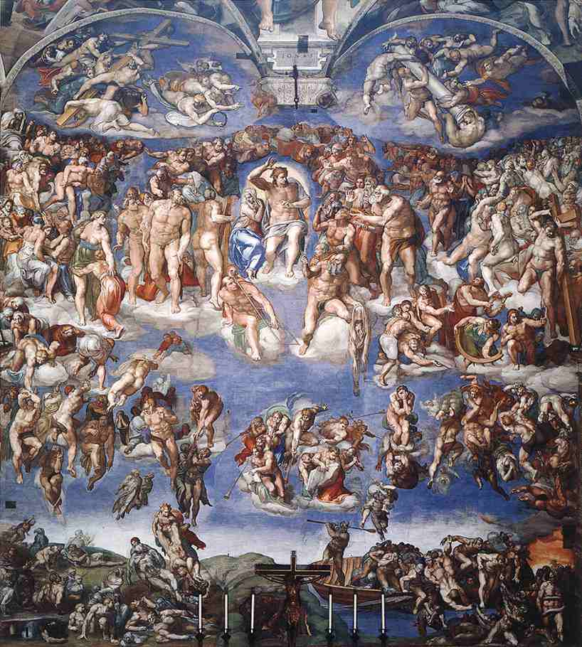
For Instance- one of the “mysteries”
Mosiah 2:38
D&C 19: 7-12

Slide 6
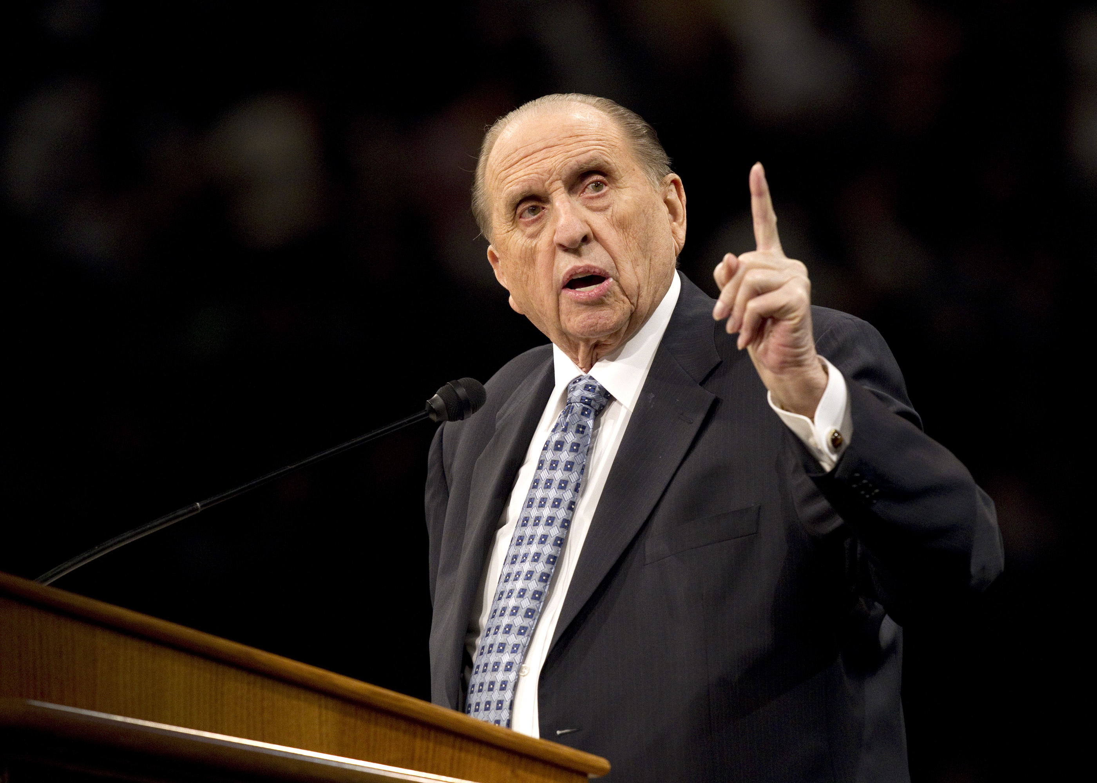
Two Important Keys #2: We learn from very mortal beings
Mosiah 2:10
I have not commanded you to come up hither that ye should fear me, or that ye should think that I of myself am more than a mortal man.
But I am like as yourselves, subject to all manner of infirmities in body and mind:
Yet I have been chosen by this people, and consecrated by my father….

Slide 7
Apostasy
Apostate Literalism:
During times of apostasy, religious leaders tend to turn gospel symbolism into literal observances.

Slide 8
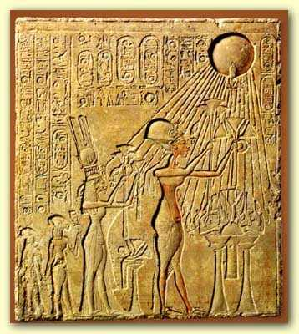
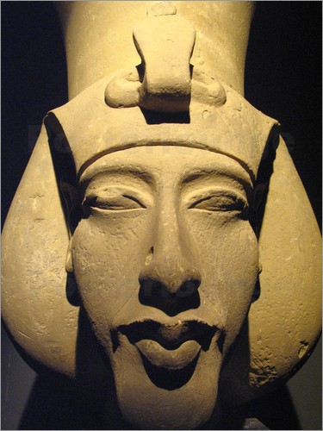

Slide 9
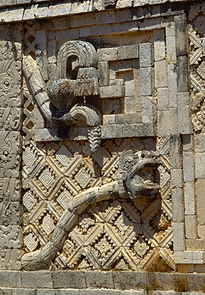
Gods?

Slide 10
Benjamin’s 5 Rules For Kings
Mosiah 2:13
Neither have I suffered that ye should… murder, or plunder, or steal, or commit adultery… or any manner of wickedness.
Alma 23:3 King of Lamanites tells his people that they “ought not to murder, nor to plunder, nor to steal, nor to commit adultery, nor to commit any manner of wickedness”
Alma 30:10 Alma disciplined those who “murdered…robbed…stole…committed adultery …yea for all the wickedness they were punished.”
Helaman 6:23 Past kings had sought to “murder, and plunder, and steal, and commit whoredoms, and all manner of wickedness, contrary to laws of their country and also the laws of their God

Slide 11
Promises Fulfilled
2 Nephi 10:1 And now I, Jacob, speak unto you again, my beloved brethren, concerning this righteous branch of which I have spoken.
2 For behold, the promises which we have obtained are promises unto us according to the flesh; wherefore, as it has been shown unto me that many of our children shall perish in the flesh because of unbelief, nevertheless, God will be merciful unto many;
and our children shall be restored, that they may come to that which will give them the true knowledge of their Redeemer.
3 Wherefore, as I said unto you, it must needs be expedient that Christ— for in the last night the angel spake unto me that this should be his name— should come among the Jews, among those who are the more wicked part of the world; and they shall crucify him—for thus it behooveth our God, and there is none other nation on earth that would crucify their God.
4 For should the mighty miracles be wrought among other nations they would repent, and know that he be their God.
Mosiah 3:2 And the things which I shall tell you are made known unto me by an angel from God. And he said unto me: Awake; and I awoke, and behold he stood before me.
3 And he said unto me: Awake, and hear the words which I shall tell thee; for behold, I am come to declare unto you the glad tidings of great joy.
4 For the Lord hath heard thy prayers, and hath judged of thy righteousness, and hath sent me to declare unto thee that thou mayest rejoice; and that thou mayest declare unto thy people, that they may also be filled with joy.
5 For behold, the time cometh, and is not far distant, that with power, the Lord Omnipotent who reigneth, who was, and is from all eternity to all eternity, shall come down from heaven among the children of men, and shall dwell in a tabernacle of clay, and shall go forth amongst men, working mighty miracles, such as healing the sick, raising the dead, causing the lame to walk, the blind to receive their sight, and the deaf to hear, and curing all manner of diseases.

Slide 12
Preparation for Baptism (The way)
Alma’s Waters of Mormon Address
and now, as ye are desirous to come into the fold of God, and to be called his people, and are willing to bear one another’s burdens, that they may be light;
9 Yea, and are willing to mourn with those that mourn; yea, and comfort those that stand in need of comfort, and to stand as witnesses of God at all times and in all things, and in all places that ye may be in, even until death, that ye may be redeemed of God, and be numbered with those of the first resurrection, that ye may have eternal life—
10 Now I say unto you, if this be the desire of your hearts, what have you against being baptized in the name of the Lord, as a witness before him that ye have entered into a covenant with him, that ye will serve him and keep his commandments, that he may pour out his Spirit more abundantly upon you?
11 And now when the people had heard these words, they clapped their hands for joy, and exclaimed: This is the desire of our hearts.
King Benjamin’s Address
And ye will not have a mind to injure one another, but to live peaceably. (Mo 4:13)
And…succor those that stand in need of our succor; ye will administer of your substance unto him that standeth in need; (Mos 4:14)
and are willing to enter into a covenant with our God to do his will. (Mo 5:5)
And they all cried with one voice saying: yea, we believe all the words which though hast spoken unto us… (Mo 5:2)

Slide 13
From the Angel
Mosiah 3:5 (from the angel to King Benjamin)
For behold, the time cometh, and is not far distant, that with power, the Lord Omnipotent who reigneth, who was, and is from all eternity to all eternity, shall come down from heaven among the children of men, and shall dwell in a tabernacle of clay,
and shall go forth amongst men, working mighty miracles, such as healing the sick, raising the dead, causing the lame to walk, the blind to receive their sight, and the deaf to hear, and curing all manner of diseases.
6 And he shall cast out devils, or the evil spirits which dwell in the hearts of the children of men.
7 And lo, he shall suffer temptations, and pain of body, hunger, thirst, and fatigue, even more than man can suffer, except it be unto death; for behold, blood cometh from every pore, so great shall be his anguish for the wickedness and the abominations of his people.
9 And lo, he cometh unto his own, that salvation might come unto the children of men even through faith on his name; and even after all this they shall consider him a man, and say that he hath a devil, and shall scourge him, and shall crucify him.
Mosiah 15:1
And now Abinadi said unto them: I would that ye should understand that God himself shall come down among the children of men, and shall redeem his people.
5 And thus the flesh becoming subject to the Spirit, or the Son to the Father, being one God, suffereth temptation, and yieldeth not to the temptation, but suffereth himself to be mocked, and scourged, and cast out, and disowned by his people.
6 And after all this, after working many mighty miracles among the children of men, he shall be led, yea, even as Isaiah said, as a sheep before the shearer is dumb, so he opened not his mouth.
7 Yea, even so he shall be led, crucified, and slain, the flesh becoming subject even unto death, the will of the Son being swallowed up in the will of the Father.

