Slide 1
They have eyes, and see not…
Jeremiah 5

Slide 2
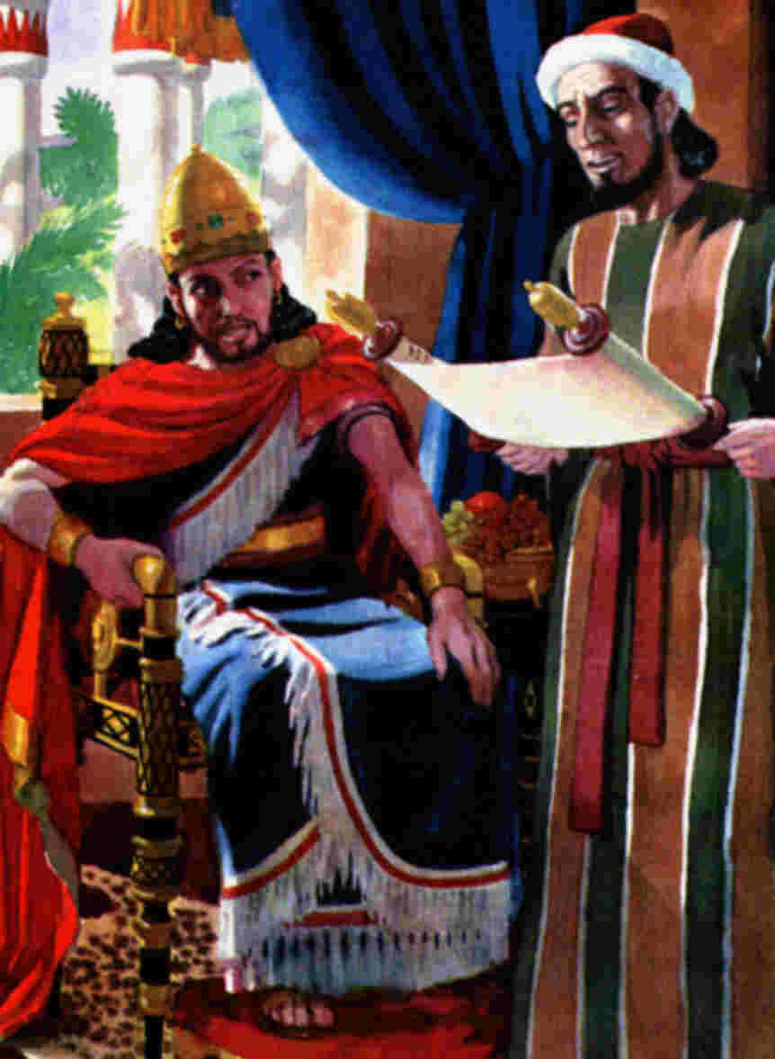
The Book is Found 2 Kings 22:8
Go up to Hilkiah the high priest, that he may sum the silver which is brought into the house of the Lord, which the keepers of the door have gathered of the people:
5 And let them deliver it into the hand of the doers of the work, that have the oversight of the house of the Lord: and let them give it to the doers of the work which is in the house of the Lord, to repair the breaches of the house,
8 ¶And Hilkiah the high priest said unto Shaphan the scribe, I have found the book of the law in the house of the Lord. And Hilkiah gave the book to Shaphan, and he read it.
10 And Shaphan the scribe shewed the king, saying, Hilkiah the priest hath delivered me a book. And Shaphan read it before the king.
11 And it came to pass, when the king had heard the words of the book of the law, that he rent his clothes.

Slide 3
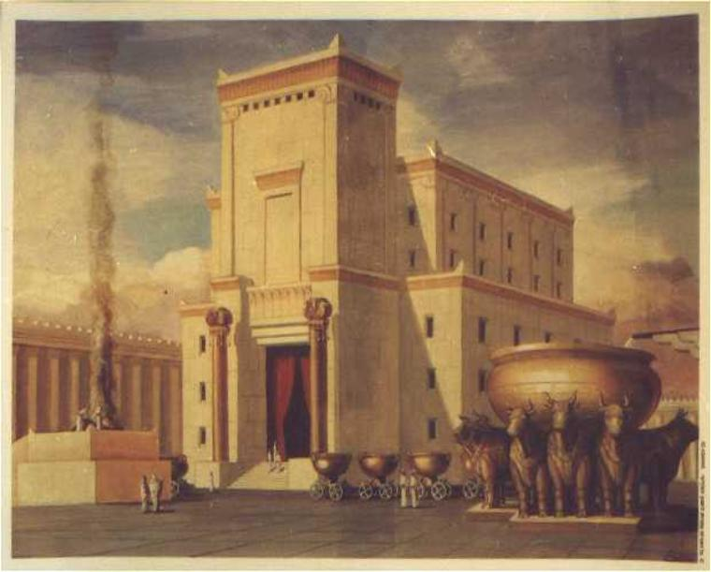
And Yet…
Jeremiah 7:4

Slide 4
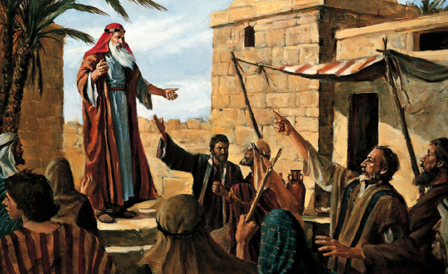
Blindness of the Jews
Jeremiah 5:21
Jacob 4:14
Helaman 8:17-20

Slide 5
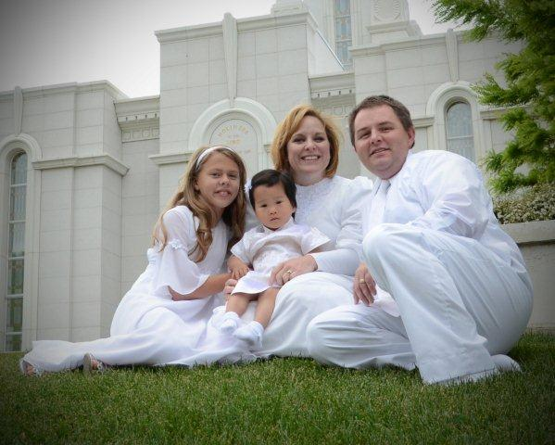
Poem
We are all blind, until we see
That in the [universal] plan
Nothing is worth the making if
It does not make the man.
Why build these [buildings] glorious,
If man unbuilded goes?
In vain we build the [world], unless
The builder also grows.
(“Ensign, May 2000)

Slide 6
Elder Neal A. Maxwell
Jacob speaks of ancient Judah as having rejected the words of its prophets...Intellectual embroidery seems to have been preferred to the whole clothing of the gospel-the frills to the fabric.
In fact, one can even surmise that complexity was preferred over plainness by some because in conceptual complexity there might somehow be escape, or excuse, for noncompliance and for failure. In any event, this incredible blindness which led to the rejection of those truths spoken by prophets and which prevented the recognition of Jesus for who he was, according to Jacob, came 'by looking beyond the mark.'
Those who look beyond plainness, beyond the prophets, beyond Christ, and beyond his simple teachings waited in vain then, as they will wait in vain now. For only the gospel of Jesus Christ teaches us of things as they really are and as they really will be.
Without revelation and its absolute anchors, The Church of Jesus Christ of Latter-day Saints would also follow the fads of the day, as some churches have done; but as Samuel Callan warned, the church that weds itself to the culture of the day will 'be a widow within each succeeding age.' This is but one of the marks of the 'true and living' Church: it is spared the fruits of faddism"
1981 Book of Mormon Institute Manual, p. 131

Slide 7
For a contrasting view… St. Hugh Nibley
Joseph Smith commends their (the Jews') intellectual efforts…to the Latter-day Saints, who lean too far in the other direction, giving their young people and old awards for zeal alone, zeal without knowledge--for sitting in endless meetings, for dedicated conformity and unlimited capacity for suffering boredom.
We think it more commendable to get up at five a.m. to write a bad book than to get up at nine o'clock to write a good one--that is pure zeal that tends to breed a race of insufferable, self-righteous prigs and barren minds. One has only to consider the present outpouring of 'inspirational' books in the Church that bring little new in the way of knowledge: truisms and platitudes, kitsch, and clichés have become our everyday diet.
The Prophet would never settle for that. 'I advise all to go on to perfection, and search deeper and deeper into the mysteries of Godliness. . . . It has always been my province to dig up hidden mysteries--new things--for my hearers.' It actually happens at the BYU, and that not rarely, that students come to a teacher, usually at the beginning of a term, with the sincere request that he refrain from teaching them anything new.
They have no desire, they explain, to hear what they do not know already! I cannot imagine that happening at any other school, but maybe it does. Unless we go on to other new things, we are stifling our powers." (Approaching Zion, p. 75)

Slide 8
Comfort and Healing
Jeremiah 8:18

Slide 9
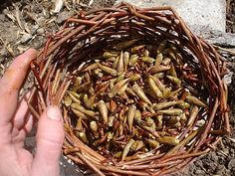
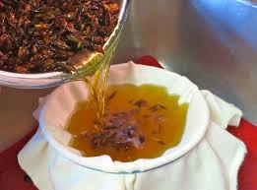
President Packer
In ancient times there came from Gilead, beyond the Jordan, an ointment made from the gum of a tree. It was a major commodity in trade. The Ishmaelite traders who purchased Joseph from his brothers were carrying this balm of Gilead to Egypt (see Gen. 37:25). It became symbolic for the power to soothe and to heal.
There is a Balm in Gilead, To make the wounded whole,
There is a Balm in Gilead, To heal the sin sick soul.
My message is an appeal to those who are not at peace, those whose lives are touched with bitterness, with hostility, or with resentment. It is a plea to those who anxiously struggle with worry, or with grief or disappointment, with guilt, or with shame.
We see so much unnecessary suffering, so many who cripple themselves spiritually carrying burdens which could be put down. Many suffer from real misfortune and injustice. Sadly, some only imagine that they do. In either case, self-inflicted penalties soon become cruel and unusual punishment.
(“Balm of Gilead,” Ensign, Nov. 1987,16)

