Slide 1
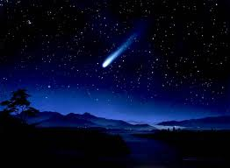
Eternity Was Our Covering…
Eternity Was Our Covering

Slide 2
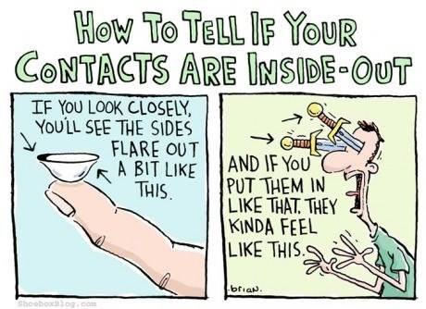
Token Humor To Make Sure We Do Today’s Class Right!

Slide 3
News of the Week?

Slide 4
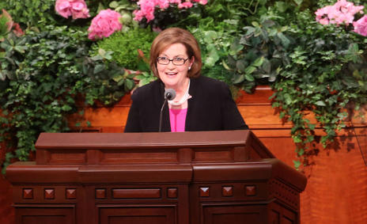
General Relief Society Conference
Keeping our covenants was the theme.
Imagine that!
We will be talking about the Abrahamic
Covenant today ☺
But first, a warning:

Slide 5
We will be likening the scriptures about Abraham to ourselves today
Likening the scriptures to our personal lives helps us discover gospel principles and receive revelation.
Nephi testified, “I did liken all scriptures unto us, that it might be for our profit and learning” (1 Nephi 19:23).
Even though the scriptures were written long ago, they provide inspiration for our modern-day dilemmas when we learn to liken them to ourselves.
Ensign, March 2009

Slide 6
How Can I Liken the Scriptures to My Own Life?
Compare scriptural events to our own lives
Find the principal being taught
Insert your name

Slide 7
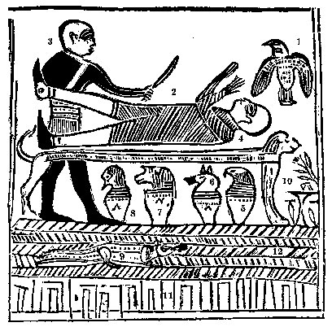
How Can I Liken This to Me?

Slide 8
CLUES:
Do I allow myself to be bound to any idolatrous altars? (My computer, my bed, my favorite store)
Do I have other gods that I worship daily?
(i.e., the god of Pinterest)
Am I aware that the Angel of the Lord is ready and waiting to help me when I finally want to make my escape?

Slide 9
Now, try it with an actual scripture!
Go to the Pearl of Great Price
Find Abraham Chapter 1
Verses 1 & 2
Insert your own name
Your own place of birth, perhaps
Use your own life events
Insert the goals you hoped to achieve
Tell the outcome, if there has been one
If you are a brave soul, share it with the class!

Slide 10
Introducing Abram…
Genesis 12
Verses 1-3
Now, the Lord had said unto Abram…
Why?
Here’s the rest of the story:
Abraham 1
Verses 1-7
Verses 15-19

Slide 11
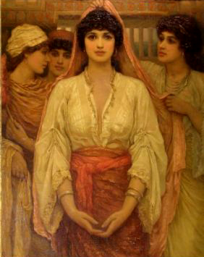
So, Abram leaves Ur of the Chaldees
He takes his wife, the lovely Sarai.

Slide 12
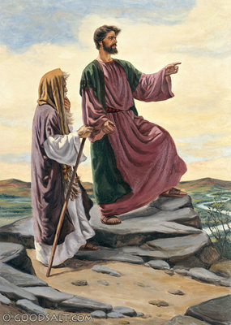
And his nephew Lot, and his wife

Slide 13
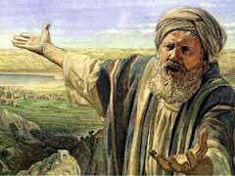
And his father, Terah, follows after them…

Slide 14
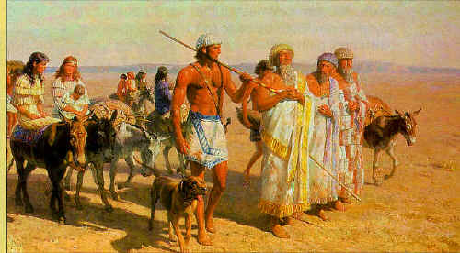
And the adventure began

Slide 15
Let’s back up—What do we know about Abram?
He was a descendant of Shem, the son of Noah.
At some time between Shem and Terah, Abram’s family became apostate.
His father was an idolater and sought to have him sacrificed.
You could say he came from a dysfunctional family…
Why are we studying about this man?

Slide 16
Even more:
He seemed to have no permanent home.
With no roof overhead, he said that “Eternity
was their covering.”
They traveled from Ur of the Chaldees in Iraq,
to Haran in Turkey, approximately 700 miles.
After spending time in Haran, they packed up again and went to claim their promised land in Canaan, 400 miles away, which was…

Slide 17
…Uninhabitable because of a terrible drought.
So, they packed up (again) and moved to Egypt, where they experienced fear, uncertainty and terror while Sarai lived in Pharaoh’s home and Abram lived the life of a bachelor. They were, however, able to eat, and Abram eventually became a very wealthy man, and then they were sent packing again, back to Canaan.
SO, WHY ARE WE STUDYING ABOUT THIS SEEMINGLY NOMADIC MAN
THAT SOME HAVE THOUGHT OF AS A LIAR AND A COWARD?

Slide 18
Abraham? A Coward???

Slide 19
The Actions and Works of Abraham Were Inspired by God.
The Lord told Abraham He would lead him by the hand. (Abraham 1:18)
Why did he leave Ur? (Genesis 12:1)
Why did he leave Haran? (Abraham 2:6)
Why did he tell the Egyptians that Sarai was his sister? Abraham 2:22)
Why did Abram accept Hagar from Sarai?
(D&C 132:34-35

Slide 20
THIS IS WHY:
ABRAHAM 1: 28-31
AND
ABRAHAM 2: 8-11

Slide 21
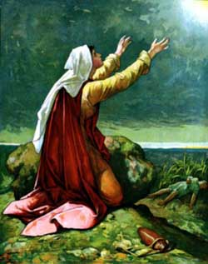
Thou, God, Seest Me! What Might This Mean To Us?
Genesis 16
Don’t be too hard on Hagar. We don’t
really know what her life had been like
up until this point in time, and
pregnancy can complicate a lot of
thoughts and emotions.
I would like to give her the benefit of
the doubt. After all, an angel did appear
To comfort and instruct her in her
distress!

Slide 22
Finally, after a long life of seeking the Lord, Abram becomes “Abraham.”
At 90 years old, Abram is commanded to be perfect. (Genesis 17:1)
He is given the covenant of circumcision (Genesis 17:2-13
The Lord changes Abram’s name to Abraham. Sarai’s name to Sarah, and reveals the coming birth of Isaac. (Genesis 17:
Circumcises himself, Ishmael and his household. (Genesis 17:23-27)

Slide 23
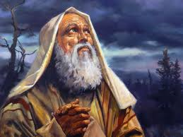
Thy Servant Has Sought Thee Earnestly; Now I Have Found Thee
Abraham 2: 13
This statement could sum up Abraham’s daily walk: always seeking and having faith that he will be found of the Lord.
What an example for us to follow!

