Slide 1
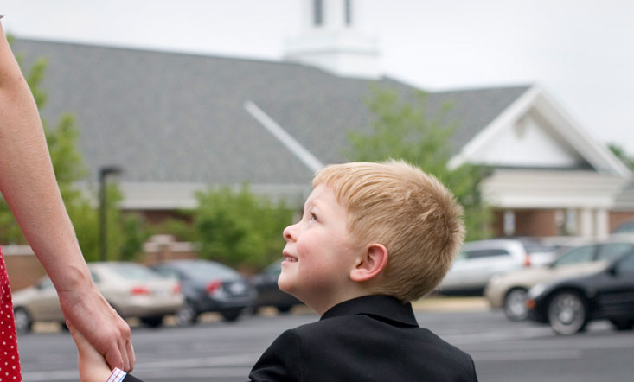
Sermon on the Mount- Meek-Being

Slide 2
True Story…
This is what I received from a client who was 1) sending me a voice text as she was driving, was 2) also listening to a recent General Conference talk and was 3) following GPS directions to my office:
I’m almost there and
As our body is the instrument of our spirit, it is vital that we-
Turn left onto Custer Road….

Slide 3
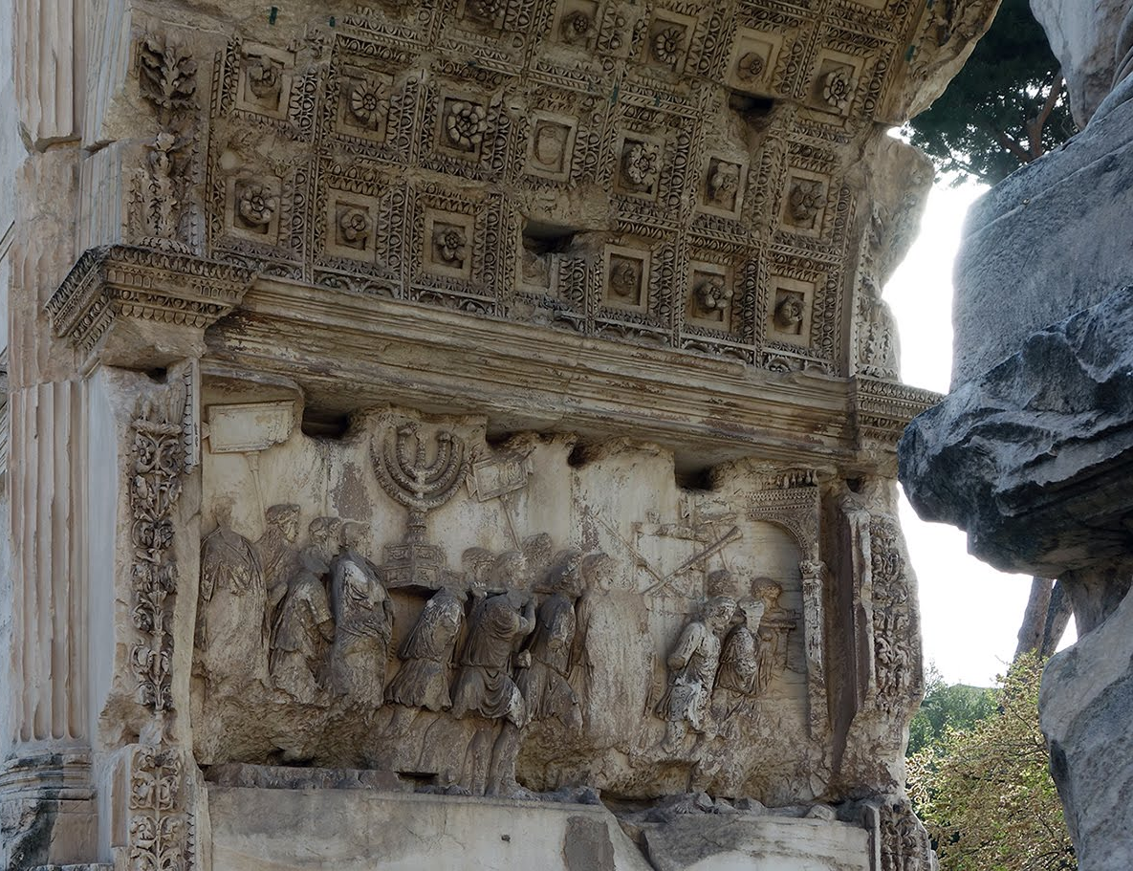
Book of Matthew In Context
Most scholars agree that the Book of Mark was written first, to the Gentiles, around 70 AD
The Book of Matthew was probably written after that; probably in response to the Book of Mark; and may have been writing to the Jews after the fall of Jerusalem.
Thus, to the Jews in diaspora, in exile.

Slide 4
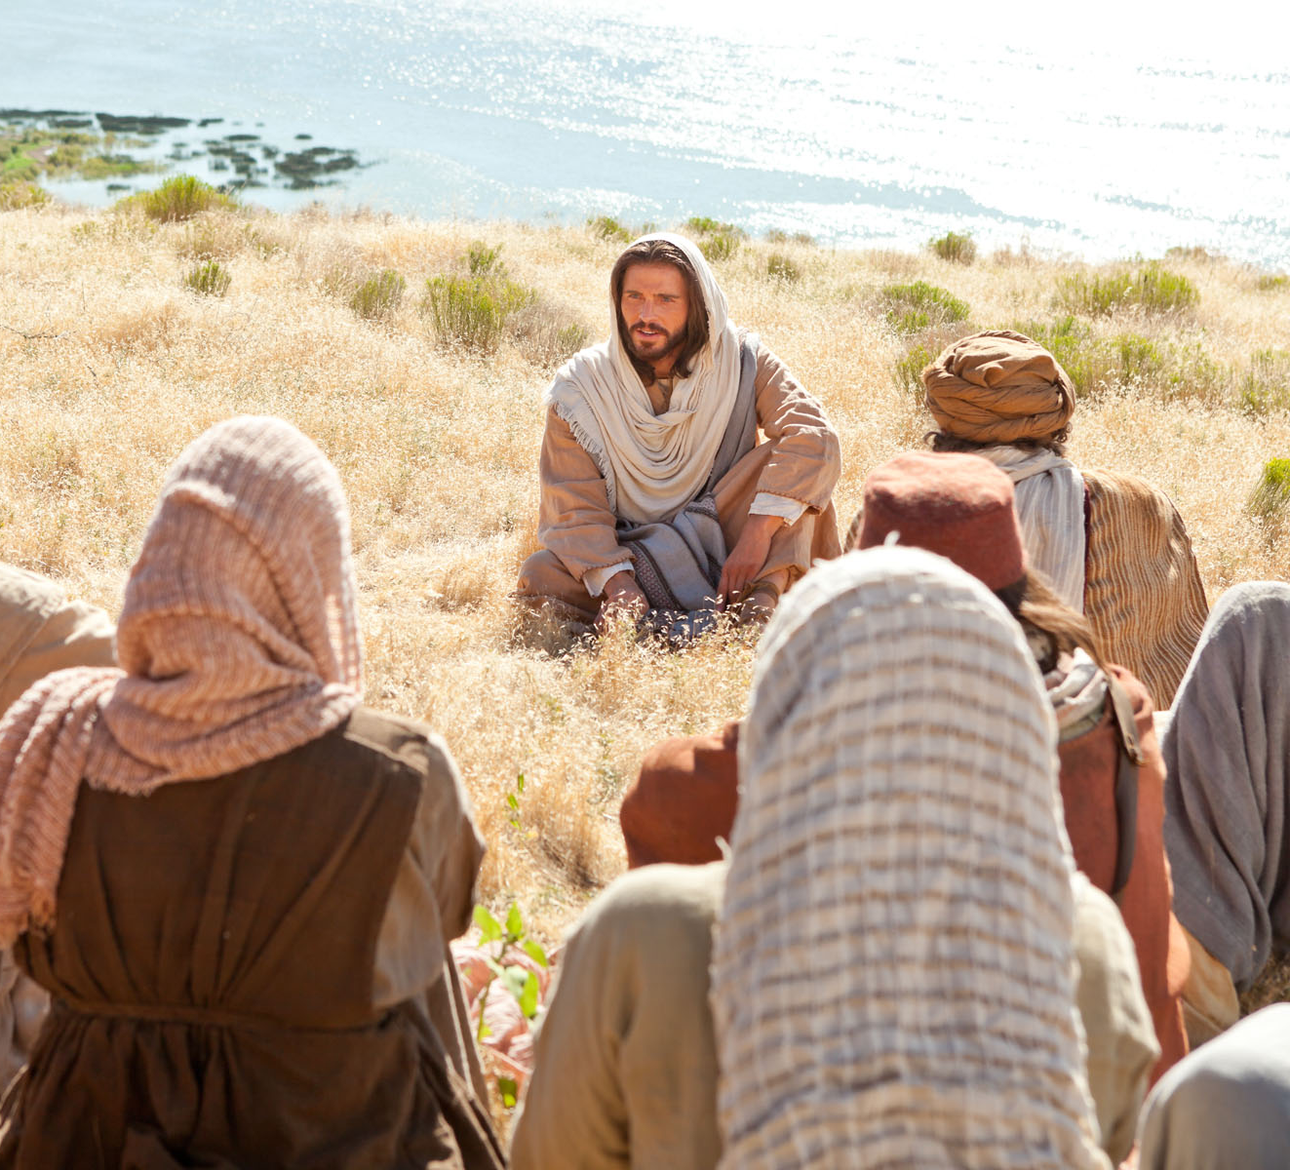
Sermon on the Mount- and Relationships
Matthew 5

Slide 5
Meekness and Peacemaking:
Is not:
Is not avoidance
Is not passive or passive-aggressive.
Is not withdrawal and silence
Is:
Recognizing and respecting different viewpoints
Seeking shared beliefs
Collaborating to find solutions
Warm and proactive.

Slide 6
Conflict-Avoidant? Or Contention Avoidant?

Slide 7
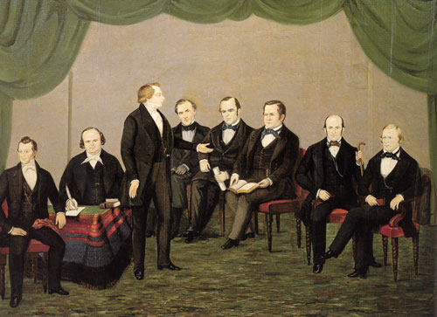
Council of 50
Council members believed they had an obligation to offer candid commentary on issues presented before the council and that their collective deliberations would lead them to correct decisions.
From the beginning of the council, Joseph Smith urged participants to “speak their minds” and “to say what was in their hearts whether good or bad.”
He said he “did not want to be forever surrounded by a set of ‘dough heads’ [unintelligent people] and if they did not rise up and shake themselves and exercise themselves in discussing these important matters he should consider them nothing better than ‘dough heads.’
(LDS.org/Council of 50)

Slide 8
Luke’s Powerful Rewrite
Matthew 5
43 ¶ Ye have heard that it hath been said, Thou shalt love thy neighbour, and hate thine enemy.
44 But I say unto you, Love your enemies, bless them that curse you, do good to them that hate you, and pray for them which despitefully use you, and persecute you;
48 Be ye therefore perfect, even as your Father which is in heaven is perfect.

Slide 9
17 ¶ And he came down with them, and stood in the plain, and the company of his disciples, and a great multitude of people out of all Judæa and Jerusalem, and from the sea coast of Tyre and Sidon, which came to hear him, and to be healed of their diseases;
19 And the whole multitude sought to touch him: for there went virtue out of him, and healed them all.
20 ¶ And he lifted up his eyes on his disciples, and said,

Slide 10
Luke’s Powerful Rewrite
Matthew 5
43 ¶ Ye have heard that it hath been said, Thou shalt love thy neighbour, and hate thine enemy.
44 But I say unto you, Love your enemies, bless them that curse you, do good to them that hate you, and pray for them which despitefully use you, and persecute you;
48 Be ye therefore perfect, even as your Father which is in heaven is perfect.
Luke 6
35 But love ye your enemies, and do good, and lend, hoping for nothing again; and your reward shall be great, and ye shall be the children of the Highest: for he is kind unto the unthankful and to the evil.
36 Be ye therefore merciful, as your Father also is merciful.
37 Judge not, and ye shall not be judged: condemn not, and ye shall not be condemned: forgive, and ye shall be forgiven:

Slide 11
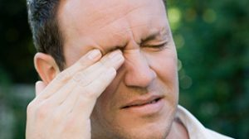
Luke’s Narrative
37 Judge not, and ye shall not be judged: condemn not, and ye shall not be condemned: forgive, and ye shall be forgiven:
38 Give, and it shall be given unto you; good measure, pressed down, and shaken together, and running over, shall men give into your bosom. For with the same measure that ye mete withal it shall be measured to you again.
39 And he spake a parable unto them, Can the blind lead the blind? shall they not both fall into the ditch?
40 The disciple is not above his master: but every one that is perfect (merciful) shall be as his master.
41 And why beholdest thou the mote that is in thy brother’s eye, but perceivest not the beam that is in thine own eye?
42 Either how canst thou say to thy brother, Brother, let me pull out the mote that is in thine eye, when thou thyself beholdest not the beam that is in thine own eye? Thou hypocrite, cast out first the beam out of thine own eye, and then shalt thou see clearly to pull out the mote that is in thy brother’s eye.

Slide 12
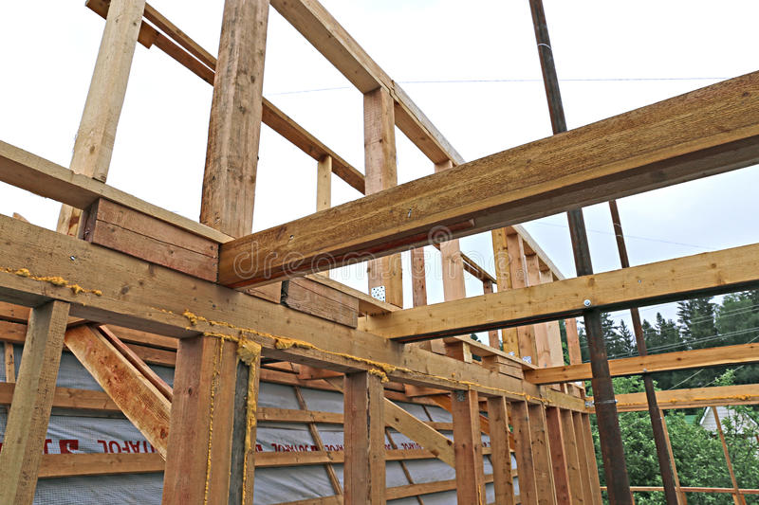
Baggage Beams
Our Emotions
Our Capabilities
Our Gifts
Our Past
Our Body Shape

Slide 13
The Moral of the Story?
Peacemakers are in the Mote Removal business!

Slide 14
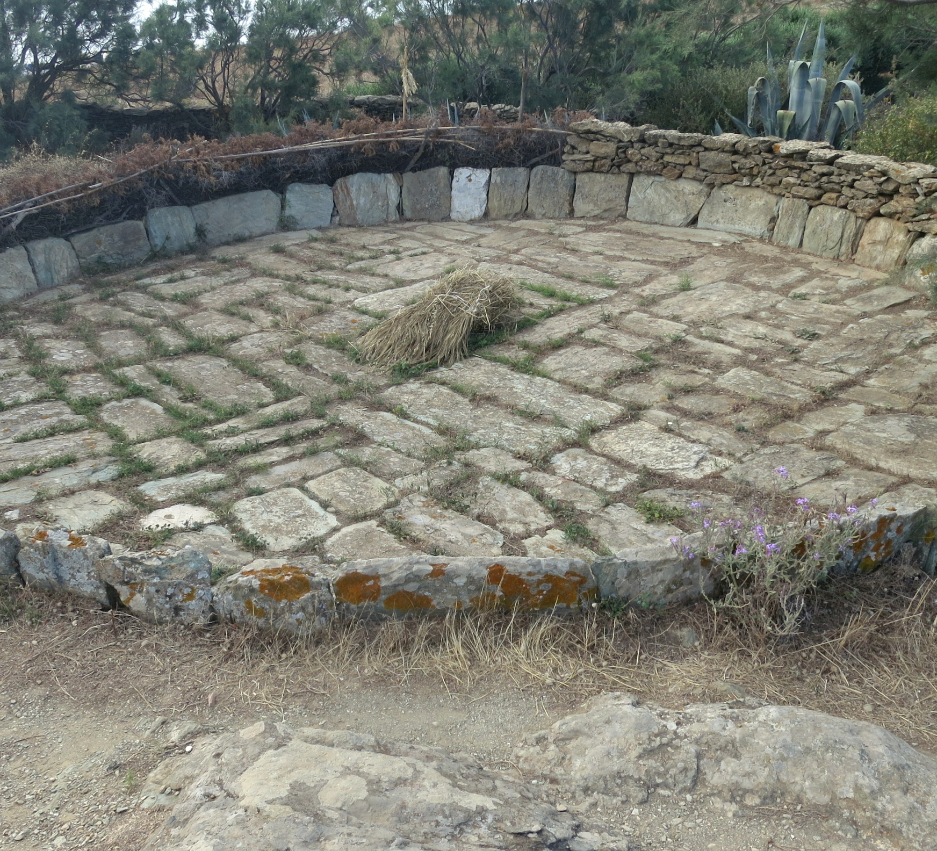
David
2 Samuel 24:16

Slide 15
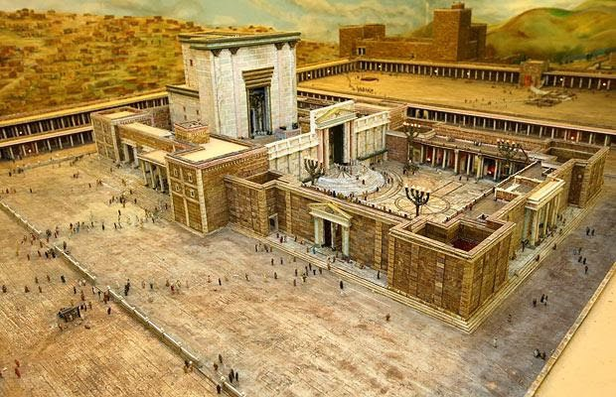
16 And when the angel stretched out his hand upon Jerusalem to destroy it, the Lord [felt sorrow] of the evil, and said to the angel that destroyed the people, It is enough: stay now thine hand.
And the angel of the Lord was by the threshingplace of Araunah the Jebusite.
18 ¶ And Gad came that day to David, and said unto him, Go up, rear an altar unto the Lord in the threshingfloor of Araunah the Jebusite.

Slide 16
Hugh Nibley
The gospel of repentance is a constant reminder that the most righteous are still being tested and may yet fall, and that the most wicked are not yet beyond redemption and may still be saved.
And that is what God wants: "Have I any pleasure at all that the wicked should die?" (Ezekiel 18:23).
There are poles for all to see, but in this life no one has reached and few have ever approached either pole, and no one has any idea at what point between his neighbor stands. Only God knows that..
(Collected Works of Hugh Nibley, Vol.8, Ch.20, p.461 - p.462).

Slide 17
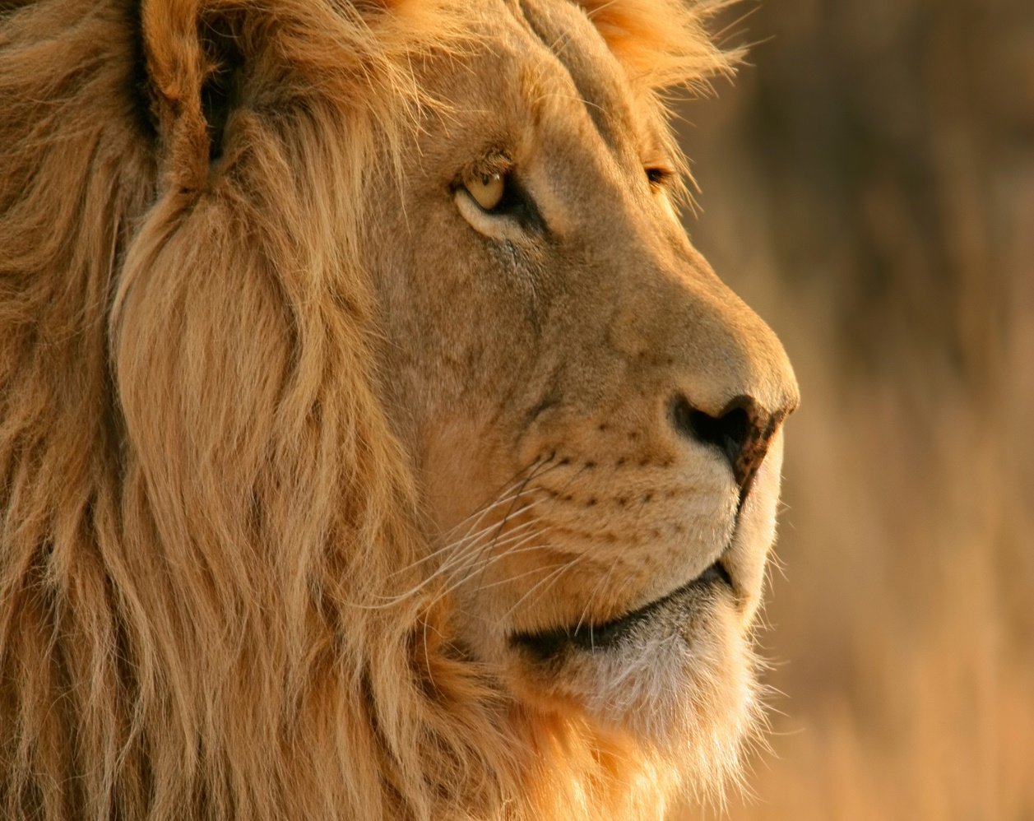
Elder CS Lewis
“Although the sight of water made her feel ten times thirstier than before, she didn’t rush forward and drink. She stood as still as if she had been turned into stone, with her mouth wide open. And she had a very good reason; just on this side of the stream lay the lion.
It lay with its head raised and its two fore-paws out in front of it, like the lions in Trafalgar Square. She knew at once that it had seen her, for it eyes looked straight into hers for a moment and then turned away– as if it knew her quite well and didn’t think much of her.
‘If I run away, it’ll be after me in a moment,’ thought Jill. ‘And if I go on, I shall run straight into its mouth.’ Anyway, she couldn’t have moved if she had tried, and she couldn’t take her eyes off it.
How long this lasted, she could not be sure; it seemed like hours. And the thirst became so bad that she almost felt she would not mind being eaten by the lion if only she could be sure of getting a mouthful of water first.
‘If you’re thirsty, you may drink.’
…For a second she stared here and there, wondering who had spoken. Then the voice said again, ‘If you are thirsty, come and drink,’ and she…realized that it was the lion speaking.

Slide 18
Elder CS Lewis
Anyway, she had seen its lips move this time, and the voice was not like a man’s. It was deeper, wilder, and stronger; a sort of heavy, golden voice. It did not make her any less frightened than she had been before, but it made her frightened in a rather different way.
‘Are you not thirsty?’ said the Lion.
‘I’m dying of thirst,’ said Jill
‘Then drink,’ said the Lion.
‘May I—could I—would you mind going away while I do?’ said Jill.
The Lion answered this only by a look and a very low growl. And as Jill gazed at its motionless bulk, she realized that she might as well have asked the whole mountain to move aside for her convenience. The delicious rippling noise of the stream was driving her nearly frantic.
‘Will you promise not to—do anything to me, if I do come?’ said Jill.
‘I make no promise,’ said the Lion.

Slide 19
Elder CS Lewis
‘Do you eat girls?’ she said.
‘I have swallowed up girls and boys, women and men, kings and emperors, cities and realms,’ said the Lion. It didn’t say this as if it were boasting, nor as if it were sorry, nor as if it were angry. It just said it.
‘I daren’t come and drink,’ said Jill.
‘Then you will die of thirst,’ said the Lion.
‘Oh dear!’ said Jill, coming another step nearer. ‘I suppose I must go and look for another stream then.’
‘There is no other stream,’ said the Lion.”

