Slide 1
Extending Forgiveness

Slide 2
Joseph F. Smith
Jesus had not finished his work when his body was slain, neither did he finish it after his resurrection from the dead, although he had accomplished the purpose for which he then came to the earth, he had not fulfilled all his work.
And when will he? Not until he has redeemed and saved every son and daughter of our father Adam that has or ever will be born upon this earth to the end of time, except the sons of perdition.”
Discourses, G.D.Watt, 1851-1886

Slide 3
J. Reuben Clark
We do not “seal our eternal progress by what we do here. It is my belief that God will save all of His children that he can: and while, if we live unrighteously here, we shall not go to the other side in the same status, so to speak, as those who lived righteously;
nevertheless, the unrighteous will have their chance, and in the eons of the eternities that are to follow, they, too, may climb to the destinies to which they who are righteous and serve God, have climbed.”
Church News, 23 April, 1960, 3

Slide 4
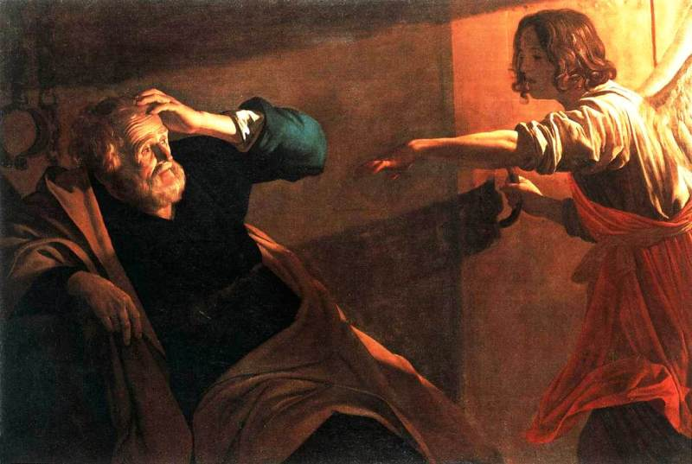
Acts 12
1 Now about that time Herod the king stretched forth his hands to vex certain of the church.
2 And he killed James the brother of John with the sword.
5 Peter therefore was kept in prison: but prayer was made without ceasing of the church unto God for him.
6 And when Herod would have brought him forth, the same night Peter was sleeping between two soldiers, bound with two chains: and the keepers before the door kept the prison.
7 And, behold, the angel of the Lord came upon him, and a light shined in the prison: and he smote Peter on the side, and raised him up, saying, Arise up quickly. And his chains fell off from his hands.

Slide 5
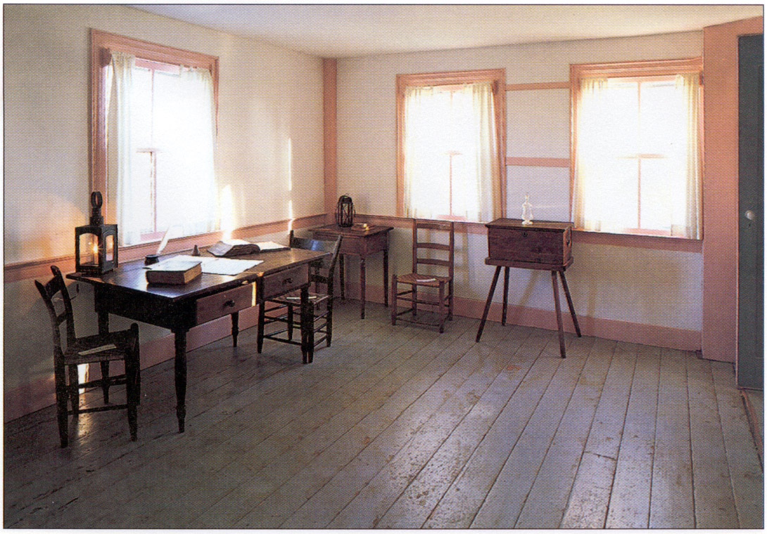
The Vision Feb 16th
D&C 76

Slide 6
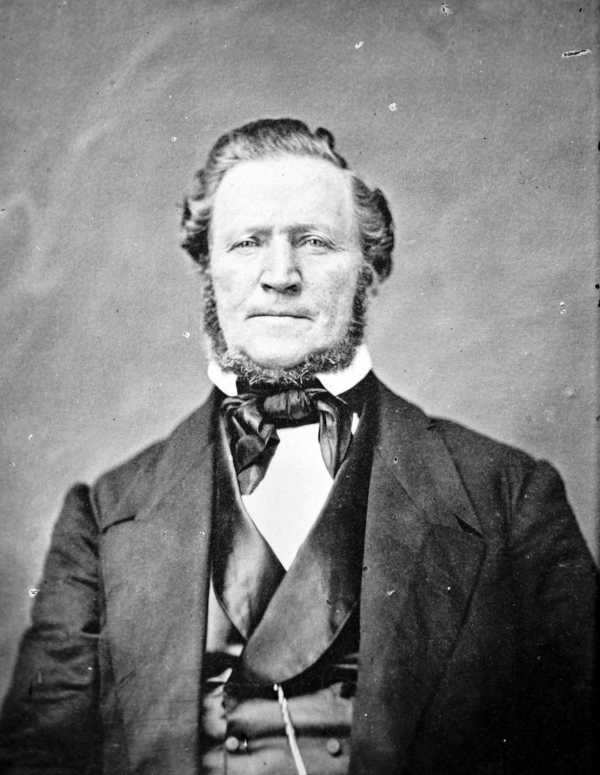
Reactions
Brigham Young recalled: “When God revealed to Joseph Smith and Sidney Rigdon that there was a place prepared for all, according to the light they had received and their rejection of evil and practice of good, it was a great trial to many,
and some apostatized because God was not going to send to everlasting punishment heathens and infants, but had a place of salvation, in due time, for all, and would bless the honest and virtuous and truthful, whether they ever belonged to any church or not. It was a new doctrine to this generation, and many stumbled at it” (JD, 16:42).

Slide 7
And even in England
Joseph Smith’s instructions to the first missionaries in England were, “To adhere closely to the first principles of the Gospel, and remain silent concerning the gathering, the vision, and the Book of Doctrine and Covenants, until such time as the work was fully established, and it should be clearly made manifest by the Spirit to do otherwise.”
One of those early missionaries to England was Joseph Fielding, who had been born in England. He approached a relative, Timothy Matthews, who was the minister of a church. When Joseph explained to him that he was now a missionary from America with a gospel to preach, Timothy Matthews was excited to hear it, so he invited the missionaries to preach in his church after regular Sabbath services and during the week.
Joseph Smith’s history records: “The Elders at Bedford continued to lecture in the basement of Mr. Matthews’ chapel from evening to evening, with the most flattering prospects until this evening, when Elder [John] Goodson, contrary to the most positive instructions of President Kimball [Heber C. Kimball], and without advising with any one, read publicly the vision from the Doctrine and Covenants, which turned the current of feeling generally, and nearly closed the door in all that region.”

Slide 8
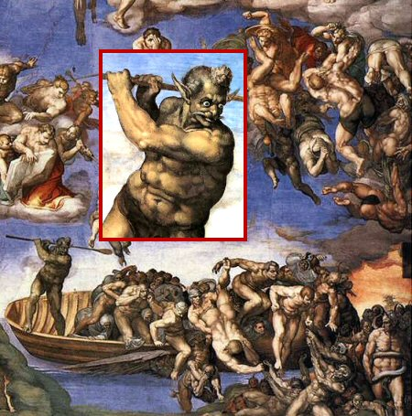
TERTULLIAN
What a spectacle when the world and its many products, shall be consumed in one great flame! How vast a spectacle then bursts upon the eye! What there excites my admiration? What my derision? Which sight gives me joy??
As I see illustrious monarchs groaning in the lowest darkness, Philosophers as fire consumes them! Poets trembling before the judgment-seat of Christ!
I shall hear the tragedians, louder-voiced in their own calamity; view play-actors in the dissolving flame; behold wrestlers, not in their gymnasia, but tossing in the fiery billows.
What inquisitor or priest in his munificence will bestow on you the favor of seeing and exulting in such things as these? Yet even now we in a measure have them by faith in the picturings of imagination. [De Spectaculis, Chapter XXX]

Slide 9
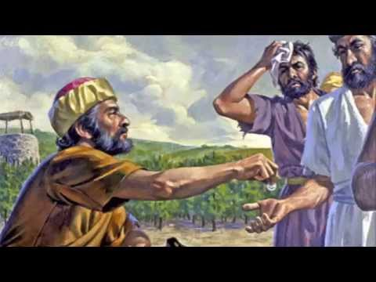
Heaven
Parable of the Prodigal son
Laborers in the Vineyard

Slide 10
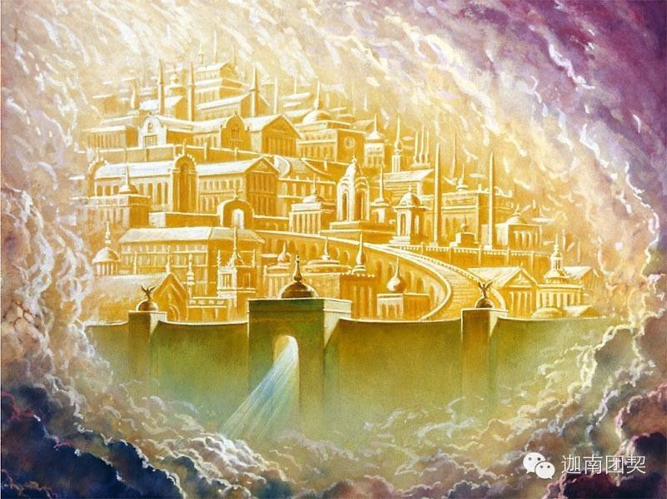
Mansions in Heaven?

Slide 11
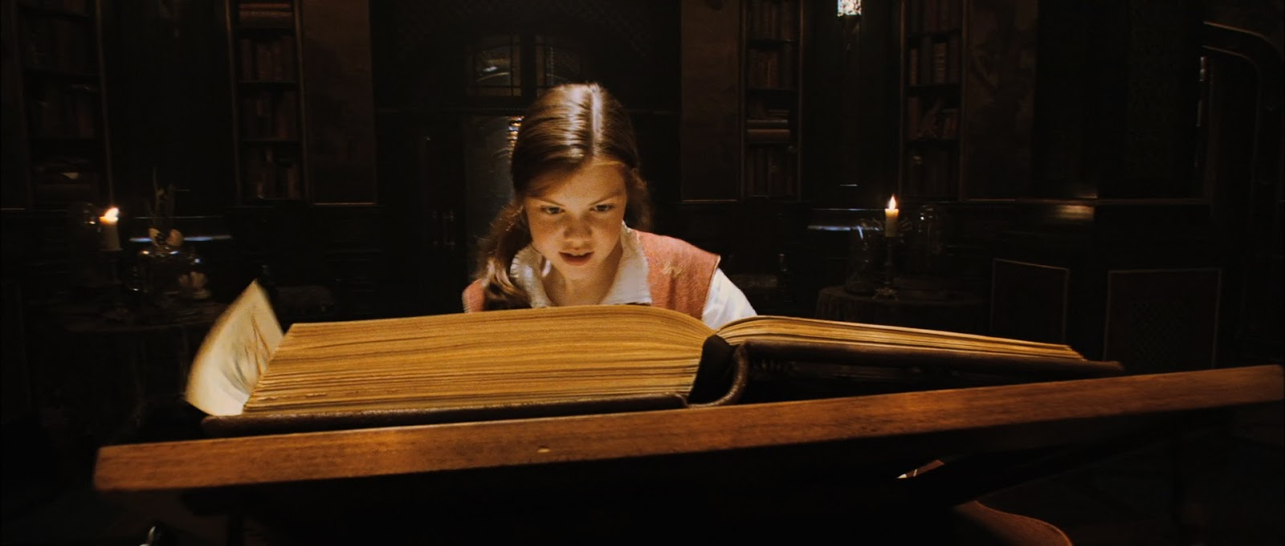
Unenforceable Rules
People should be nice
People should tell the truth
Parents should be fair
Donuts should be fat-free
Spouses should be considerate
People should recognize our efforts
Church leaders should recognize our needs
Earthly justice should always work
Mortality should be predictable

Slide 12
Guarantees we would like
If I slather them in Purell they won’t ever get sick…
A great Pinterest meme will change my life…
(Sending it to someone will change theirs!)
If they carry a toothbrush everywhere, they won’t have cavities…
If we always pay our tithing we will never have financial problems…
The family that prays together will never lose a kid…
If I marry a returned missionary in the temple our marriage will never have spiritual problems…

Slide 13
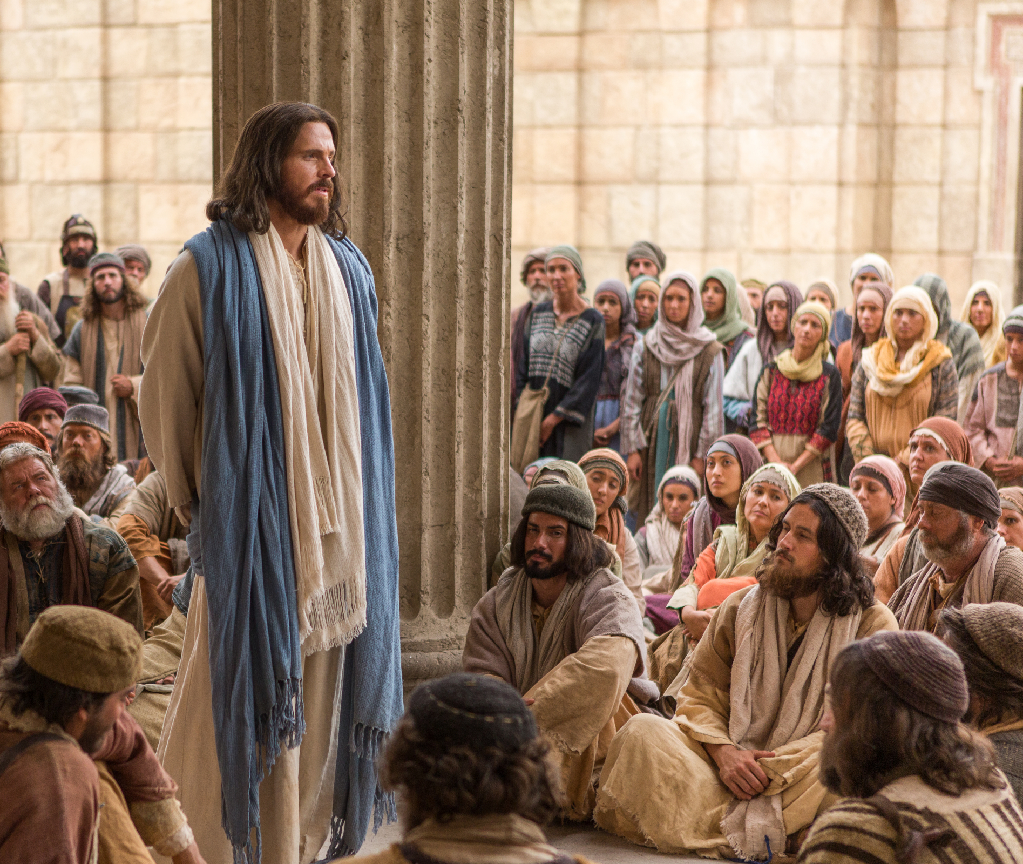
The Great Question:
Why did God give us the commandments?
D&C 1:17
Wherefore, I the Lord, knowing the calamity which should come upon the inhabitants of the earth, called upon my servant Joseph Smith, Jun, and spake unto from heaven and gave him commandments….
One important purpose of the commandments?
To learn how to love….

Slide 14
Our Greatest Challenge?
Luke 6
For if ye love them which love you, what thank have ye?
But love ye your enemies, and do good and (be generous), hoping for nothing again; and your reward shall be great…
For he is kind unto the unthankful and to the evil

Slide 15
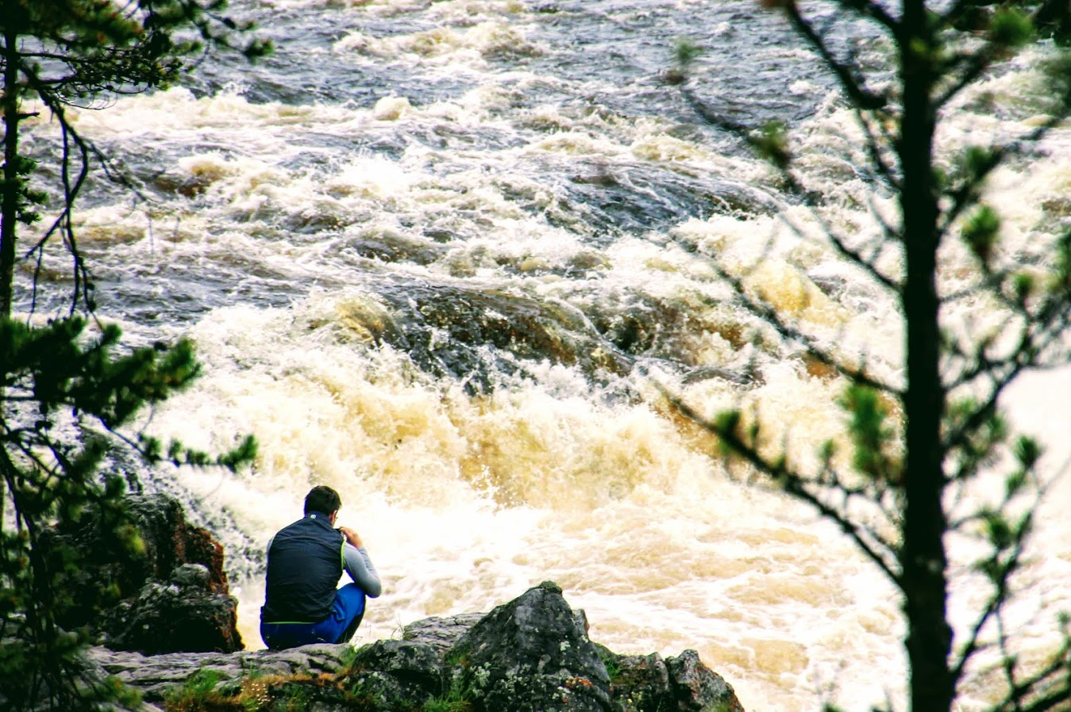
Grief Cycle
Painful Event
Grief and Loss

Slide 16
Common responses
Numbness
Emotional Waves
Reduced Concentration
Sleeping Difficulties
Eating Difficulties

Slide 17
Grief Cycle
Painful Event
Grief and Loss
Our Story Is Changed

Slide 18
Our Story is Painfully Altered
I thought people wouldn’t hurt me—and they did. The world is less safe.
I was married—now I’m single. My dream is gone.
Mom was always there—now she’s not.
I’ve been healthy—now I’m ill.
I pictured having a perfect Mormon family—now he doesn’t believe. This is not what I agreed to.
I’ve always done everything right—and he’s looking at porn? Am I doing something wrong here?
I thought my kids were great—now she is 13!
I know everybody here—now we have to move.

Slide 19
Grief Cycle
Painful Event
Grief and Loss
Our Story is Changed
Seeds of Hope and Gratitude
(Forgive)

Slide 20
The Story Begins to change
When I was first divorced, I felt alone. But I’m grateful for the sweet friends who have reached out to me. It slowly gets better.
I’m grateful for a Savior who wept with me in hard times. I’m feeling him more these days.
Even though Mom is gone, I’ll always be grateful for the legacy she left. Looking through old pictures I’m remembering a lot.
I’m grateful that the last few months have been easier with more good days.

Slide 21
CS Lewis….
You can't see anything properly while your eyes are blurred with tears. You can't, in most things, get what you want if you want it too desperately: anyway, you can't get the best out of it. 'Now! Let's have a real good talk' reduces everyone to silence.
I have gradually come to feel that the door is no longer shut and bolted. Was it my own frantic need that slammed it in my face? The time when there is nothing at all in your soul except a cry for help may be just the time when God can't give it:
you are like the drowning man who can't be helped because he clutches and grabs. Perhaps your own reiterated cries deafen you to the voice you hoped to hear….

Slide 22
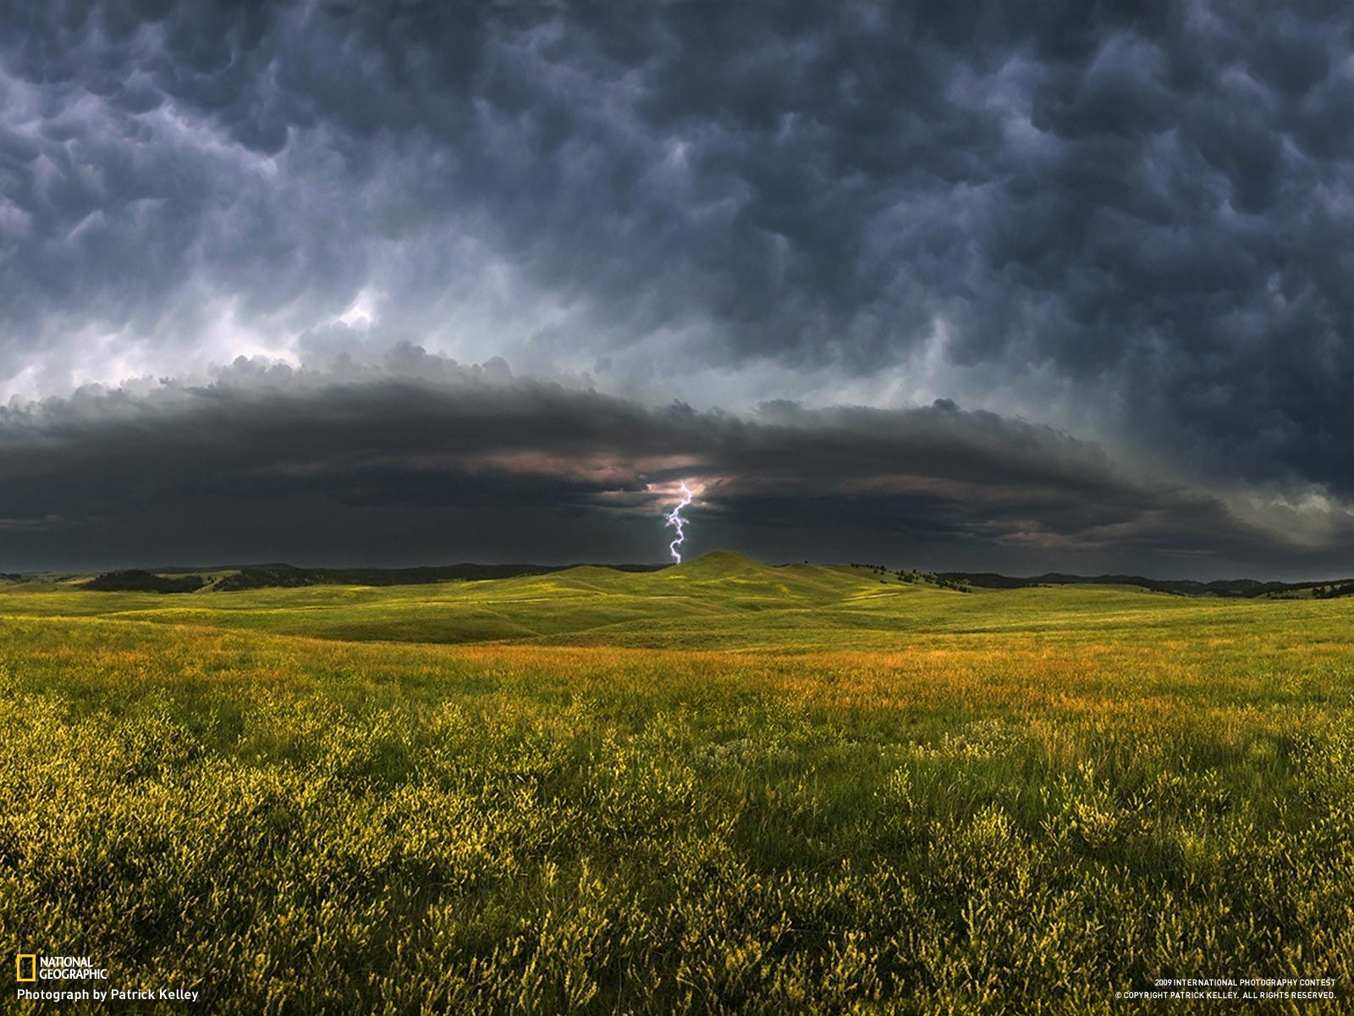
Grief Cycle
Painful Event
Grief and Loss
Our Story is Changed
Seeds of Hope and Gratitude
(Forgive)
Reminders and Triggers

Slide 23
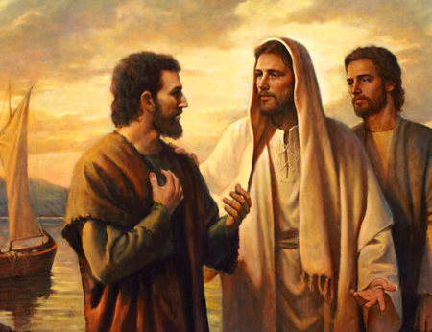
The Great Injunction
Matt 18:21 ¶Then came Peter to him, and said, Lord, how oft shall my brother sin against me, and I forgive him? till seven times?
22 Jesus saith unto him, I say not unto thee, Until seven times: but, Until seventy times seven.

Slide 24
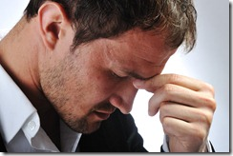
Fred Luskin Stanford Medical School
If you’ve been…treated badly, and you don’t really heal, you’re going to be less trusting, more defensive, and more quarrelsome with the next guy—or even the next five—because you still carry visceral pain.
When we can’t move past that, we stay a prisoner of our worst experiences.”

Slide 25
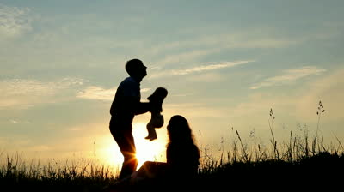
Forgiveness helps quiet our anger so it doesn’t spill over onto innocent lives

Slide 26
What Forgiveness is Not
Forgiveness is not condoning unkindness
Forgiveness is not forgetting that something painful happened
Forgiveness is not excusing poor behavior
Forgiveness is not denying or minimizing your hurt
Forgiveness may not mean reconciling with the offender
Forgiveness does not mean you have to give up feelings or stay numb or be unsafe

Slide 27
Remember
When I refuse to forgive, I choose to remain a victim—forever at the mercy of an unkindness.
As a result, the world becomes a more threatening place, filled with random malice I am powerless to prevent.

Slide 28
Science suggests
People who forgive are healthier, spiritually, emotionally, and physically, than those who don’t.
The practice of forgiveness is health enhancing.
(The state of forgiveness is a natural, premortal, Celestial Kingdom-type state.)
Grateful people forgive more quickly.

Slide 29
Grief and Forgiveness
Grieving a Loss
Forgiveness
Stress Response
Higher Blood Pressure
Increased cortisol endangering your heart
Suppressed immune system
Decreased ability to problem solve

Slide 30
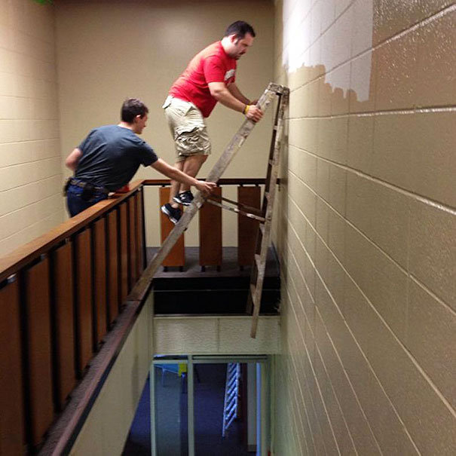
Question
What are your self-soothing skills for dealing with a loss?
Do they help or just make matters worse?

