Slide 1
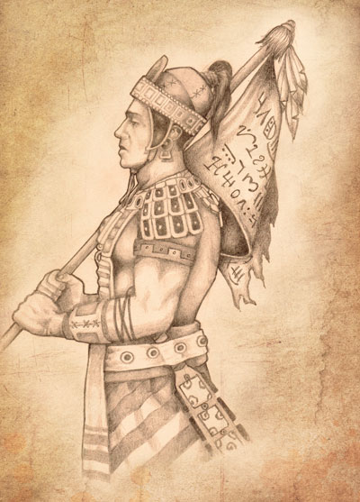
The Title of Liberty

Slide 2
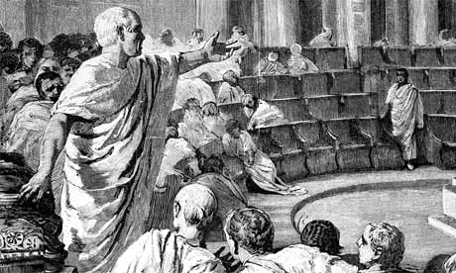
The Kingmen Rebellion
Alma 46

Slide 3
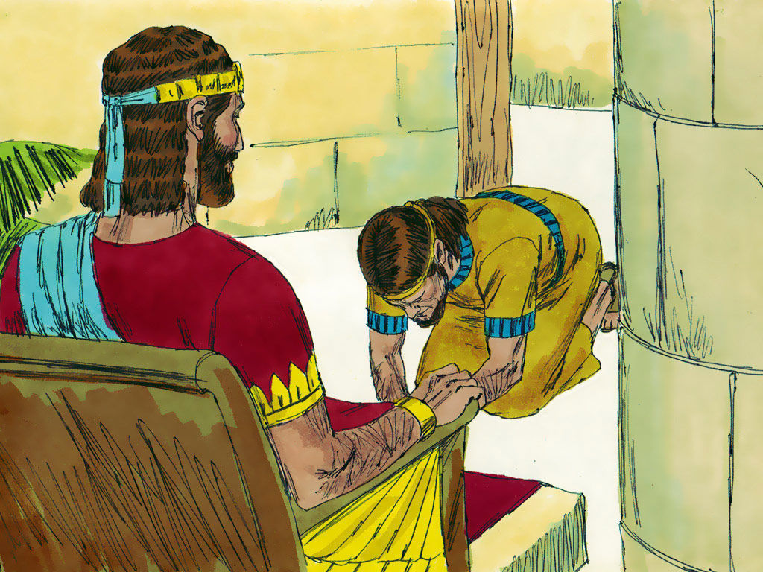
Motivation
The question is not why Amalickiah and the lower judges would want a king. Clearly, they stand to gain in the obvious grab for power.
The real question is for their followers, as it was for the followers of Korihor and Nehor: What was in it for them?

Slide 4
Moroni’s Response
Alma 46:11

Slide 5
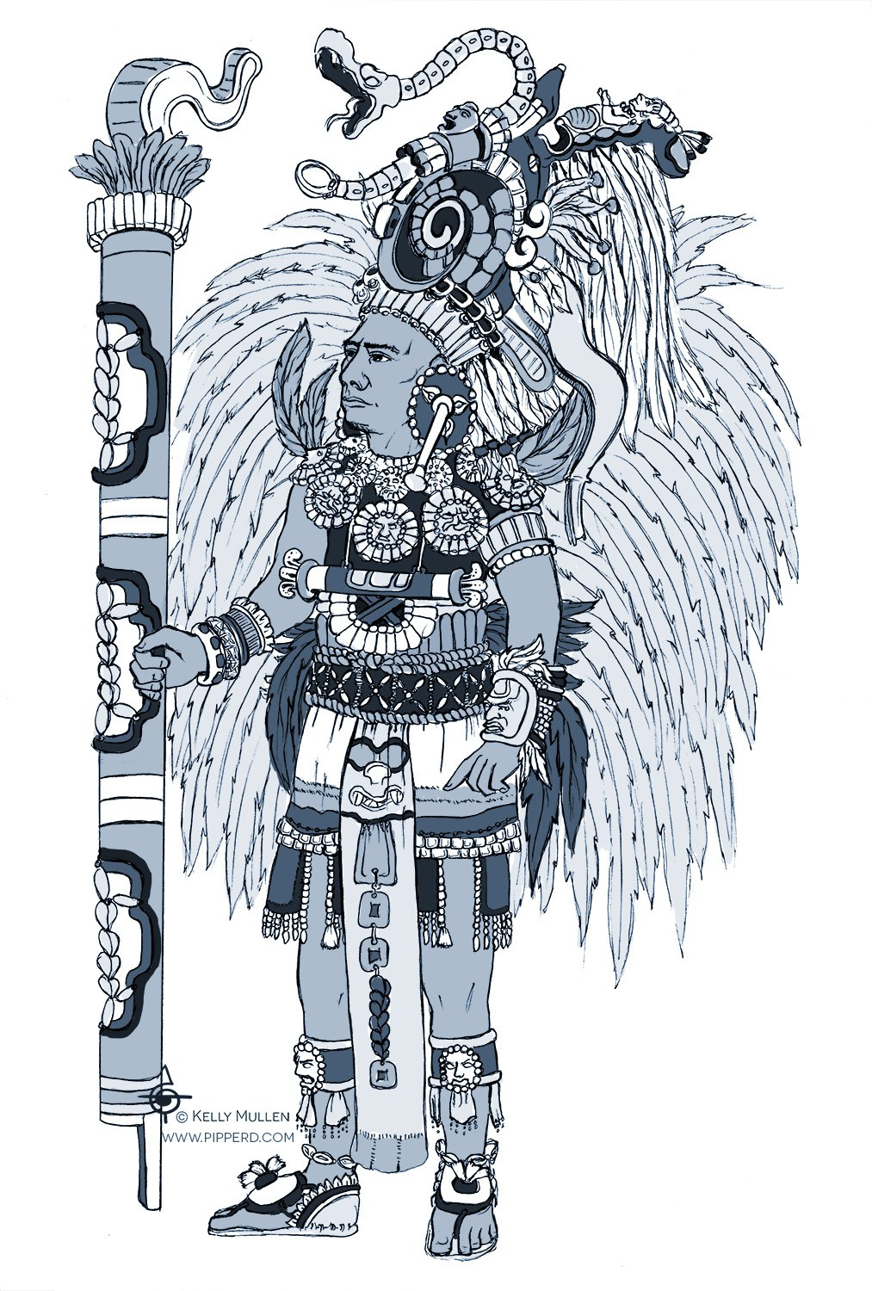
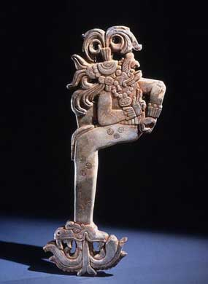
K'awiil scepter
Symbol of Mayan Kingship

Slide 6
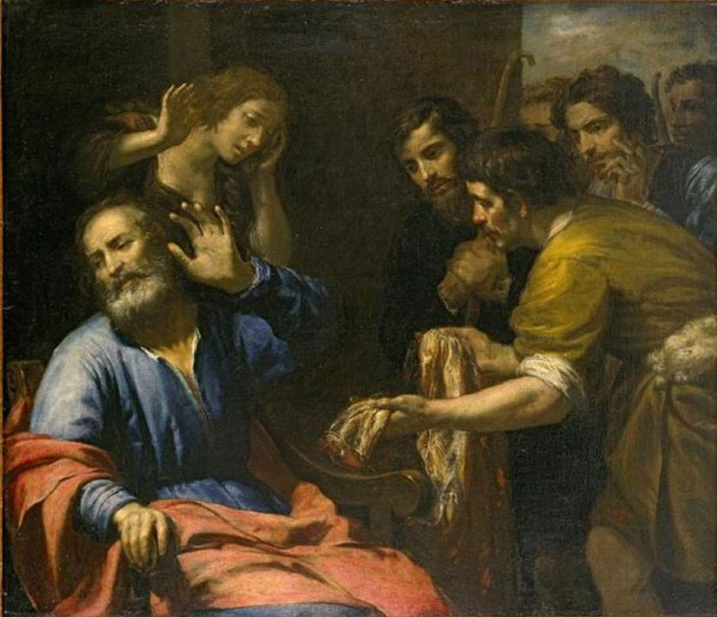
St. Hugh Nibley, Ancient Arab text
And when Joseph had made himself known unto them [his brethren] he asked them about his father, saying, 'What did my father after [I left]?' They answered, 'He lost his eyesight [from weeping].'
Then he gave them his garment [qamis, long outer shirt]. According to ad-Dahak that garment was of the weave [pattern, design] of Paradise, and the breath [spirit, odor] of Paradise was in it, so that it never decayed or in any way deteriorated [and that was] a sign [omen]. And Joseph gave them that garment, and it was the very one that had belonged to Abraham, having already had a long history.
And he said to them, 'Go, take this garment of mine and place it upon the face of my father so he may have sight again, and return [to me] with all your families.' And when they had put Egypt behind them and come to Canaan their father Jacob said, 'Behold, I perceive the spirit [breath, odor] of Joseph, if you will not think me wandering in my mind and weakheaded from age.' . . . [for] he knew that upon all the earth there was no spirit [breath, odor] of Paradise save in that garment alone. . . .

Slide 7
St. Hugh Nibley, Ancient Arab text
And as-Sadi says that Judah said to Joseph, 'It was I who took the garment bedaubed with blood to Jacob, and reported to him that the wolf had eaten Joseph; so give me this day thy garment that I might tell him that thou art living, that I might cause him to rejoice now as greatly as I caused him to sorrow then.'
And Ibn-Abbas says that Judah took the garment and went forth in great haste, panting with exertion and anxiety . . . and when he brought the garment he laid it upon [Jacob’s] face, so that his sight returned to him. And ad-Dahak says that his sight returned after blindness, and his strength after weakness, and youth after age, and joy after sorrow….

Slide 8
St. Hugh Nibley, Ancient Arab text
"Note here that there were two remnants of Joseph's garment, one sent by Joseph to his father as a sign that he was still alive (since the garment had not decayed), and the other, torn and smeared with blood, brought by Judah to his father as a sign that Joseph was dead.
Moroni actually quotes Jacob ('Now behold, this was the language of Jacob' [Alma 46:26]) as saying: 'Now behold, this giveth my soul sorrow; nevertheless, my soul hath joy in my son' (Alma 46:25)...

Slide 9
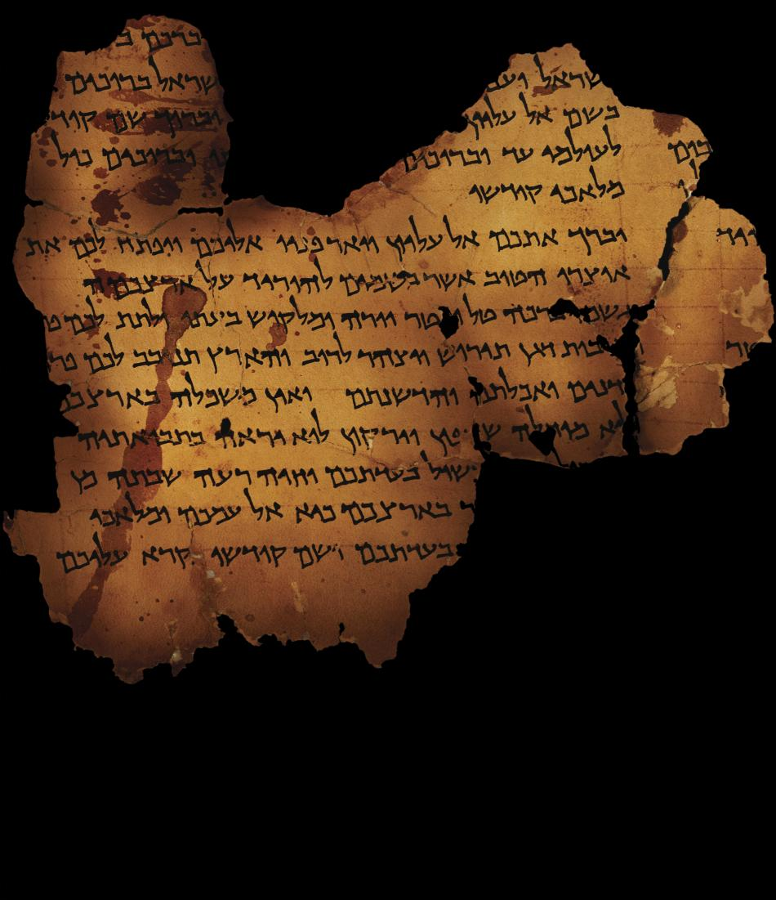
War Scroll, Dead Sea Scrolls at Qumron
The description of the banners. (13) Rule of the banners of the whole congregation according to their formations. On the grand banner which is at the head of all the people they shall write, "People of God," the names "Israel"
(14) and "Aaron," and the names of the twelve tribes of Israel according to their order of birth. On the banners of the heads of the "camps" of three tribes
(15) they shall write, "the Spirit [of God," and the names of three tribes. O]n the banner of each tribe they shall write, "Standard of God,"

Slide 10
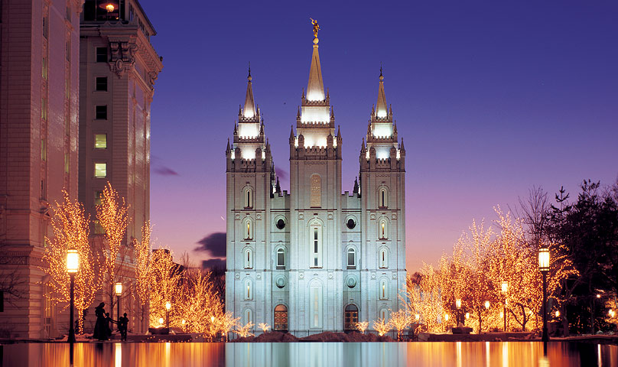
Covenants
Covenants with God:
1) New Name given
2) Title (inheritance of land)
3) Requirements of Obedience
4) Spiritual power granted

