Slide 1
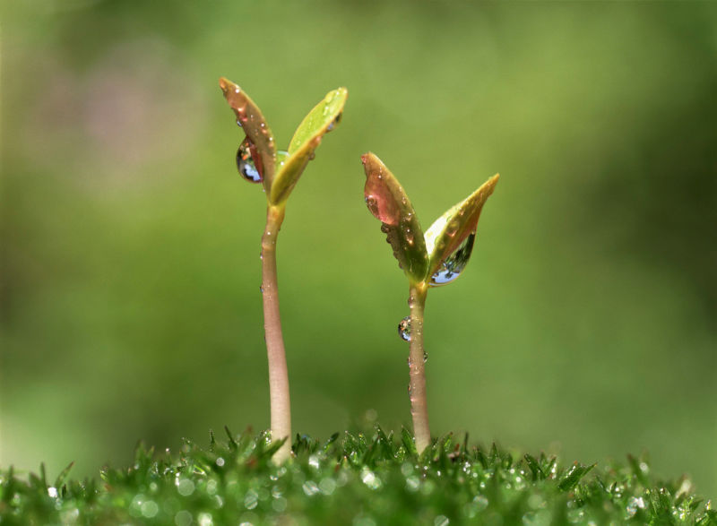
Planting
Alma 33,34

Slide 3
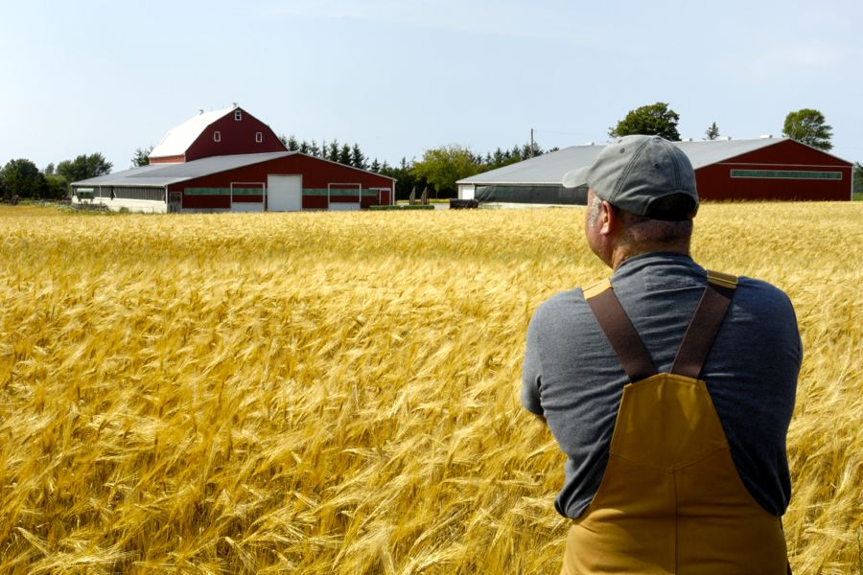
How to Plant?
Alma 33

Slide 4
Prayer of Zenos
4 For he said: Thou art merciful, O God, for thou hast heard my prayer,
even when I was in the wilderness; yea, thou wast merciful when I prayed concerning those who were mine enemies, and thou didst turn them to me.
5 Yea, O God, and thou wast merciful unto me when I did cry unto thee in my field; when I did cry unto thee in my prayer, and thou didst hear me.
6 And again, O God, when I did turn to my house thou didst hear me in my prayer.
7 And when I did turn unto my closet, O Lord, and prayed unto thee, thou didst hear me.
8 Yea, thou art merciful unto thy children when they cry unto thee, to be heard of thee and not of men, and thou wilt hear them.
9 Yea, O God, thou hast been merciful unto me, and heard my cries in the midst of thy congregations.
10 Yea, and thou hast also heard me when I have been cast out and have been despised by mine enemies; yea, thou didst hear my cries, and wast angry with mine enemies, and thou didst visit them in thine anger with speedy destruction.
11 And thou didst hear me because of mine afflictions and my sincerity; and it is because of thy Son that thou hast been thus merciful unto me, therefore I will cry unto thee in all mine afflictions, for in thee is my joy;

Slide 5
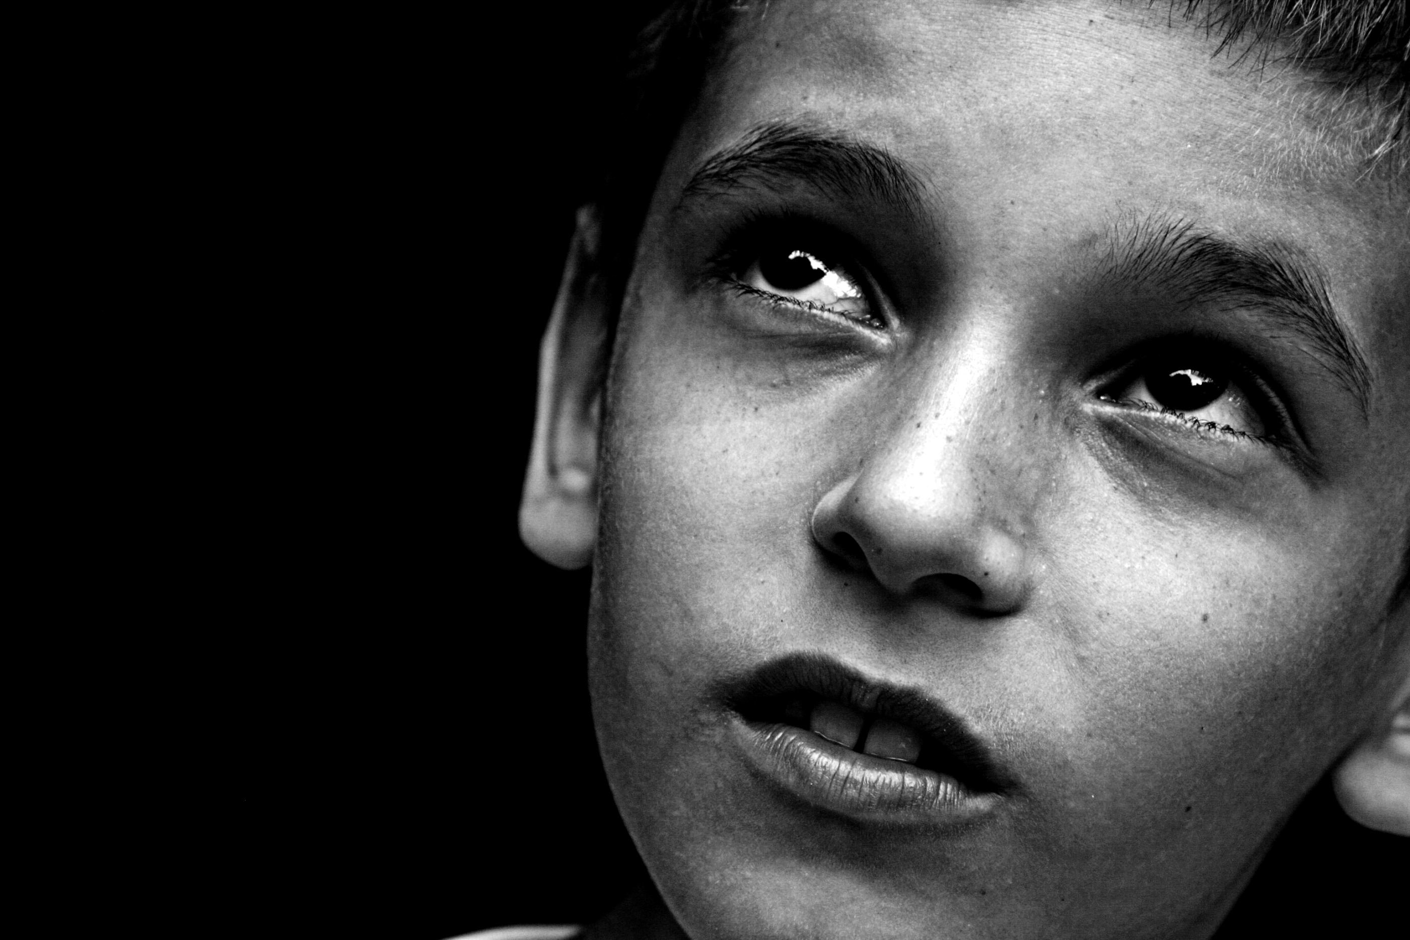
Question:
How important, to our worship, is believing in a God that hears us?

Slide 6
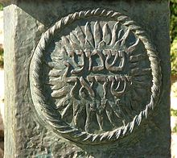
Shema (Sh’ma)
Sh'ma Yisra'eil Adonai Eloheinu Adonai echad. Hear, Israel, the Lord is our God, the Lord is One.

Slide 7
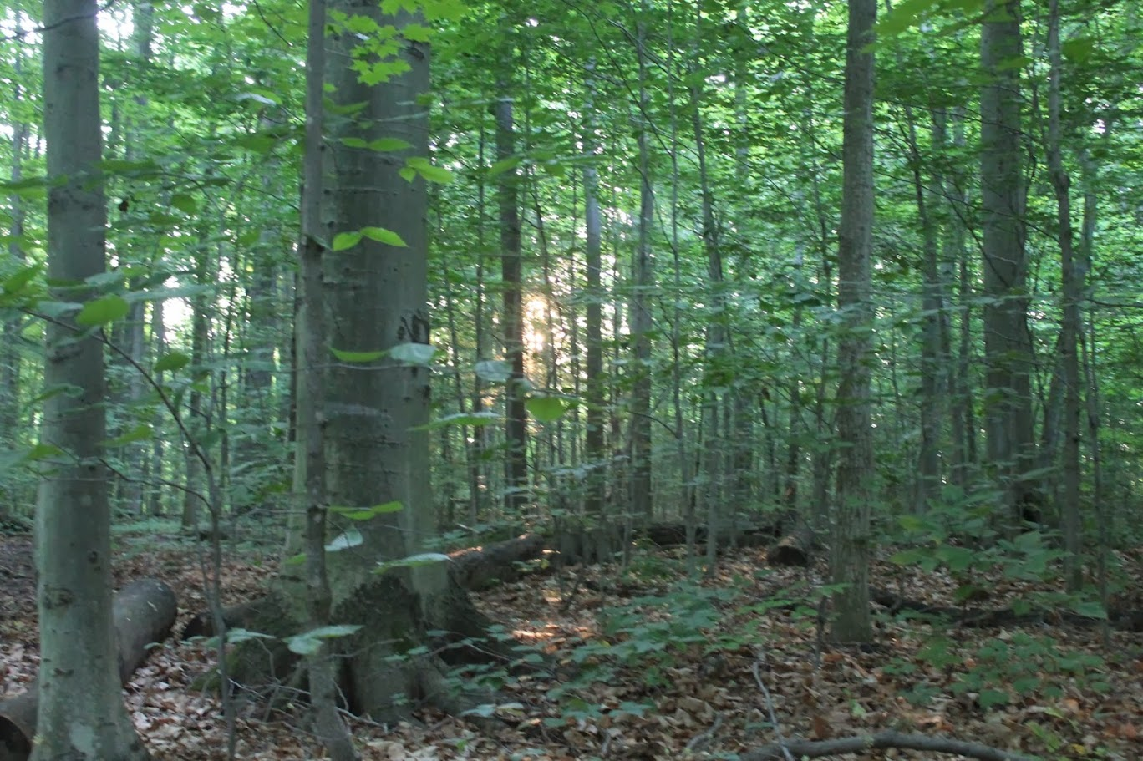
Alma Principle
Plantings can occur as we come to believe in a God that hears us-
and we hear him.

Slide 8
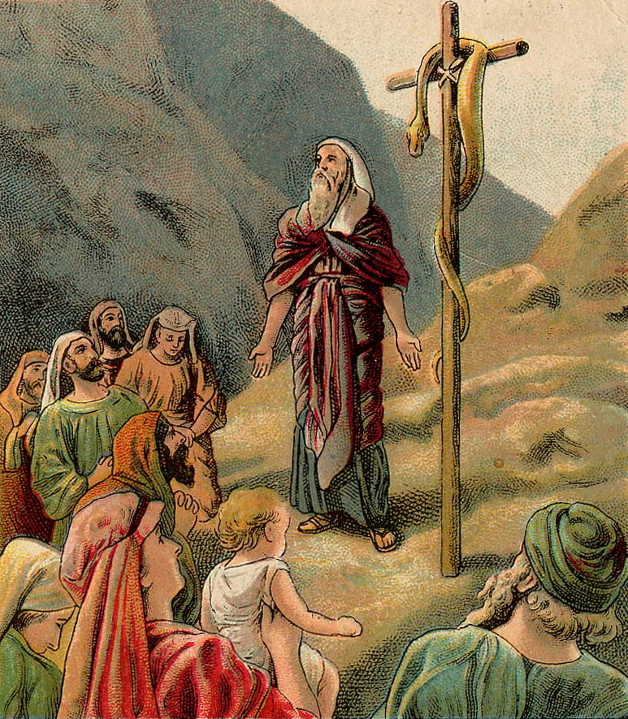
Moses, Another Witness
Alma 33:19

Slide 9
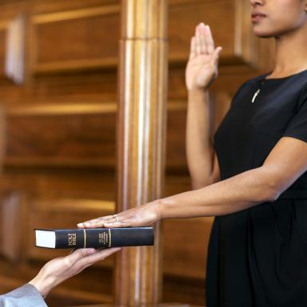
Witnesses, Witnesses, Witnesses
Alma 34

Slide 10
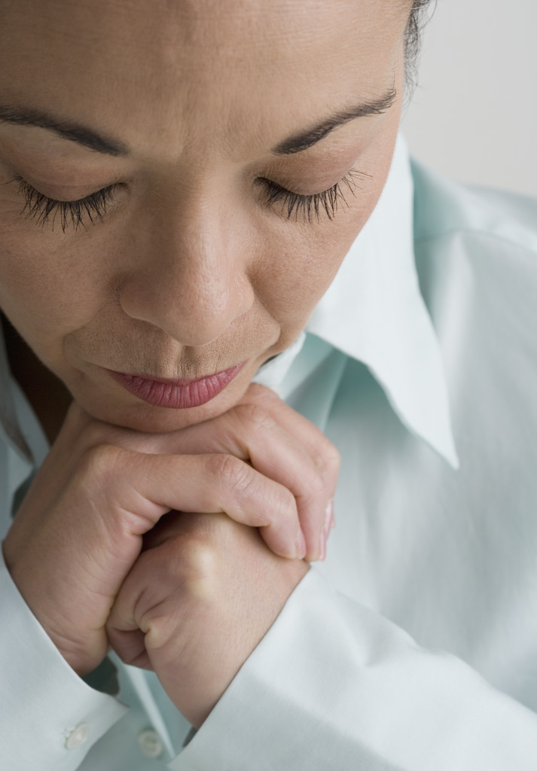
The Real Secrets to Planting…
Alma 34:38-40

