Slide 1
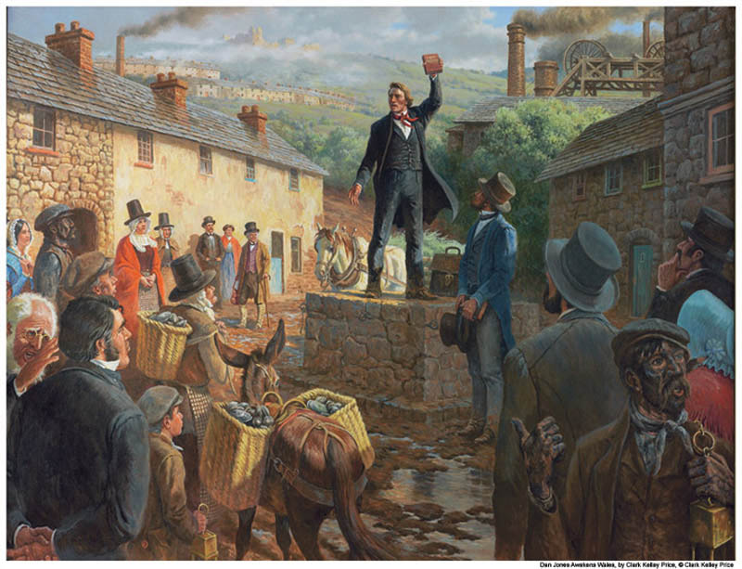
Oath and Covenant
www.kevinhinckley.com

Slide 2
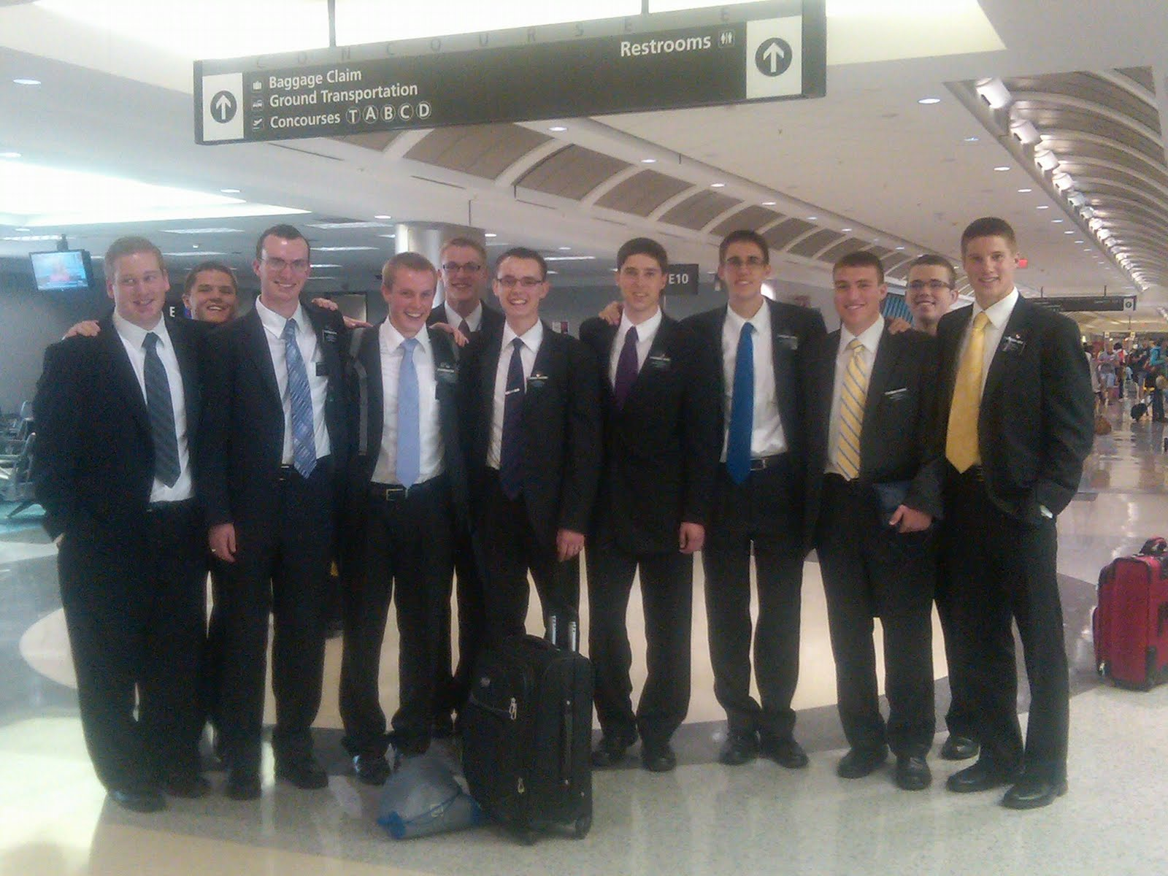
History
Elders called in January 1832, now returned
Joseph Returned from Missouri

Slide 3
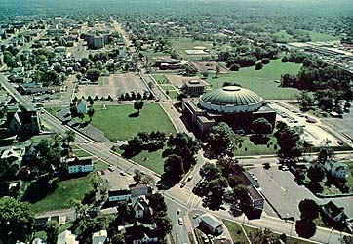
Revelation
D&C 84: 1-4

Slide 4
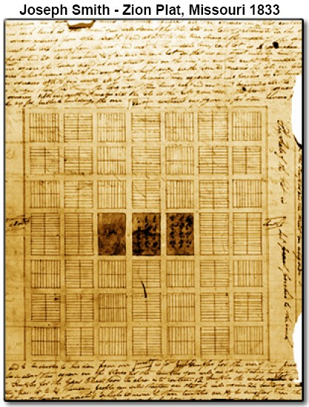

Slide 5
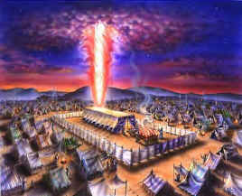
Filled with Glory
D&C 84: 5, 32

Slide 6
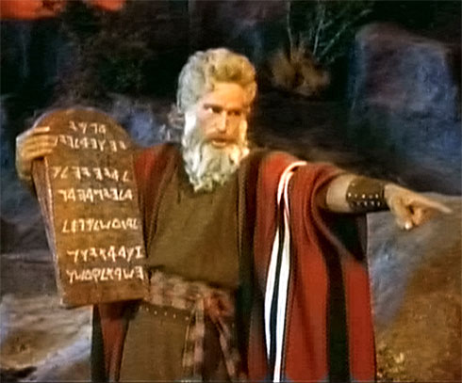
Moses’ Line of Authority
D&C 84: 6-13

Slide 7
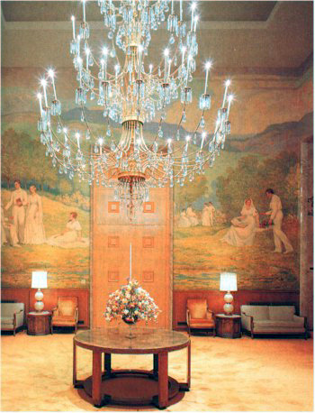
The Preparatory Gospel
D&C 84: 20-27

Slide 8
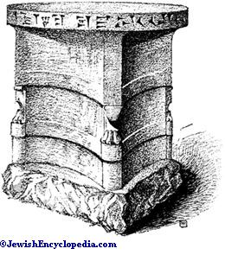
Sacrifice
D&C 84:31

Slide 9
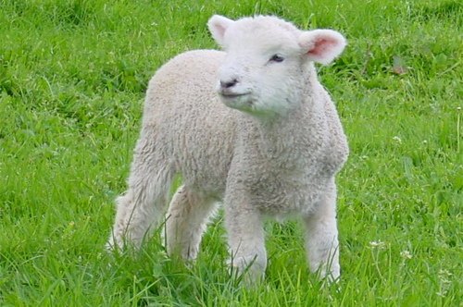
Joseph Smith
It is generally supposed that sacrifice was entirely done away when the Great Sacrifice (i.e., the sacrifice of the Lord Jesus) was offered up, and that there will be no necessity for the ordinance of (animal) sacrifice in the future: but those who assert this are certainly not acquainted with the duties, privileges and authority of the Priesthood, or with the prophets. . . .
These sacrifices, as well as every ordinance belonging to the Priesthood, will, when the Temple of the Lord shall be built, and the sons of Levi purified, be fully restored and attended to in all their powers, ramifications, and blessings.
It is not to be understood that the Law of Moses will be established again with all its rites and variety of ceremonies; this has never been spoken of by the prophets; but those things which existed prior to Moses' day, namely, sacrifice will be continued.
(History of the Church, 4:211)

Slide 10
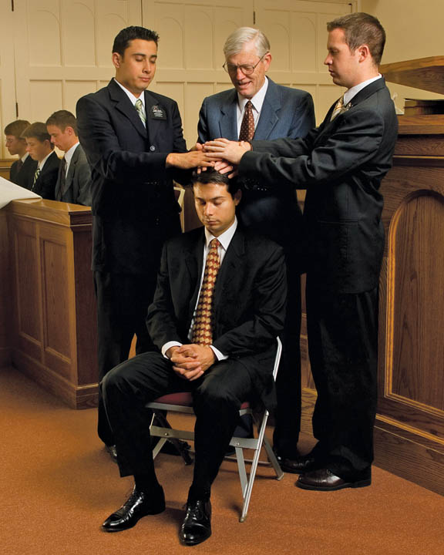
Oath and Covenant
D&C 84:39,40

Slide 11
