Slide 1
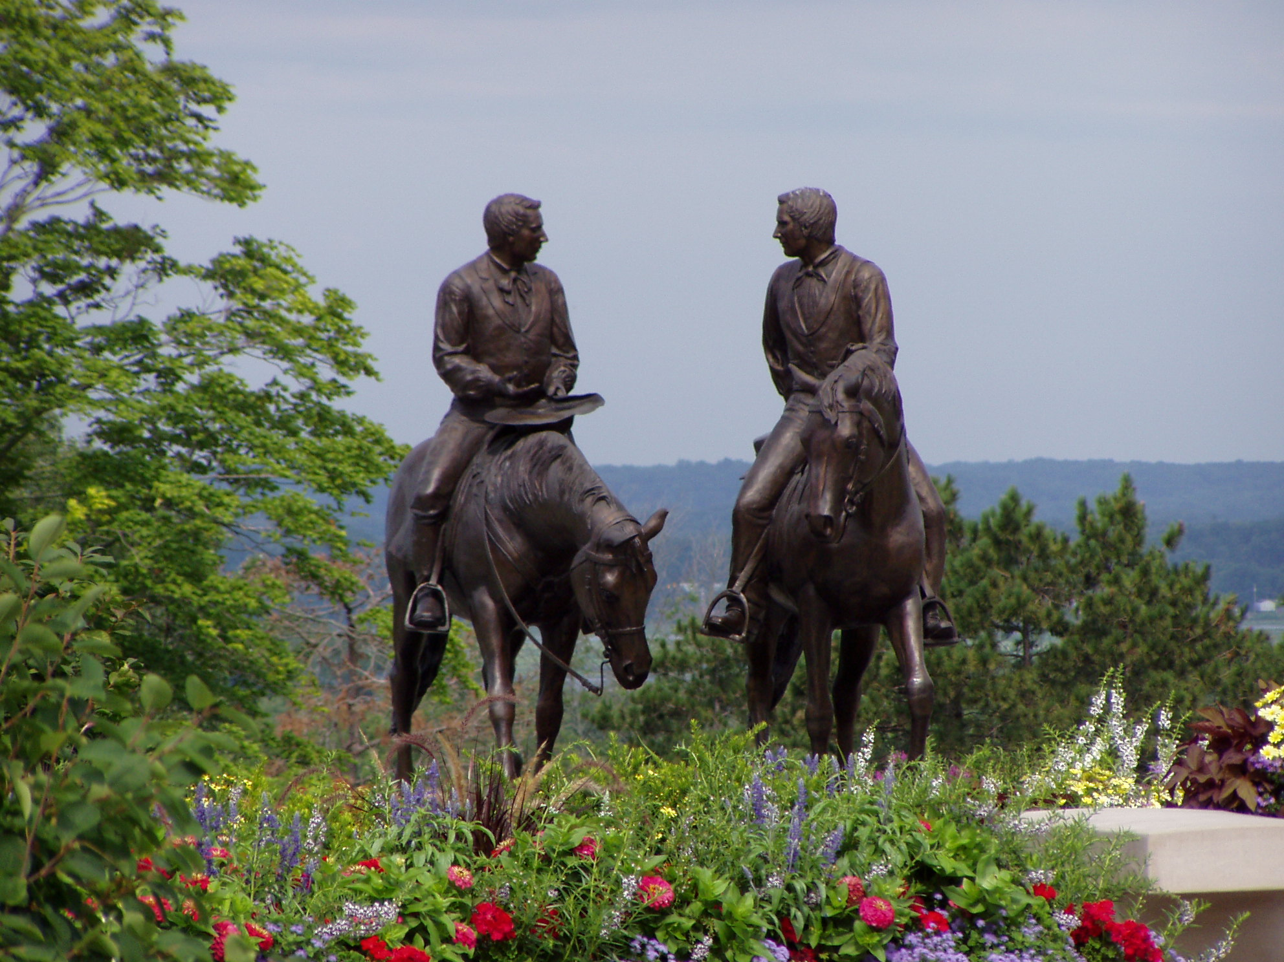
My Word, my Rock
Kevinhinckley.com

Slide 2
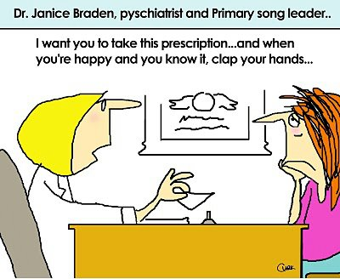

Slide 3
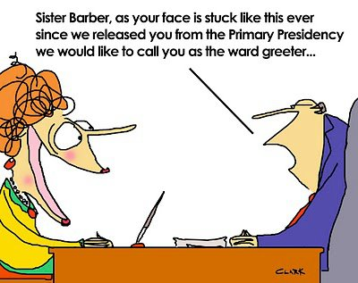

Slide 5
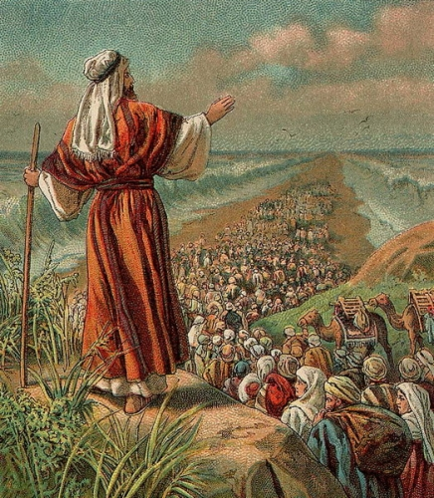
Sons of Levi
D&C 13

Slide 6
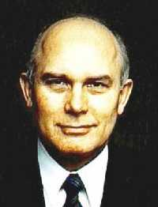
Elder Dallin H. Oaks
The ministering of angels “can also be unseen. Angelic messages can be delivered by a voice or merely by thoughts or feelings communicated to the mind. … Most angelic communications are felt or heard rather than seen.
Through the Aaronic Priesthood ordinances of baptism and the sacrament, we are cleansed of our sins and promised that if we keep our covenants we will always have His Spirit to be with us.
… So it is that those who hold the Aaronic Priesthood open the door for all Church members who worthily partake of the sacrament to enjoy the companionship of the Spirit of the Lord and the ministering of angels."

Slide 7
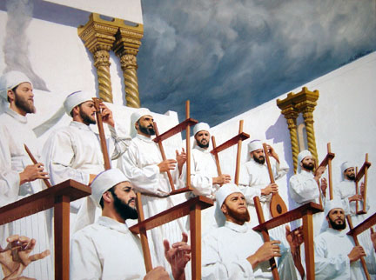
Joseph Smith
“To usher in the dispensation of the fulness of times (a dispensation incorporating the blessings, doctrine, and authority of all former dispensations and embodying the restoration of all things), it was necessary that the Aaronic Priesthood be restored.
Because John the Baptist restored the Aaronic Priesthood, the literal sons of Levi—descendants of the ancient Levites and of Aaron—shall yet render priesthood service in this dispensation as the Restoration progresses and as the Lord directs through his First Presidency.”
Teachings of the Prophet Joseph Smith, pp. 171–72.

Slide 8
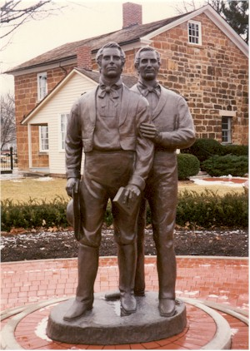
Hyrum Smith How he would ‘know’
D&C 11:10

Slide 9
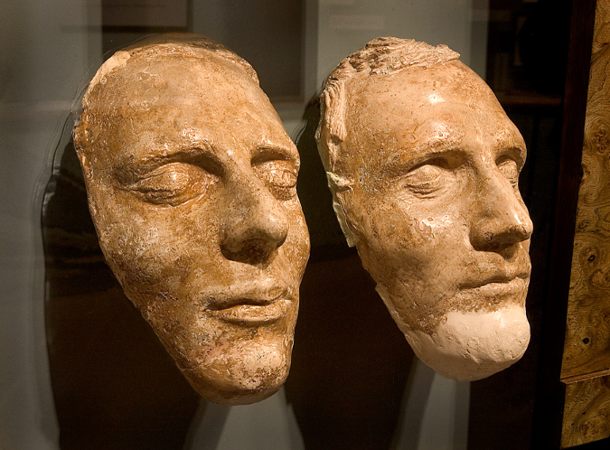
Hyrum
Joseph Fielding Smith
The Lord declared that Hyrum Smith had a gift. The great gift which he possessed was that of a tender, sympathetic heart; a merciful spirit.
The Lord on a later occasion said: ‘Blessed is my servant Hyrum Smith; for I, the Lord, love him because of the integrity of his heart, and because he loveth that which is right before me, saith the Lord.’
This great gift was manifest in his jealous watch care over the Prophet lest some harm come to him.”
(Church History and Modern Revelation, 1:57.)

Slide 10
Hyrum Smith How he would ‘know’
D&C 11:10
D&C 11:13,14
D&C 11:12
Alma 41:14

Slide 11
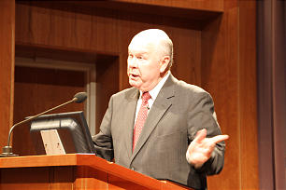
Question:
Robert Millett
A Baptist minister was in my office one day. We were chatting about a number of things, including doctrine. He said to me, “Bob, you people believe in such strange things!” “Like what?” I asked. “Oh, for example,” he said, “you believe in blood atonement. And that affects Utah’s insistence on retaining death by a firing squad.”
I responded, “No, we don’t.” “Yes, you do,” he came right back. “I know of several statements by Brigham Young, Heber C. Kimball, and Jedediah Grant that teach such things.” “I’m aware of those statements,” I said.
I then found myself saying something that I had never voiced before: “Yes, they were taught, but they do not represent the doctrine of our Church. We believe in the blood atonement of Jesus Christ, and that alone.”
My friend didn’t skip a beat: “What do you mean they don’t represent the doctrine of your Church? They were spoken by major Church leaders.”
Religious Educator 4, no. 3 (2003): 15–

Slide 12
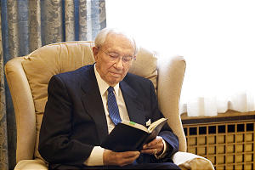
Our Doctrine
D&C 11: 21, 16

Slide 13
How DO we know doctrine?
Wait…until you shall have:
My Word
My Rock
My Church
My Gospel
Sources for Doctrine today:
The Scriptures
Living Prophets
Church Publications
Gospel Ordinances
(D&C 84:20)

