Slide 1
Did I not speak peace?
Kevinhinckley.com

Slide 2
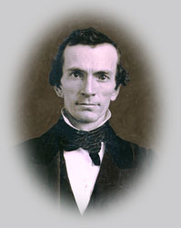
D&C 6:29-31
President Joseph Fielding Smith wrote the following concerning Oliver Cowdery and the martyrdom of Hyrum Smith:
“Had Oliver Cowdery remained true, had he been faithful to his testimony and his calling as the ‘Second Elder’ and Assistant President of the Church,
I am just as satisfied as I am that I am here that Oliver Cowdery would have gone to Carthage with the prophet Joseph Smith and laid down his life instead of Hyrum Smith.
That would have been his right. Maybe it sounds a little strange to speak of the martyrdom as being a right, but it was a right.
Oliver Cowdery lost it and Hyrum Smith received it. According to the law of witnesses --and this is a divine law --- it had to be” (Doctrines of Salvation, 1:221-22).

Slide 3
How the Lord teaches
Should I help Joseph translate?
Question:
Principles:
D&C 6:2
D&C 6:7
Answer:
Yes!!

Slide 4
How did Oliver know?
D&C 6: 14-16, 22, 23 22,23

Slide 5
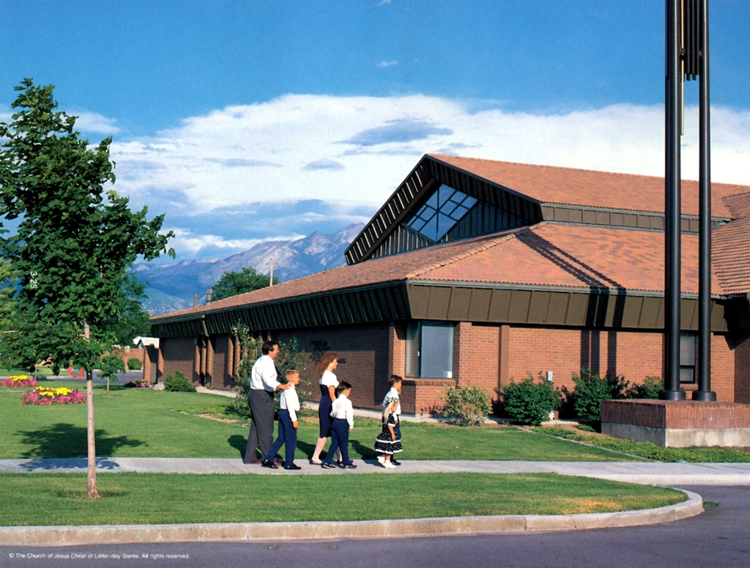
Question
3 Nephi 9:20
Like Oliver and the Lamanites, could an active Latter Day Saints be receiving answers to prayers and not know it?
Why?

Slide 6
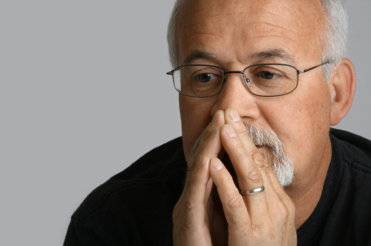
Elder Bednar
As we gain experience with the Holy Ghost, we learn that the intensity with which we feel the Spirit’s influence is not always the same.
Strong, dramatic spiritual impressions do not come to us frequently.
Even as we strive to be faithful and obedient, there simply are times when the direction, assurance and peace of the Spirit are not readily recognizable in our lives.
2006 April General Conference

Slide 7
Personality Types
Talkers
Socializer
Friend oriented
Office/room: Disorganized, pictures
Job: Sales/Marketing
Spiritual Strength:
Openness
Spiritual Weakness:
Comparisons
Thinkers
Analyzer
Object oriented
Office/room: Cluttered
Job: engineers/computer hardware
Spiritual Strength:
Understanding
Spiritual Weakness:
Not trusting a prompting (feeling)
Doers
Achiever
Accomplishment oriented
Office/Room: Awards
Job: Boss
Spiritual Strength:
Action
Spiritual Weakness:
Patience
Planners
Organizers
Process oriented
Office/Room: yes, the socks are folded
Job: Office manager, programmer
Spiritual Strength:
Service
Spiritual Weakness:
Spontaneity

Slide 8
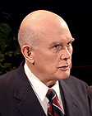
Elder Dallin H. Oaks
I know from experience that some seasoned members of the Church do not know when they are receiving a witness of the Spirit. . . .
Perhaps lifelong members of the Church don't recognize the testimony of the Spirit because they have had it so often they take it for granted. Perhaps they are looking for something startling and different. . . .
I have heard adult members of the Church claim they do not have a testimony because they have never experienced a 'burning in the bosom.' (D&C 9:8.)
If I thought this scriptural "burning" only referred to caloric heat, I would have to say that I have never had a burning in the bosom either. . . . In this usage, it does not seem to refer to heat but rather to an intensity of feeling.
For me, the witness of the Holy Ghost is an intense feeling of serenity or well-being.“
(Teaching, Learning 'by the Spirit', LDS Church News, 1993, 01/02/93)
Notes:
MTC, 1988

Slide 9
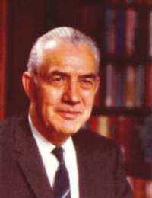
Stupid of thought?
Elder Mark E. Peterson
D&C 9: 7-9
This was to given to Oliver Cowdery who was attempting to translate the Book of Mormon.
It is not applicable, generally, to the rest of the church.
(England Leeds Mission, May, 1976)

Slide 10
Elder Dallin H. Oaks
I know from experience that some seasoned members of the Church do not know when they are receiving a witness of the Spirit. . . .
Perhaps lifelong members of the Church don't recognize the testimony of the Spirit because they have had it so often they take it for granted. Perhaps they are looking for something startling and different. . . .
I have heard adult members of the Church claim they do not have a testimony because they have never experienced a 'burning in the bosom.' (D&C 9:8.)
If I thought this scriptural "burning" only referred to caloric heat, I would have to say that I have never had a burning in the bosom either. . . . In this usage, it does not seem to refer to heat but rather to an intensity of feeling.
For me, the witness of the Holy Ghost is an intense feeling of serenity or well-being.“
(Teaching, Learning 'by the Spirit', LDS Church News, 1993, 01/02/93)
Notes:
MTC, 1988

Slide 11
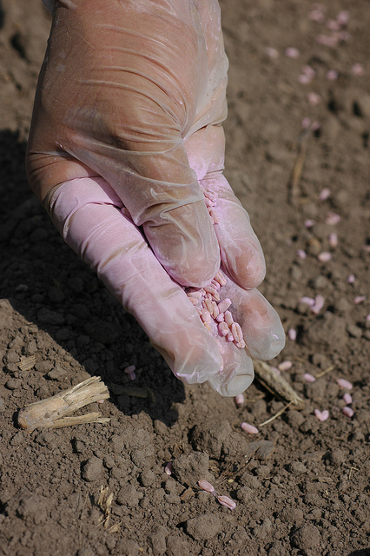
Elder Bednar
The law of the harvest is real; we cannot gather crops in the fall which we did not properly plant and cultivate during the spring and summer. And we cannot realistically expect to recognize "big" promptings if we consistently fail to heed the "small" ones.
…Thus, revelation from our Heavenly Father comes most frequently in small increments and, like all knowledge, is granted according to our preparation.
Misguided attempts to get spiritually supercharged through unusually long prayers, lengthy and unwise fasting, and intensive, short-term temple attendance certainly are no substitute for gradual, consistent, and conscientious attention to the promptings of the Holy Ghost.
(BYUI Devotional)
Notes:
Receiving, Recognizing, and Responding to the Promptings of the Holy Ghost
Elder David A. Bednar

Slide 12
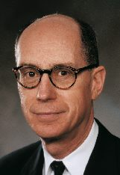
Elder Henry B. Eyring
I somehow managed to arrange [an] interview…with President Harold B. Lee. He received me in a kindly way. In my anxiety, I soon blurted out my question: “President Lee, how do I get revelation?”
He smiled. I am glad he didn't laugh, since it was an odd question to ask. But he answered my question with a story…
Then he gave me the lesson, which I now give to you, in about these words: “Hal, when we had done all we knew how to do, when we had our backs to the wall, then God gave us the revelation. Hal, if you want to get revelation, do your homework.”
I suppose I should have been embarrassed to take his time to learn what the Lord told us all long ago. You recall the rebuke to Oliver Cowdery …
Now, in fairness to Oliver Cowdery, he had some reason to be confused. The Prophet Joseph seemed to have the windows of heaven opened to him… at a speed that could easily have misled Oliver.
I bear you my solemn testimony that the Lord opens the heavens to his servants today… But I also bear you my testimony that the words ‘study it out’ mean a degree of patience, labor, and persistence commensurate with the value of what you seek

