Slide 1
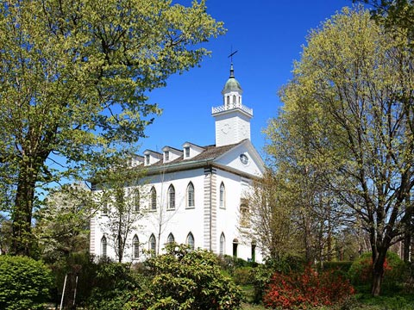
The Law D&C 42
www.kevinhinckley.com

Slide 2
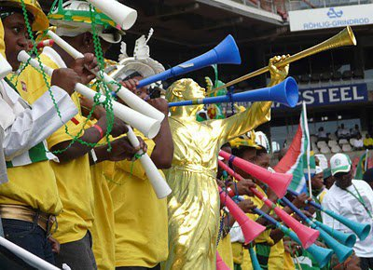
Little know fact from the World Cup

Slide 3
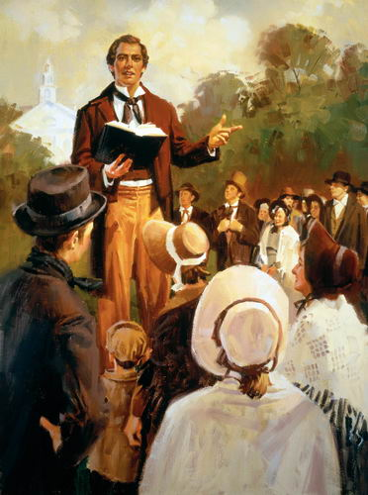
Preface…
Heading from D&C 41
D&C 42:61

Slide 4
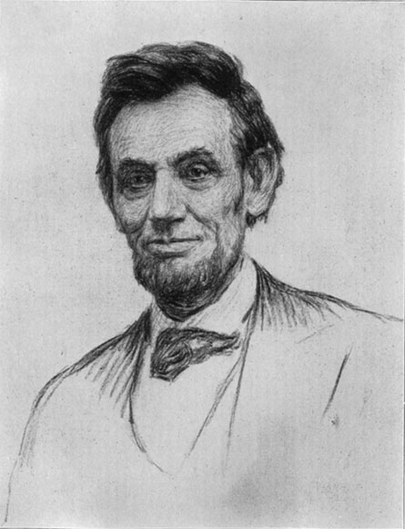
Elder Holland
So life has its oppositions and its conflicts and the gospel of Jesus Christ has answers and assurances.
In a time of terrible civil warfare, one of the most gifted leaders ever to strive to hold a nation together said what could be said of marriages and families and friendships.
Praying for peace, pleading for peace, seeking peace in any way that would no compromise union, Abraham Lincoln said in those dark, dark days of his First Inaugural,
Though passion may have strained, it must not break our bonds of affection. The mystic chords of memory will yet swell…when again touched, as surely they will be
By the better angels of our nature.
(The Peaceable things)

Slide 5
The Law
D&C 42: 1-6
15 Commandments

Slide 6
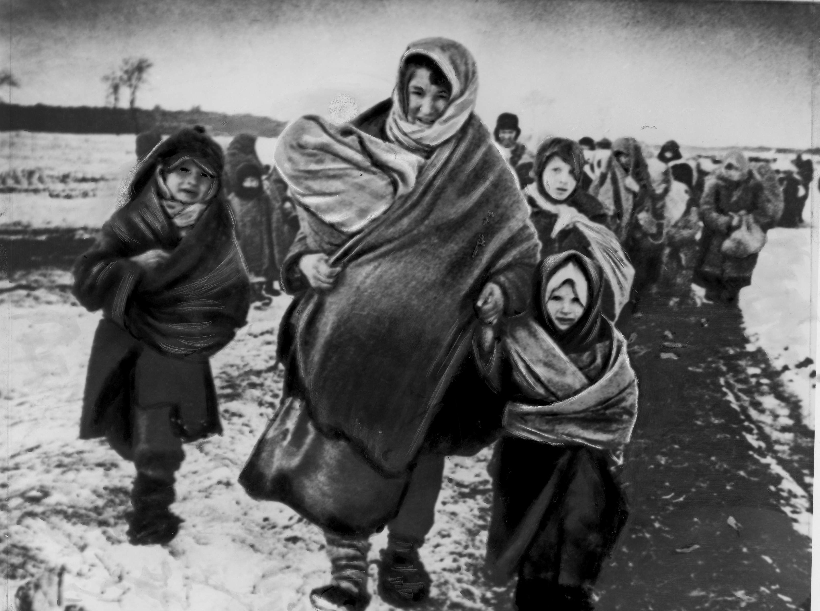
The Poor
D&C 42:29-32

Slide 7
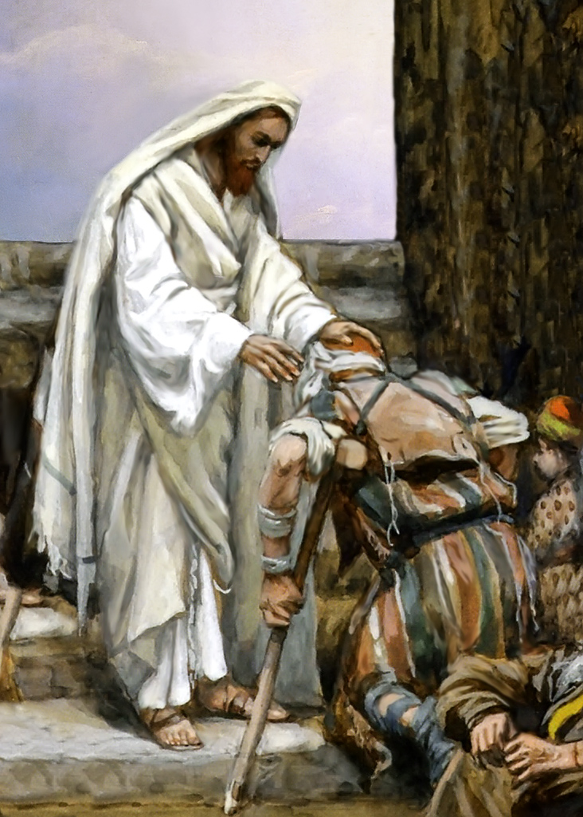
The Sick
D&C 42: 43-46

Slide 8
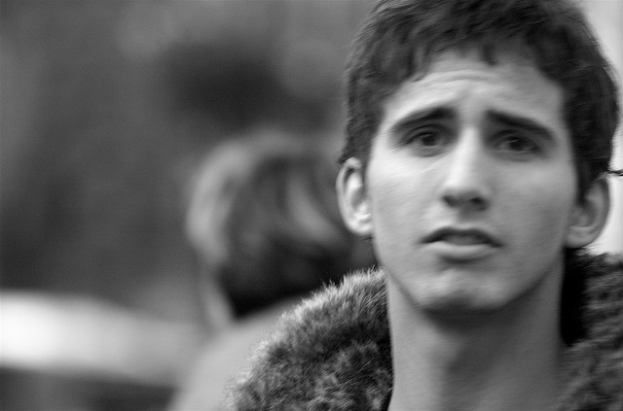
The Weak
D&C 42:52,53

Slide 9
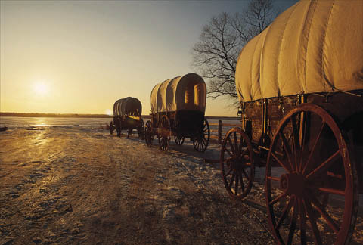
Flee to the West
D&C 42: 62-64

