Slide 1
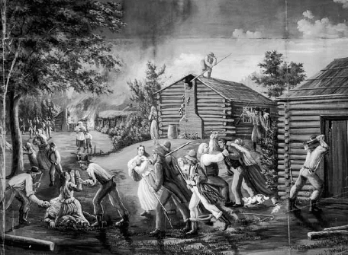
The Fall of Zion

Slide 2
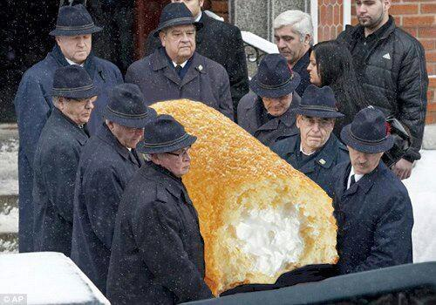

Slide 3
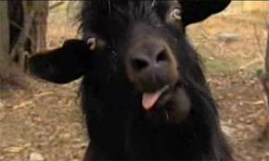
KSL Morning News….
SMITHFIELD — In an unusual encounter during his morning route, a 14-year-old Utah paperboy says a goat knocked him onto the ground and chased him up a tree.
Smithfield resident Jaxon Gessel says he was delivering papers Tuesday morning when a goat approached him from the side and head-butted him off his bike.
"It just freaked me out when it stood up on its hind legs and just wrapped its front legs around me, and pulled me off," Gessel said.
He had seen a shape in the morning darkness and didn't think much of it at first, passing it off as a dog. Then, he said, it started making a "grunting noise" and he saw the goat approaching him.
The goat chased the teen up a tree and the two looked back and forth at each other for about an hour.
The teen says the hour-long standoff ended when the goat started chasing girls passing by. Gessel says he jumped from the tree and grabbed the goat's collar to help them.
Smithfield police say they got a call from Gessel's parents reporting he was overdue, and from residents reporting a boy struggling with a goat.
"He kind of had his paper-bag sitting in the tree where he was. He was delivering newspapers and… he was about halfway up the tree," said Smithfield Police Officer Brandon Muir.
The goat, Voldemort, was impounded by Smithfield animal control officers but has returned home.
"He's a really good pet, good with kids, a good lawnmower," Benson said.
Voldemort is a mini longhair fainting goat and for sale, his owner said.

Slide 4
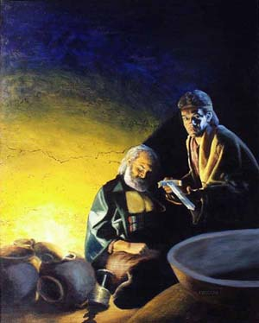
10 And it came to pass that I was constrained by the Spirit that I should kill Laban; but I said in my heart: Never at any time have I shed the blood of man. And I shrunk and would that I might not slay him.

Slide 5
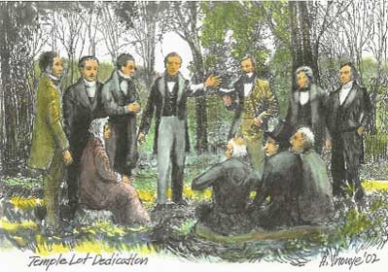
D&C 84 Verily this is the word of the Lord, that the city New Jerusalem shall be built by the gathering of the saints, beginning at this place, even the place of the temple,
which temple shall be reared in this generation.
For verily this generation shall not all pass away until an house shall be built unto the Lord, and a cloud shall rest upon it,

Slide 6
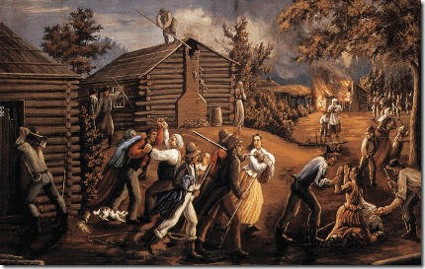
W.W.Phelps
The mob has quit whipping and now beats with clubs. Lyman Leonard, one of the number that returned from Van Buren county had two chairs broken to splinters upon him, and was then dragged out of doors and beat with clubs till he was supposed to be dead, but he is yet alive.
Josiah Sumner and Barnet Cole were severely beaten at the same time. The mob have commenced burning houses, stacks, etc.; and we shall not think it out of their power, by any means, to proceed to murder any of our people that shall try to live in that county, or perhaps, only go there.
Such scenes as are happening around us are calculated to arouse feelings and passions in all, and to strengthen the faith and fortify the hearts of the Saints for great things.

Slide 8
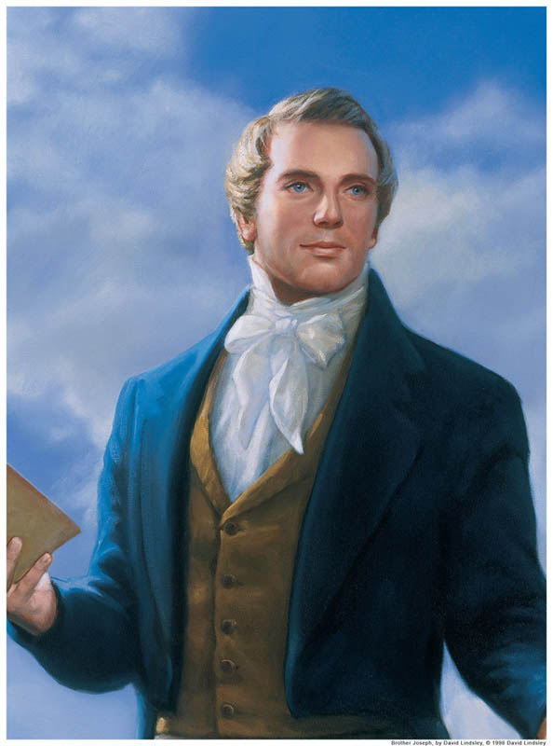
Joseph Smith
I cannot learn from any communication by the Spirit to me, that Zion has forfeited her claim to a celestial crown, notwithstanding the Lord has caused her to be thus afflicted, except it may be some individuals, who have walked in disobedience…
I have always expected that Zion would suffer some affliction… but how many will be the days of her purification, tribulation, and affliction, the Lord has kept hid from my eyes; and when I inquire concerning this subject, the voice of the Lord is: Be still, and know that I am God!...
Now, there are two things of which I am ignorant; and the Lord will not show them unto me, perhaps for a wise purpose in Himself—I mean in some respects—and they are these:
Why God has suffered so great a calamity to come upon Zion, and what the great moving cause of this great affliction is; and again, by what means He will return her back to her inheritance, with songs of everlasting joy upon her head.
These two things, brethren, are in part kept back that they are not plainly shown unto me. (HC, 1: 454.)

Slide 9
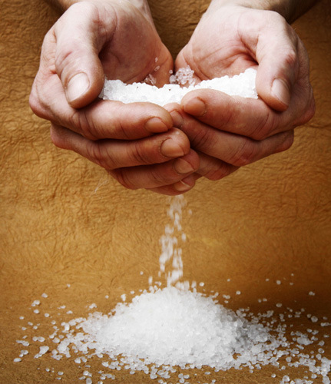
Why?
D&C 103:3-8

Slide 10
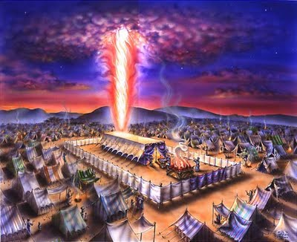
D&C 103: 15-19

Slide 11
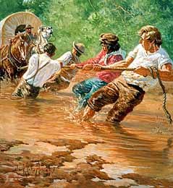
How?
Zion’s Camp
v. 30

Slide 12
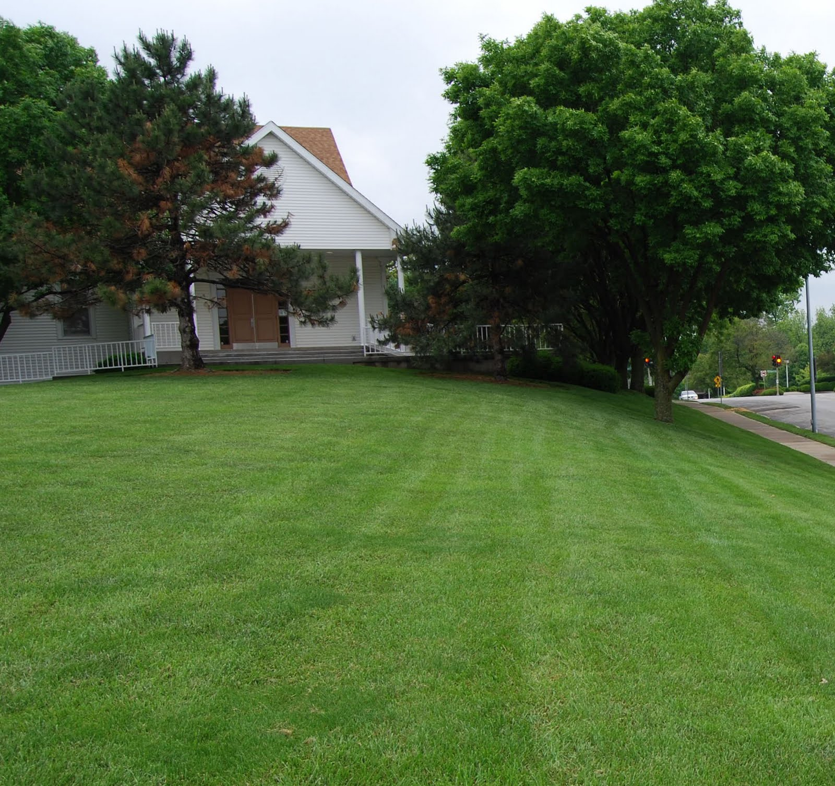
The Result?
D&C 105:1-9

