Slide 1
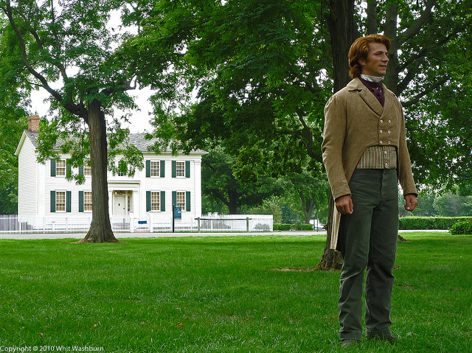
Be of Good Cheer
www.kevinhinckley.com

Slide 2
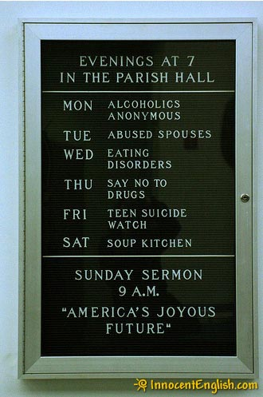
Welcome to Church

Slide 3
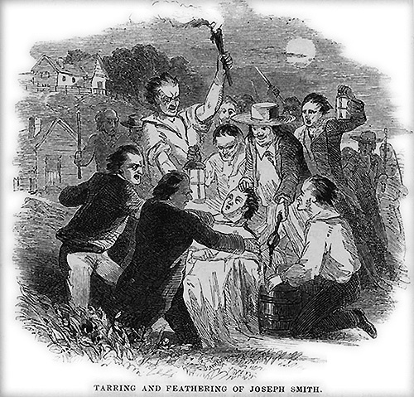
History
Tar and Feathered, March 24th
Sidney Rigdon hiding in Kirtland

Slide 4
Earthlife in a nutshell
D&C 78:7
For if:
You will that I give unto a place in the celestial world
You must prepare yourselves
By:
Doing the things which I have commanded you
And required of you

Slide 5
Little Children
D&C 78:10-19

Slide 6
Sins
82:3,4
For of him unto much is given much is required; and he who sins against the greater light shall receive the greater condemnation.

Slide 7
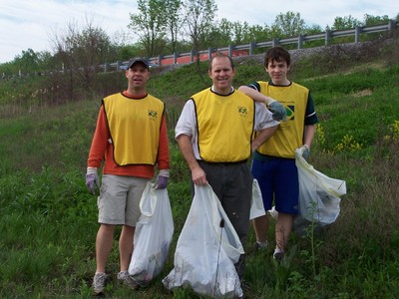
Neal A. Maxwell
Of the many restored truths, God has surely given us enough and to spare. Soberingly, however, we have been told that “unto whom much is given much is required”.
I hope we feel the cutting edge of the word required. It is used instead of the milder expected.
Neither does the Lord say, “It would be nice if …”
The word is required, bringing us back again to the need for submissiveness in discipleship.
(“Becoming a Disciple,” Ensign, June 1996, 15)

Slide 8
Sins and Prayer
82:3,4
For of him unto much is given much is required; and he who sins against the greater light shall receive the greater condemnation.
Ye call upon my name for revelations, and I give them unto you;
And inasmuch as ye keep not my sayings, which I give unto you, ye become transgressors

Slide 9
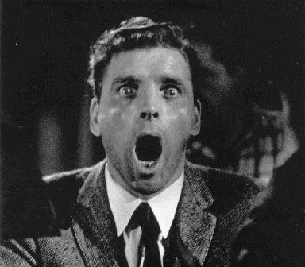
Much, much misunderstood!!
D&C 82:7

Slide 10
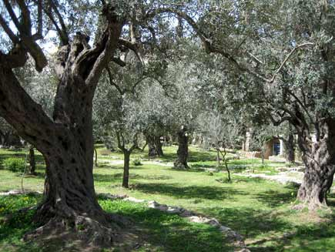
The Atonement
D&C 19
Eternal punishment is God’s punishment.
Endless punishment is God’s punishment.
For behold, I, God, have suffered these things for all, that they might not suffer if they would repent;
17 But if they would not repent they must suffer even as I;
Rebellious State
(Natural Man)
Willfully Sin
His Grace + Our Suffering
Kingdom of Glory
(Terrestial or Telestial
Covenant State
(Son/Daughter of God)
Sin & Our Sorrow
His Grace + Gethsemne
Heirs of His Glory
(Celestial Kingdom)

Slide 11
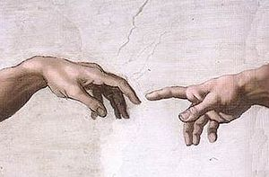
Finally
D&C 82: 8-10

Slide 12
I give unto you a new commandment
That you may understand my will…
Or in other words
I give unto you directions
How you may act before me
…that it may turn to you for your salvation
I the Lord, am bound, when ye do what I say
But when ye do not what I say, ye have no promise

