Slide 1
Wealthy- or Rich?

Slide 2
Nephite Wealth Seminar
You can have riches only if you don’t want them.
You can have riches only if you are planning on feeding the poor, the needy and the afflicted.
If you are righteous, you will have more riches than the wicked.
You can have riches only if you wear comely clothes, not costly apparel.
Thus, my wealth is actually a sign of my righteousness (though I really didn’t want it….)

Slide 3
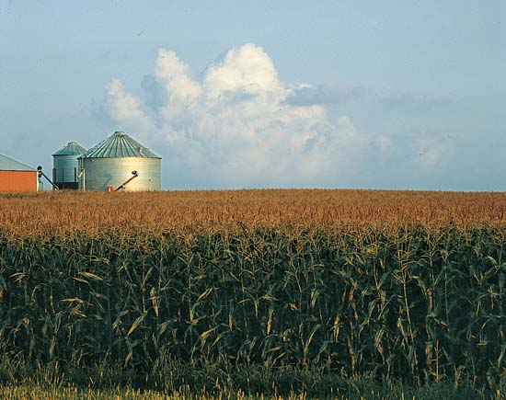
Adam Smith Wealth of Nations 1776
Three traits of prosperous nations:
1) Specialization
2) Free Trade
3) Freedom of choice and laws
Book of Mormon adds:
4) Loving and friendly towards each other (at-one-ing)

Slide 4
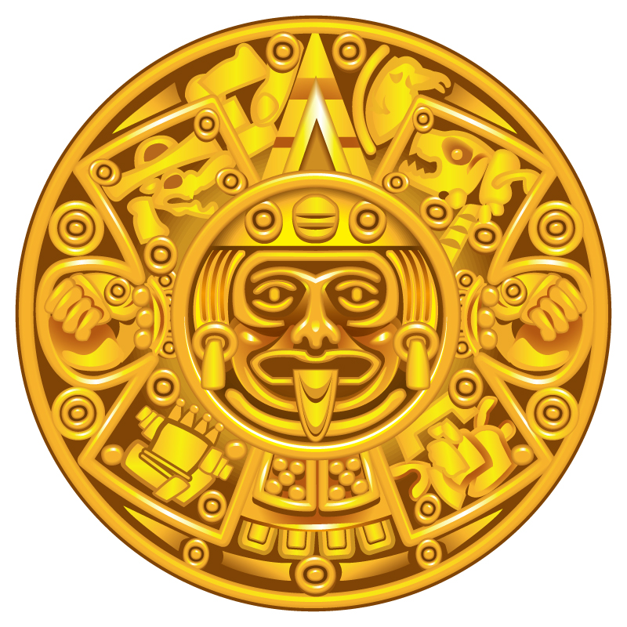
Wealth and Riches
Alma 1

Slide 5
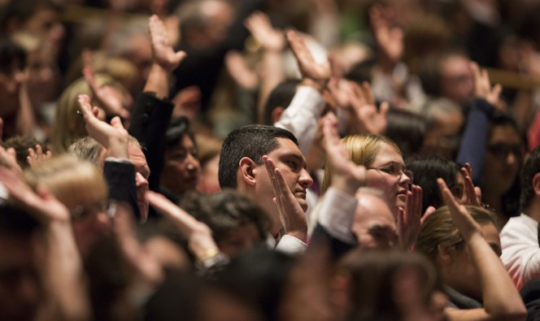
Principle:
Working for the establishment of Zion, is working for the establishment of At-one-ment, the establishment of one heart and one purpose and one mind.
It is economic, spiritual and emotional oneness.
And we are under covenant to help in its creation.

Slide 6
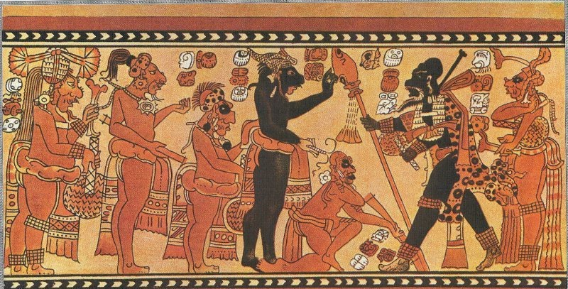
The Cursing
Alma 3:14

Slide 7
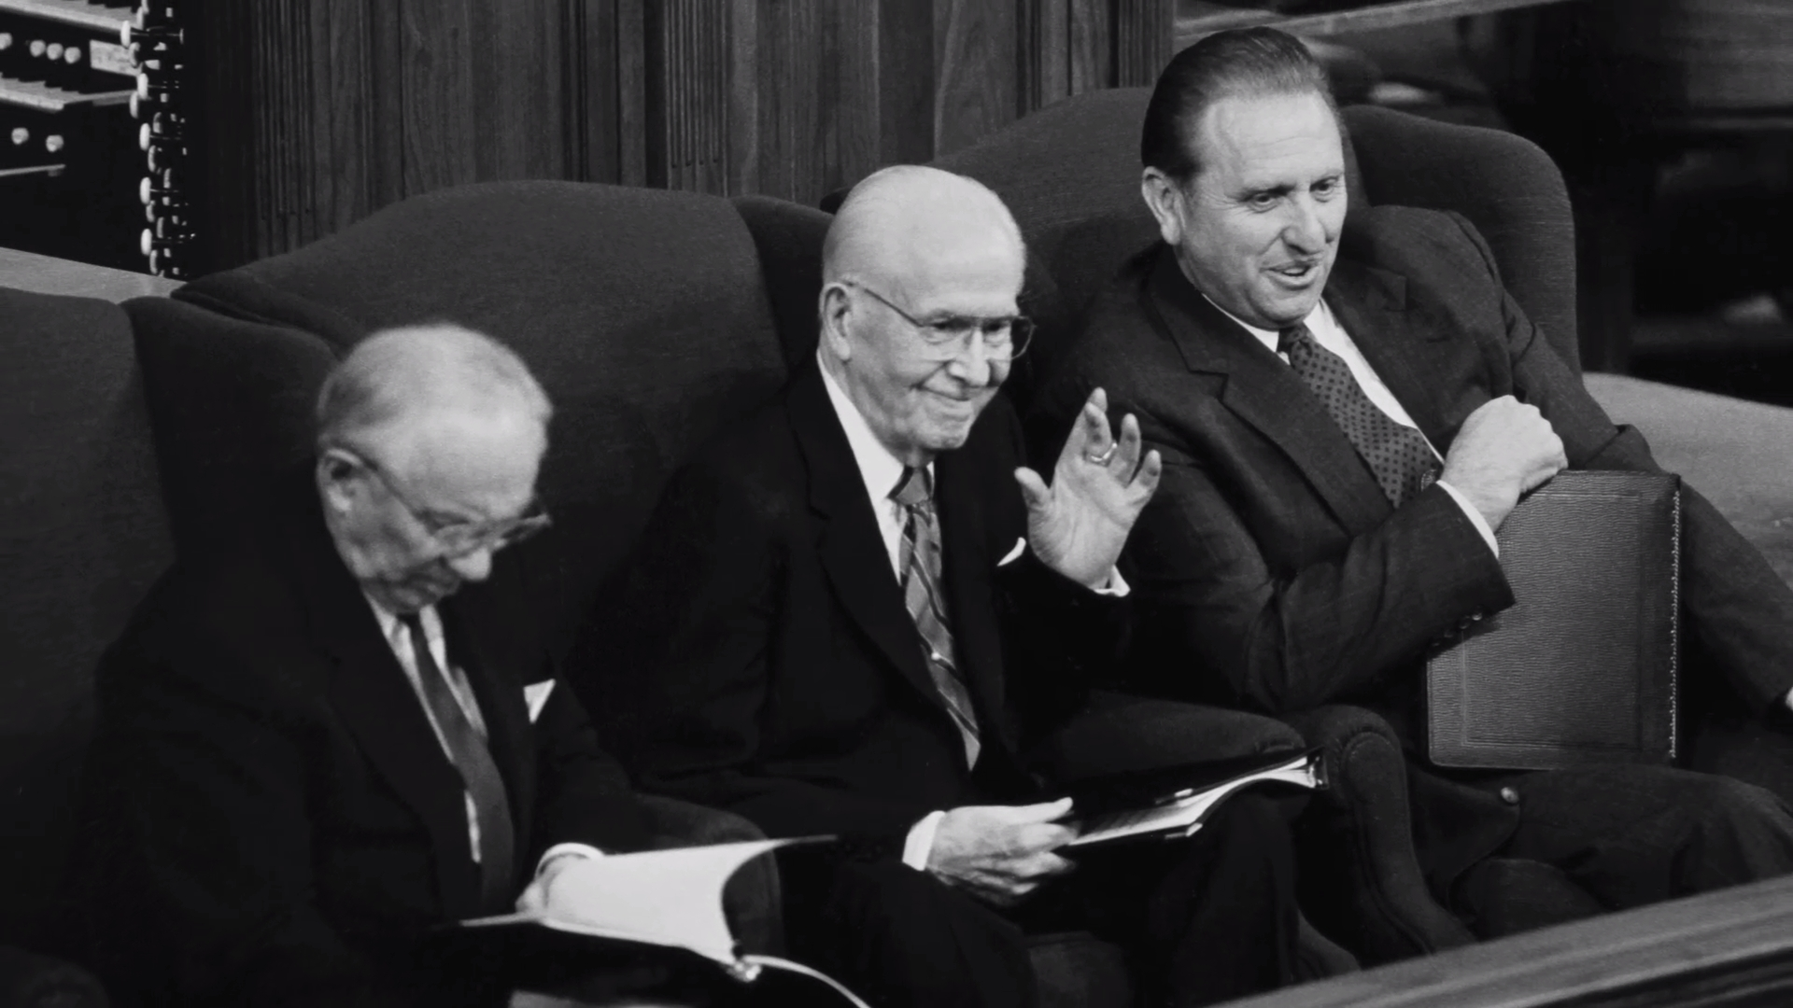
President Benson 1989
The central feature of pride is enmity—enmity toward God and enmity toward our fellowmen. Enmity means “hatred toward, hostility to, or a state of opposition.” It is the power by which Satan wishes to reign over us.
Pride is essentially competitive in nature. We pit our will against God’s. When we direct our pride toward God, it is in the spirit of “my will and not thine be done.”
Our will in competition to God’s will allows desires, appetites, and passions to go unbridled.

Slide 8
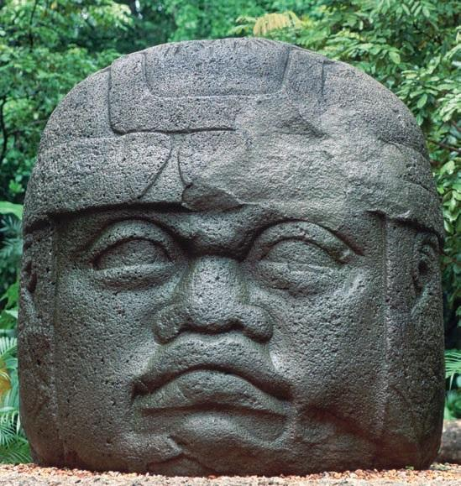
Marks of the World- the Amlicites
Alma 3:4

Slide 9
Lamanite Mocking?
Conducted at specially dedicated temples on the top of large pyramids …sacrifices were most often carried out by stretching the victim over a special stone, cutting open the chest and removing the heart using an obsidian or flint knife.
The heart was then placed in a stone vessel (cuauhxicalli) or in a chacmool (a stone figure carved with a recipient on their midriff) and burnt in offering to the god being sacrificed to.
2 Nephi 5
And he had caused a cursing to come upon them…because of their iniquity
For behold, they had hardened their hearts against him, that they had become like unto a flint…

