Slide 1
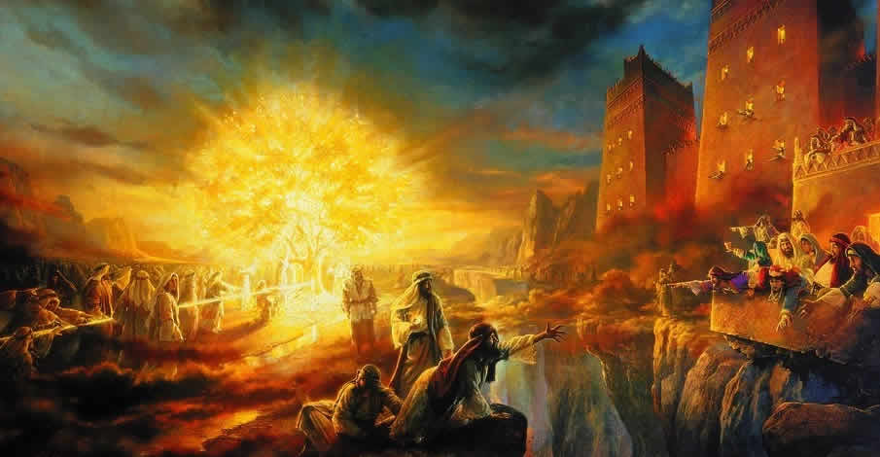
The Wisdom Tree
1Nephi 8

Slide 2
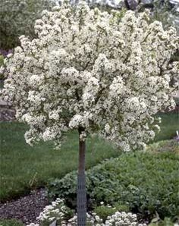
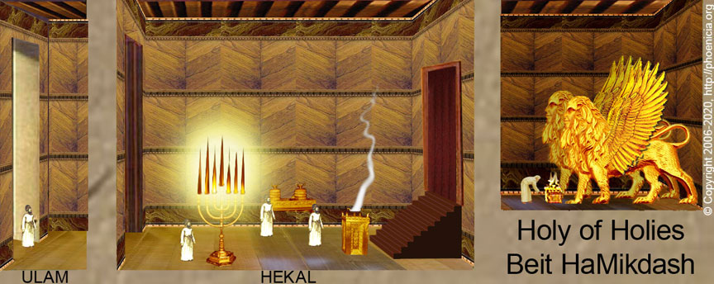
The Fortunate Fall
Reconciliation

Slide 3
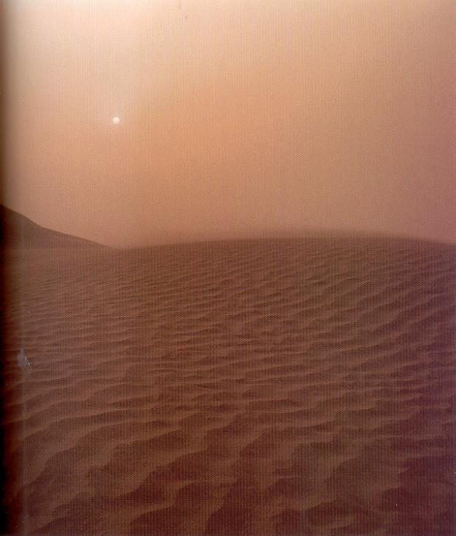
1 Nephi 8
4 But behold, Laman and Lemuel, I fear exceedingly because of you; for behold, methought I saw in my dream, a dark and dreary wilderness.
5 And it came to pass that I saw a man, and he was dressed in a white robe; and he came and stood before me.
6 And it came to pass that he spake unto me, and bade me follow him.
7 And it came to pass that as I followed him I beheld myself that I was in a dark and dreary waste.
8 And after I had traveled for the space of many hours in darkness, I began to pray unto the Lord that he would have mercy on me, according to the multitude of his tender mercies.

Slide 4
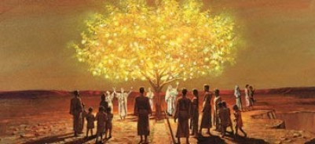
The Tree
9 And it came to pass after I had prayed unto the Lord I beheld a large and spacious field [as if it had been a world].
10 And it came to pass that I beheld a tree, whose fruit was desirable to make one happy.
11 And it came to pass that I did go forth and partake of the fruit thereof; and I beheld that it was most sweet, above all that I ever before tasted. Yea, and I beheld that the fruit thereof was white, to exceed all the whiteness that I had ever seen.
12 And as I partook of the fruit thereof it filled my soul with exceedingly great joy; wherefore, I began to be desirous that my family should partake of it also; for I knew that it was desirable above all other fruit.

Slide 5
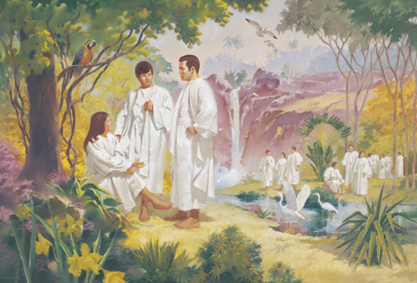
Joy and our Kindred
1 Nephi 8:13

Slide 6
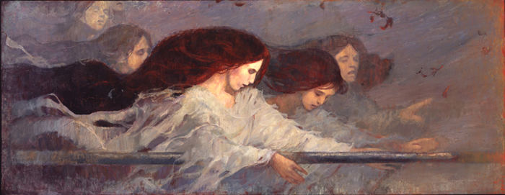
Rod of Iron
1 Nephi 8:19

Slide 7
Margaret Barker at the Worlds of Joseph Conference
Consider as well the mysterious rod of iron in this Book of Mormon vision. In the Bible, the rod of iron is mentioned four times as the rod of the Messiah. Each mention in the King James Version says the Messiah uses the rod to "break" the nations or to "rule" them.
The ancient Greek translation (the Septuagint) is significantly different; it understood the Hebrew word in Psalm 2:9 to mean "shepherd" and it reads, "He will shepherd them with a rod of iron."
The Greek text of the Book of Revelation actually uses the word "shepherd,“…The holy child who was taken up to heaven (Revelation 12:5) was to "shepherd the nations with a rod of iron."
Lehi's vision has the iron rod guiding people to the great tree--the older and probably the original understanding of the word.

Slide 8
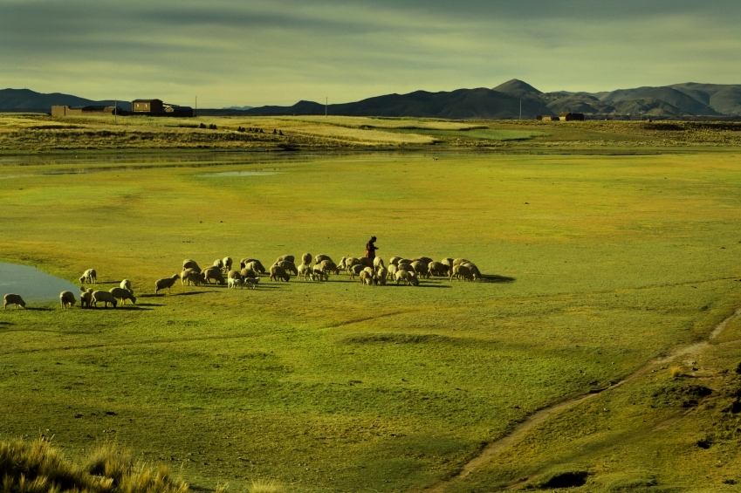
Psalm 23
1 The Lord is my shepherd; I shall not want.
2 He maketh me to lie down in green pastures: he leadeth me beside the still waters.
3 He restoreth my soul: he leadeth me in the paths of righteousness for his name’s sake.
4 Yea, though I walk through the valley of the shadow of death, I will fear no evil: for thou art with me; thy rod and thy staff they comfort me.
5 Thou preparest a table before me in the presence of mine enemies: thou anointest my head with oil; my cup runneth over.
6 Surely goodness and mercy shall follow me all the days of my life: and I will dwell in the house of the Lord for ever.

Slide 9
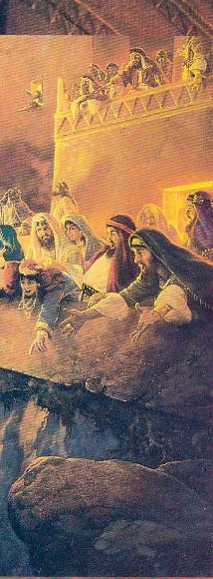
The “Temple Gone Dark”
1 Nephi 8:26

