Slide 1
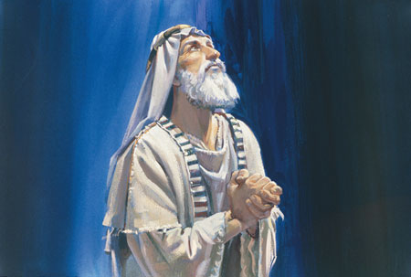
The Words of Lehi
2 Nephi 1

Slide 2
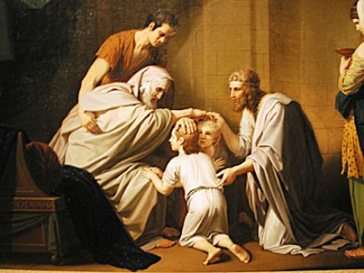
Israel Blesses His Sons
Genesis 47

Slide 3
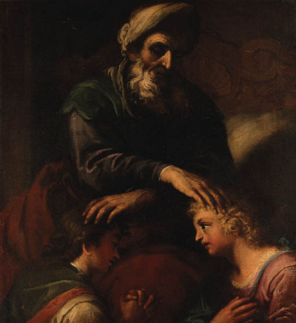
Lehi on his deathbed
2 Nephi 1:4
Daniel 1:3-4

Slide 4
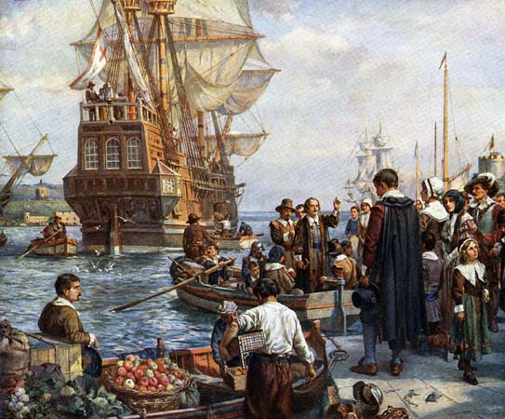
A Choice Land
2 Nephi 1:5

Slide 5
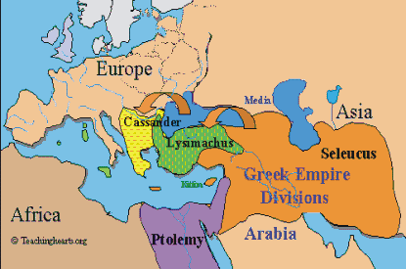
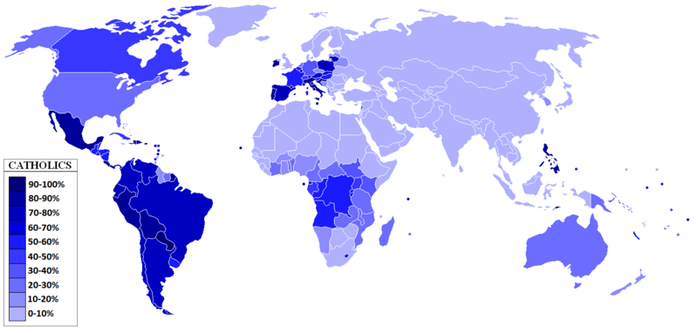
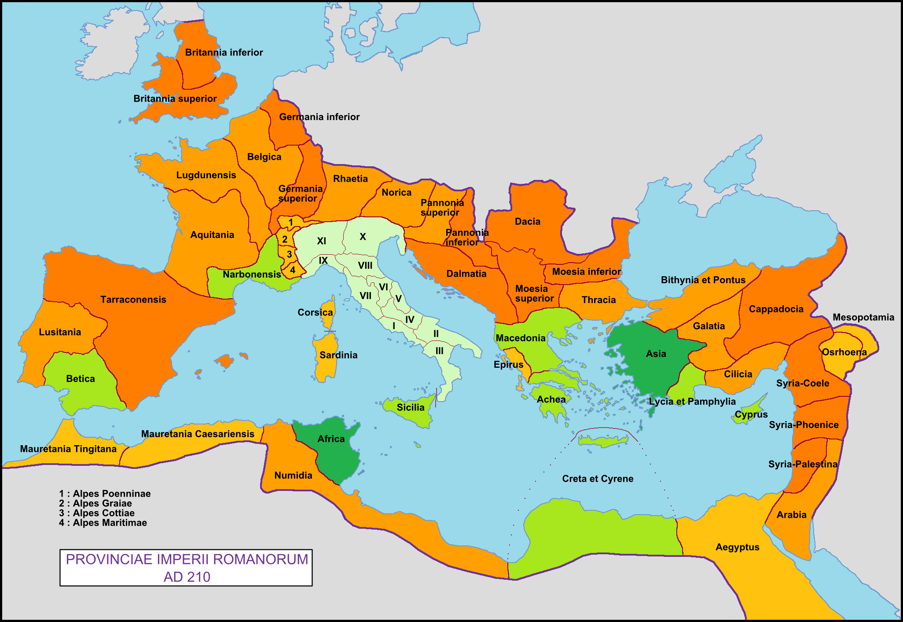
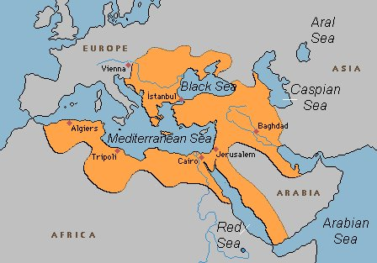
Roman Catholic Influence….

Slide 6
The “Promised Land”
The Inheritance:
Promised to Lehi’s seed forever (Covenant seed)
Also all those who should be led…by the hand of the Lord
There shall be none to molest them…and dwell in safety forever.
Can be a curse to those who fail to serve the Savior

Slide 7
A Little Shakespeare Anyone? 2 Nephi 1:14
"whose limbs ye must soon lay down in the cold and silent grave, from whence no traveler can return"
(2 Nephi 1:14)
“that undiscovered country, from whose bourne no traveler returns”
Hamlet

Slide 8
The Great Atonement of our God
2 Nephi 2

