Slide 1
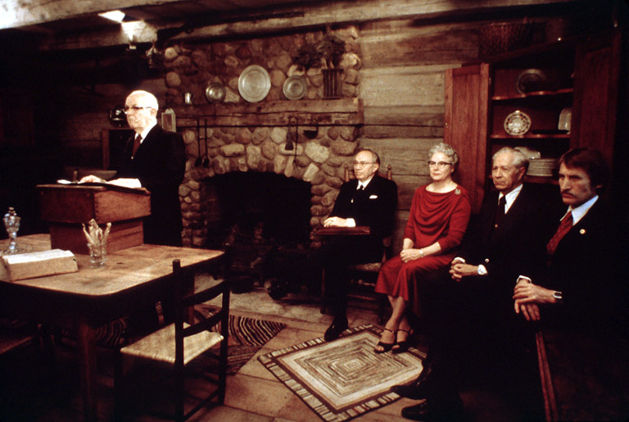
The Rise of the Church
D&C 20

Slide 2
Psychology 101: Passive-Aggressive…

Slide 3
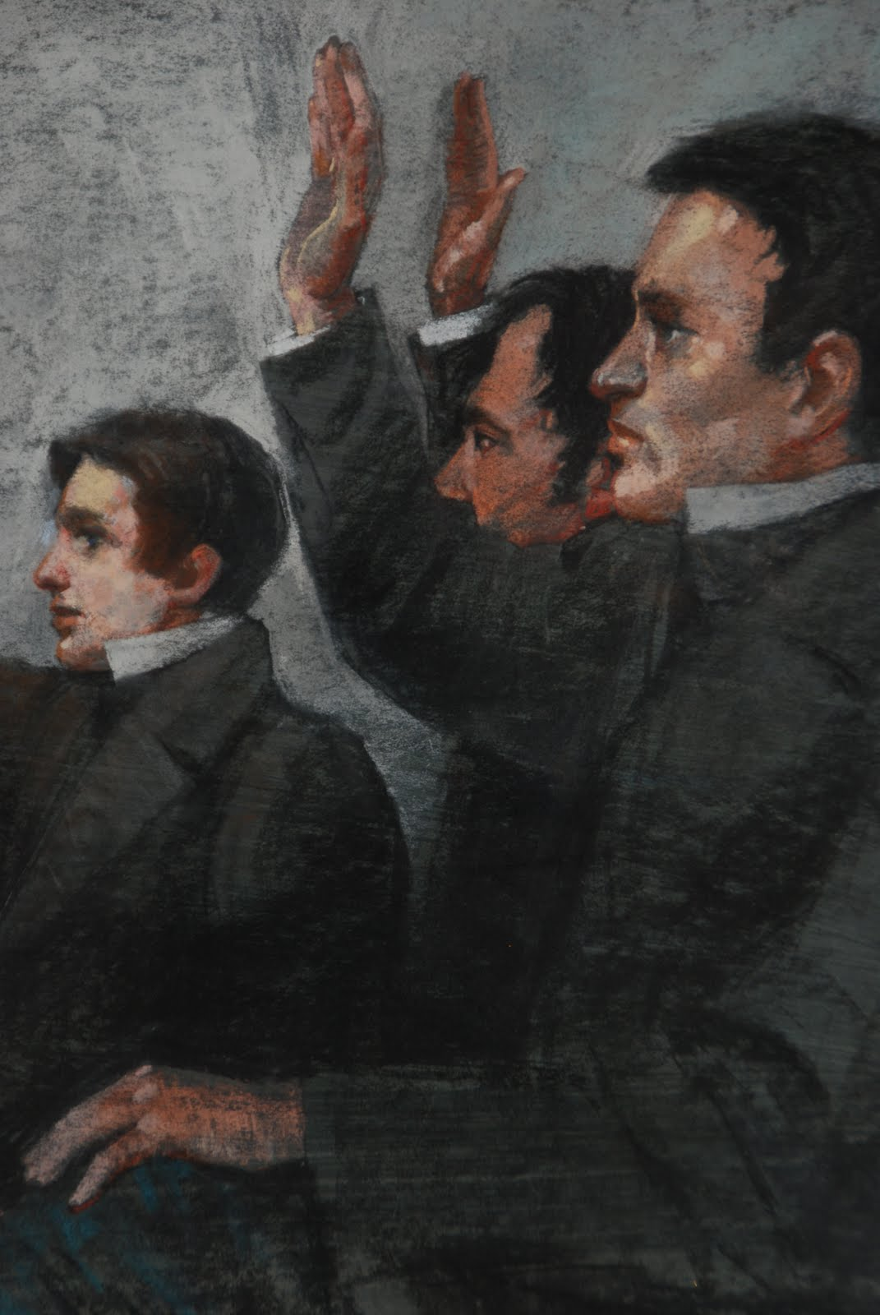
The Organization of the Church
Priesthood given in 1829
D&C 18:2-4

Slide 4
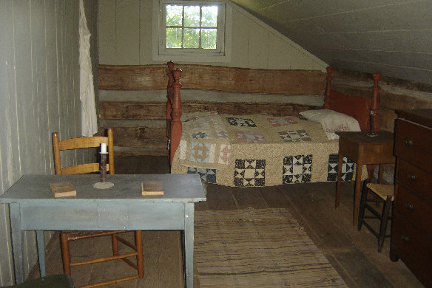
June 1829
“… for we had not long been engaged in solemn and fervent prayer, when the word of the Lord came unto us in the chamber, commanding us that I should ordain Oliver Cowdery to be an elder in The Church of Jesus Christ; and that he should also ordain me to the same office; and then to ordain others, as it should be made known unto us from time to time.
We were, however, commanded to defer our ordination until such time as it should be practicable to have our brethren, who had been and who should be baptized, assembled together, when we must have their sanction to … ordain each other,
and have them decide by vote whether they were willing to accept us as spiritual teachers or not; when also we were commanded to bless bread and break it with them, and to take wine, bless it, and drink it with them;
afterward proceed to ordain each other according to commandment; then call out such men as the Spirit should dictate, and ordain them;
and then attend to the laying on of hands for the gift of the Holy Ghost, upon all those whom we had previously baptized, doing all things in the name of the Lord.” (DHC 1:60–61.)

Slide 5
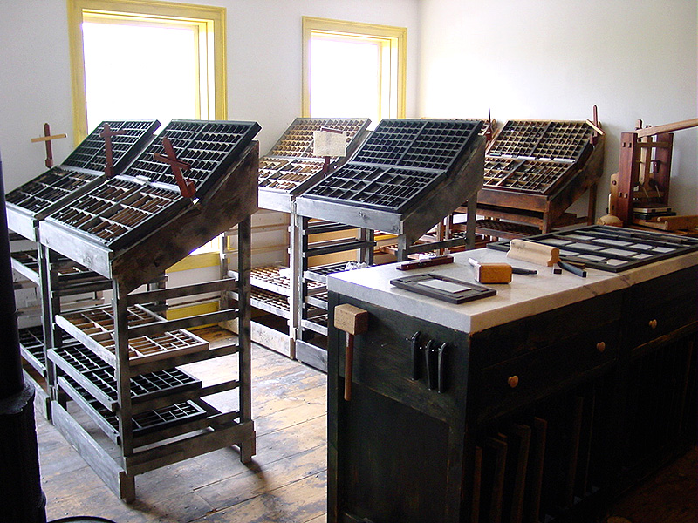
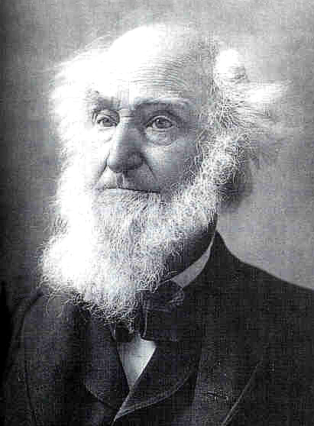

Slide 6
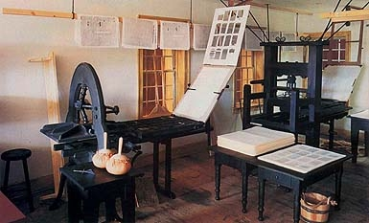

Slide 7
Know then thyself, presume not God to scan! The proper study of mankind is Man - - - Pope. By O. Dogberry, Esq.] Palmyra, January 13, 1830. [New Series -- No. 3. (From the "Book of Mormon," erroneously called the "Gold Bible.") ____ THE FIRST BOOK OF NEPHI. HIS REIGN AND MINISTRY. ____ CHAPTER I. (Continued from our last.) And it came to pass that he departed into the wilderness. And he left his house, and the land of his inheritance, and his gold, and his silver, and his precious things, and took nothing with him, save it were his family, and provisions, and tents, and he departed into the wilderness; and he came down by the borders near the shore of the Red Sea; and he traveled in the wilderness, on the borders which was nearer the Red Sea; and he did travel in the wilderness with his family, which consisted of my mother, Sarah, and my elder brothers, who were Laman, Lemuel, and Sam.

Slide 8
Know then thyself, presume not God to scan! The proper study of mankind is Man - - - Pope. By O. Dogberry, Esq.] Palmyra, June 12, 1830. [Third Series -- No. 5. THE BOOK OF PUKEI. -- Chap. 1. 1. And it came to pass in the latter days, that wickedness did much abound, and the "Idle and slothful said one to another, let us send for Walters the Magician, who has strange books, and deals with familiar spirits; peradventure he will inform us where the Nephites, hid their treasure, so be it, that we and our vagabond van, do not perish for lack of sustenance.

Slide 9
Vol. VII. -- No. 28.] Palmyra, N. Y., Friday, March 19, 1830. [Whole No. 336. We are requested to announce that the "Book of Mormon" will be ready for sale in the course of next week.

Slide 10
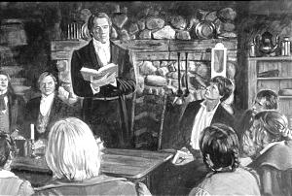
On April 6th
Gathered at the Peter Whitmer Farm in Fayette, NY
About 30-40 persons gathered
Six people constituted the formal organization
Those six baptized that day
Another four also baptized-
Martin Harris
Joseph and Lucy Mack Smith
Porter Rockwell

Slide 11
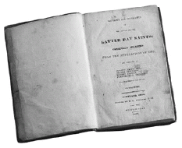
Section 20 Structure
1-4 Intro
5-12 Joseph Called and Purified
13-16 Witnesses Testify
17-28 Nature of God and Man

Slide 12
Hugh Nibley
The astonishing fulfillment of Moroni's prophecy to a country kid living out in the backwoods, that his name would be known for good and evil among men everywhere, is enough in itself to prove that Joseph Smith was a true prophet. . . .
It was mostly Moroni's fault. The night he visited Joseph Smith, he widened the yawning gulf which the First Vision had placed between Joseph and normal people, and removed him from the sphere of established theology and rational thinking.
Some kind of an inspired super-devil might have gotten away with some of the things he did, but no blundering, dreaming, undisciplined, shallow, and opportunistic fakir could have left behind what Joseph Smith did, both in men's hearts and on paper.

Slide 13
Section 20 Structure
1-4 Intro
5-12 Joseph Called and Purified
13-16 Witnesses Testify
17-28 Nature of God and Man
29-36 You too can be purified

Slide 14
Confusing?
Justification
Sanctification
Christ,
Acts 13:39; Mosiah 14:11
by faith,
Acts 26:18; Romans 3:28, 30
by grace,
Romans 3:24; D&C 20:30.
by works,
James 2:21–25.
by Christ's blood,
Romans 5:9.
and by the Spirit.
Moses 6:60
by Christ
1 Corinthians 1:2; Hebrews 2:11.
by the grace of God,
Moroni 10:33; D&C 20:31.
by the truth,
John 17:17, 19
by the word of God
1 Timothy 4:5.
by God the Father,
Jude 1:1.
by law
D&C 88:21, 34.
by water
Ephesians 5:26
by the Holy Spirit
Romans 15:16;
and by blood
Hebrews 9:14

Slide 15
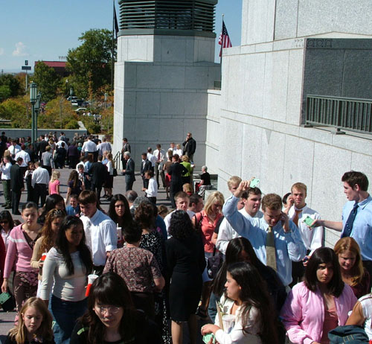
Being ‘Saved’
Christians who follow the teachings of John Calvin deny the possibility of "falling from grace," insisting instead on the "perseverance of the Saints" (once saved always saved).
This is a major difference between Latter-day Saints and Calvinist Christians.
We as members of the Church sometimes get confused and insist that coming into the covenant requires works, which, if we perform well, God will then reward with grace.
But this is backwards.
Entering the covenant requires faith and grace; staying in it, enduring to the end and not falling from grace already received, requires work as well.

Slide 16
Section 20 Structure
1-4 Intro
5-12 Joseph Called and Purified
13-16 Witnesses Testify
17-28 Nature of God and Man
29-36 You too can be purified
37- Baptism and Church Structure

Slide 17
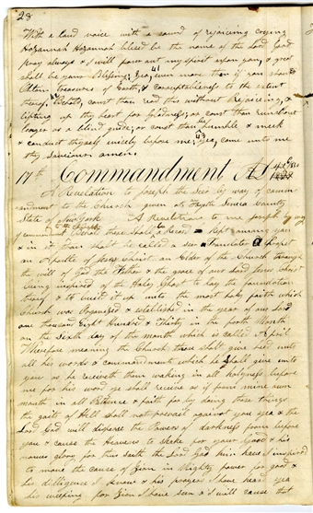
Section 21
Received April 6th
V. 6-8

Slide 18
Elder Maxwell
“God does not live in the dimension of time as do we. We are not only hampered by our finiteness (experiential and intellectual), but also by being in the dimension of time.
Moreover, God, since ‘all things are present’ with him, is not simply predicting based solely on the past.
In ways that are not clear to us, he sees rather than foresees the future, because all things are at once present before him”
( Things As They Really Are [1978], 29;

