Slide 1
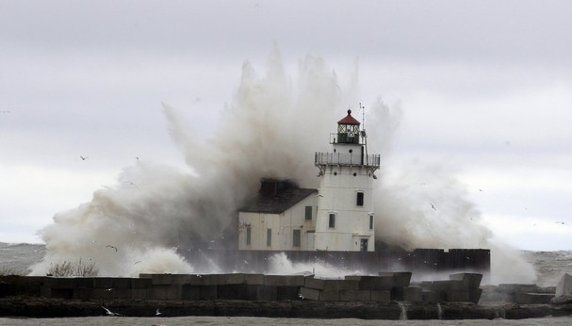
The Oracles
www.kevinhinckley.com

Slide 2
Keys
D&C 90:2,3

Slide 3
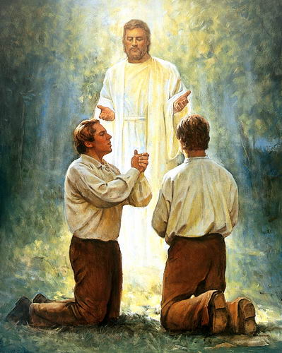
George Q. Cannon
Now we may come to this conclusion; that God, having once bestowed the keys of the holy Priesthood on man here on the earth for the building of His Church, will never take them from the man or men who hold them and authorize others to bestow them.
If you will read the history of the Church from the beginning, you will find that Joseph was visited by various angelic beings, but not one of them professed to give him the keys until John the Baptist came to him.
Moroni, who held the keys of the record of the stick of Ephraim, visited Joseph; he had doubtless, also, visits from Nephi and it may be from Alma and others, but though they came and had authority, holding the authority of the Priesthood, we have no account of their ordaining him, neither did Joseph ever profess, because of the ministration of these angels, to have authority to administer in any of the ordinances of the Kingdom of God.
He never baptized anybody, nor attempted to lay on hands for the reception of the Holy Ghost; and, in fact, he never attempted, that we have any account of, to exercise any of the functions of the holy Priesthood. He was a prophet, it is true, but a man may be a prophet and yet not have authority to administer in the Priesthood.
(Journal of Discourses, 12/5/1869, vol. 13:47)

Slide 4
Keys
Priesthood
Keys
Priesthood
Authority
Motherhood
Authority

Slide 5
D&C 90:5

Slide 6
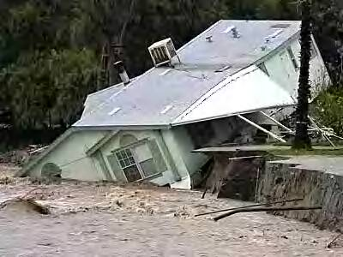
Robert Millett
“Every person builds a house of faith. We do so knowingly or unknowingly. And every builder soon learns that a good building with bad foundations is worse than useless; it is dangerous.
As one Christian writer has observed, ‘If the stability of buildings depends largely on their foundations, so does the stability of human lives. The search for personal security is a primal instinct, but many fail to find it today. Old familiar landmarks [will be] obliterated. Moral absolutes which were once thought to be eternal are being abandoned’ (Stott 22).
Thus our house of faith can be no more secure than the foundation upon which it is built. Foolish men build upon the shifting sands of ethics and the marshlands of human philosophies and doctrines.
The wise build upon the rock of revelation, heeding carefully the living oracles, lest they be ‘brought under condemnation ... and stumble and fall when the storms descend, and the winds blow, and the rains descend, and beat upon their house’ (D&C 90:5).
All that we do as members of The Church of Jesus Christ of Latter-day Saints must be built upon a foundation of faith and testimony and conversion.

Slide 7
D&C 88:119

Slide 8
The Temple
My Family
My Life

Slide 9
How do we do this?
D&C 90:24
D&C 88
124 Cease to be idle; cease to be unclean; cease to find fault one with another; cease to sleep longer than is needful; retire to thy bed early, that ye may not be weary; arise early, that your bodies and your minds may be invigorated.
125 And above all things, clothe yourselves with the bond of charity, as with a mantle, which is the bond of perfectness and peace.

Slide 10
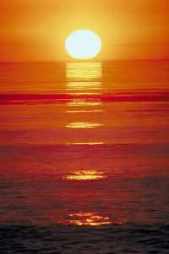
Elder CS Lewis
Make no mistake, [Christ would say] if you let Me, I will make you perfect. The moment you put yourself in My hands, that is what you are in for. Nothing less, or other, than that. You have free will, and if you choose, you can push Me away. But if you do not push Me away, understand that I am going to see this job through.
Whatever suffering it may cost you in your earthly life, whatever inconceivable purification it may cost you after death, whatever it costs Me, I will never rest, nor let you rest, until you are literally perfect—until My Father can say without reservation that He is well pleased with you, as He said He was well pleased with Me. This I can do and will do. But I will not do anything less.
God's demand for perfection need not discourage you in the least in your present attempts to be good, or even in your present failures. Each time you fall He will pick you up again. And He knows perfectly well that your own efforts are never going to bring you anywhere near perfection.
On the other hand, you must realize from the onset that the goal toward which He is beginning to guide you is absolute perfection; and no power in the whole universe, except you yourself can prevent Him from taking you to that goal. That is what you are in for.
[Mere Christianity, 1960, pp. 172, 174]

