Slide 1
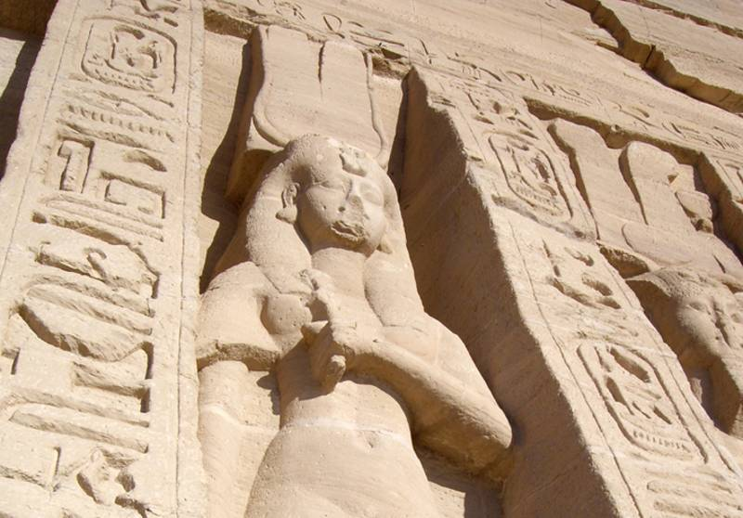
The Egypt in Us

Slide 2
Important Moving Tip…

Slide 3
YouTube Video

Slide 4
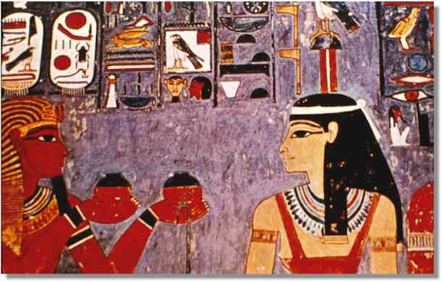
Question:
Which was the harder task?
Removing Israel from Egypt-
Or removing Egypt from Israel?

Slide 5
The Cankoring Effect of Unhealed Egypt….
1- First, grateful for God’s help—because it is a rescue…
2- Second, taking for granted God’s help by lusting after other things. (Forgetfulness)
3- Finally, loathing and hatred towards God and his prophets. (Pride)

Slide 6
1st Step- grateful for the help
Exodus 16
So the people rested on the seventh day
And the house of Israel called the name thereof Manna; and it was like coriander seed, white; the taste of it was like the wafers made with honey.
( much better than unleavened bread!)
And the children of Israel did eat manna forty years, until they came to the land inhabited.

Slide 7
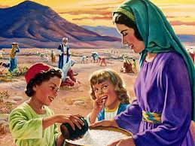
Step 2- Taking for granted God’s help by Lusting after other things
Numbers 11

Slide 8
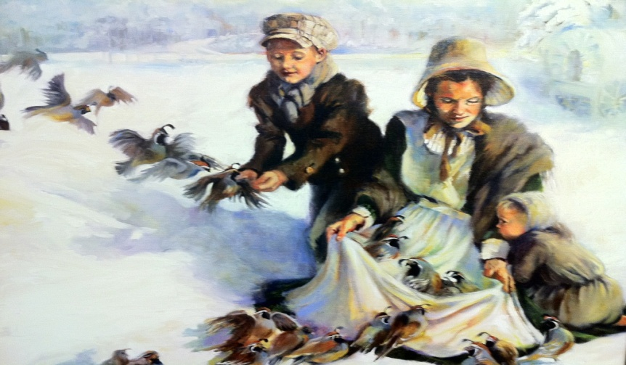
Thomas Bullock
On the 9' of October, several wagons with oxen having been sent by the Twelve to fetch the poor Saints away, were drawn up in a line on the river banks, ready to start.
But hark! What noise is that? See the quails descend; they alight close by our little camp of twelve wagons, run past each wagon tongue, they arise, fly round the camp three times, descend, and again run the gauntlet past each wagon. See the sick knock them down with sticks, and the little children catch them alive with their hands. Some are cooked for breakfast, while my family were seated on the wagon tongues and ground, having a wash tub for a table.
Behold, they come again. One descends upon our tabard, in the midst of our cups, while we were actually round the table eating our breakfast. Which a little boy about eight years old catches alive with his hands; they rise again, the flocks increase in number, seldom going seven rods from our camp,continually flying around the camp, sometimes under the wagons, sometimes over, and even into the wagons, where the poor sick saints are lying in bed; thus having a direct manifestation from the Most High, that although we are driven by men, He has not forsaken us, but that His eyes are continually over us for good.
At noon, having caught alive about 50 and killed some 50 more, the captain gave orders not to kill any more, as it was a direct manifestation and visitation from the Lord. In the afternoon hundreds were flying at a time. When our camp started at 3 p.m., there could not have been less than 500 (some say 1500) flying around camp. Thus, I am a witness to this visitation."

Slide 9
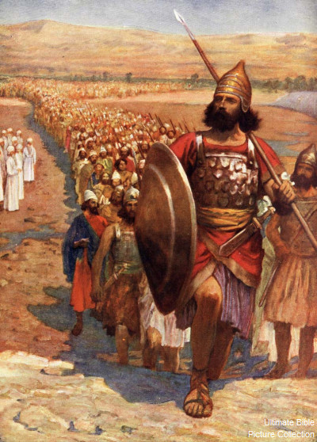
Lusting for Power and Control
Numbers 16

Slide 10
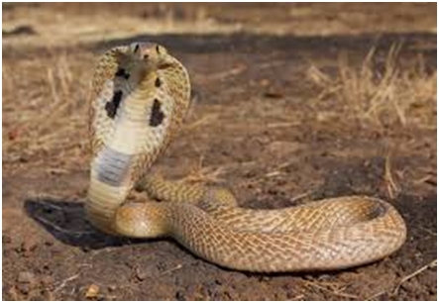
Finally, loathing and hatred towards God and his prophets. (Pride)
Numbers 21

Slide 11
