Slide 1
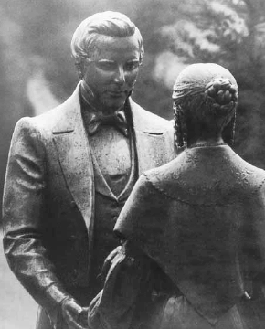
The Husband Whisperer
www.kevinhinckley.com

Slide 2
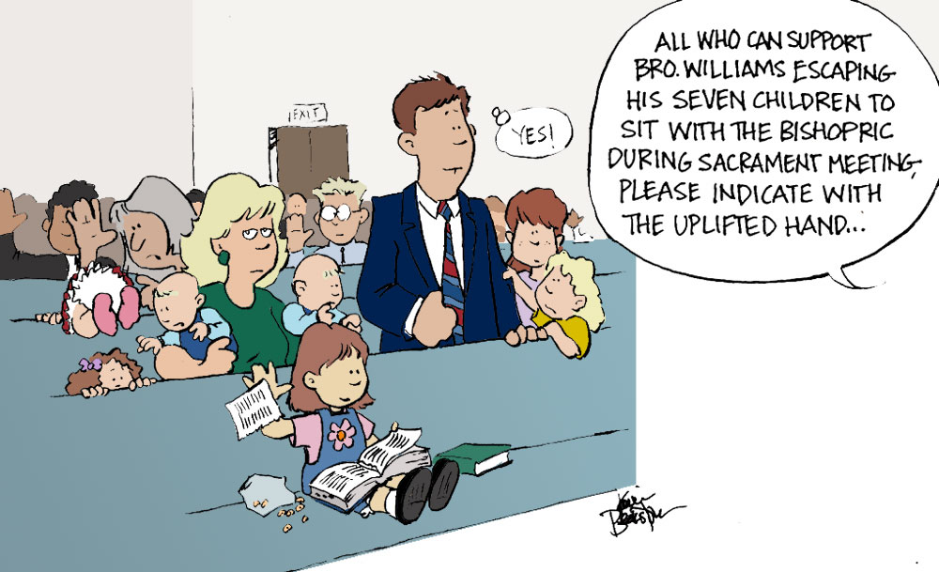

Slide 3
Now, some things to chew on

Slide 4
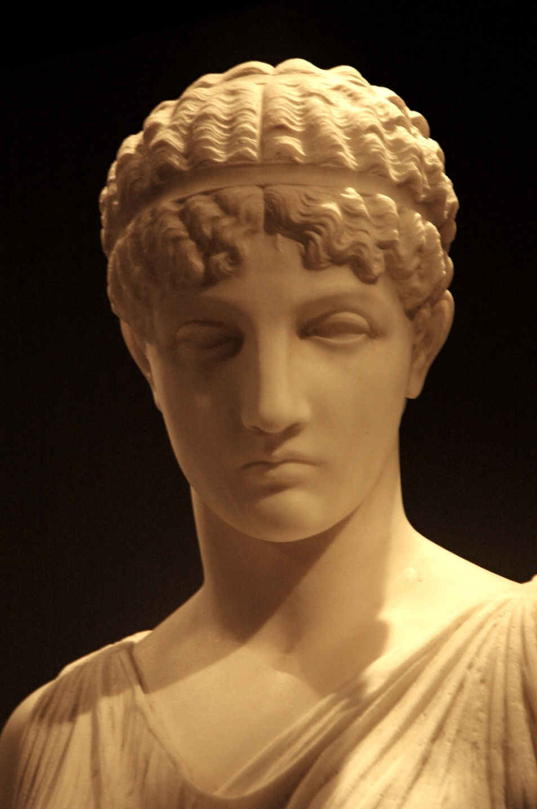
Yesterday….
Lady Wisdom
(A Wife of Wisdom)

Slide 5
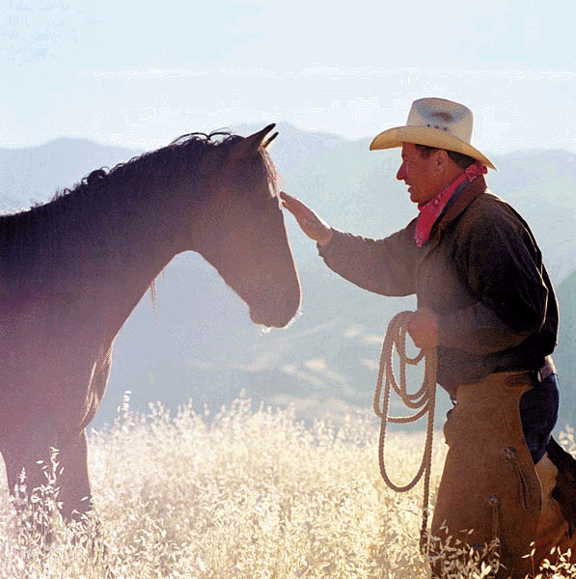
The Horse Whisperer
Gentler, Softer
More emphasis on relationships
Tension and Release
Longer Ropes, Avoid metal bits if possible

Slide 6
The Role of Women
Moses 3:15-22
15 And I, the Lord God, took the man, and put him into the Garden of Eden, to dress it, and to keep it.
18 And I, the Lord God, said unto mine Only Begotten, that it was not good that the man should be alone;
wherefore, I will make an help meet for him.

Slide 7
Help Meet
Help (Hebrew Ezar)
-succor or to save
Meet (Hebrew Neged)
- One like us
Help Meet-
One, just like us, who saves us…

Slide 8
1 Peter 3
1 Likewise, ye wives, be in subjection to your own husbands;
1 Likewise, ye wives, be in Service to your own husbands;

Slide 9
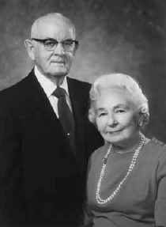
President Kimball
“I have a question about the word rule. It gives the wrong impression. I would prefer to use the word preside because that’s what he does. A righteous husband presides over his wife and family.”….
“Also we remember the man the Lord was talking about when he said these words to Eve. Adam was the great Michael, he who had helped Jehovah create the earth, the great first prophet of the Lord on earth, a most righteous son of God.
Those who interpret God’s blessing upon Eve as a punishment have not understood the meaning of scripture. The Lord was telling Eve that she would be watched over, cared for, and protected by the righteous love of a noble husband as she entered the fallen world.
In the misunderstandings typical of mortality, how ironic that many men take this verse and use it as license to exercise unrighteous dominion and to rule over their wives instead of treating their wives in a manner to encourage a spouse’s desire toward them.”
(S. Michael Wilcox, “I Have a Question,” Ensign, Feb. 1994, 63)

Slide 10
1 Peter 3
1 Likewise, ye wives, be in subjection to your own husbands;
that, if any obey not the word, they also may …be won by the [conduct] of the wives;
2 While they behold your chaste [conduct] coupled with fear.
3 Whose adorning let it not be that outward adorning of plaiting the hair, and of wearing of gold, or of putting on of apparel;
4 But let it be the hidden man of the heart, in that which is not corruptible,
even the [beauty] of a meek and quiet spirit which is in sight of God of great price.
1 Likewise, ye wives, be in Service to your own husbands;

Slide 11
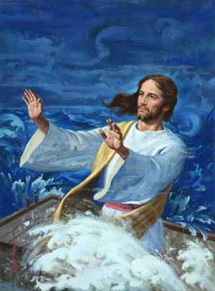
Key Component
Meekness is great power under complete control

Slide 12
What Meekness is NOT
Weak
Wimpy
Naggy/Whiney
Subservient
Self Demeaning
Self Destructive

Slide 13
The Pattern
3 Nephi 11:3
They heard a voice as if it came out of heaven
…it was not a harsh voice
Neither was it a loud voice
Nevertheless it being a small voice
It did pierce them…to the center,
Yea, it did pierce them to the very soul.
…and they heard the voice and …understood it not.
And again the third time they did hear the voice.
And did open their ears to hear it;
And their eyes were towards the sound
And the third time they did understand the voice

Slide 14
Step 1- Own Personal Conduct
Where do you need to improve?

Slide 15
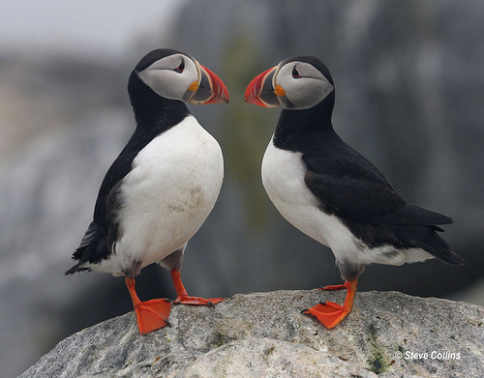
Step 2 Spirit to Spirit
1- Still Small Voice
2- Physical Contact
3- Eye Contact

Slide 16
Step 3- Empathy (I Statements)
How are you feeling?
How does this effect you?
What are your concerns?

Slide 17
Step 4- Planning
What would you like to do?
Keep it short!

Slide 18
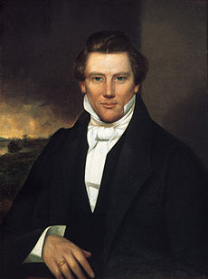
Misunderstanding
in the very first meeting of what would become known as the Relief Society, Joseph instructed the sisters that they were to "provoke the brethren to good works in looking to the wants of the poor . . .
to assist by correcting the morals and strengthening the virtues of the community, and save the Elders the trouble of rebuking.“
Later, on April 28, 1842, he amended this by instructing as to how they were to provoke the brethren:
"You must put down iniquity and by your good example provoke the Elders to good works.“
The Restoration of the New and Everlasting Covenant of Marriage Sperry Symposium, Joseph Smith and the Doctrinal Restoration (Salt Lake City 2005)

Slide 19
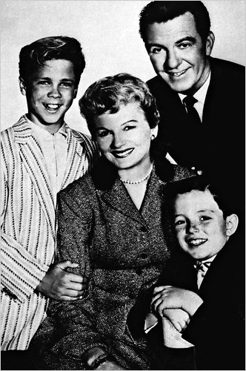
Careful!!!
Question:
What do you envision?

Slide 20
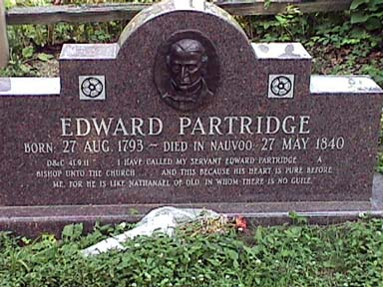
Edward Partridge
D&C 41:9,11
And, again, I have called my servant Edward Partridge; and I give a commandment,
that he should be appointed …and ordained a bishop unto the church,
And this because his heart if pure before me, for he is like unto Nathanael of old, in whom there is no guile.

